Slide 1
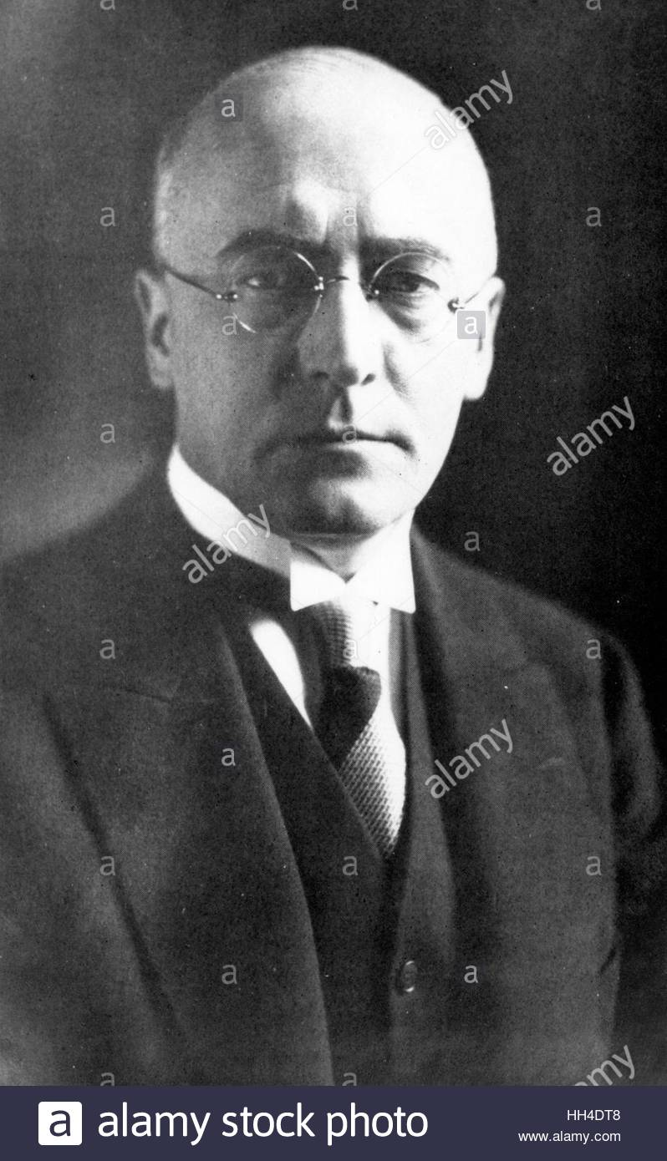
Why were people beginning to vote for the NSDAP during the Great Depression?
In this lesson, we will:
Describe NSDAP policies towards different groups within Germany.
Assess electoral data from the election after 1929.
Starter: Using the textbook, explain why we could consider Bruning a failure of a chancellor?

Slide 3
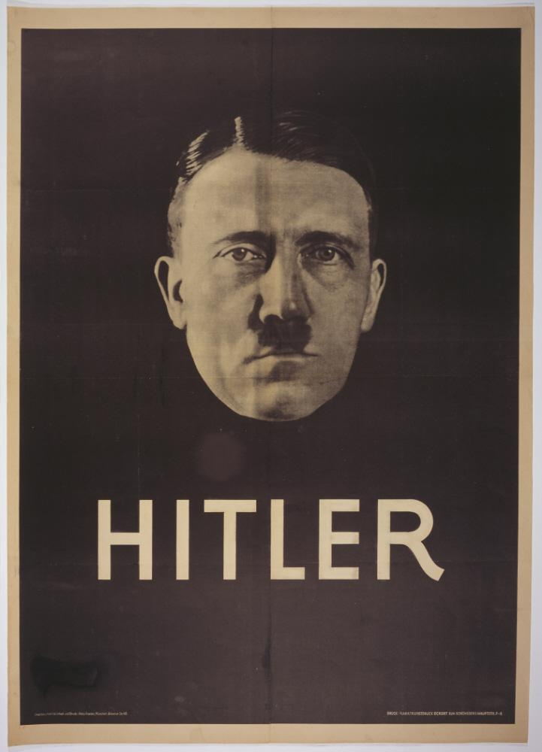
What was so appealing about the Nazi Party?
The Weimar Republic had appeared weak and useless at dealing with unemployment, but the Nazi Party was strong and promised to restore order and make Germany strong in the world.
Their leader (Hitler) was very popular – he was featured in all posters and spoke in as many parts of the country as possible. He was one of the first politicians to use aeroplanes in a whirlwind tour of Germany in the 1930 and 1932 elections.
They had massive support from businesses, so could use posters, radio broadcasts and aeroplanes to their advantage.
The SA and SS made them look strong enough to deal with any unrest. Much stronger than the KPD.

Slide 4
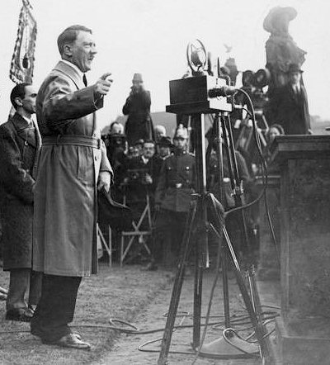
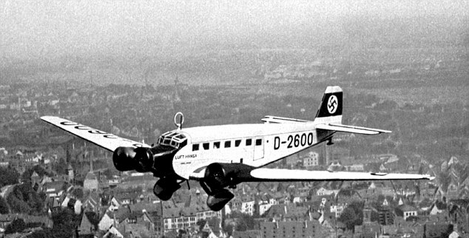
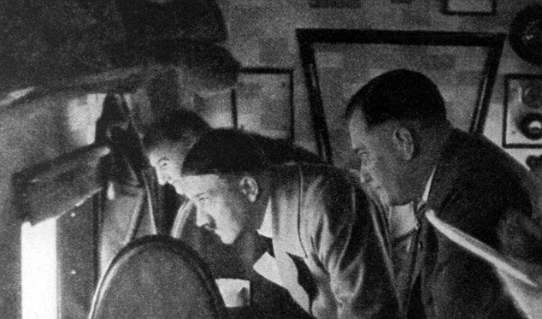

Slide 5
Learning Task One
Targets 7-9
Identify three ways the Nazi Party tried to get their support
Explain clearly how each policy would have convinced them to support the party.
For each of the different groups within Germany:
Young people
Businesses
Working class
Middle class
Women
Farmers
Targets 5-6
Identify three ways the Nazi Party tried to get their support
What impact would this have? Did it work?
Targets 1-4
For each, explain why they supported the Nazi Party.

Slide 6
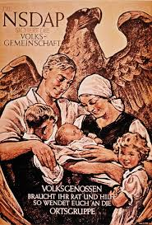
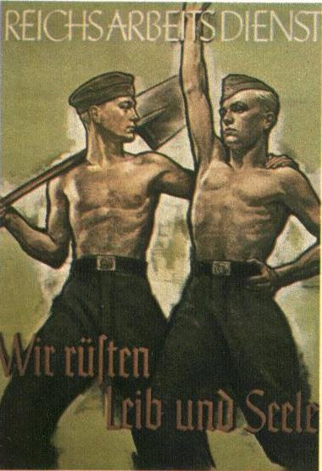
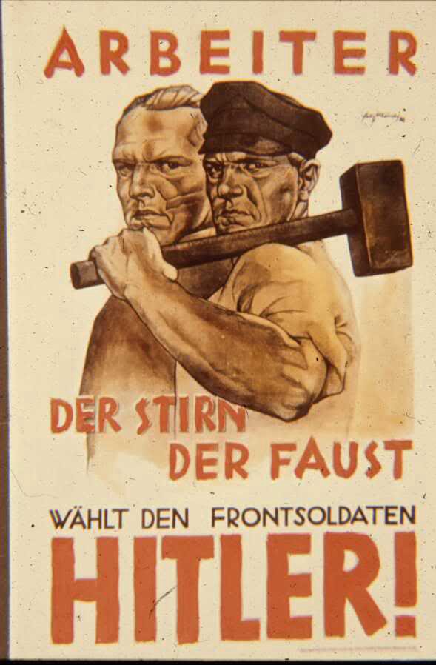
Women and the family
Young People
Working Class

Slide 7
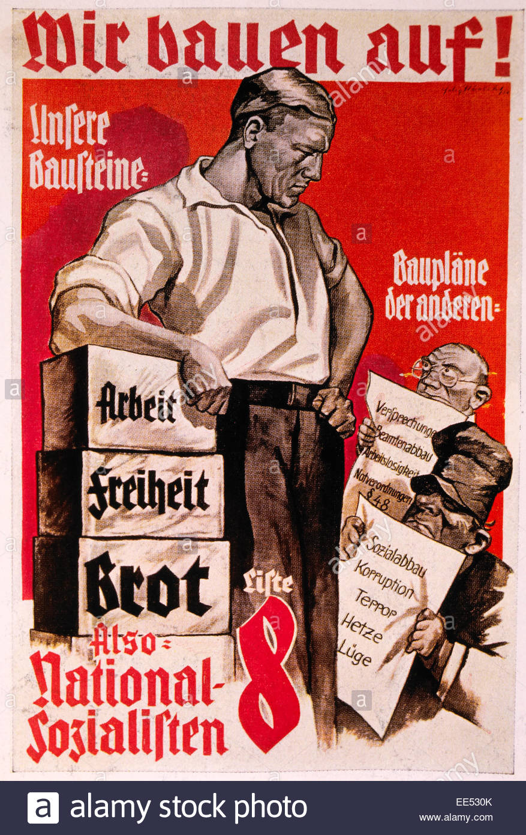
Businesses
Middle Classes
Farmers

Slide 8
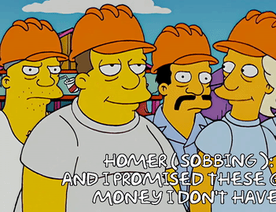
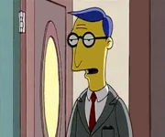
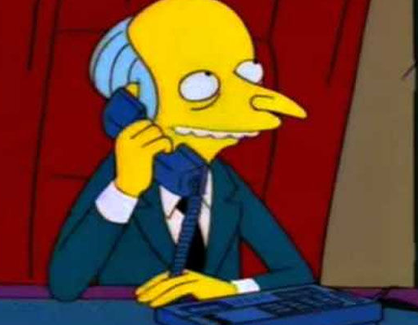
Working Class
Middle Class
Business
Used their name (National Socialist Workers Party) to show they cared about the workers.
Used policies to attract them – traditional values, stronger Germany, full employment etc.
Propaganda used slogans promising “Work and bread”
Hitler promised to fix the problems of the Great Depression (they had lost land, savings etc.)
Nazis offered an alternative to Communists.
Nazis were against moral decline (drinking, sexual openness etc.). Middle classes welcomed a return to traditional German values.
Biggest appeal to businesses was making Germany a strong trading partner in the world.
They also promised to keep Communists out of power. This would have appealed to businesses as a Communist government could lead to industries being taken under state control.

Slide 9
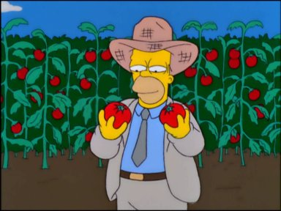
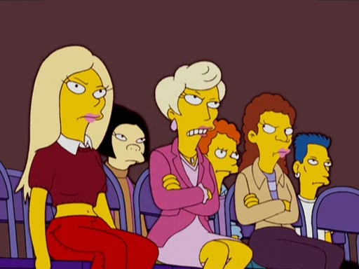
Farmers
Young People
Women
Propaganda showed women that the party appealed to women and the family. Slowly many women came to see this as attractive.
Some women liked the loans they could get if they had children. Some women liked how the Nazis made them feel like the most important part of the future Germany
Changed their policy to say private land would only be confiscated if owned by Jews which reassured farmers as it would protect them form communists.
Also traditional views on women, art and culture was similar to those held by farmers who despised the relaxed atmosphere of the 1920s.
Nazis used fashionable uniforms, colourful rallies and Hitler’s speeches to appeal to young people.
Hitler Youth was well received by young boys who saw it as a way of becoming a strong soldier and make new friends.

