Slide 1
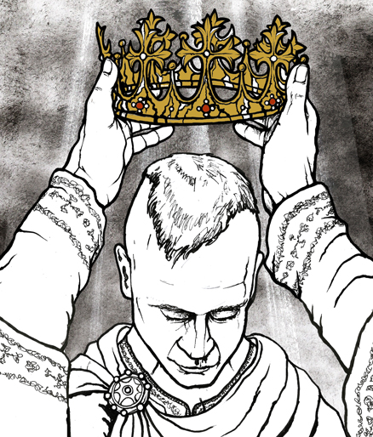
How bad was crime in the western territories?
In this lesson, we will:
Describe what criminal activity looked like in western territories.
Assess how successful law enforcement was to tackle crime.
Starter: Explain why William’s coronation as King was important for England.
Hint: if something or someone is important, it means impact.

Slide 2
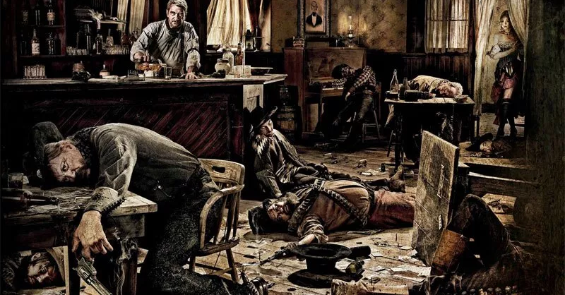
How bad was it in mining communities?
Californian law stated that people had the right to stake a claim. This gave them the right to all gold found there.
Claim jumping was common – men would steal land.
Some made money illegally by ‘salting a claim’ – planting gold flakes and conning someone into buying the land.
Road agents were gangs of criminals who would rob travellers on the roads in and out of mining communities.
Due to the difficulties of life, the overcrowding and alcohol, violence was common.
Fights could break out over prostitutes, gambling, debt or theft. Sometimes it ended in shooting or stabbing.
https://www.youtube.com/watch?v=rqKacXetFgw
1:04 onwards

Slide 3
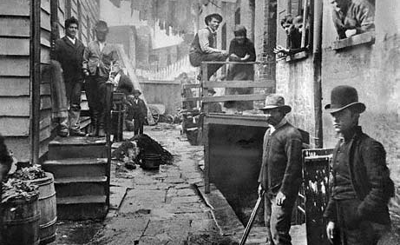
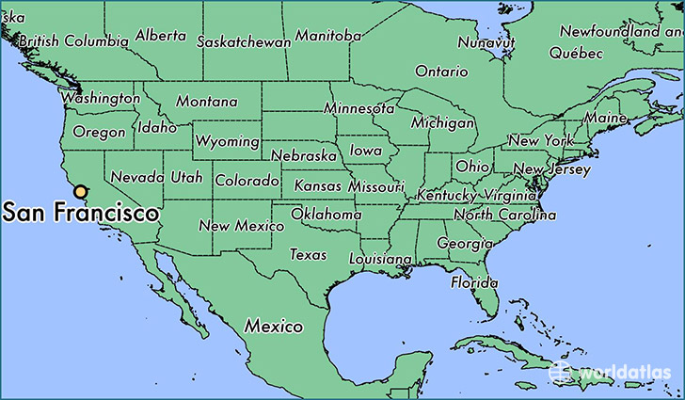
How bad was it in San Francisco?
In 1852, a famine in China forced thousands to emigrate to the USA. Between 1851 and 1852, 18,000 Chinese people emigrated to the western territories.
Thousands who returned to San Francisco from the gold hills, found a massive lack of jobs.
Many unemployment men turned to crime. Many formed gangs to protect themselves.
Racism against Chinese immigrants increased (some were stopped from working new claims) Chinese communities harassed. Some formed gangs like the ‘San Yums’ and ‘See Yups’.
San Francisco became known as the “Barbary Coast” due to it’s violent reputation and the amount of brotherls.

Slide 4
The Barbary Coast is the haunt of the low and the vile of every kind. The petty thief, the house burglar, the tramp, the whoremonger, lewd women, cutthroats, murderers, all are found here. Dance-halls and concert-saloons, where blear-eyed men and faded women drink vile liquor, smoke offensive tobacco, engage in vulgar conduct, sing obscene songs and say and do everything to heap upon themselves more degradation, are numerous. Low gambling houses, thronged with riot-loving rowdies, in all stages of intoxication, are there. Opium dens, where heathen Chinese and God-forsaken men and women are sprawled in miscellaneous confusion, disgustingly drowsy or completely overcome, are there.
Benjamin Estelle Lloyd's Lights and Shades of San Francisco (1876)

Slide 5
Learning Task One
For each of the five crimes below, explain what they were.
Claim jumping
Salting a claim
Road agents
Bar fights
Barbery Coast
Challenge:
Write a short paragraph explaining why the western territories became hot beds for criminal activity.

Slide 6
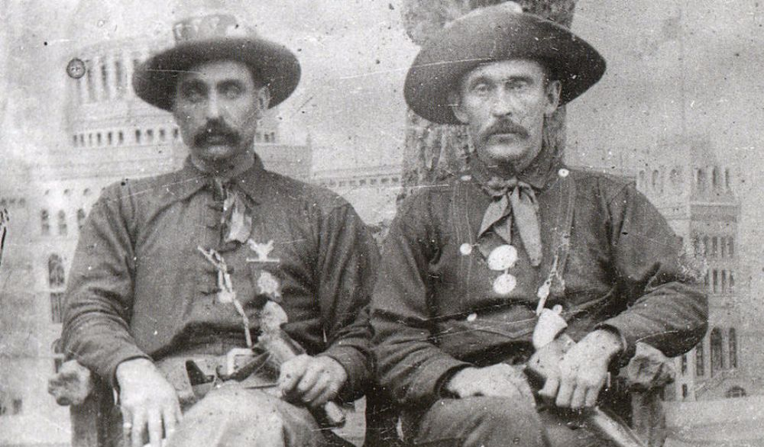
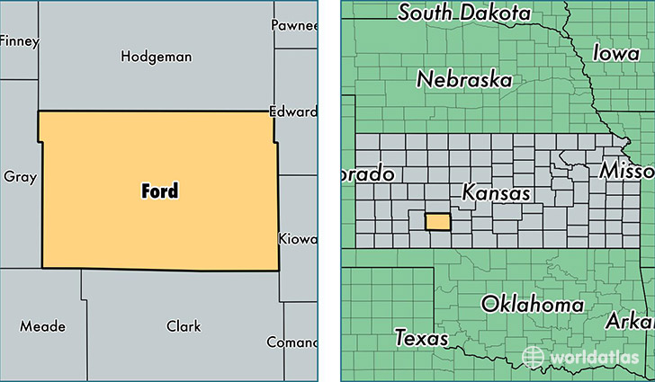
How did the government deal with this?
The Federal Government appointed governors for a territory, along with three judges and a U.S. marshal.
The Marshal could appoint deputies to help him, and also order men to join a posse to hunt criminals down.
Once a territory had a population of 5,000 people, it could elect a sheriff for each community.
An example is Chalkley Beeson, Sheriff of Ford County in Kansas. He was sheriff for 8 years between 1891 and 1896.

Slide 7
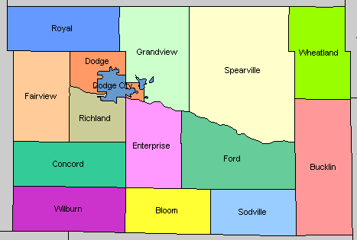

Slide 8
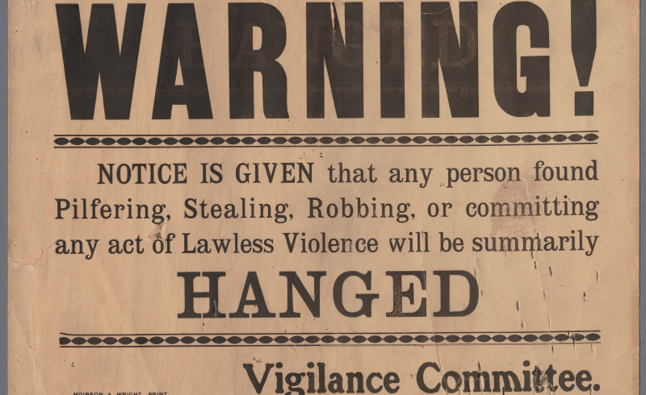
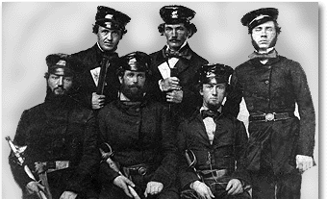
How did the city of San Francisco deal with this?
Due to the crime wave, many townspeople thought the legal system and courts were corrupt.
The rich business men of the city set up a vigilance committee of 200 men.
They captured any suspected criminals, tried them and punished them.
50% were found not guilty, 25% were deported, 15% were handed over to the police and 10% were lynched.
This idea spread through many mining communities in the west.
Mining courts only settled claim disputes, not crime. So vigilance committees were ideal.

Slide 9
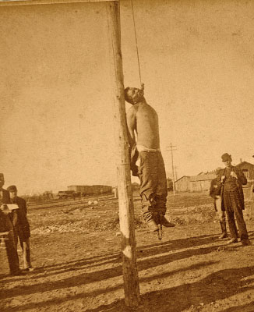
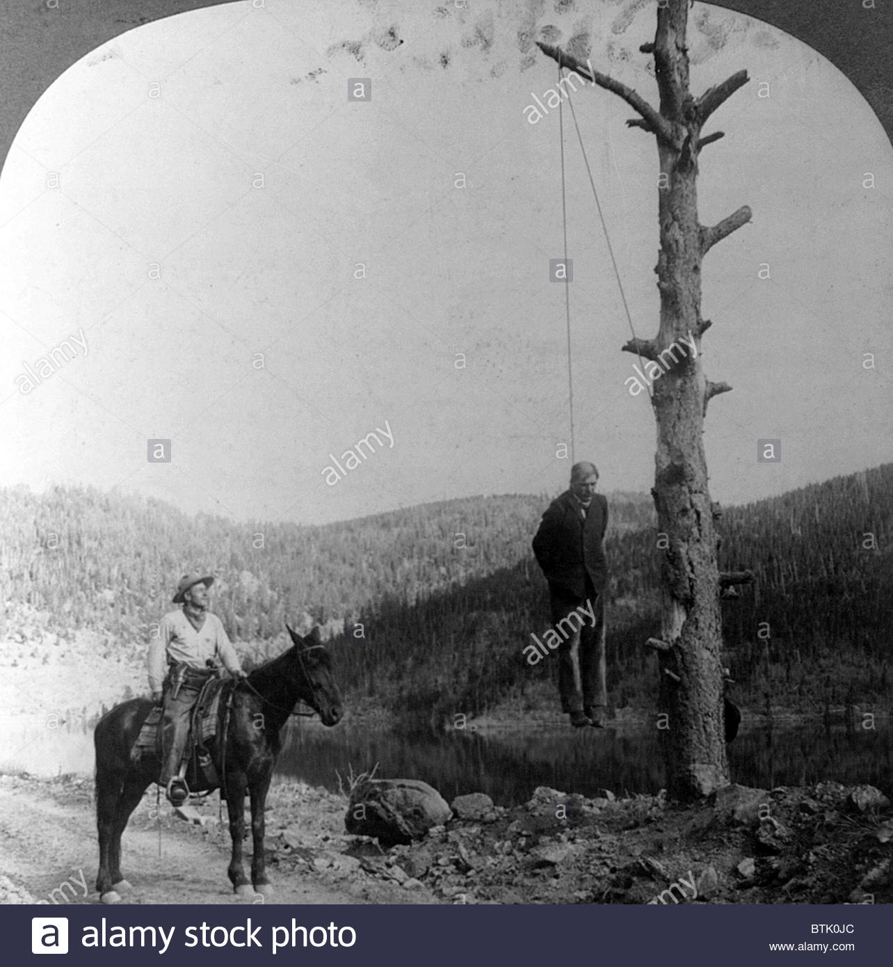

Slide 10
Learning Task Two
For each strategy below, identify:
Vigilance committees
Sheriffs
What it was/how it worked.
The positives of this strategy
The negatives/limitations of it.

