Slide 1
Why was the Pacific Railroad Act so important for the development of the West?
To Jeems, Davie. you. must. be, a good boy. and. Quit. hunting on Sunday and shooting your gun in the night. you keep people from sleeping. I live in a big rock above the Ford of the Creek. I went from Lincoln County County during the War I was Killed at Manassus in 1861. I am here now as a Locust in the day Time and. at night I am a Ku Klux sent here to look after you and all you Jim Crows and make you know your place. I have got my eye on you every day, I am at the Ford of the creek every evening From Sundown till dark I want to meet you there next Saturday tell platt Madison we have, a Box. For him and you. We nail all, radicals up in Boxes and send them away to KKK - there is. 200 000 ded men retured to this country to make you and all the rest of the radicals good Democrats and vote right with the white people
In this lesson, we will:
Describe the key features of the 1861 Pacific Railroad Act
Explain the impact the act had on various aspects of the United States
Starter: Read this source to the right. Davie Jeems was the first black sheriff in Lincoln County Georgia. Why do you think it was sent? Who sent it?

Slide 2
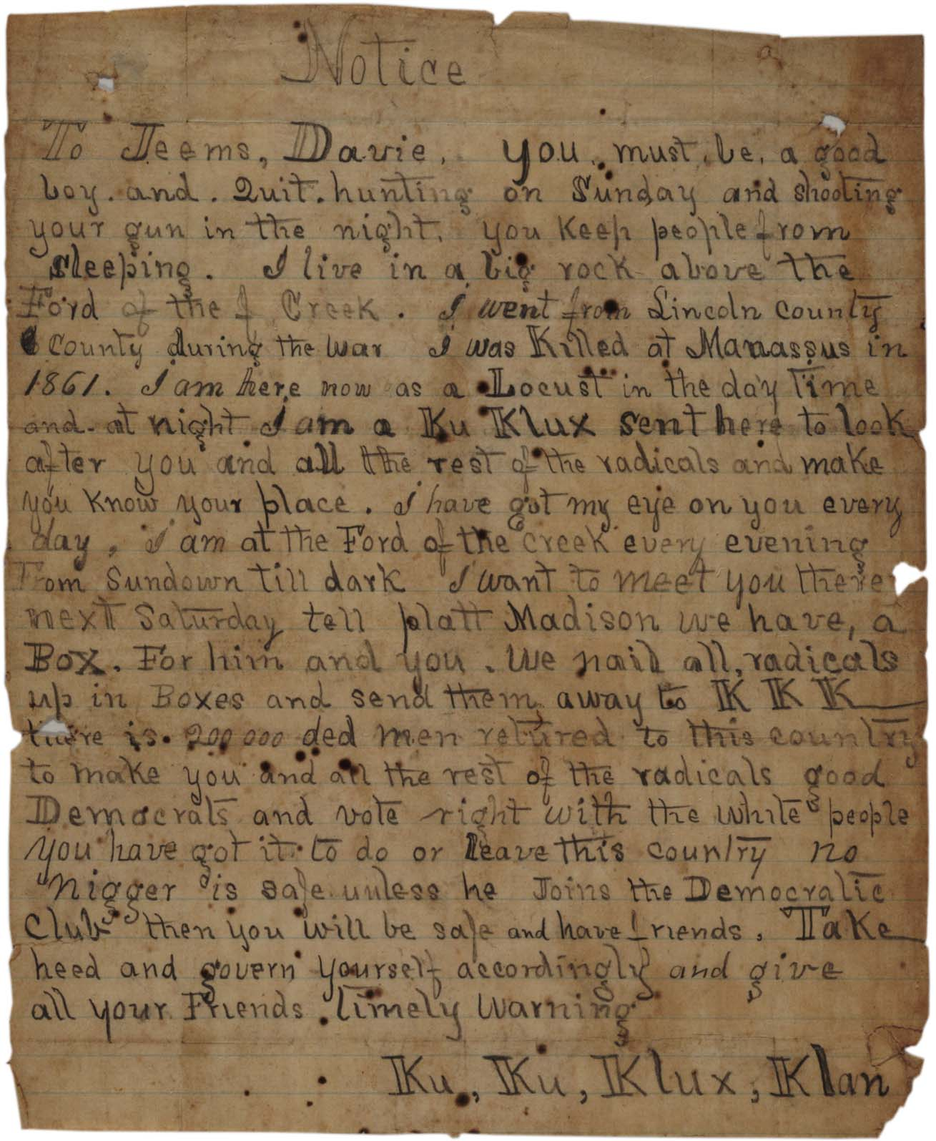
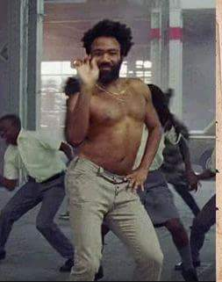
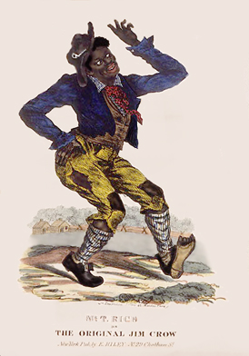

Slide 3
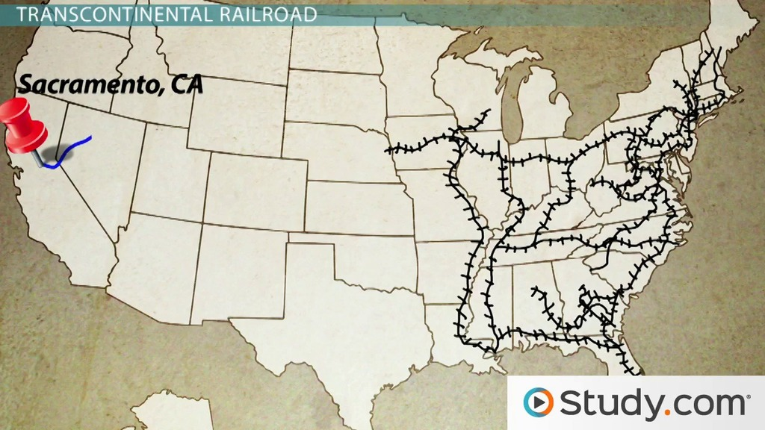
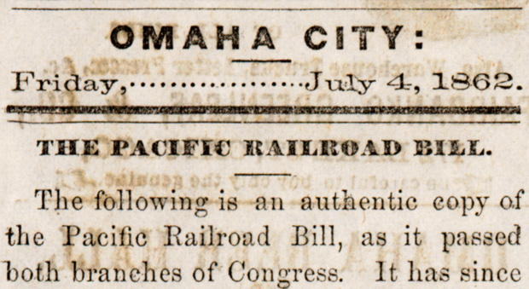
Debates over the rails
America’s rail network only reached as far as the Missouri River.
After 1830, there was great demand to connect the states in the North East, to the states and territories in the West.
However, very few railroad companies were willing to invest so much money in this 2,000km risk.
The US government was locked in debates over the proposed plan for a ‘Transcontinental railroad’
Northern politicians wanted this new railroad to connect in a big, industrial city like Chicago.
Southern politicians disagreed, and wanted a southern route to benefit their cotton industry.
When the south left the USA in 1861, Lincoln acted fast to pass the Pacific Railroad Act.

Slide 4
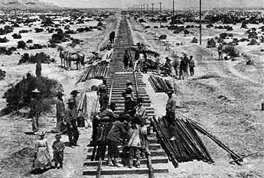
What did the Pacific Railroad Act do?
It selected a route that went from Sacramento (California) to Omaha (Nebraska)
It offered the contract to two companies: the Central Pacific and Union Pacific.
The Central Pacific would start in Sacramento, building eastwards.
The Union Pacific would start in Omaha, building westwards.
It offered each company a loan of $16,000 for every mile of track they laid ($48,000 if through a mountain)
For every mile of track they sold, the government would give the companies free land to sell for profits.

Slide 5
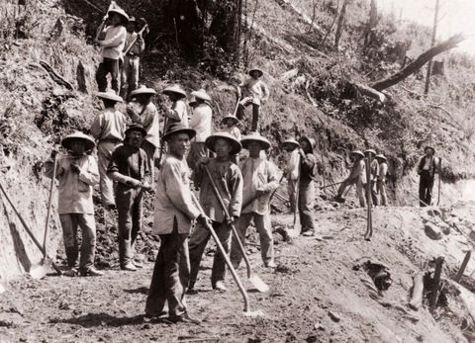
In the East, the Central Pacific Company used 10,000 Chinese workers

Slide 6
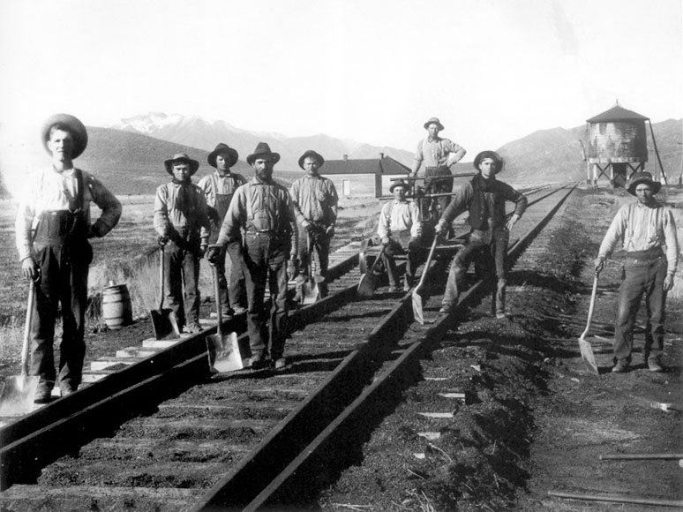
In the West, the Union Pacific Company used 8,000 immigrants from Ireland, Germany and Italy.

Slide 7
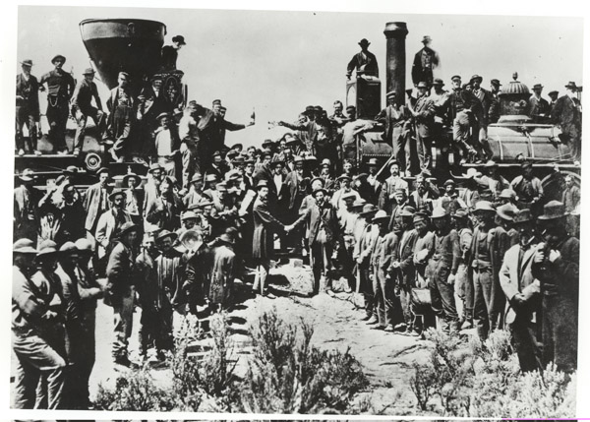
The two railroads met on May 10, 1869, at Promontory Summit, Utah Territory.

Slide 8
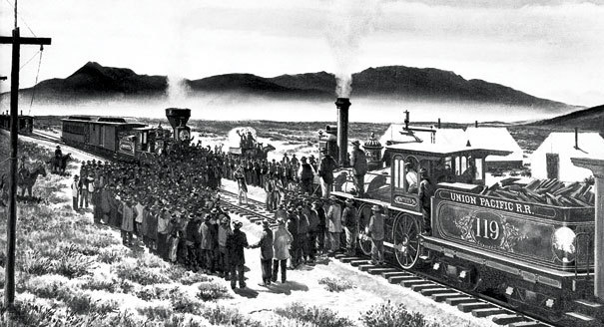

Slide 9
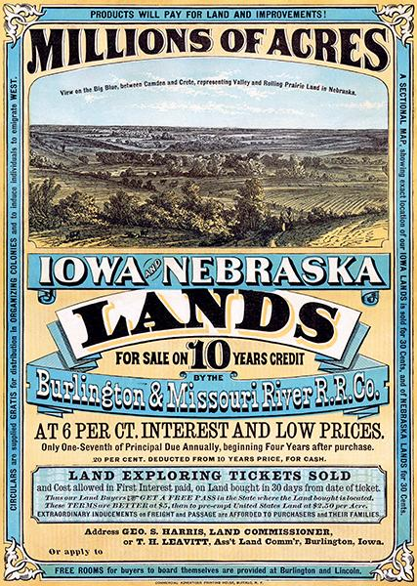
How did it benefit the settlement of the west?
Together, the companies were given 45 million acres of land in the mid-west and west.
They used marketing to encourage people to buy their land grants.
Sometimes, they would arrange tours of the land to show people the benefits.
Advertising agents would tour the big cities of the east, to advertise this cheap land.
Each railroad company had a Bureau of Immigration, to persuade people from foreign countries to buy their land.
In one year, 10,000 Scandinavians settled in Nebraska and 60,000 Germans settled in Kansas.

Slide 10
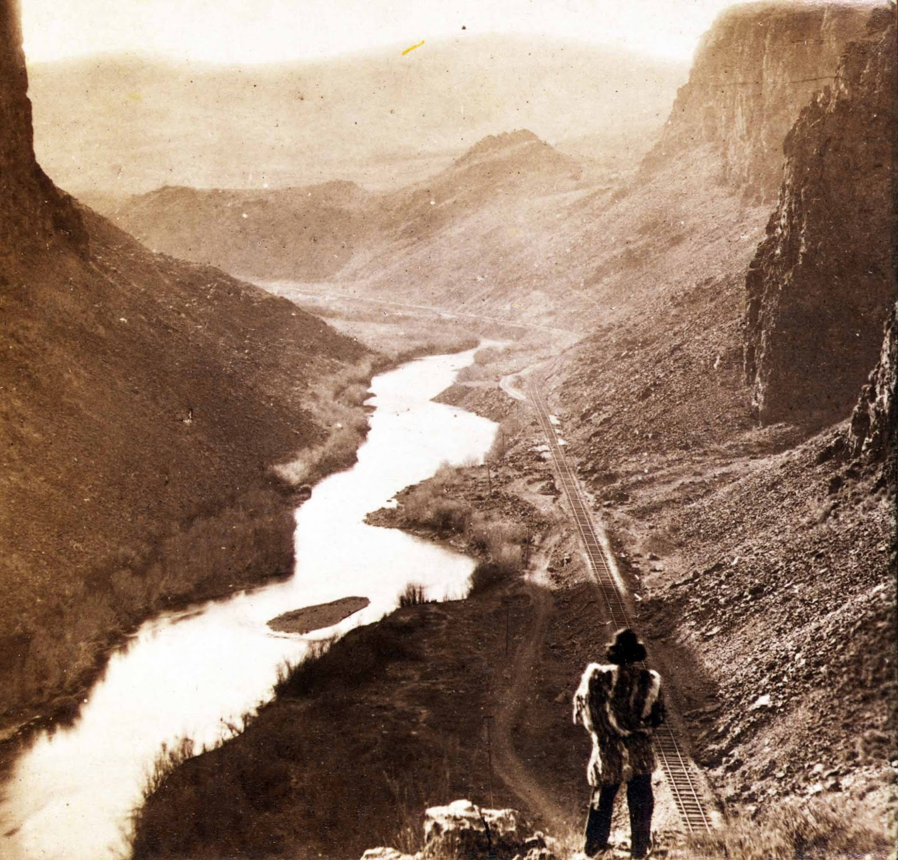
Learning Tasks
On your map of the United States, draw in the route of the new railroad.
Beneath the map, explain how the Pacific Railroad Act benefitted the railroad companies.
For each of the following, explain how the railroad effected them:
Cattlemen
Homesteaders
Foreigners
Plains Indians

