Slide 1
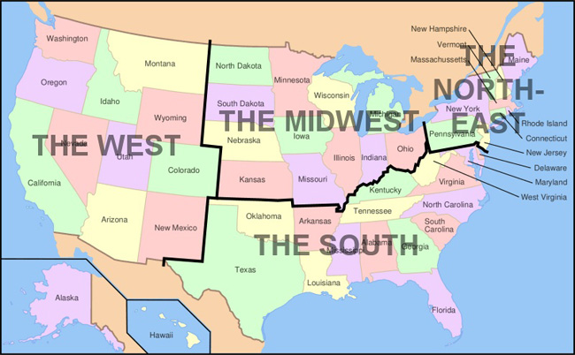
Why was the Homestead Act so important for the development of the West?
In this lesson, we will:
Describe the key features of the 1861 Homestead Act.
Explain the importance of the Homestead Act
Starter: Write down any three states in the American west.

Slide 2
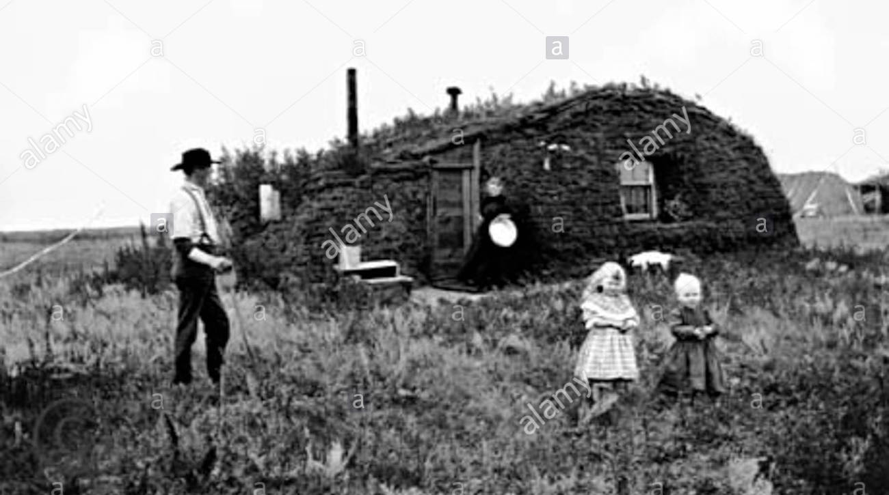
What was the Homestead Act?
When the southern states left the USA in 1861, it meant the US government was controlled by the Northern states.
This allowed President Lincoln to pass the Homestead Act without any opposition.
Motivated by manifest destiny, the government wanted white settlers to migrate west and farm the land.
Lincoln was keen to avoid ‘speculation’ – when wealthy landowners bought up large areas of cheap land and rented it for profits.
The Homestead Act was the solution, as it offered 160-acre plots of land to ordinary people only.
For $10, a family could claim a plot of land so long as they farmed it for 5 years and built a house.

Slide 3
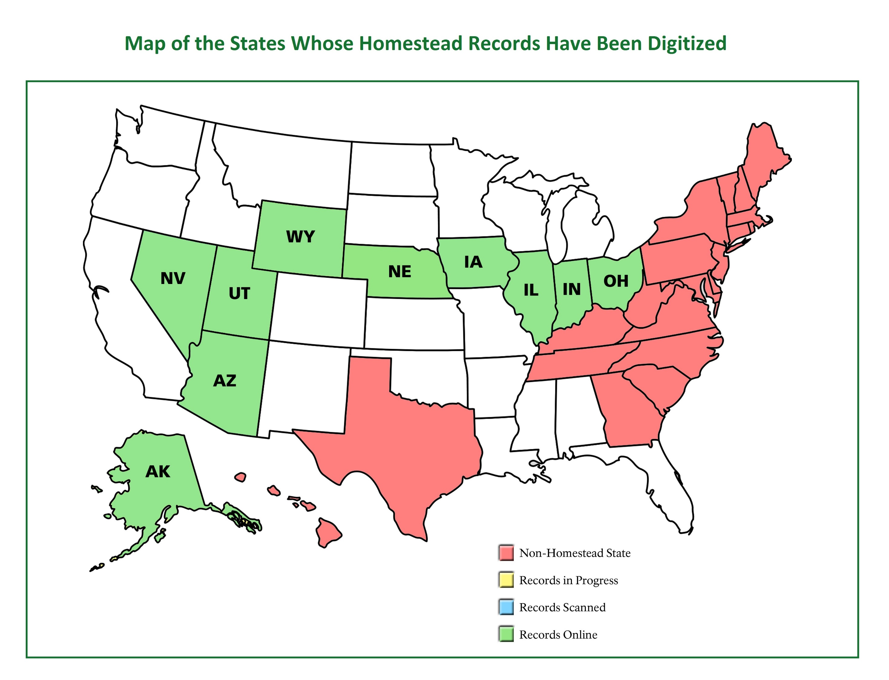

Slide 4
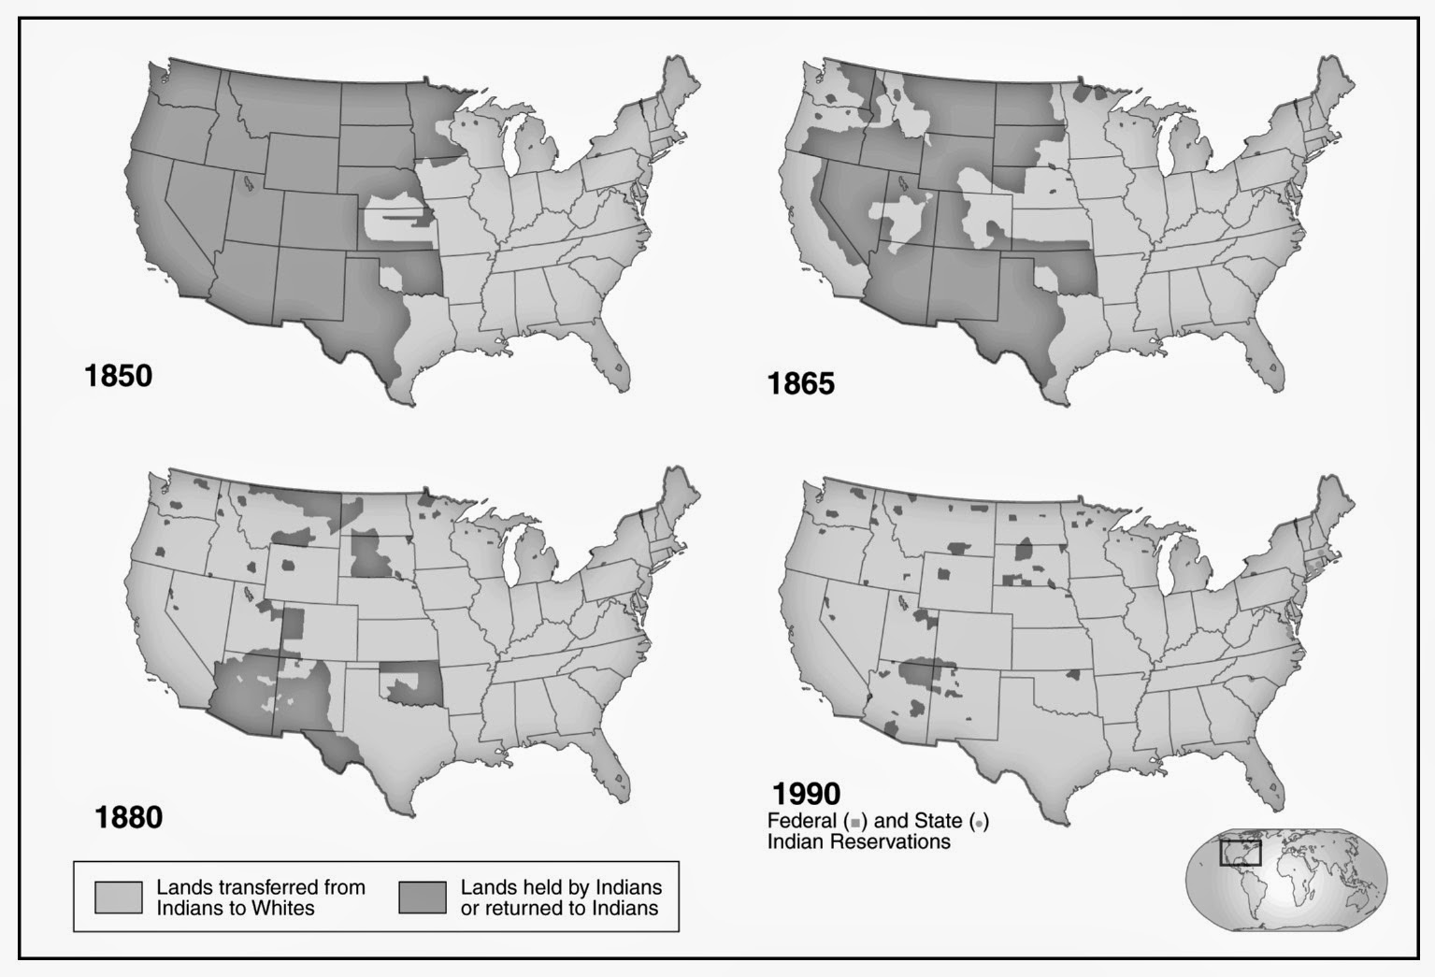

Slide 5
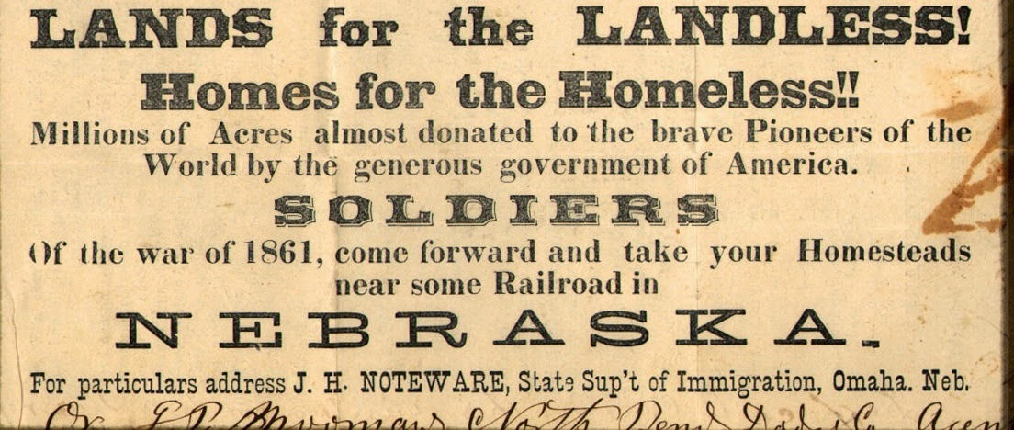
Learning Task One
Cut out the pamphlet advertising homestead land in Nebraska.
Complete questions a – d on p. 41 around your pamphlet.
Circle each part that you are discussing in your answer.

Slide 6
Why was it important?
It showed the government’s commitment to manifest destiny.
It allowed parts of the Great Plains to be settled for the first time (30% of the USA was settled through this act)
It encouraged migration from the south, as ex-slaves could own land for the first time after 1866.
It encourage immigration from Europe, as it offered land even to those who were not U.S. citizens (people had to submit declarations of intent to become citizens)

Slide 7
Learning Task One
Reasons why Homestead Act was important
It ultimately led to rich landowners making profits from the land
It showed the government’s commitment to manifest destiny.
It allowed parts of the Great Plains to be settled for the first time
It encourage more migration and immigration to the west.
To the right are four sentences about the Homestead Act.
Decide firstly, if they are good or bad impacts.
Beside each, explain each with precise knowledge.

