Slide 1
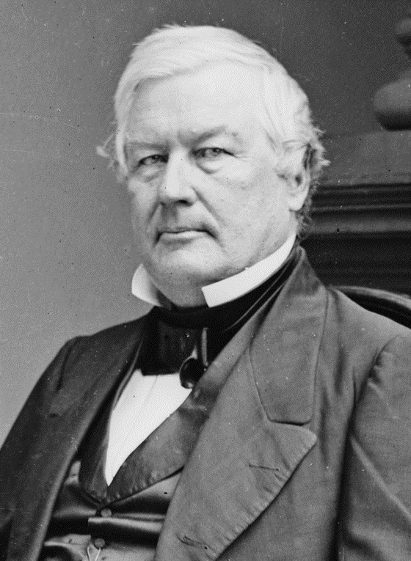
Why was the 1851 Fort Laramie Treaty so important for the Plains Indians?
In this lesson, we will:
Describe the key terms of the Fort Laramie Treaty.
Explain the importance of the treaty
Starter: In 1851, President Fillmore had a solution to solve the tension between white migrants and Plains Indians.
What was it?
What did it state?

Slide 2
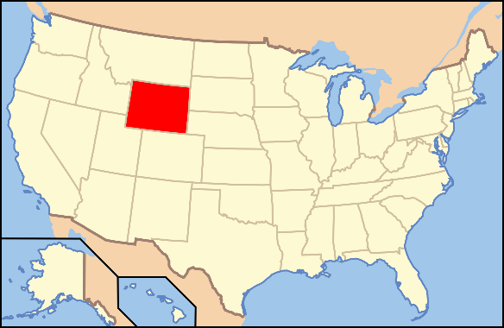
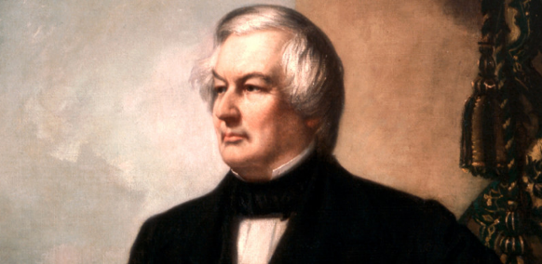
What was the government’s solution?
In 1851, President Millard Fillmore organised a meeting with the a council of Plains Indians at Fort Laramie, Wyoming.
He aimed to get them to agree to end their fighting with other tribes and guarantee safe passage for migrants.
He also wanted to get them to agree to fixed land boundaries.
He demanded each tribe name a chief to represent them at the meeting.
Translators would be sent in to help translate the Indian language into English.

Slide 3
Not all Indians understood the treaty, as there were not enough translators.
The Chief did not represent the whole tribe – he could not make his tribe follow it.
Problems with negotiating with the Indians.
Indians could not agree to land boundaries, as they were nomadic.
Many tribes did not attend.
Those who attended were there only for food and gifts.

Slide 4
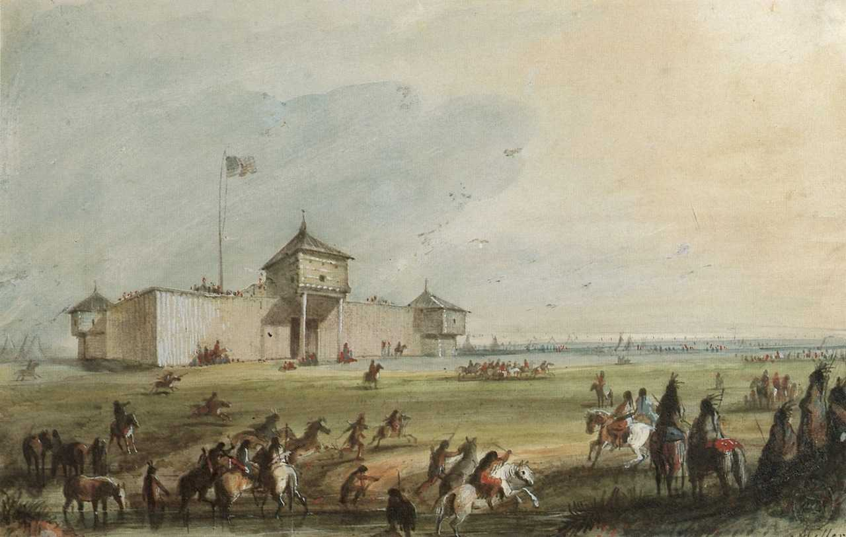

Slide 5
Learning Task One
How did the gold rush cause problems for the Plains Indians?
How did the gold rush cause more tension between the different types?
Why some tribes refused to turn up to Fort Laramie to negotiate?
What did the Fort Laramie Treaty offer the Indians?
Why did the Lakota refused to give up the land they had taken from other tribes?
What problems were there with signing the treaty?
What caused the treaty to collapse in 1854?
https://www.youtube.com/watch?v=OJwaKp00UwE

Slide 6
What did the Fort Laramie Treaty state?
Plains Indians must stop fighting.
The Lakota were to keep all the land they had conquered from other tribes.
Tribal boundaries were drawn up between different tribes.
White migrants must be allowed safe passage.
Railroad company surveyors must be allowed in.
Government must be allowed to build roads and forts through their land.
Pay compensation if any terms are broken. In return, the government would pay $50,000 to the tribes per year.

Slide 7
Learning Task Two
“I can explain why the Fort Laramie Treaty was important”
For each sentence below, explain how it is applicable to the 1851 Fort Laramie Treaty:
Plains Indian’s began to lose their independence.
It undermined the Permanent Indian Frontier (negotiated months before)
It caused more white migration through Indian Territory.
It was the first step towards reservations.

