Slide 1
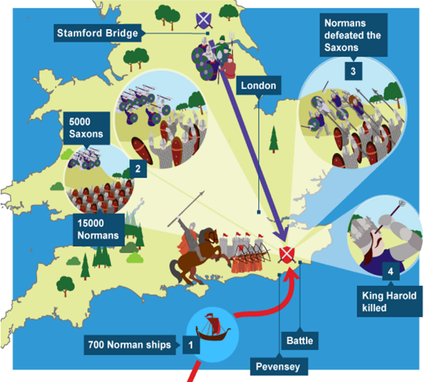
Why was Duke William of Normandy victorious at Hastings in October 1066?
In this lesson, we will:
Describe the advantages and disadvantages of Harold’s and William’s army at Hastings.
Explain why William’s army were victorious at Hastings.
Starter task:
“The weather was a blessing in disguise for William” Explain how this is true. Use precise examples!

Slide 2
What happened after Stamford Bridge?
Whilst King Harold of England rested in York, William landed in Pevensey.
William’s army began to convert old Iron Age forts across the South Coast into motte and bailey castles.
William ordered his men to raid, pillage and burn across Wessex (called ‘harrying’)
When news reached King Harold of the Norman invasion, he became enraged.
His mother and brother (Gyrth) pleaded with him to march to London and force William to come to him.
Instead, Harold rallied his army and decided to march to meet William in the south.

Slide 3
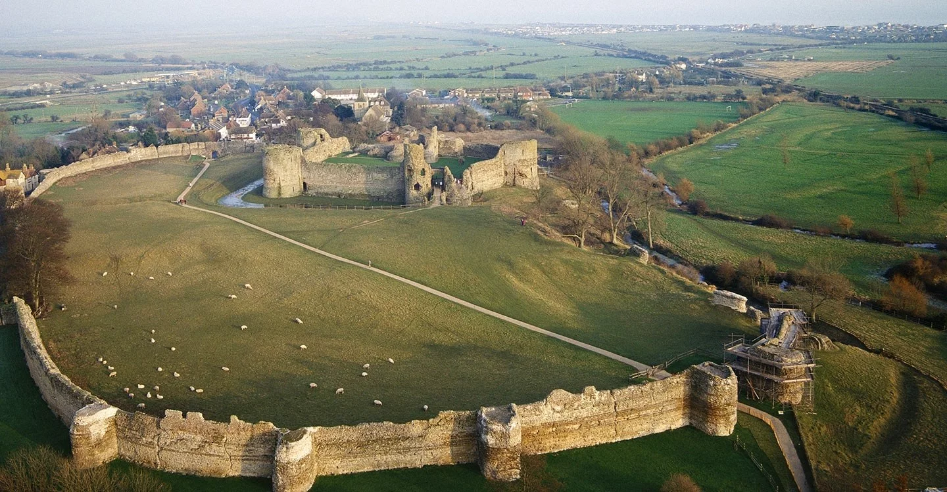

Slide 4
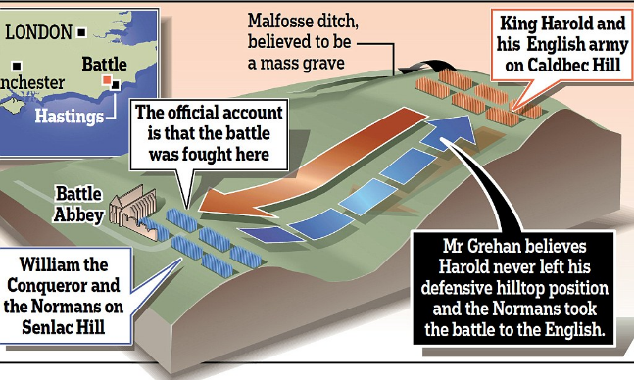
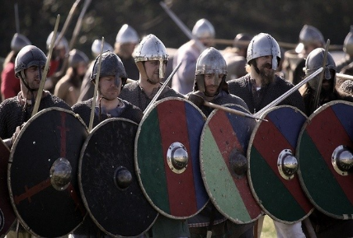
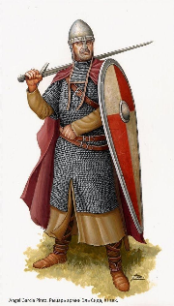
Where did they meet?
King Harold’s army met with the Normans at Battle, just north of Hastings.
The Saxons arranged themselves in a shield wall atop Senlac Hill, cutting the Normans off from the main route to London.
William’s army was very strong, but was at a disadvantage as they had to charge up hill.
The Normans had 800 mounted knights, and 7,000 soldiers. They were heavily armoured with chainmail.
The Saxons numbered about 7,000 and were made up of thegns, housecarls and the fyrd. Many were fighting with no chainmail.

Slide 5
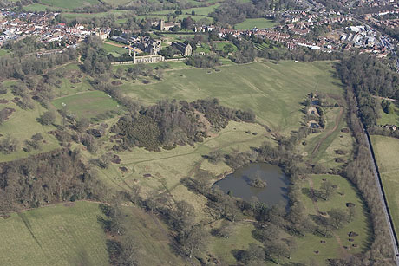

Slide 7
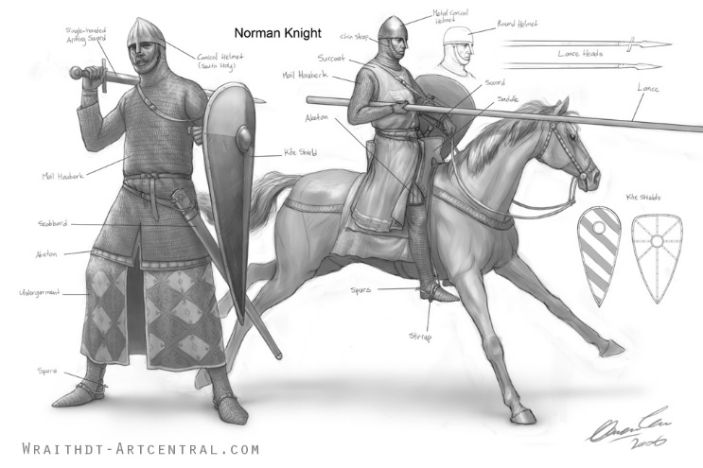

Slide 8
Learning Task One
Your teacher will give you a diagram with both armies on it.
For each, identify strengths and weaknesses of each!
Blue groups
- Should you need it, your teacher has provided with you a list of facts. You should categorise them into the correct column (e.g. an advantage or a disadvantage)

Slide 9
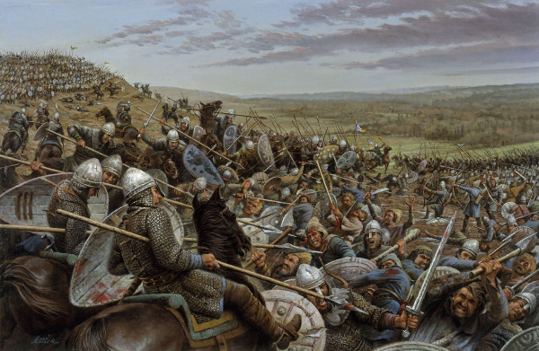
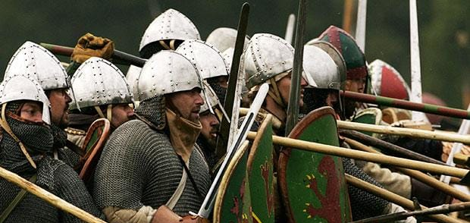
What happened during the battle?
At 9am, William ordered his archers to open fire on Harold’s shield wall.
As they were firing up hill, the damage was minimal.
Next, William’s infantry were ordered to charge the shield wall.
Due to little damage, William then ordered his knights to charge the shield wall.
For 3 hours, William’s infantry and knights charged the shield wall but it held strong.
By midday, the Battle of Hastings was locked in a stalemate.

Slide 10
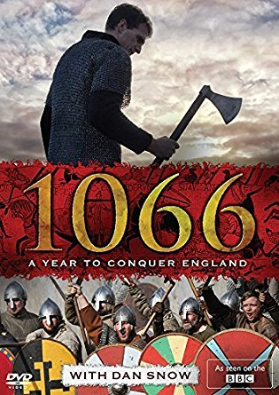
Learning Task Two
Your teacher will show you a 10 minute clip from the 2017 documentary “1066: One Year to Conquer England”.
As you watch it, answer the following questions:
What happened around mid-day which changed the battle?
How did William use this to his advantage?
When it came down to hand to hand combat; who had the advantage?
What ended the battle?

Slide 11
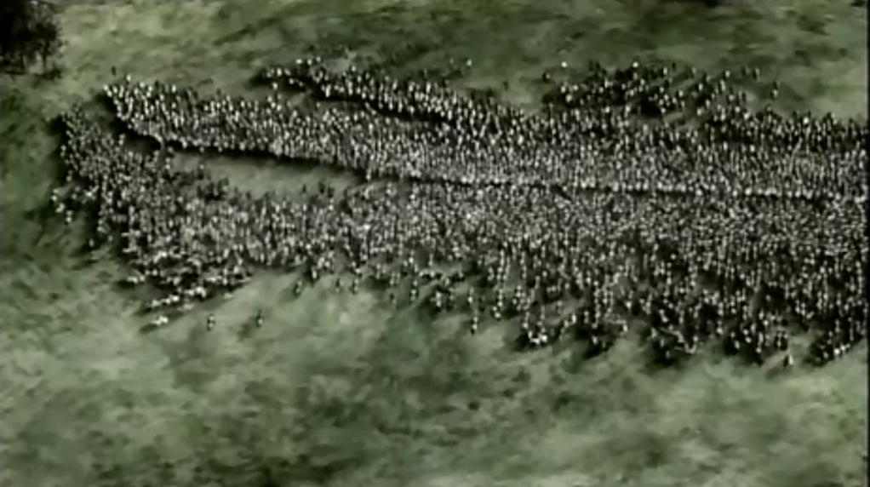
During the chaos of charging the wall, some Norman soldiers on the left flank begin to retreat. Legends say they heard a rumour William had been killed.

Slide 12
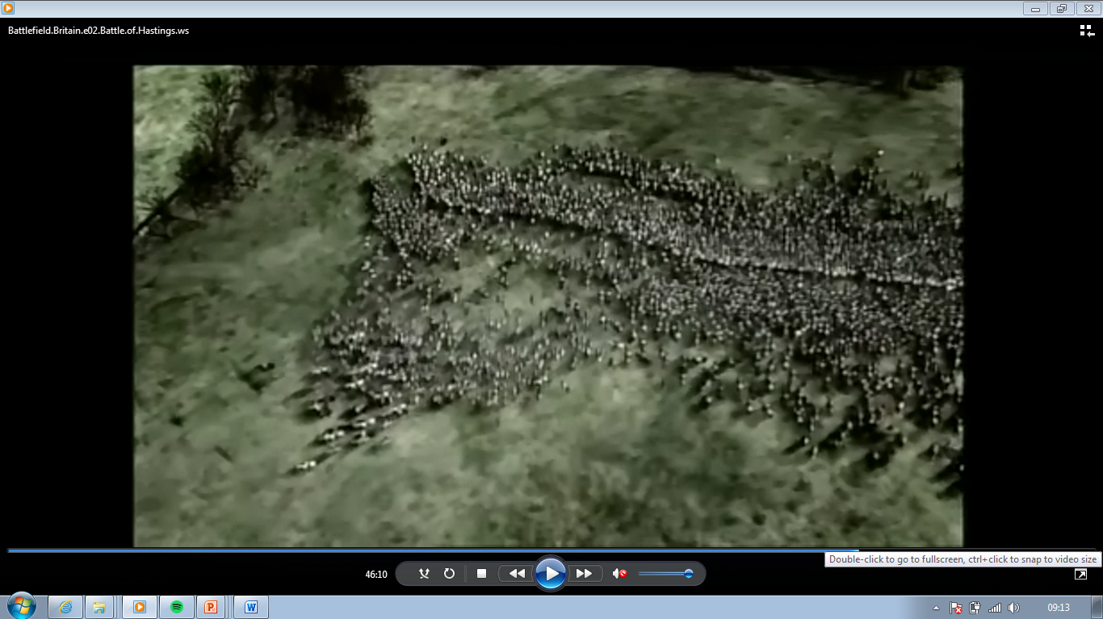
Many of the Anglo-Saxons break ranks and pursue the fleeing Normans.

Slide 13
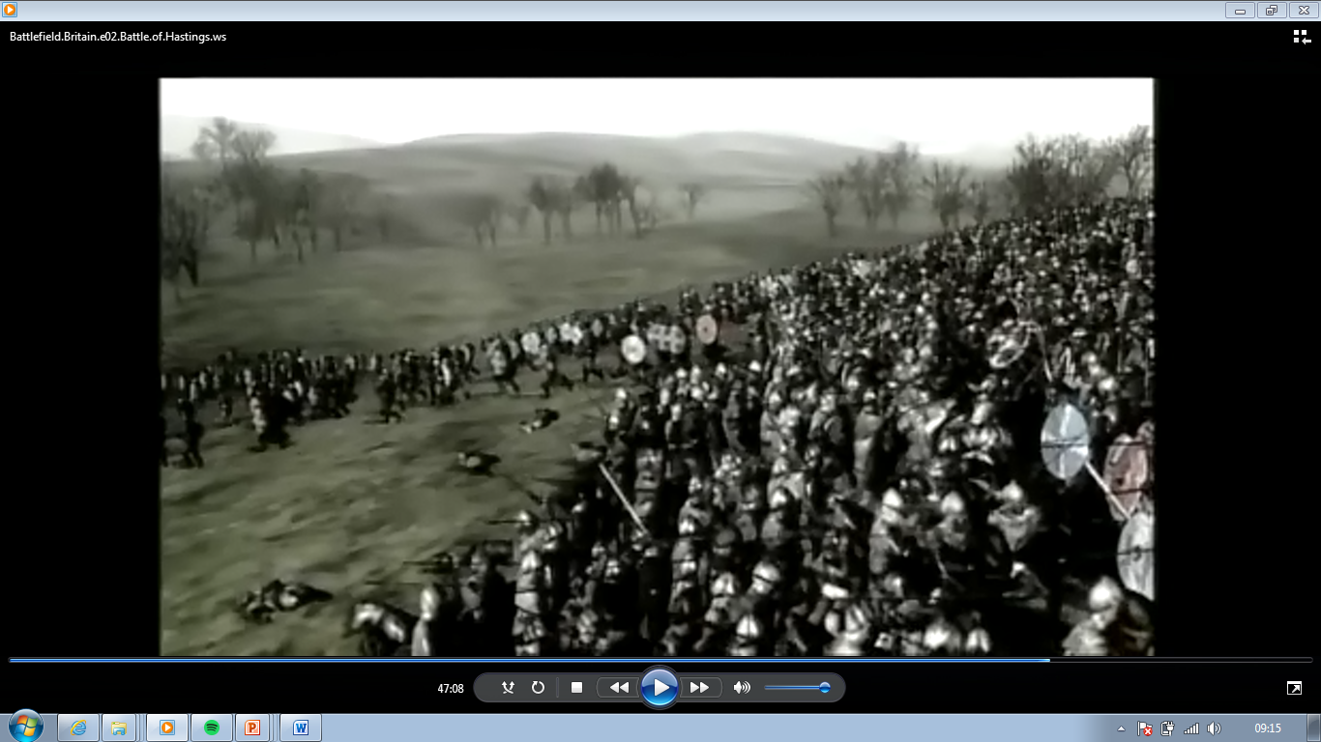
As King Harold is fighting on foot, he cannot get over to the flank to stop his men charging. He watches as his shield wall breaks on the left.

Slide 14
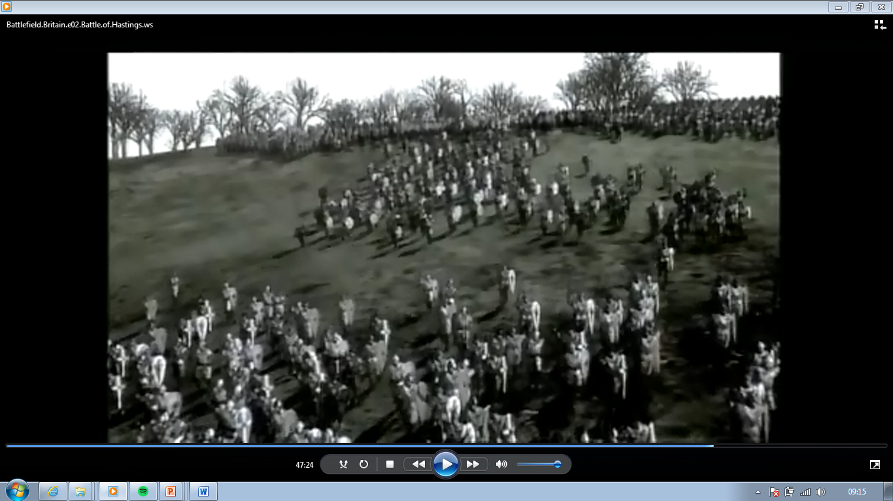

Slide 15
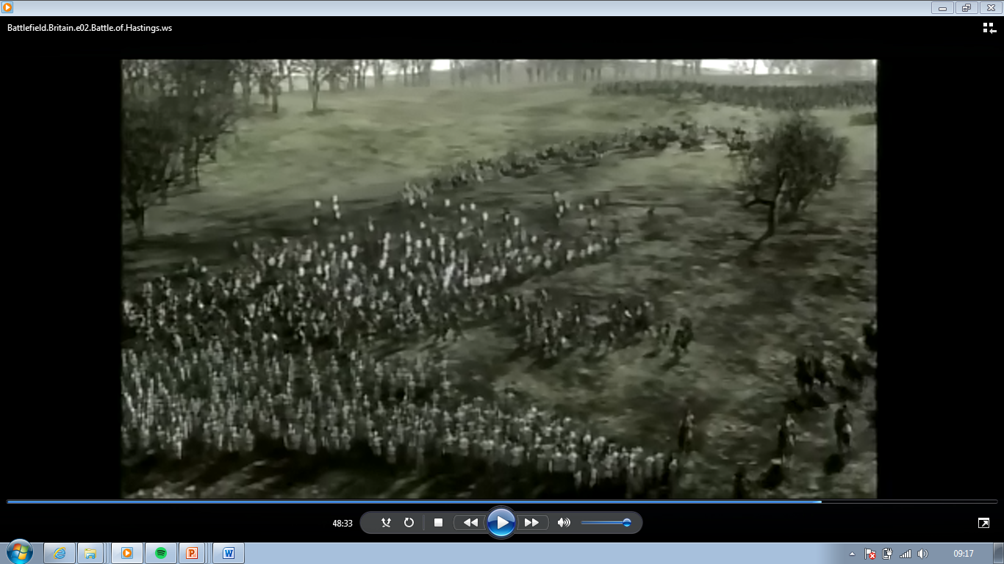
The Anglo-Saxons pursue the Normans down the hill into a marshy area. William then seizes the opportunity and orders his knights to charge in and cut them down.

Slide 16
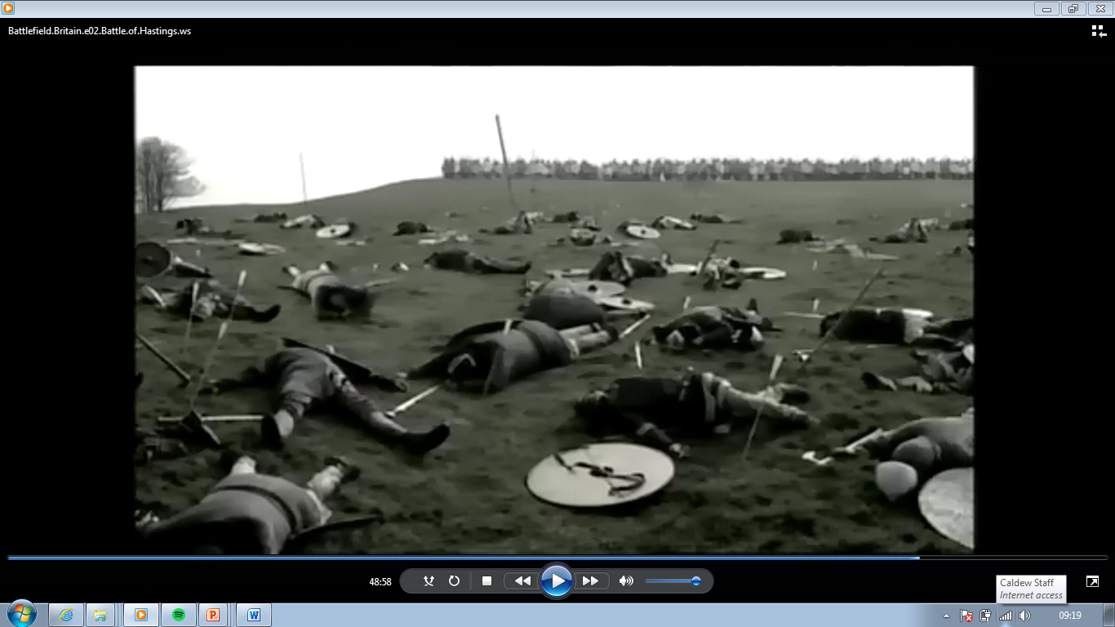
With these men dead – both armies pause and regroup. William decides to use this tactic (feigned-retreat). He uses it time and time again over several hours to weaken the shield wall.

Slide 17
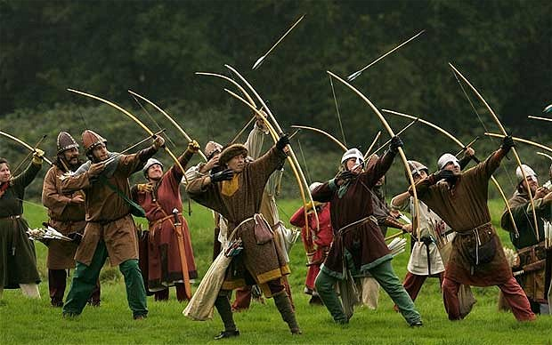
As day begins to fade – William plans his final big push. He orders his archers to fire up into the air in order to hit behind the shield wall.

Slide 18
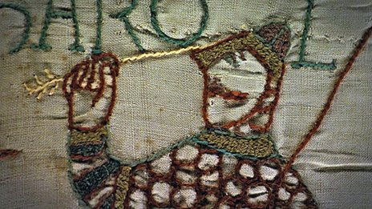
King Harold is hit by one of the arrows and dies. William then orders his entire army to charge the wall.

Slide 19
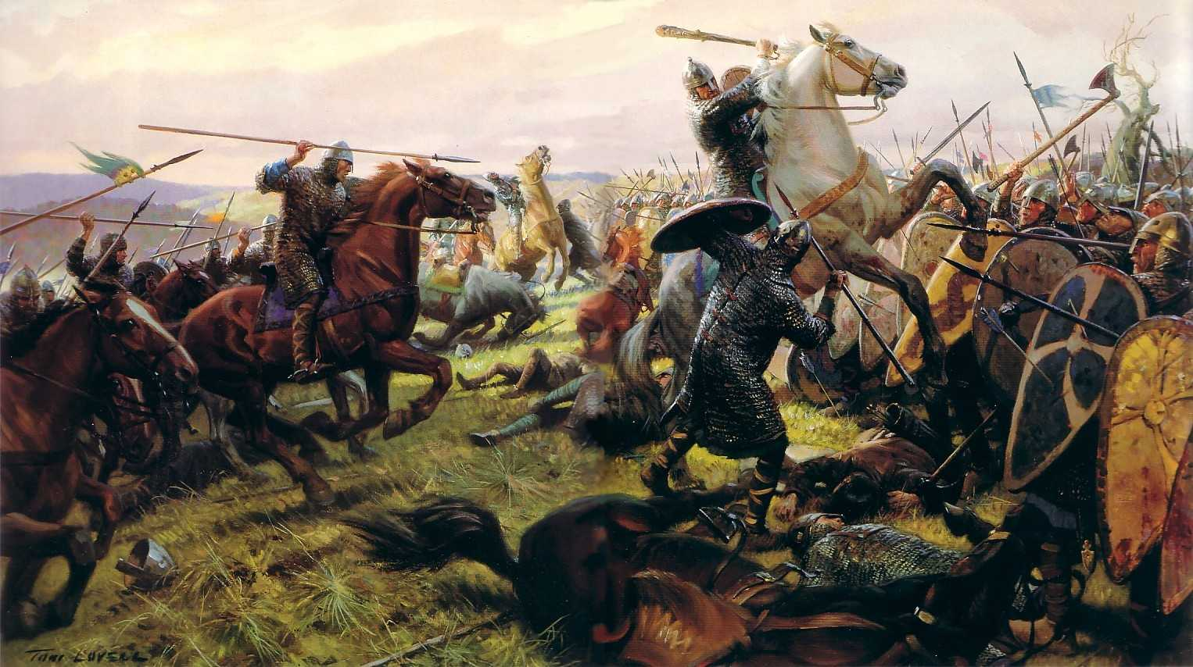
After hours of fighting, the Anglo-Saxon shield wall falls and William’s army cuts them down. Harold, his brothers and all their houscarls are killed.

Slide 20
Learning Task Three
Cut out the four diamond cards.
On each, write down examples to explain how this factor helped William win.
Now glue them into your book in order of importance.
Most important at the top, least at the bottom!

