Slide 1
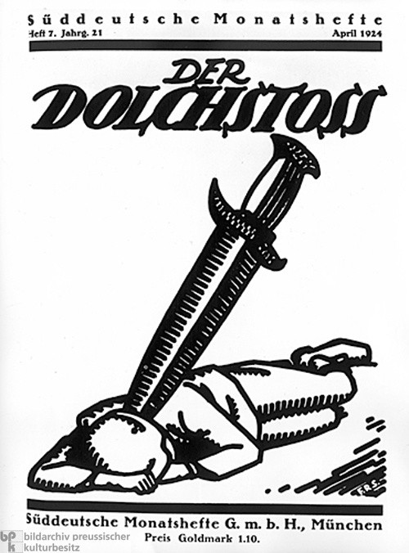
Why was 1923 such a disastrous year for Germany?
In this lesson, we will:
Explain what caused hyperinflation in Germany.
Assess it’s impact on Germany.
Starter: Respond to any marking in your book.
Then: Using last lesson’s work, explain why many in Germany would have seen Ebert as a weak Chancellor.

Slide 2
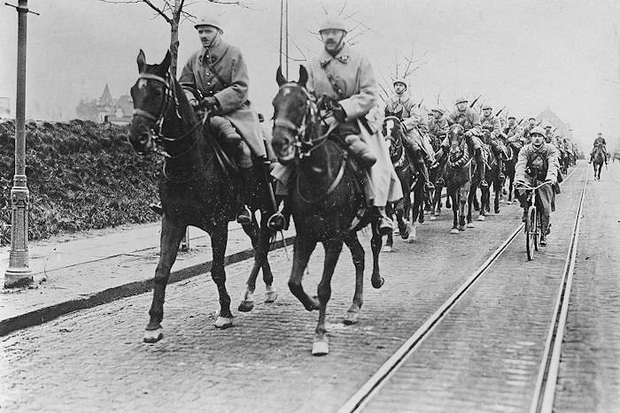
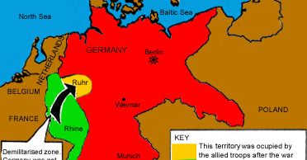
Why did the French invade in 1923?
By 1923, the Weimar Government was bankrupt – gold reserves had been spent on the war and dealing with the Spartacists and Freikorps.
By losing the coalfields in Silesia and imposing reparations, the Versailles Treaty made things worse.
In December 1922, Germany failed to send coal to France from the Ruhr.
In reaction, French troops invaded the Ruhr valley in January 1923. They seized raw materials, industrial goods and machinery.
Ebert’s government told workers to strike but not be violent.
French troops began to arrest German workers, and take control of all factories.

Slide 3
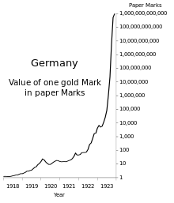
What impact did this have on Germany?
It crippled Germany’s economy, as 80% of the countries iron, steel and coal were in the Ruhr.
It increased unemployment and the shortage of manufactured goods.
To pay their debts and keep wages, Ebert’s government printed more money.
They had 300 paper mills and 2,000 printing ships printing paper bank notes.
This increased inflation (more money = prices increase = more money).
By 1923, inflation was so high that it hit ‘hyperinflation’

Slide 4
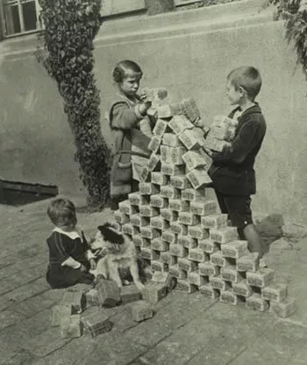
How did things get worse?
Due to hyperinflation, people had to carry huge baskets of money.
Workers were often paid twice a day, to try to buy goods before prices increased.
Some shops refused to take money, instead asking for goods in trade.
Many began looting shops as they could not afford food.
The German currency became worthless for importing goods (£1 = 20 billion marks in 1923)
Foreign suppliers refused to accept German marks for goods.
People’s savings in banks became worthless.

Slide 5
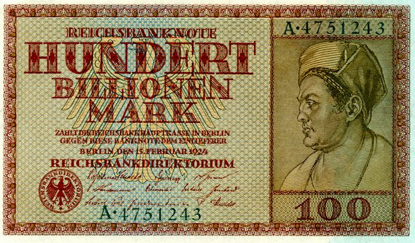

Slide 6
Learning Task One
Orange/Green Groups: Explain the election data provided to you. Use context of the period.
All targets
Organise the cards given to you into cause and effect. Draw lines to link cause to their effects.
Blue groups
Explain clearly how the events of 1923 would have benefitted Far Right parties like the DAP.

