Slide 1
Why did the church oppose the Nazis during the 1930s?
Source A: Extract from a speech by Hitler in the Reichstag on the Enabling Law, March 1933.
Christianity is the unshakeable foundation of the moral and ethical life of our people. The National Government’s concern will be for cooperation of the Church with the State. It expects, however that (this) will meet
DO NOW:
What can we infer from Source A about the Nazis and religion in 1930s Germany?
In this lesson, we will:
Explain why the Church opposed the NSDAP in the 1930s.
Describe how they opposed them

Slide 2
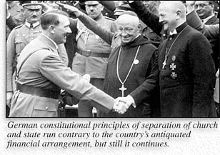
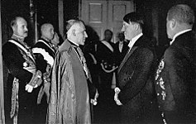
Doomed from the start?
Christianity clashed with the ideas of Nazism.
The NSDAP preached strength through violence and racialism. Christianity preached tolerance, peace and respect for all people.
Catholics owed allegiance to the Pope, rather than to the state.
Catholic schools were separate and taught Catholic ideas rather than Nazi ideas.

Slide 3
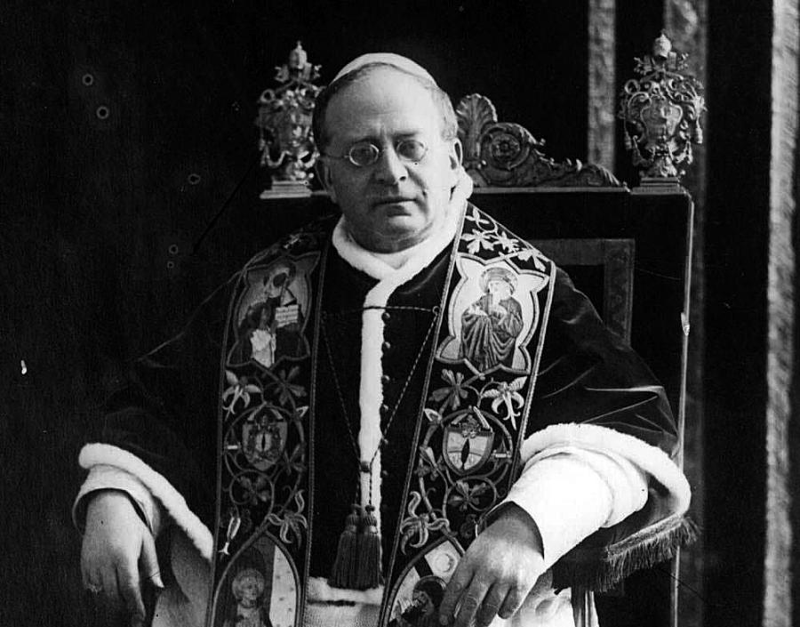
The Nazis places importance on marriage, family and moral values. Most Christians also believed in the importance of these
Christians feared communism because it was anti-religious, and Hitler promised to destroy communism.
Why did some Christians support the NSDAP?
Hitler and Pope Pius XI signed a concordant – Hitler would grant freedom of worship for Catholics and Catholic schools.

Slide 4
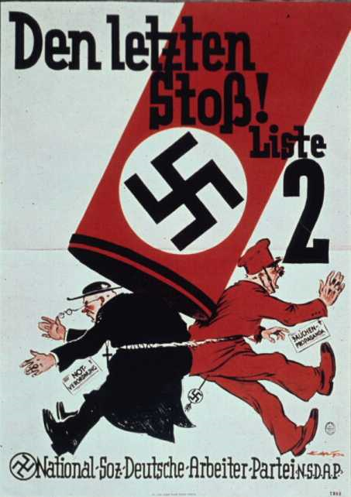
Throughout the 1930s, Catholic priests were arrested and sent to concentration camps.
All Catholic schools were either closed or converted into state schools.
Catholic youth groups were banned (replaced by the Hitler Youth after 1939)
In reaction, Pope Pius XI issued a statement which attacked the Nazis in 1937 (‘With Burning Anxiety’)
Eventually over 400 Catholic Priests were sent to Dachau.

Slide 5
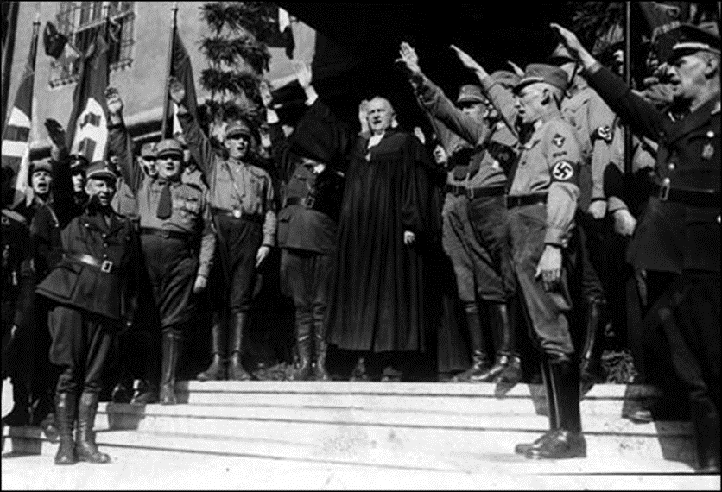
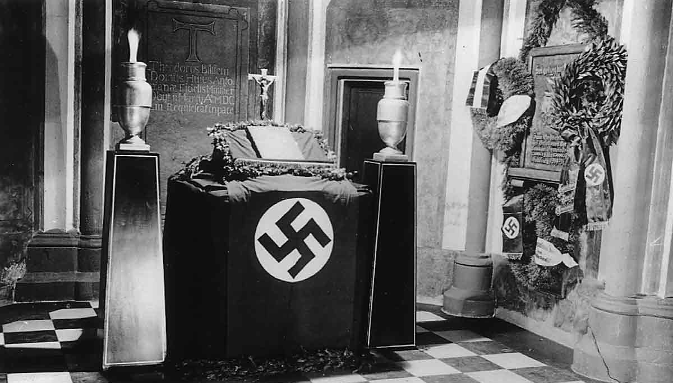
To control Protestants, the Nazis united all their churches to form the ‘Reich Church’.
It was led by Ludwig Muller (Reich Bishop of Germany)
Only pastors who supported Nazi ideas were allowed to keep working.
Swastikas were introduced to all Reich churches.
Jews were banned from being baptised Christian.
The Old Testament was banned (link to Jewish teachings)

Slide 6
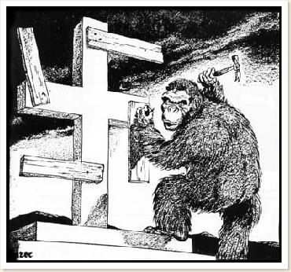
Learning Task One
I can explain why Christians opposed the Nazis
Source A: Cartoon drawn by British cartoonist Phillip Zec in 1935
What is this cartoon trying to say about religion in Nazi Germany?
Provide evidence from the source to support this.
Provide examples from 1930s Germany to support this interpretation.
Stretch Challenge:
What evidence is there that Zec was critical of Fascism?

Slide 7
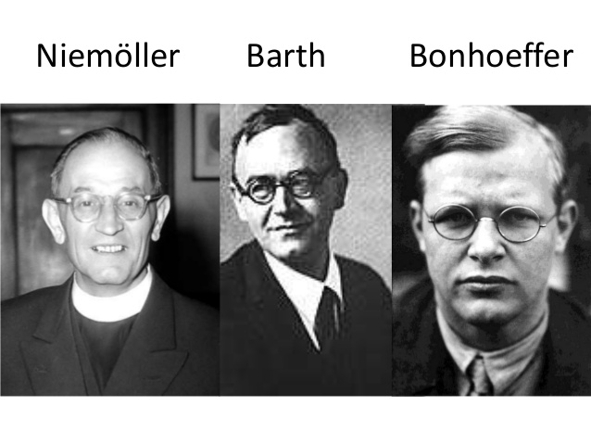
How did German Protestants resist?
In 1933, a group of Protestant pastors, including Martin Niemöller, set up the Pastors’ Emergency League (PEL).
They opposed two key aspects of Nazi treatment of Protestant Churches in Germany. (The joining of regional churches into one national German Christian Church. Nazi attempts to stop Jews becoming Christians)
In 1934 they set up the ‘Confessing Church’ which saw 6,000 people join.
In their sermons, they attacked the Nazis.
Over 800 pastors were arrested and sent to concentration camps for this.

Slide 8
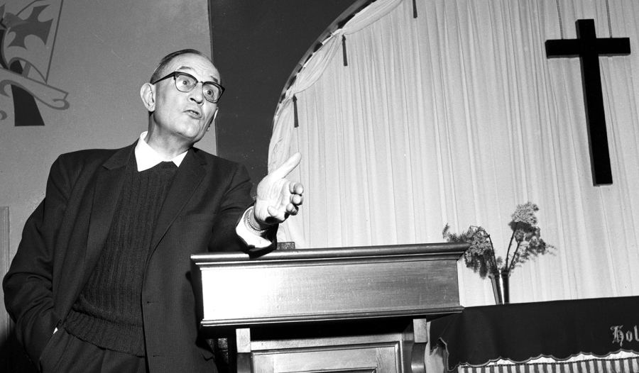
Martin Niemoller
Served in First World War as a U-boat commander.
Trained as a pastor in 1920.
Was critical of the Weimar Government in the 1920s.
Voted for the Nazis in 1924 and 1933.
The Gestapo bugged his phone in 1934, which turned him against them.
He spoke out against them and was arrested constantly between 1934 and 1937.
Between 1937 and 1945 he was imprisoned for ‘treason’
First they came for the Socialists, and I did not speak out—because I was not a Socialist. Then they came for the Trade Unionists, and I did not speak out—because I was not a Trade Unionist. Then they came for the Jews, and I did not speak out—because I was not a Jew. Then they came for me—and there was no one left to speak for me.

Slide 9
Learning Task Two
I can describe how the Church opposed the Nazis
Make a table with two columns. In one column, list ways Christian Churches in Germany resisted or opposed Hitler and the Nazis. In the other column, list ways in which they didn’t.
Make a similar table for Martin Neimöller, to show his opposition and support for the Nazis.

