Slide 1
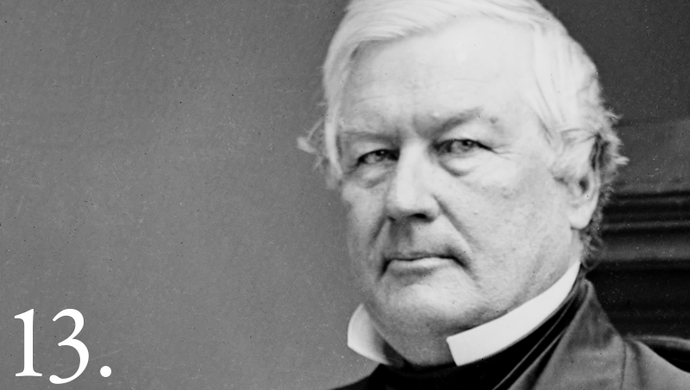
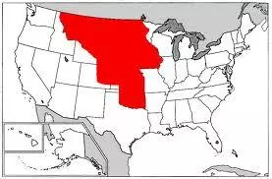
What caused people to migrate west in the 1840s?
In this lesson, we will:
Describe the push and pull factors that caused people to migrate west in the 1840s.
Explain the consequences of migration west.
Starter: Why had the ‘Indian Frontier’ failed by the 1840s?
What was President Fillmore’s solution for the ‘Indian Problem’?

Slide 2
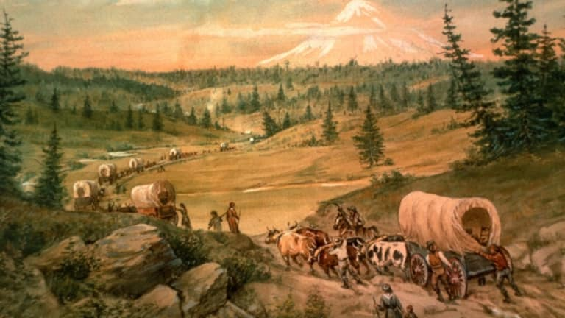
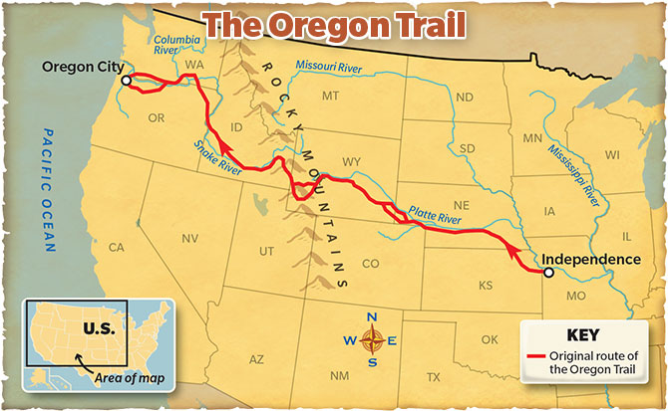
Government support for migration
In 1841, President John Tyler was keen for Americans to expand into Oregon.
If enough Americans populated Oregon, it could become American rather than British.
His government funded $30,000 to allow the Oregon Trail to be mapped for travellers.
The map made it easier for people to use the trail, as it seemed safer.
This trail started at Missouri and travelled through the Great Plains, Rocky Mountains to Oregon.
It allowed wagons to travel safely across the difficult terrain. Over 400,000 people used it
https://www.youtube.com/watch?v=kmxZ4vMTPVg&t=1491s

Slide 3
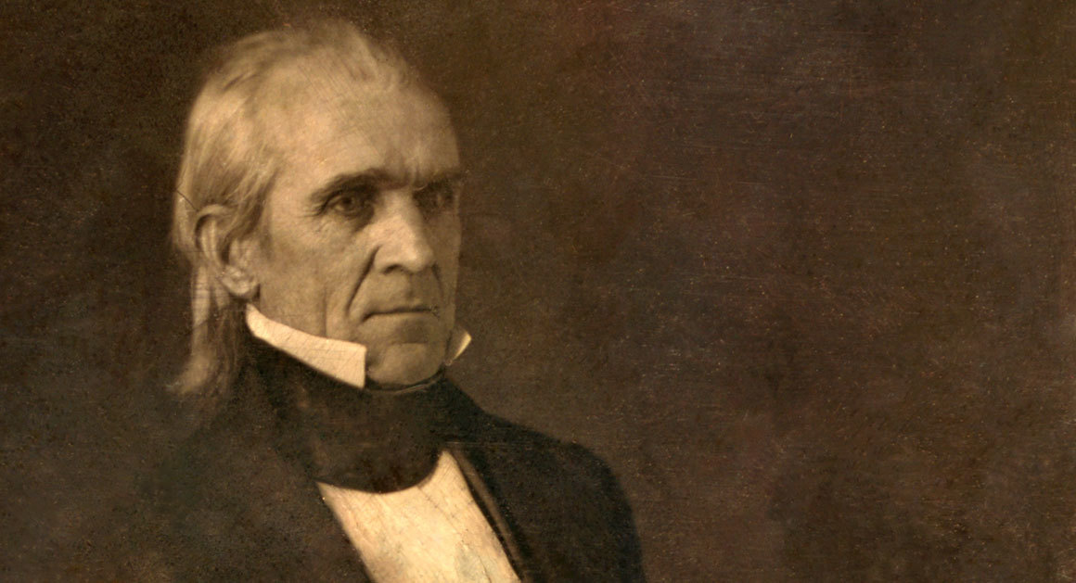
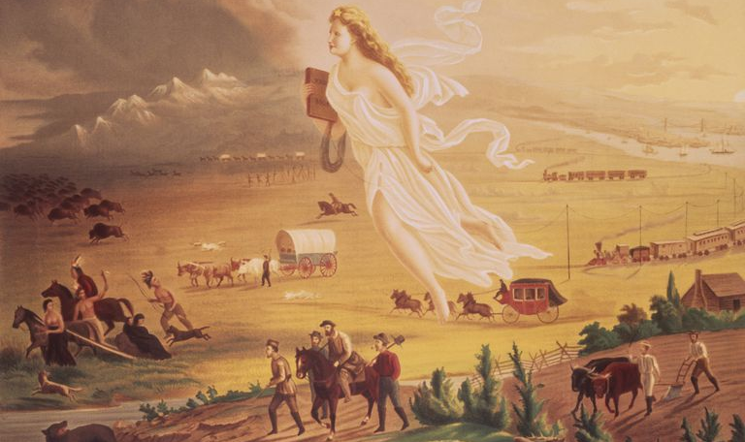
The concept of Manifest Destiny
In 1845, President James K. Polk argued that America should aggressively expand into the west.
The idea, was that God had given the land to those who would modernise and farm it.
White Americans were driven to expand into the western territories, as they should it was their destiny.
They should carry industry, technology, Christianity and American values to the ‘savage west’.
This justified much of America’s land gains from Mexico and the British.
It also justified the cultural destruction of the Native Americans.

Slide 4
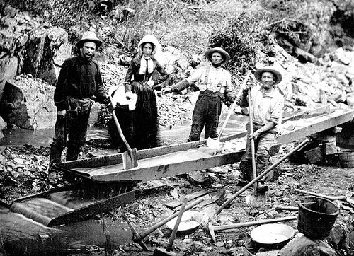
The gold rush acted as an incentive
Days after the discovery, California became part of the USA from Mexico.
By Mid-March, newspapers reported large quanitites of gold being mined. By June, 4,000 men had travelled to California.
Migrants arrived from Mexico, Chile, Peru and China.
Throughout 1849, men from the East borrowed money, mortgaged their property and spent their savings to travel to California.
By December 1849, California’s population had increased from 800 to 100,000.

Slide 5
Learning Task One
All targets:
Create two mind maps showing:
Push factors for westward migration
Pull factors for westward migration.
Key words to use:
Economic crisis
Fur traders
Incentive
Persecution
Manifest destiny
Terrain

Slide 6
Poor Economic Conditions
1837, economic crisis in East and South. Banks collapsed, people lost their savings. Businesses failed and thousands became unemployed. Unemployment was at 25% in many areas, wages were cut by 40%. People headed west for better wages and employment.
Some feared religious persecution
The Mormons were a religious group that were shunned by other Christians because of their beliefs (e.g. polygamy). They were met with violence and forced to leave the East. E.g. in 1845, their leader Joseph Smith was murdered. They headed to Salt Lake Valley, Utah for safety.
Trails made it easier to travel
The Oregon Trail started at Missouri and travelled West, through the Great Plains and Rocky Mountains to Oregon. It allowed wagons to travel across the difficult terrain. Between 1836 and 1869, over 400,000 people had used it. It could cope with large groups of people at one time e.g. 1843 a part of 900 people used it.
Prospect of free land
Traders and fur-trappers had brought back stories of rich, fertile land west of the Rocky Mountains. Many saw this as a perfect opportunity for a fresh start.
The U.S. government encourage people
US government wanted Americans to settle in Oregon, rather than Brits. In 1841, the US government provided $30,000 to allow the Oregon Trail to be mapped for travellers. This encouraged people to use it, as it seemed less dangerous.
What caused “Westward Expansion”?
The thought of getting rich from the “gold rush”
In 1849 – 100,000 men travelled to California in the hope of becoming rich. They came from all over the world across the Oregon Trail. By 1855, California’s population was over 300,000. Others went to profit off the gold rush by selling equipment to prospectors, or provide services such as alcohol and prostitution.
Many believed it to be their “manifest destiny”
Whites believed God had put them on Earth to expand from sea to shining sea. They had to bring civilisation and modernity to the west – including the Native Americans.

Slide 7
Learning Task Two
Green and orange groups
Explain two consequences of the California Gold Rush (8 marks)
All targets:
Read the article from History Channel on the Gold Rush.
Blue groups
Your teacher will give you a template to answer a GCSE question. Using what you have read, complete the missing sections.
https://www.history.com/topics/westward-expansion/gold-rush-of-1849

Slide 8
Increased crime rate in the west
Rapid population increase caused overcrowding adding to crime. Bandits, gambling, prostitution and racist crimes against emigrants.
Environmental damage
Mercury getting into the water, it poisoned many Indians. Mercury infected the fish, which the Indians ate. Cutting down trees often created floods which killed a lot of the food sources for Indians.
California became a U.S. state
Due to rapid population growth, California applied in 1849 to become a state. This caused a crisis, as it would become a free state and this annoyed the slave states. This led to the 1850 Compromise.
Indians killed
Thousands of Indians were killed by white settlers looking to claim gold land. Other killed by diseases brought in e.g. cholera. 60% of all Indians in California were killed by disease. Population fell from 150,000 in 1845 to 30,000 by 1890.

