Slide 1
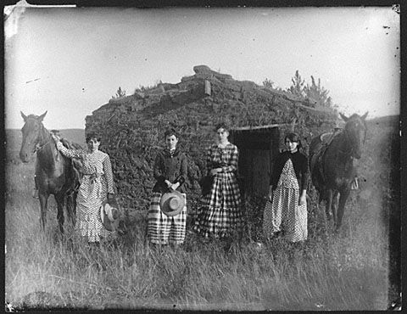
Why did public health begin to improve in the mid-19th Century?
Starter: Can you explain who these people are?
In this lesson, we will:
Explain how vaccines became mass produced.
Assess the most important factor in explaining why public health began to improve.

Slide 2
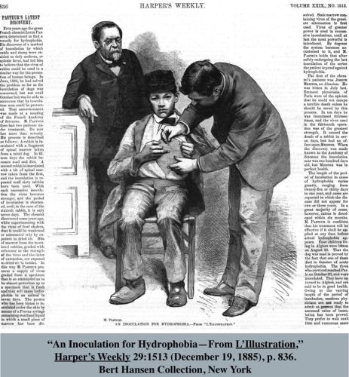
How did vaccines become mass produced?
The groundwork for vaccines was already there – Jenner had developed a smallpox vaccine, Pasteur had proved germs exist, and Koch had proved different germs cause different disease.
Louis Pasteur put all this together and began to work to make vaccines for different disease.
In 1879, Pasteur proved that a dead form of chicken cholera could be used to vaccinate the chickens.
By using the weakened versions of cultures, Pasteur developed vaccines for anthrax and rabies.
Vaccines work by creating an immune response – the body fights off the weakened disease and in doing so, creates antibodies.

Slide 3
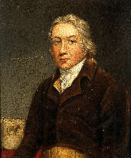
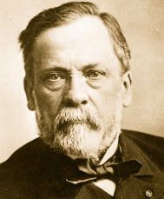
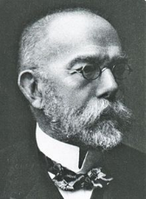
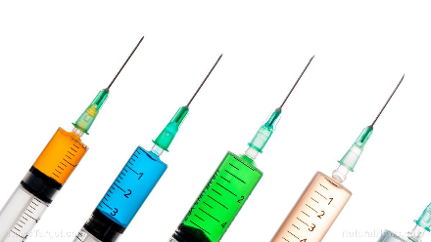
Mass produced vaccines

Slide 4
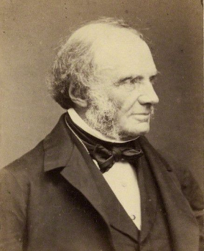
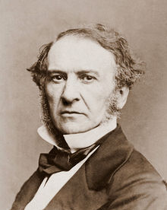
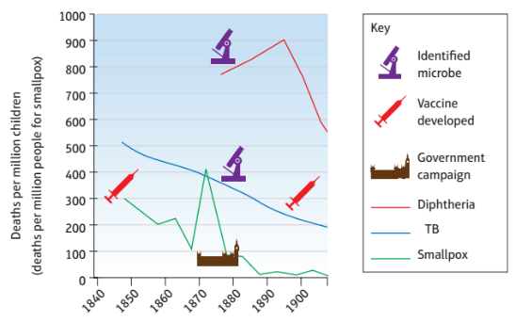
How did the British government improve public health?
From the 1860s, the UK government began to take more action to improve living conditions in the cities.
In 1865, 1,300 miles of new sewers were build in London. Slums were demolished in Birmingham.
In 1872, compulsory vaccinations for smallpox was introduced.
In 1875, the Public Health Act was passed. It brought in many rules that councils had to follow to improve living conditions.

Slide 5
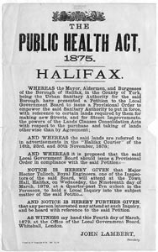
How did the British government improve public health?
1834 Poor Law Amendment Act Medical Officers were appointed to workhouses which provided basic medical care for the poor.
1853 Vaccinations were made compulsory although no one was given the power to enforce them.
1855 Nuisance Removal Act This Act made overcrowded housing illegal.
1864 Factory Act This made unhealthy conditions in factories illegal.
1875 Public Health Act This brought together a range of Acts covering sewerage and drains, water supply, housing and disease. Local authorities had to appoint Medical Officers in charge of public health. Local sanitary inspectors were appointed to look after slaughterhouses and prevent contaminated food being sold.

Slide 6
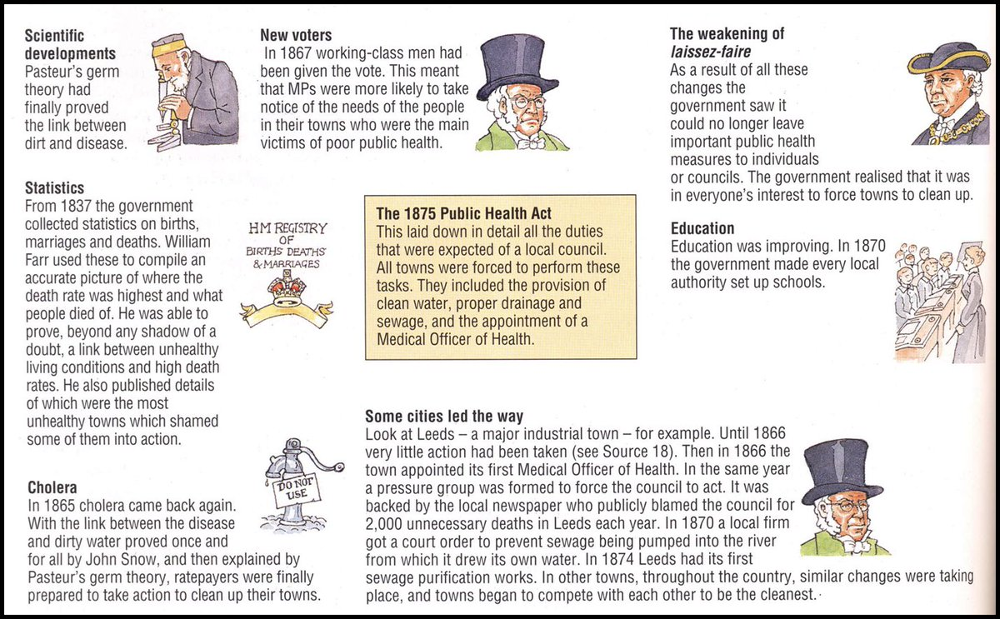

Slide 7
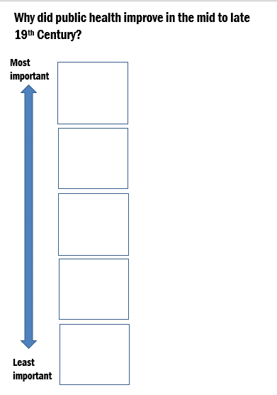
Learning Task Two
On your pyramid diagram, decide which factors are most to least important in explaining why public health improved:
Development of vaccines
Public Health Act
Introduction of compulsory vaccination
Changing opinions
Publication of Germ theory

