Slide 1
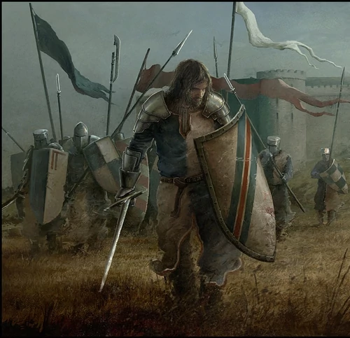
Why did Harold Godwinson become King of England in 1066?
In this lesson, we will:
Describe the different claimants to the throne of England in 1066.
Explain why Harold Godwinson was chosen as King of England.
Starter: Go back to your task from last lesson.
“Harold Godwinson had a firm control of England by 1066”
Provide examples to support this, and counter this.

Slide 2
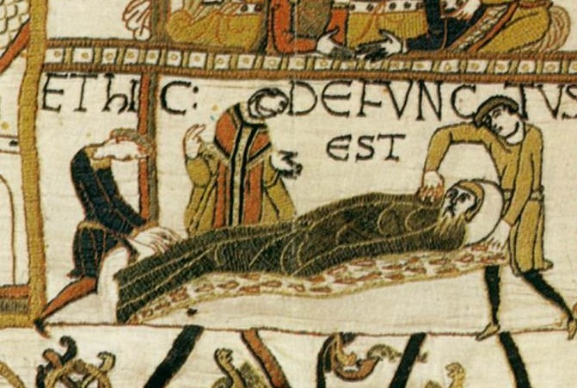
What caused a ‘succession crisis’?
After Earl Tostig was exiled, King Edward was forced by Earl Harold Godwinson to accept it.
Soon after; he suffered a stroke and was bedridden for the year.
On his death bed, Edward was surrounded by wife, Harold and several nobles including the Archbishop of Canterbury
In his fever, he is rumoured to have promised his kingdom and wife to Harold’s protection.
On 5th January 1066, King Edward the Confessor died at the age of 55.
Edward and Edith had no children. His only named heir was Edward the Exile, who had died in exile in Hungary in 1057.

Slide 3
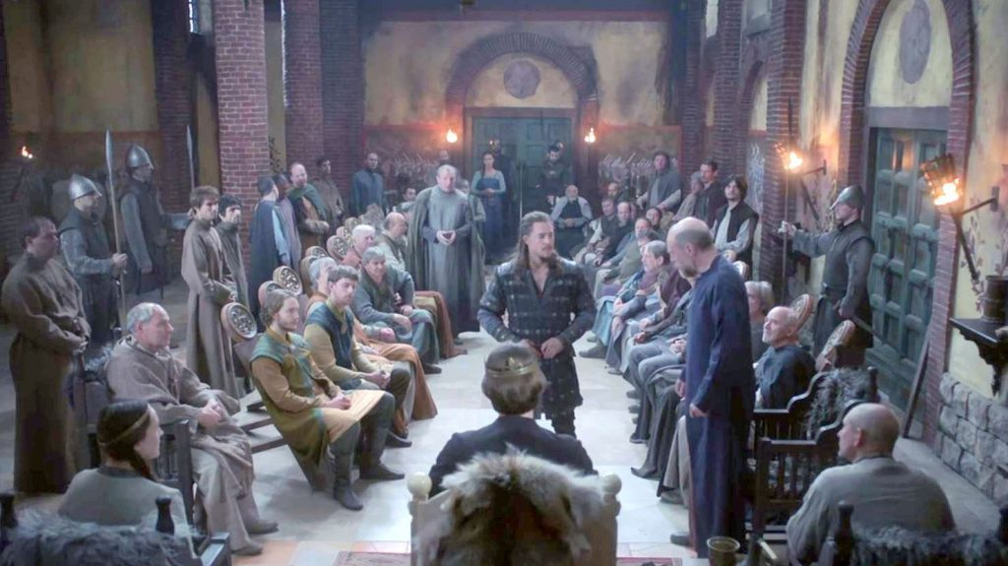
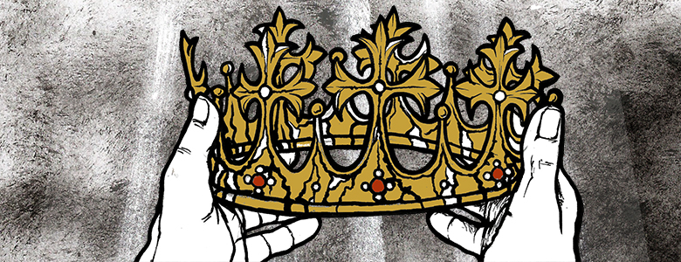
What problems did the Witan face?
Immediately after Edward’s death, Harold Godwin acted quickly to seize power.
The Witan was gathered in London for Edward’s funeral.
Gyrth Godwinson, Earl of East Anglia, was part of the Witan.
Gyrth, Harold and their mother Gytha began to pressure the Witan to crown Harold as King.
However, the Witan knew that crowning Harold would cause tension with Normandy and Norway.
Harold was not the only person with a claim to the throne of England.

Slide 4
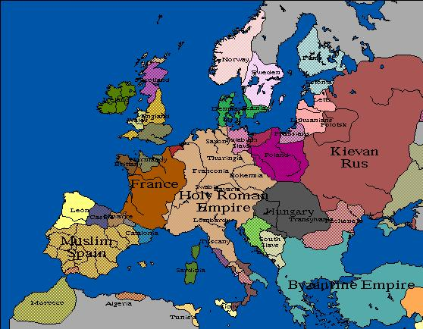
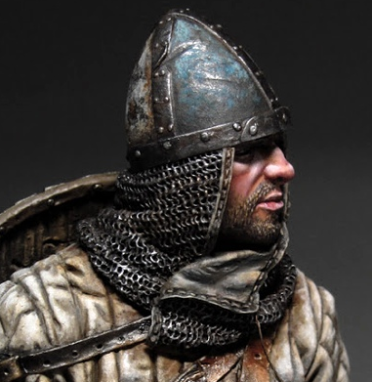
Edgar, son of Edward the Exile.
King Harald of Norway
William, Duke of Normandy

Slide 5
Learning Task One
Green groups + orange groups
For each, identify strengths and weakness of their claims.
Colour code (e.g. green and red)
Read the claims of each of the men below with your teacher.
Watch the video produced by the BBC on these men.
Blue groups:
For each; summarise their claim to the throne of England.
https://www.youtube.com/watch?v=1sK4JX0co8I

Slide 6
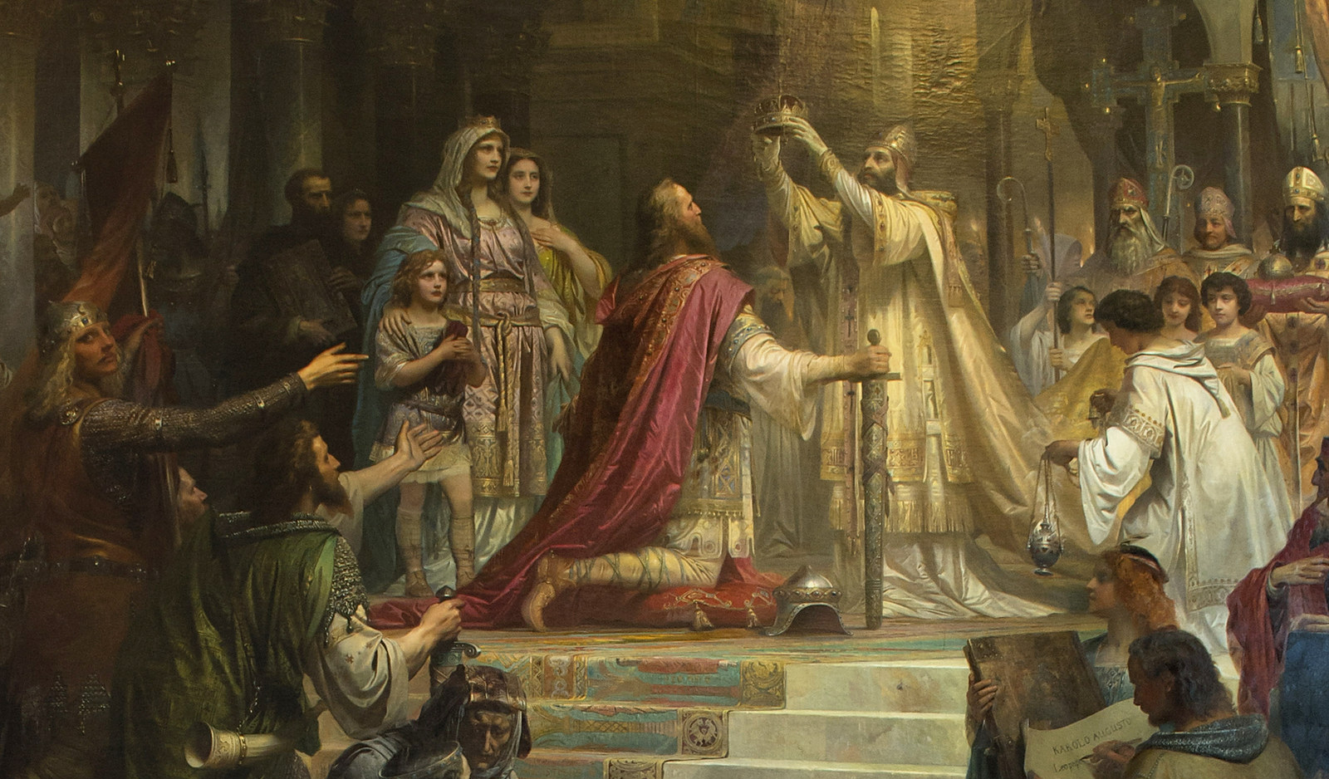
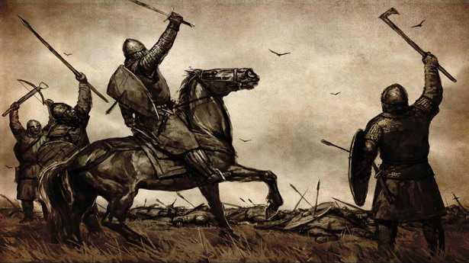
Why was Harold crowned King?
The Witan crowned Harold as ‘King Harold II of England’ on 6th January 1066.
The Witan were already gathered for Edward’s funeral, so it made sense.
Harold had already been governing England in all but name under Edward the Confessor.
He had shown himself as a warrior and politician during the invasion of Wales.
His family were extremely powerful, so he was seen as England’s main defence against Normandy and Norway.
His family had corrupted the Witan – most of the bishops on the Witan were either chosen by his family, or loyal to them.

Slide 7
Learning Task Two
Green groups + orange groups
Write down the question.
Explain clearly, in bullet point form, how the Witan and Power helped Harold become King.
Explain one other reason, from your own knowledge.
Use precise examples to prove your point.
Explain why Harold Godwinson was crowned King of England in 1066.
You may use the following:
Witan
Power
Blue groups:
Write down the question.
Explain clearly, in bullet point form, how the Witan and Power helped Harold become King.

