Slide 1
What was surgery like by the time of the First World War?
In this lesson, we will:
Describe the key features of aseptic surgery
Assess how advanced x-rays and blood transfusion was by 1914.
Starter: Collect the worksheet to your right. Around each picture:
Which century would you place it?
Identify/circle key features of that time period.

Slide 2
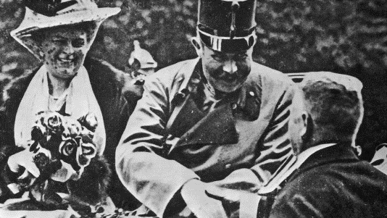
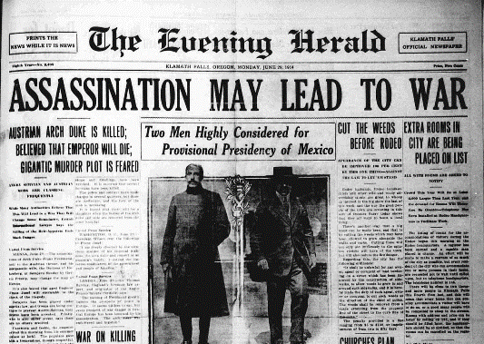
What caused the First World War?
In 1914, Serbian terrorists assassinated the prince of Austria-Hungary; Franz Ferdinand. As an ally of Austria, Germany pledged unconditional military support.
When Austria-Hungary declared war on Serbia, Serbia’s ally Russia entered the war. With a German declaration of war on Russia, France entered the war.
When the German army marched through Belgium to defeat France, the British Empire entered the war.
By late 1914, the British and French armies found themselves bogged down in trench warfare.

Slide 3
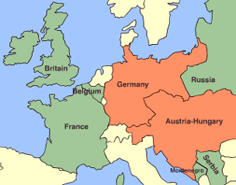
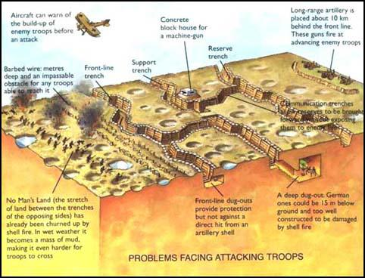

Slide 4
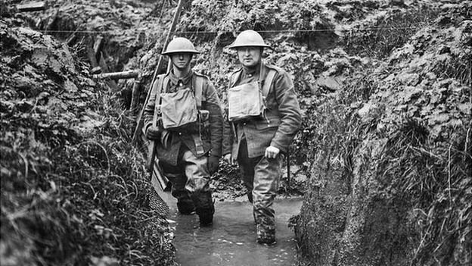

Slide 5
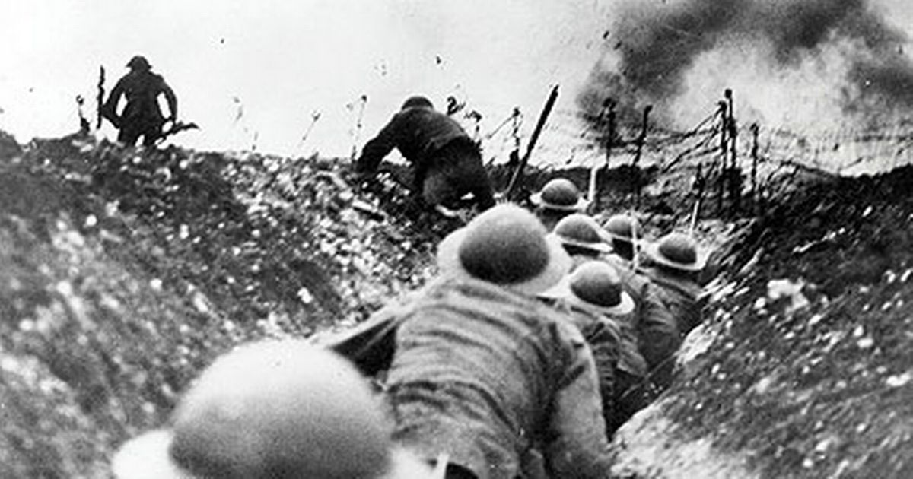

Slide 6
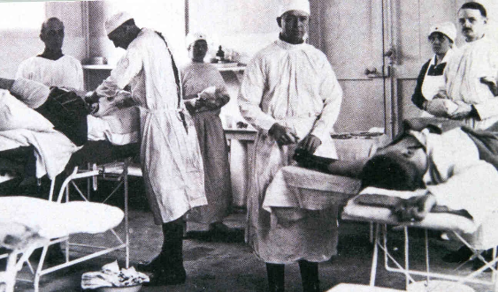
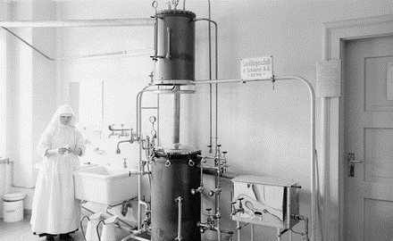
What was surgery like in 1914?
By 1914, surgery was aseptic.
All medical staff would wash their hands, faces and arms before entering the operating theatre.
Rubber gloves and gowns were worn.
All equipment was sterilised in an autoclave (it used boiling steam to kill all germs)
Surgeons would have access to new technology like x-rays and blood transfusion, but they were very basic!

Slide 7
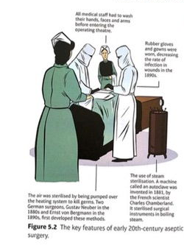
Learning Task One
Go back to your starter sheet. Using the information we have just gone through, add in details of aseptic surgery!

Slide 8
Checkpoint: Can you describe the key features of aseptic surgery?
What is an autoclave?
How did surgeons in 1914 stop germs spreading?
What does aseptic mean?

Slide 9
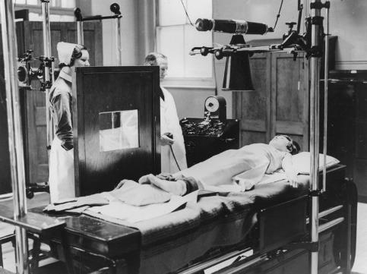
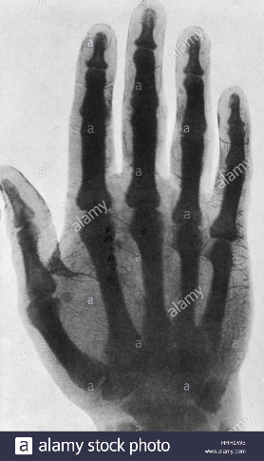
How basic were x-rays in 1914?
X-rays had been discovered in 1895 by a German physicist.
By 1896, Glasgow Royal Infirmary was the first hospital to set up its own radiology department. Dr John Macintyre used x-rays to diagnose kidney stones!
However, the amount of radiation released was 1,500 times more powerful than today. People could lose hair, or suffer burns.
The machine used glass tubes, which often broke.
The machines were very large, and would take 90 minutes.

Slide 10
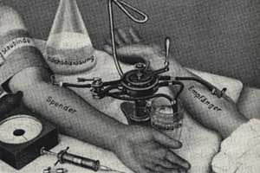
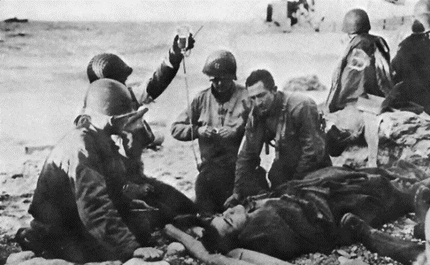
How basic was blood transfusion?
James Blundell first experimented with blood transfusion in 1818. Out of 10 patients, 5 lived.
The machine he developed to do it was still being used by the time of the war in 1914.
Blood could not be stored, so it had to be transferred directly from the donor.
Blood could often clot, so would block the tubes (fixed by Professor Almorth Wright in 1894)
The patient could reject the blood if it wasn’t the correct type (fixed by Karl Landsteiner in 1901)

Slide 11
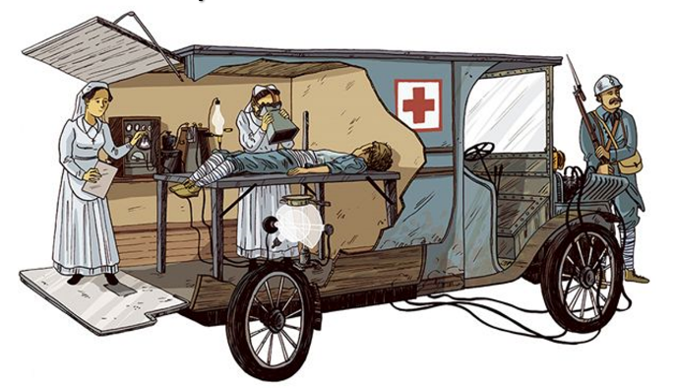
Learning Task Two
Take the subheadings:
Blood transfusion
X-rays
For each, identify:
WWW (What went well)
EBI (Even better if)

Slide 12
Checkpoint: Can you assess how advanced x-ray and blood transfusion was by 1914?
Identify why x-rays were useful to WW1 surgeons.
Who was the first doctor to use x-rays to diagnose a patient?
Identify two problems with x-rays by 1914.
Why was blood-transfusion so useful to WW1 surgeons?
Write down two features of blood transfusion.

