Slide 1
What system was used to transport the injured during the First World War?
In this lesson, we will:
Describe the key stages of the ‘Chain of Evacuation’
 | 1914 | 1918
Medical Officers | 3,168 | 13,063
Soldiers | 16,331 | 131,099
Starter: Look at the table to the right. What does this suggest about medical staff during the Great War?

Slide 2
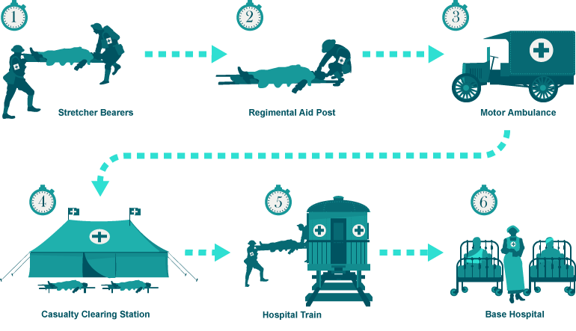
Dressing Station
Notes:
Complete sheet using: 159-162
http://www.bbc.co.uk/guides/zs3wpv4

Slide 3
RAMC
Royal Army Medical Corps. Was responsible for medical care founded in 1898.
FANY
First Aid Nursing Yeomanry. Founded in 1907. First women's voluntary organisation to provide front line support. E.g. First aid and driving Ambulances.

Slide 4
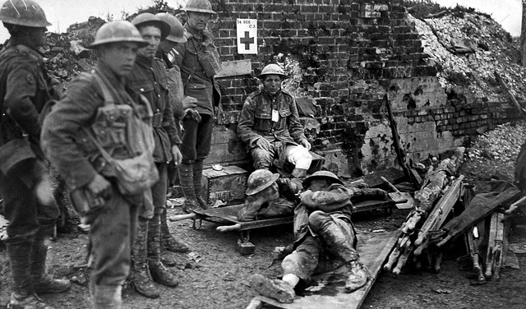
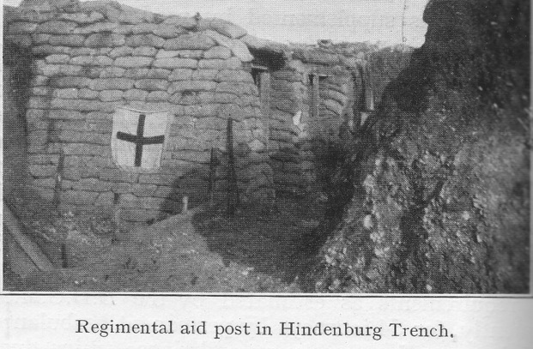
What was a Regimental Aid Post?
Located within 200 meters of frontline.
Usually in a communication trench, or abandoned building (e.g. Church)
It would be manned by Medical Officers or stretcher bearers.
Men would walk here, or be carried.
Purpose was to give immediate first aid and get the men back into battle quickly.
It did not deal with serious injuries.

Slide 5
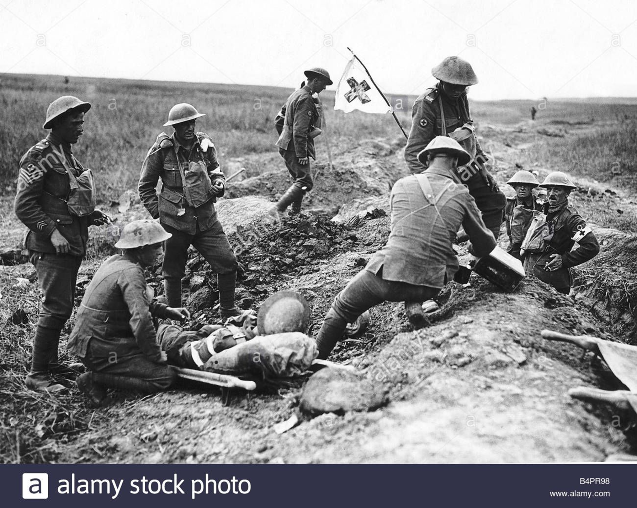

Slide 6
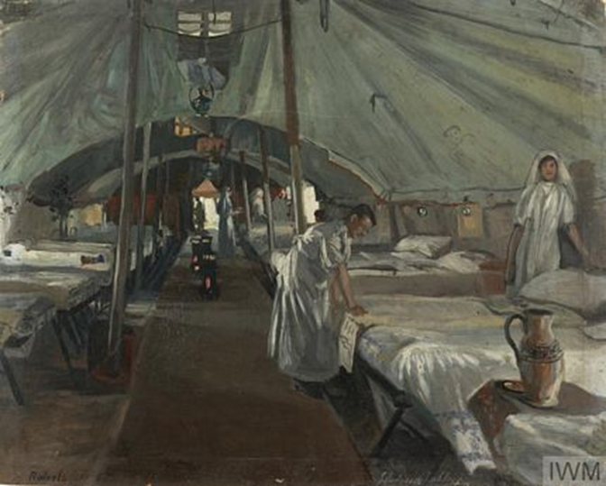
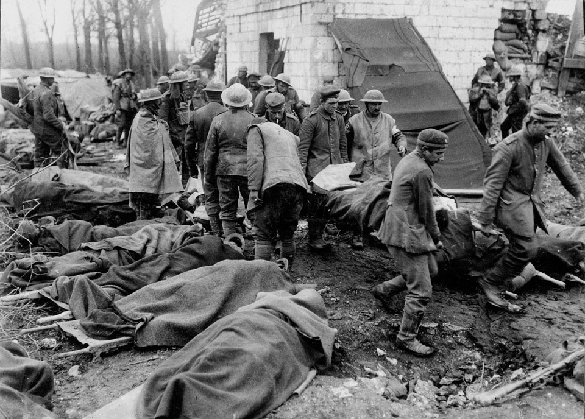
What was a Dressing Station?
Dressing stations should have been 400m from the frontline, but this often did not happen.
Dressing Stations were located in abandoned buildings, dug-outs or bunkers.
Tents were sometimes used.
Would be staffed by 10 medical officers belonging to RAMC. After 1915, nurses would be here too.
Could deal with 150 men at a time, but often more during battle. Only for a week. After a week, either returned to battle or moved to a CCS

Slide 7
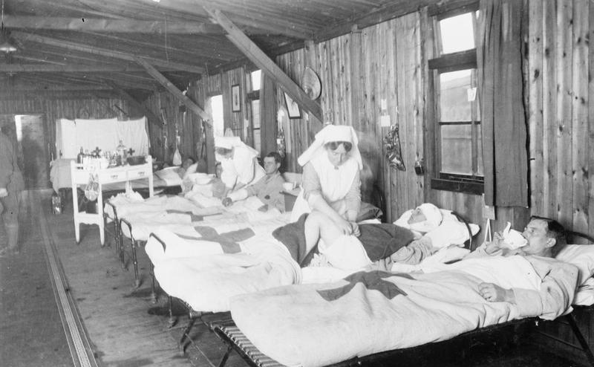
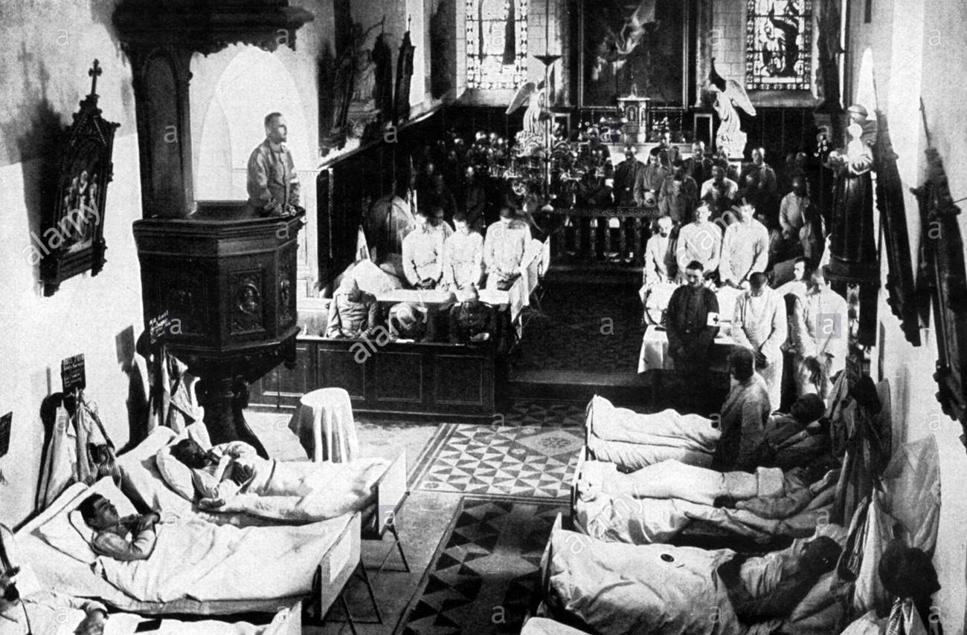
What was a Casualty Clearing Station?
CCS were located a long way from the frontline, to provide safety.
Set up in factories or schools.
Near railway lines.
Dealt with serious injuries like those to the head and chest.
When wounded arrived, they were divided into three groups (this is called triage)
They were often under extreme pressure to work quickly during battle. 3.7% of the men died.

Slide 8
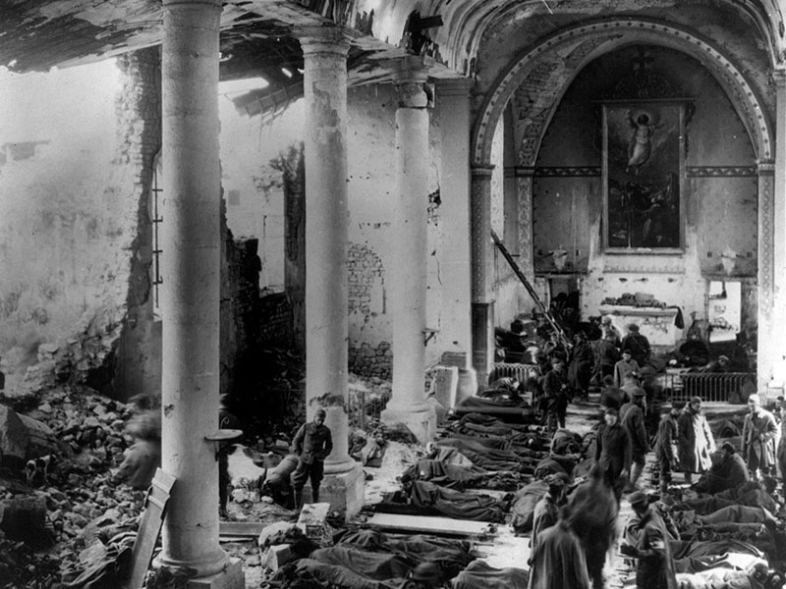

Slide 9
Base hospitals were near the coast, so they could be transported back to Britain.
They would perform serious surgery such as amputation.
Soldiers would be in separate wards based on their injuries. Specialist doctors would be in each ward.

Slide 10
Learning Task One
Your teacher will give each table a label.
As a class, you must create a human chain at the front of the class in chronological order.
Your teacher will play the patient!

Slide 11
Checkpoint: Can you describe the key stages of the ‘Chain of Evacuation’?

