Slide 1
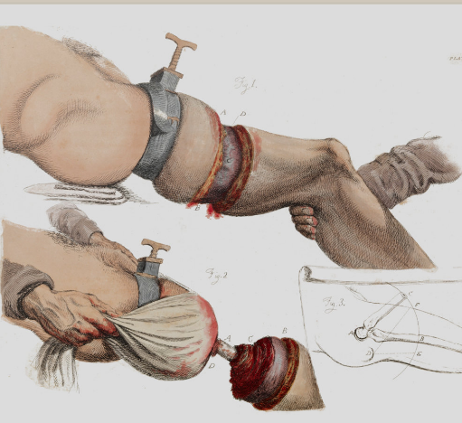
What problems were there with transporting the injured in 1914?
In this lesson, we will:
Describe how transportation of the wounded changed during the First World War.
Starter: This image is from a 19th Century textbook. What process is it showing? Explain using your knowledge of the time period!

Slide 2
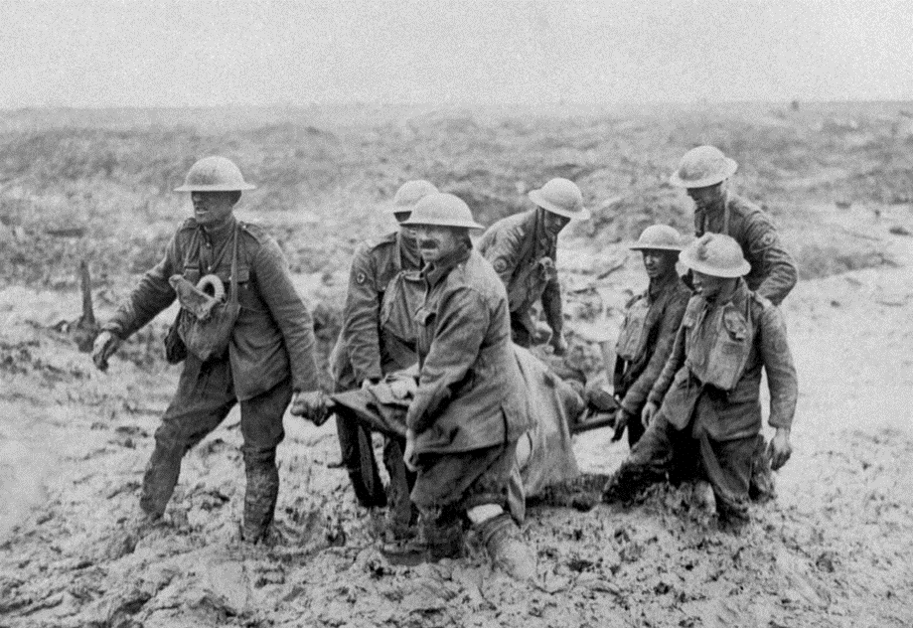
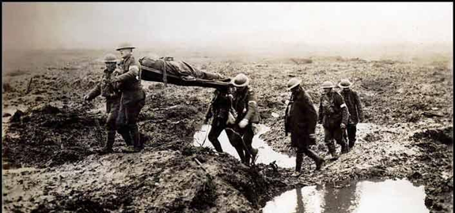
Who would collect the injured on the battle field?
The landscape on the Western Front was often very muddle, and full of craters.
The land was once used for farmland, so the soil was full of fertiliser which caused infection.
Men who were injured had to be transported as quickly as possible.
This task fell to stretcher bearers.
There were only four stretcher-bearers per company and so it was often sometime before they received medical help.
In good conditions two men could carry a wounded man on a stretcher. However, after heavy rain it took four men to lift a stretcher.

Slide 3
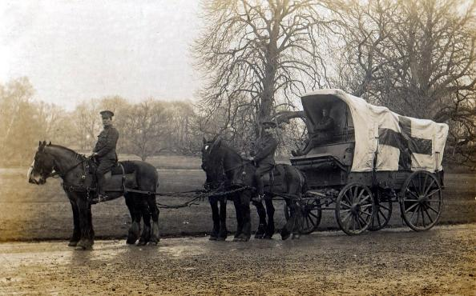
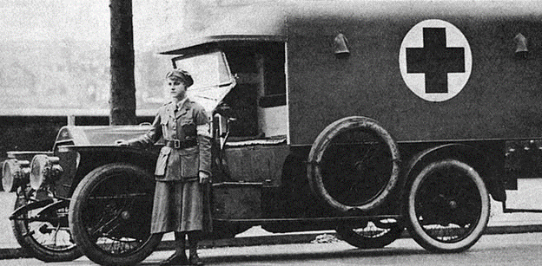
Ambulances on the Western Front
When the BEF was first sent to France in 1914, the leadership of the army chose not to send any motorised ambulances.
It was soon realised that this was a mistake, as the horse-drawn wagons could not cope with the high numbers of injured.
The Times led a charity appeal to raise money for motor ambulances. After 3 weeks the appeal had bought 512 ambulance wagons which make it easier to move the injured.
Motor ambulances still had limitations – they could not operate in the muddy terrain so horse wagons were still used. Sometimes 6 horses were used rather than 2.

Slide 4
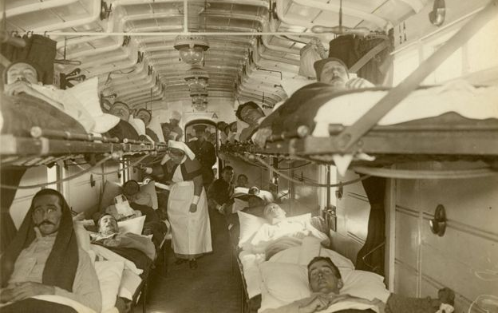
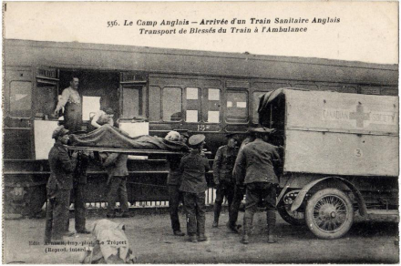
How were trains, barges and ships used?
To move men away from the Western Front to hospitals on the coast, trains were used.
In the first few months, the Royal Army Medical Corps (RAMC) had to use industrial good trains to transport the injured.
It wasn’t until November 1914 that the first trains specifically designed for the injured came into service. They had spaces for stretchers fitted down both sides of each carriage
By 1915 many were worried that the high amount of trains carrying injured were causing disruption for trains carrying weapons. Canal barges began to be used to free up the railways. Although slow, it was much comfier and it meant soldiers could bypass Base Hospitals and be transferred straight to ships destined for Britain.
https://www.youtube.com/watch?v=1UM3N-f1BSU

Slide 5
Learning Task One
Next to each picture:
Identify what it is.
Explain the problems of it.
Explain how it benefited soldiers
Explain if/how it changed throughout the war.

Slide 6
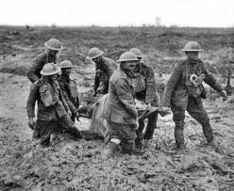
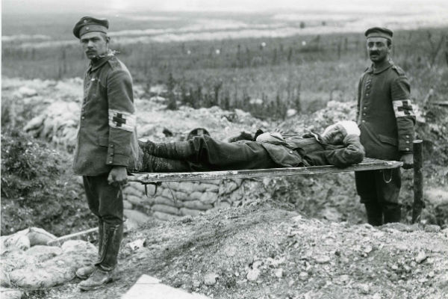
Checkpoint: Can you describe how transporting the injured changed during the war?
1914
1917 (Battle of Passchendaele)

Slide 7
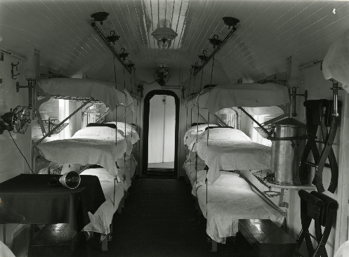
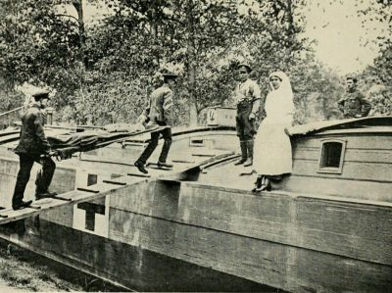
Checkpoint: Can you describe how transporting the injured changed during the war?
1914
1918

Slide 8
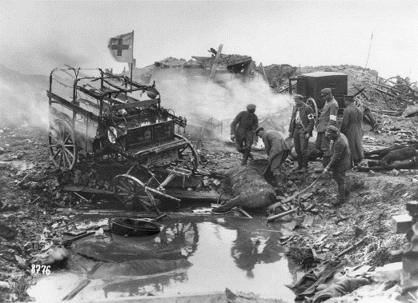
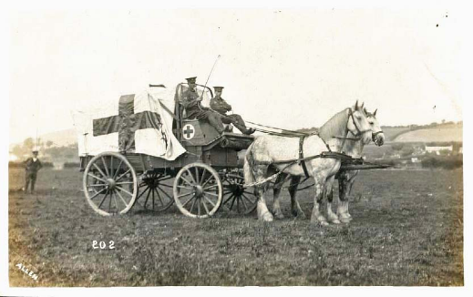
Checkpoint: Can you describe how transporting the injured changed during the war?
1914
1918

