Slide 1
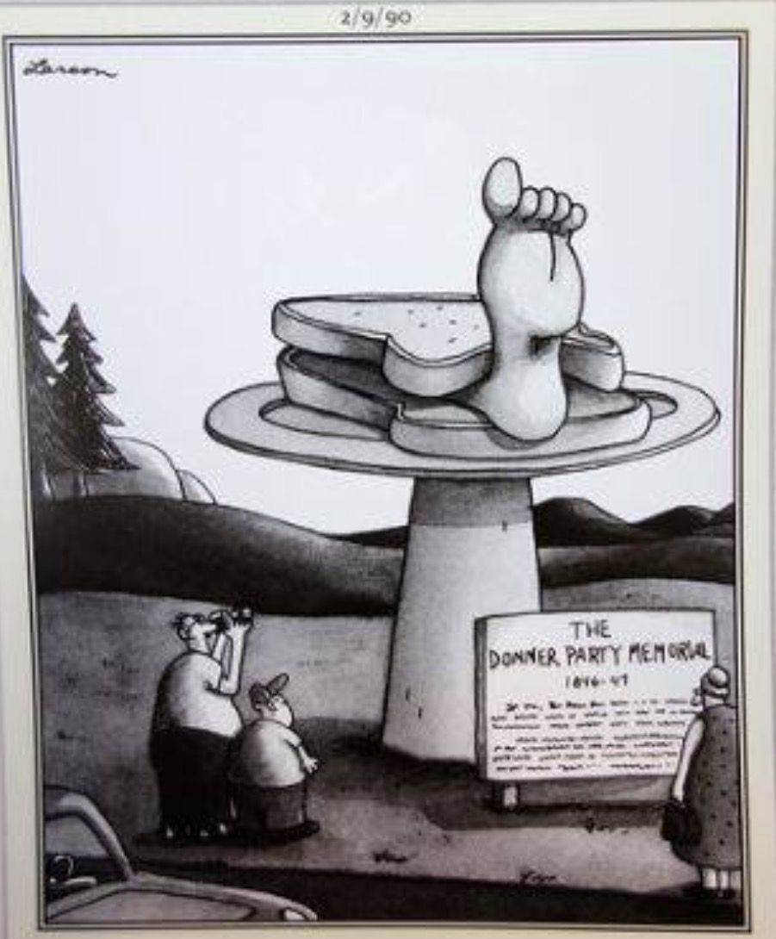
What problems faced farmers in the western territories of Kansas and Nebraska?
Starter:
Write a paragraph explaining why the Donner Party migration failed.
Write another paragraph explaining why the Mormon migration was a success!
In this lesson, we will:
Describe the dangers facing farmers in Kansas and Nebraska.
Explain the solutions that helped make life possible in these territories.

Slide 2
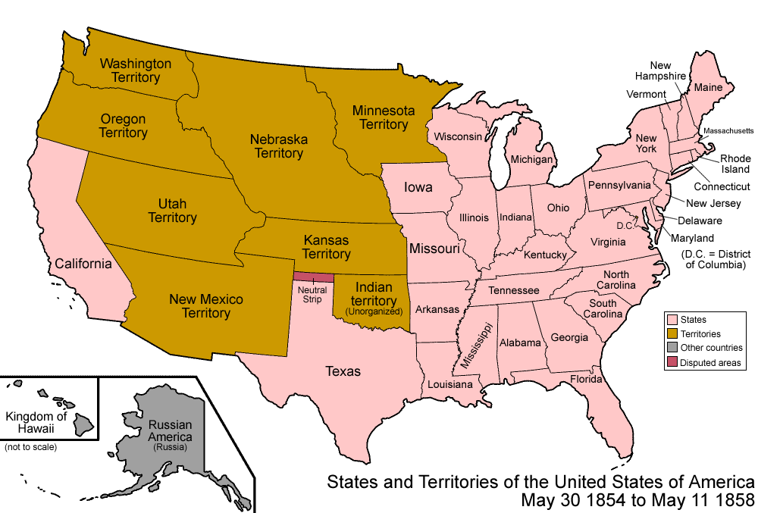
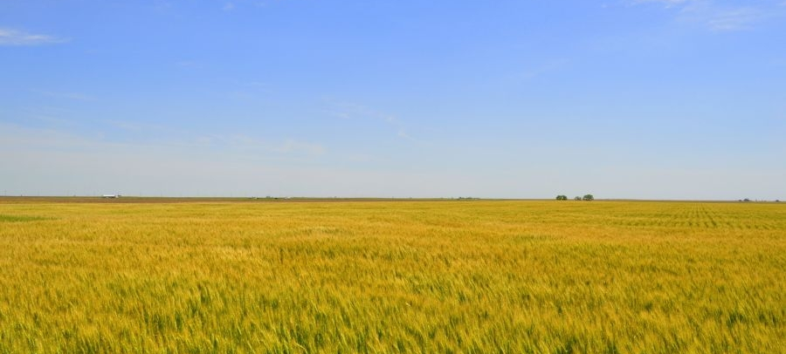
Why settle in the mid-west?
In the 1840s and 1850s, more migrants began to settle in territories like California and Oregon.
Many had travelled west on the Oregon Trail to own their own farm land.
The land was really fertile and perfect for growing wheat.
So much wheat was being grown in California, that farmers started exporting to Europe. This created huge profits for farmers.
In 1854, the U.S. government created two new ‘territories’ in the mid-west. Kansas and Nebraska.
Thousands of white settlers flooded into the region to settle on this new farm land.

Slide 3
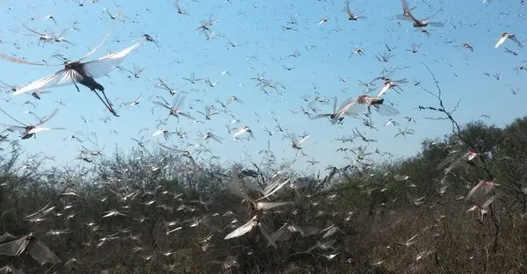
What problems existed for farmers?
There was only 38cm of rainfall in a year. This often caused droughts and fires due to the heat. This killed crops.
There was a huge lack of rivers or streams. So no water for animals or drinking.
The high heat meant no trees could grow, so there was a huge lack of timber to build.
The winters were extremely cold, which meant crops died causing food shortages.
The soil was so dry that a hard crust formers making it hard to farm.
Grasshoppers killed crops, grass and sometimes sheep.

Slide 4
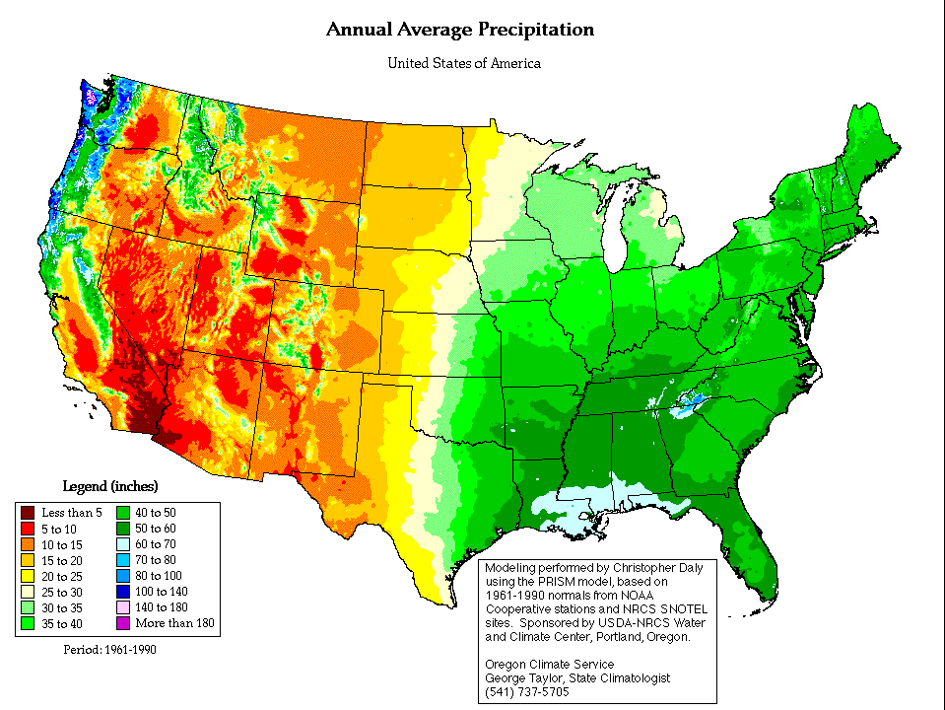
Learning Task One
For each below, explain the negative consequences for farmers:
Low rainfall
Few trees
Extreme Climate
Challenge:
Despite these problems, people continued to migrate to Kansas and Nebraska in the 1850s. Can you explain this?
https://www.youtube.com/watch?v=oLvlYmC8cw4

Slide 5
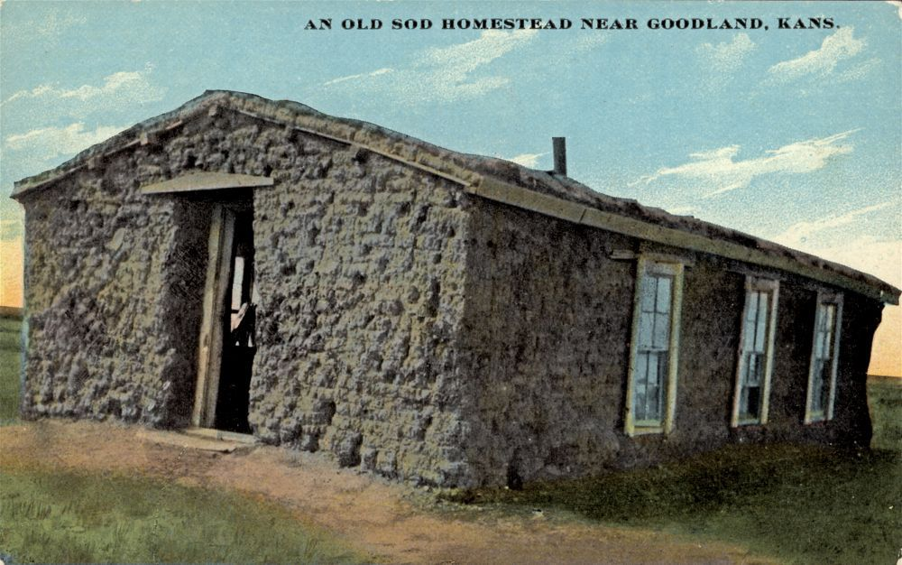
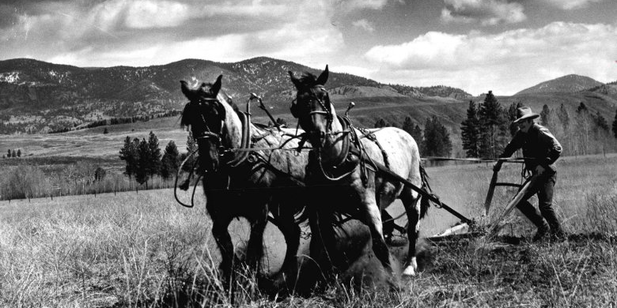
What solutions were put forward for farmers?
For fuel, buffalo dung was dried in the sun. This could then be burned for heat.
For shelter, settlers made bricks of ‘sod’ (mud). These were used to build ‘sod houses’
Wells could be dug to winch water from upto 300ft down. However, this was expensive and hard work.
Farmers dug up the grass by hand with spades. Sometimes ‘sod-busters’ were hired to use a heavy plough and oxen.
People would have to travel to the nearest settlement and buy large amounts of supplies to last them months.

Slide 6
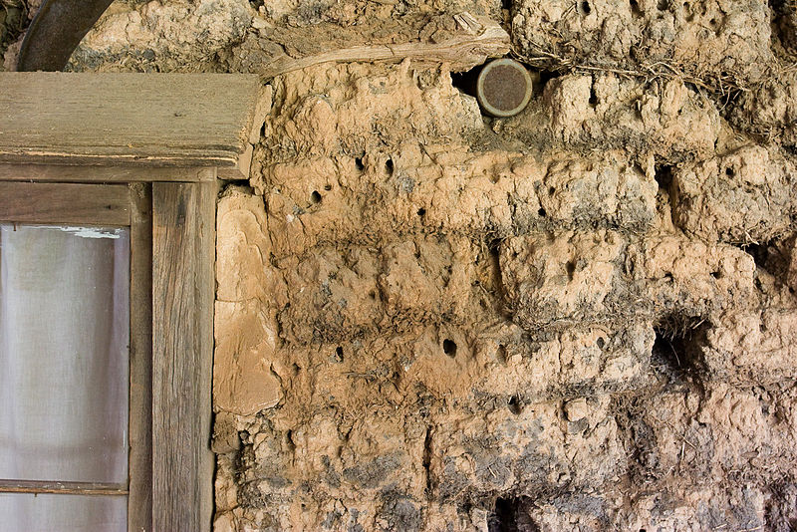

Slide 7
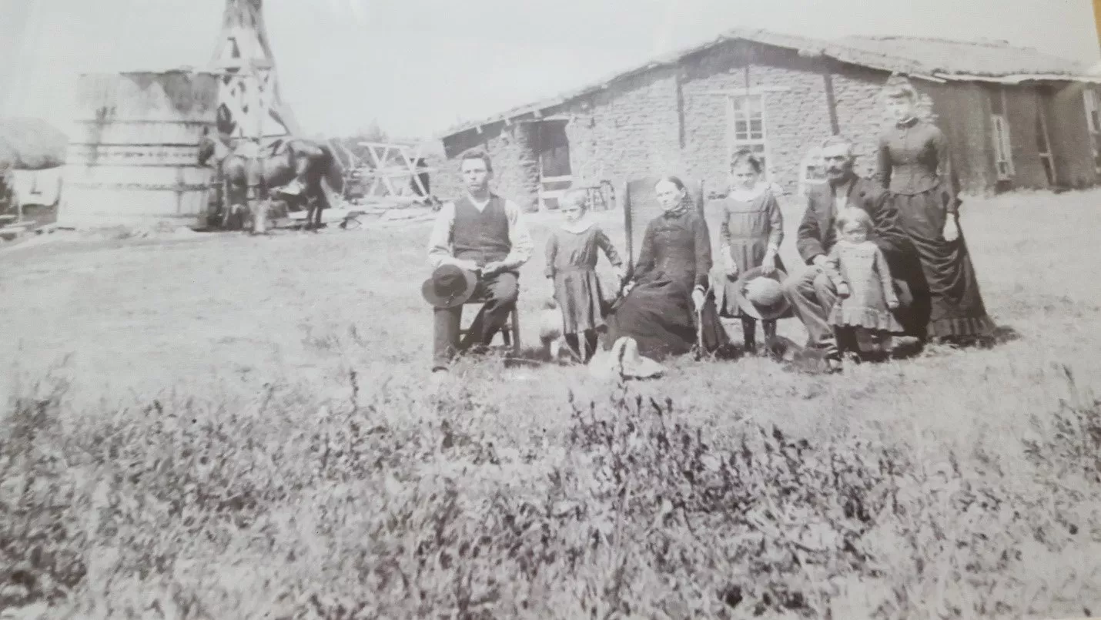
Learning Task Two
Cut out the photograph of a farming family in Kansas.
Around it, circle the solutions put forward to help farmers survive in Kansas and Nebraska.
Beside them, explain how it helped them.
Challenge:
Much travelling on the Oregon Trail, there were some dangers of farming life that had no solutions. Can you explain what they were?
https://www.youtube.com/watch?v=oLvlYmC8cw4

