Slide 1
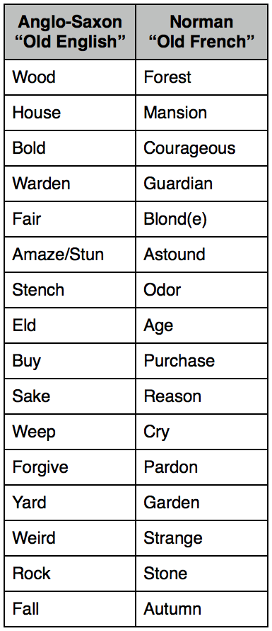
What kind of a man was King William I?
In this lesson, we will:
Assess whether or not William was a good man by 11th Century standards.
Starter task:
By 1086, Saxon culture had been totally wiped out. Provide three pieces of evidence to back this up!

Slide 2
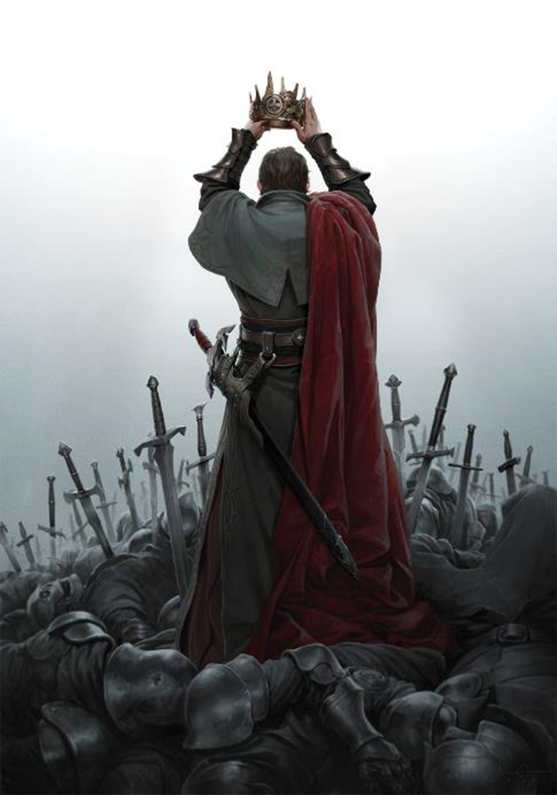
Was William tough?
He became Duke at age 9 and had to survive several assassination attempts due to his illegitimacy.
He was constantly at war to crush his enemies and strengthen his power in Normandy.
By 1066, he had over 10 years of experience at fighting, strategy, logistics, cavalry tactics, castle building and siege warfare.
He successfully invaded the most advanced kingdom in Europe in 1066.
He showed brutality in the way he dealt with the northern rebellions in 1069.

Slide 3
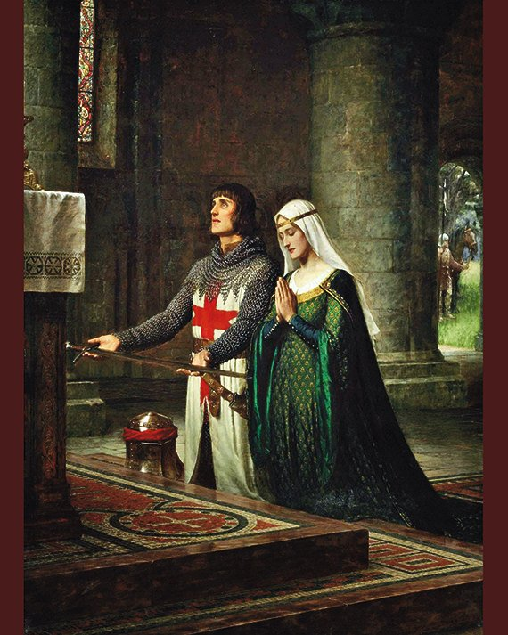
Was William religious?
He had several churches build in Normandy and in England (e.g. Mon St. Michel, Bayeux, Hastings)
Lots of abbeys and monasteries were founded by his Archbishop Lanfranc.
He had the Church of England reformed to make it more like Rome e.g. priests being celibate.
He ordered everyone who fought with him at Hastings to do 40 days repentance for every man they killed.
On his death bed, he begged forgiveness for his brutality in England.

Slide 4
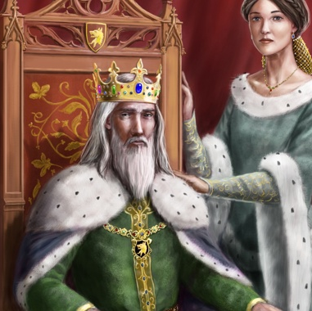
Was William a good husband?
He never had a mistress of fathered any illegitimate children.
He had Matilda act as regent of Normandy whilst he was in England.
When she died, he wept for days and never took another wife.
He listened to Matilda when his son Robert rose up against him. She organised a meeting to restore peace.

Slide 5
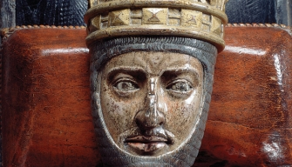
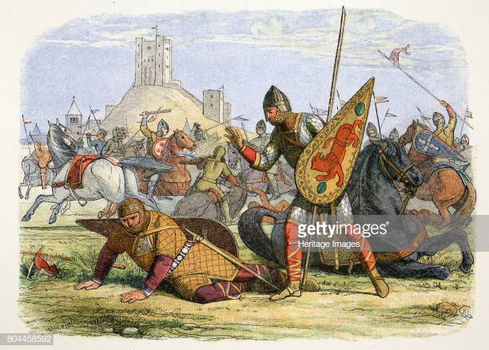
Was William a good father?
He and Matilda had 9 children – the three eldest were Robert, William and Henry.
He nicknamed Robert “Curthose” meaning dumpy legs.
His favourite son was William. He thought Robert was a good fighter, but did not think he could lead Normandy against its enemies.
In 1077, after a bad prank Robert had a fight with William. When William didn’t punish him, Robert led a band of men to capture Rouen Castle.

Slide 6
King William I led an army against his son Robert at Remalard. Robert fled to Flanders and continued to raid Normandy.
Matilda organised a meeting between William and Robert in Easter 1080. William restored Robert as his heir.
Rebellion, 1077-1080
In 1079, Robert fought his father and knocked him off his horse. He then allowed his father to escape. William was embarrassed.
Matilda sent money behind William’s back to Robert. He was furious

Slide 7
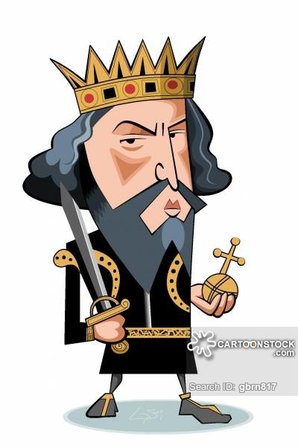
Learning Task
For each statement below, identify evidence to support and counter it:
William was a good father
William was a strong Christian
William was a tough and brutal fighter
William was a greedy man

