Slide 1
What impact did the Wall Street Crash have on Germany after 1929?
Although they had a 25 point programme, the party did not have a proper ideology.
They had no proper structure.
They were virtually unknown outside Munich.
The SA were a potential threat to Hitler, as they were difficult to control.
They were split between nationalists and socialists within the party.
Starter: Using your knowledge from last lesson. Explain for each problem how Hitler attempted to fix the Nazi Party after his release from prison.
In this lesson, we will:
Explain the consequences of the Wall Street Crash on German society in the 1930s.
Explain how the Nazi Party gained support from different areas of German society.

Slide 2
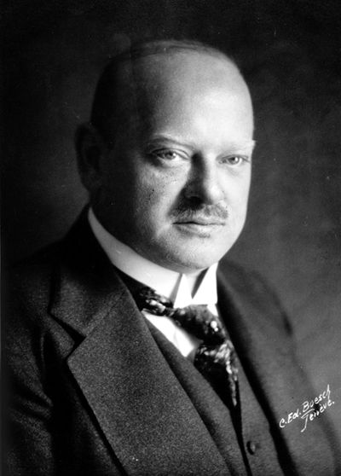
“Germany is in fact dancing on a volcano. If the short-term loans are called in by America, a large section of our economy would collapse.”
Gustav Stresemann, September 1929

Slide 3
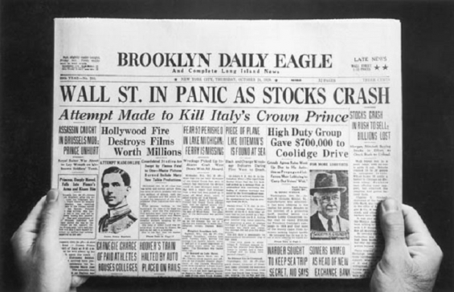
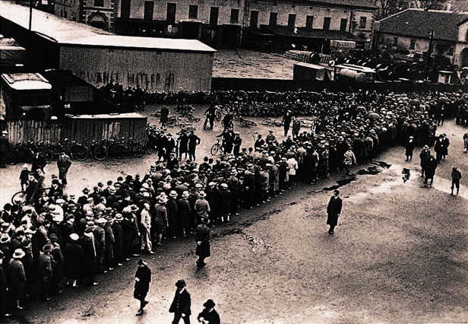
How important was the Wall Street Crash, 1929?
In October 1929, the price of shares on Wall Street in New York began to fall.
This led to panic selling – on 24th October 1929 13 million shares were sold. Within a week, investors had lost $4 billion
German banks were massive investors in the US stock exchange so suffered huge losses.
Germans rushed to their banks to get their money out which caused them to run out of cash
This caused countless banks to go out of business and the entire banking system to collapse!

Slide 4
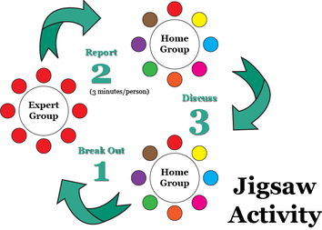
Learning Task One – Jigsaw learning
Each group will be assigned one area of the German population to research.
In your grid, write down how the Wall Street Crash effected them!
People’s wages
People’s employment
People’s savings
People’s houses
Far left & right parties

Slide 5
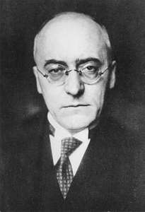
How did the Weimar government react to the crisis?
Prior to Wall Street Crash, Gustav Stresemann died.
In his replacement, Heinrich Bruning became Chancellor of Germany in 1930.
To tackle the effects of the Great Depression on Germany, he suggested a national plan.
Tax the middle and upper classes heavily, to pay for unemployment benefit.
Use some of this money to buy land for the homeless
Ban the SS and SA to prevent violence and a Civil War.

Slide 6
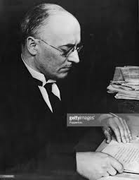
Bruning – a failure of a Chancellor?
Right wing – Hated his plan, as it taxed the middle and upper class heavily, whom they relied on for financial support.
Left wing – hated his plan, as it was not enough to deal with the crisis.
As a result in 1930, the Reichstag voted to reject Bruning’s plan.
The Chancellor now had no control over the government – this made them all look incapable.
Forced to resign in 1932.

Slide 7
Learning Task Two – Debate!
Glue a picture of Bruning into the middle of a page.
You will be told whether you are arguing for or against the statement below:
“Heinrich Bruning was incompetent at dealing with the effects of the Wall Street Crash in Germany”
After 10 minutes, we will debate this question!

