Slide 1
What impact did the American Civil War have on settlement in the west?
In this lesson, we will:
Explain how the Civil War caused some to migrate west.
Starter:

Slide 2
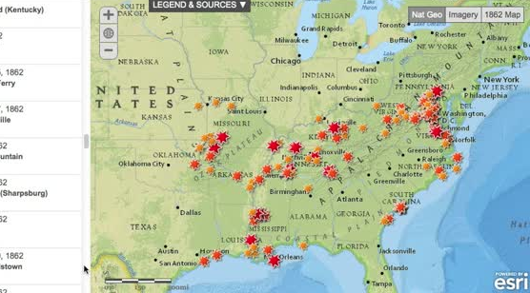
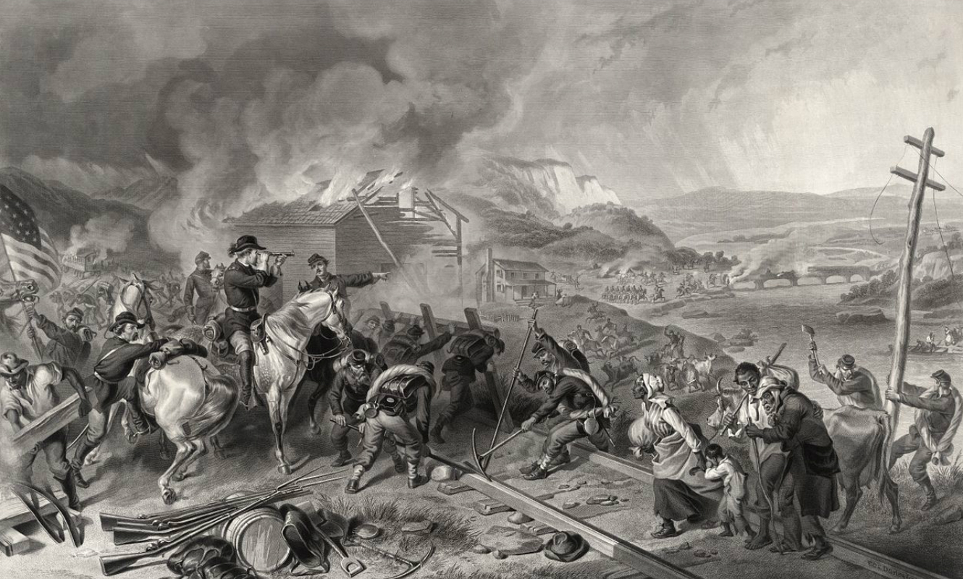
What was the American Civil War?
In 1861, seven southern states left the USA and set up their own Confederate States of America.
In reaction, President Abraham Lincoln declared war on them.
For four years, the armies of the Union and Confederacy fought each other. Over 600,000 Americans died.
Most of the fighting took place in the South-East of the United States.
In order to force the Confederate Armies to surrender, General William Sherman used scorched earth policies.
His army destroyed railway lines, telephone wires, roads and burned buildings and crops.
When the Confederacy was defeated, slavery was abolished throughout the United States.

Slide 3
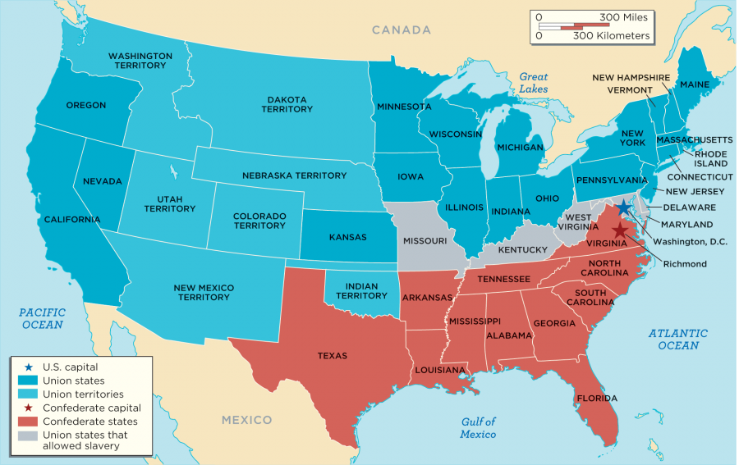

Slide 4
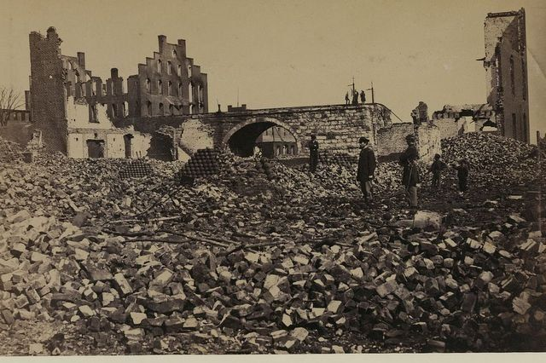

Slide 5
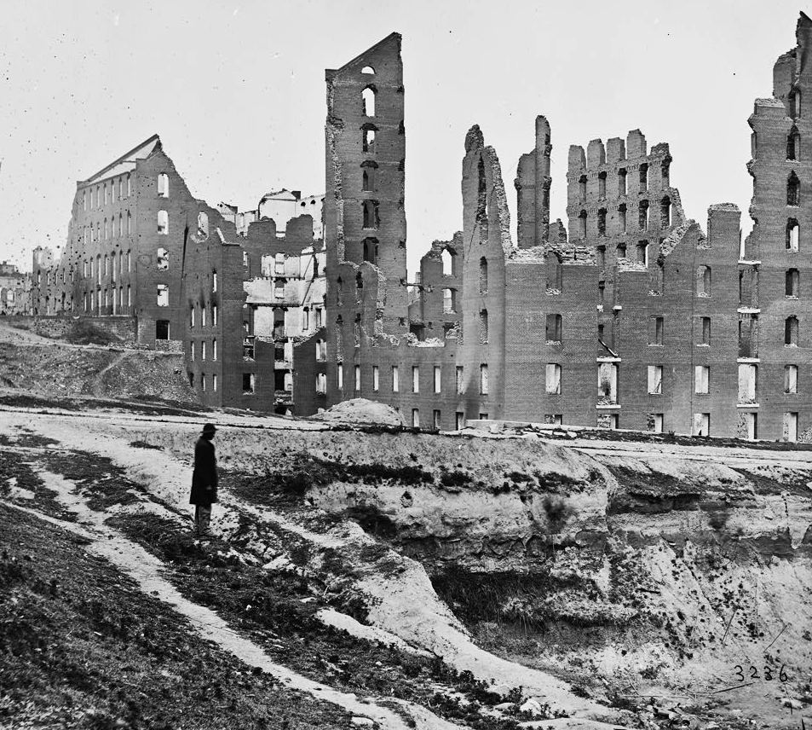

Slide 6
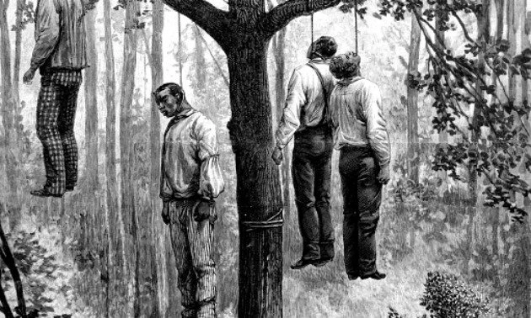

Slide 7
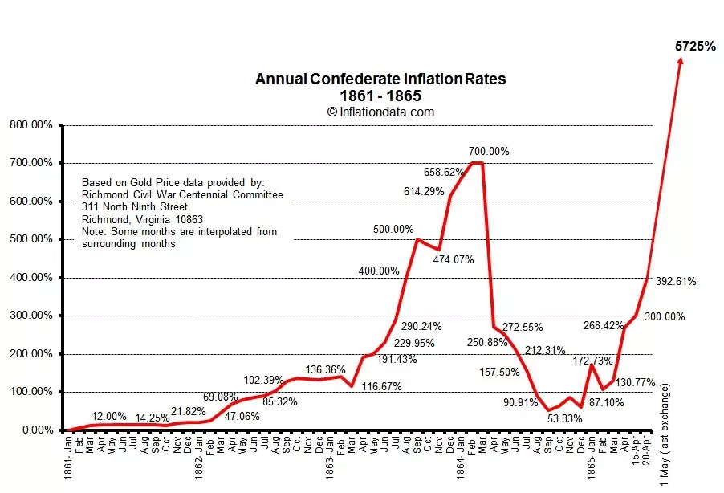

Slide 8
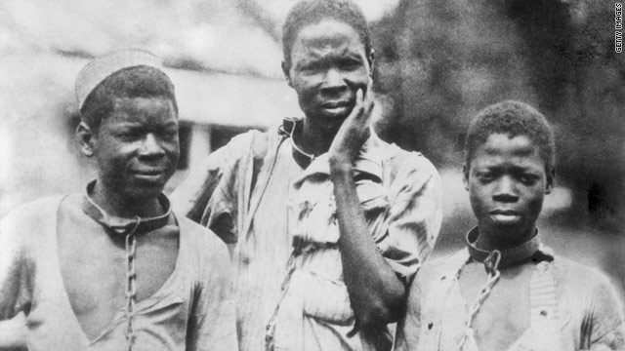
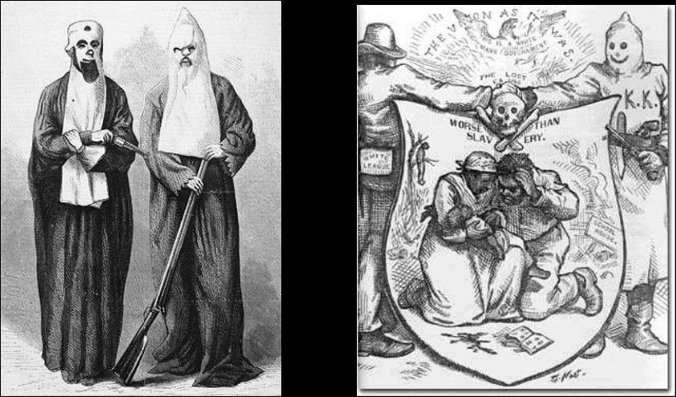
How did the war cause people to migrate west?
Overnight, 6 million African-Americans were now free citizens. These ex-slaves now saw the land in the west as an opportunity to escape the devastation of the war.
Many were driven out by racist violence from groups like the Ku Klux Klan (founded 1866)
Due to the high debt of going to the war, many southern states suffered high inflation and unemployment.
Rich northerners saw the perfect opportunity to invest and buy up land in the south. Southerners called them “Carpetbaggers”
Many ex-soldiers decided to head west for better opportunities.
https://www.youtube.com/watch?v=R0js0F_eQpg

Slide 9
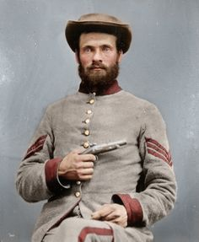
Learning Task One
Cut out each photograph, one is a ex-Confederate soldier and the other an ex-slave.
Explain how the Civil War affected them.
Explain how the Civil War caused them to migrate west.

