Slide 1
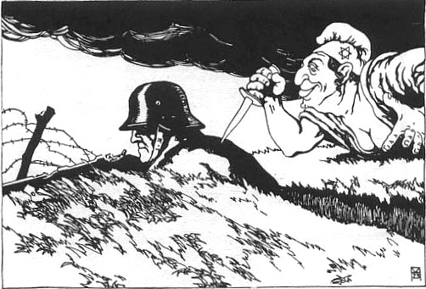
What happened during the 1923 Munich Putsch?
Source A: Cartoon published in NSDAP newspaper ‘The People’s Observer’ in 1922
In this lesson, we will:
Explain why Hitler tried to seize power in 1923.
Explain why the Beer Hall Putsch of 1923 ultimately failed.
Starter: What can we infer from Source A about NSDAP policies in the 1920s?

Slide 2
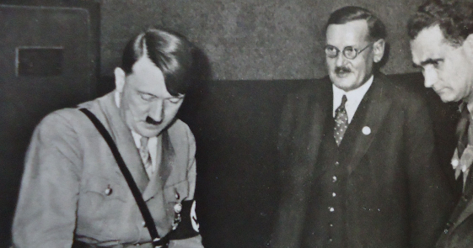
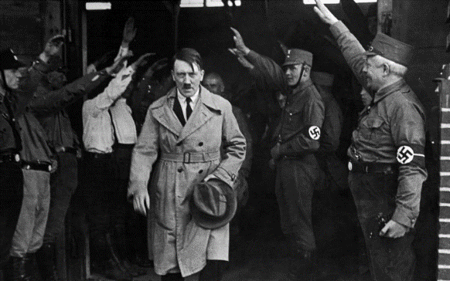
How did Hitler gain control of the NSDAP?
In June 1921, some members of the NSDAP wanted to merge with the DSP (German Socialist Party)
Upon returning from Berlin, Hitler announced that he would leave the party.
He argued that he would rejoin on the condition that he would replace Drexler as party chairman, and that the party headquarters would remain in Munich.
His strategy proved successful, and at a special party congress on 29 July, he was granted absolute powers as party chairman, replacing Drexler, by a vote of 533 to 1.

Slide 3
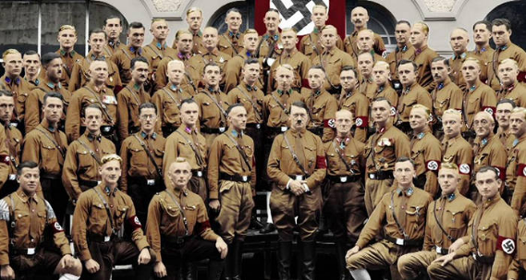
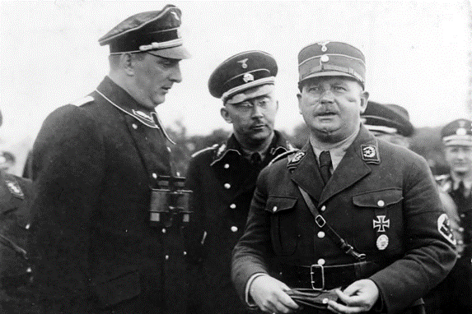
How did he develop the party as leader?
As leader, Hitler began to build up a paramilitary force for the party. In August 1921, Hitler set up the SA (stromtroopers).
He got Ernst Rohm to recruit ex-soldiers from the Freikorp units.
They dressed in brown uniforms, earning the nickname ‘Brownshirts’
The SA paraded in the streets as a show of force.
By August 1922, they numbered about 800 and impressed people with a sense of power and organisation.
At NSDAP meetings, the SA was used to control the crowds, subduing any opposition to Hitler, often with violence.

Slide 4
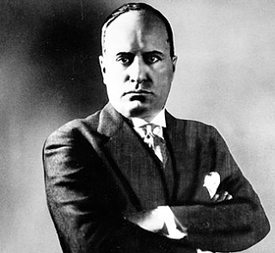
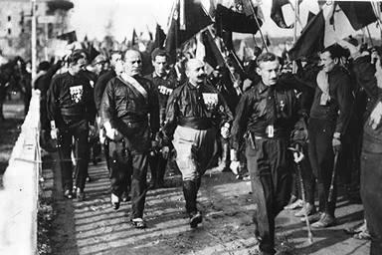
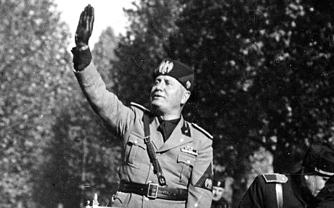
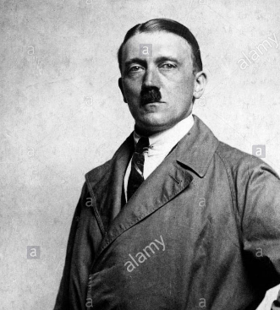
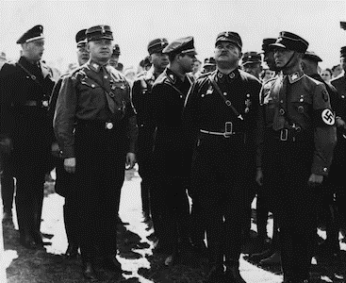
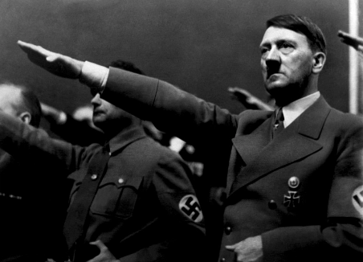

Slide 5
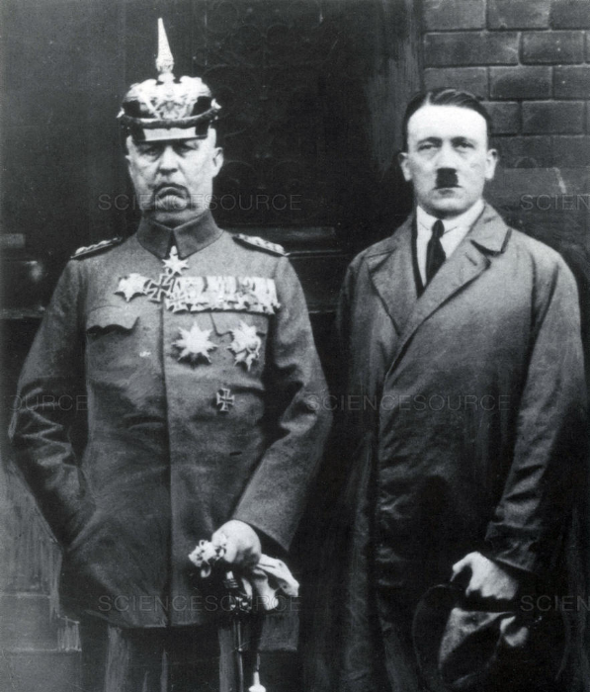
Who was General Erich Ludendorff?
In May 1923, Adolf Hitler met with General Ludendorff.
Ludendorff had been leader of the German war effort during the First World War.
He was extremely well respected across German society.
Ludendorff was very critical of the Weimar Government.
He became very attracted to the ideas of the NSDAP.

Slide 6
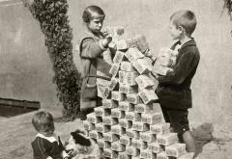
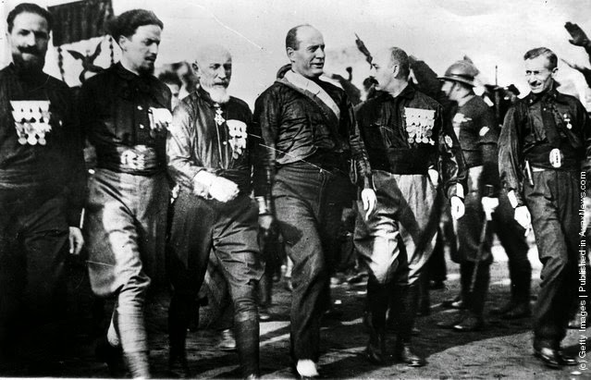
Learning Task One
All targets
As a class, read p.49
Using this, create a spider diagram to explain three reasons why Hitler chose 1923 as the year to seize power.

Slide 7
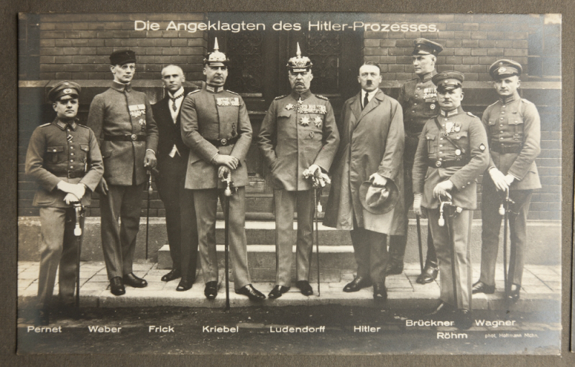
What happened during the Putsch?
On 8th November 1923, the Bavarian local government were meeting in a beer hall. It was led by Gustav von Kahr (leader), von Seisser (head of police) and von Lossow (head of army)
Hitler and 600 of his SA burst in – shooting into the ceiling and declaring he was taking over Bavaria and then marching on Berlin. Ludendorff would lead the army.
At gunpoint, Hitler forces the Bavarian leaders to support him. Rohm and the SA took control of the police and army headquarters.
However, the main army barracks remained in the hands of the army loyal to the government.
Ludendorff released Kahr, Seisser and Lossow to meet their wives. He took their word that they would not call the authorities.

Slide 8
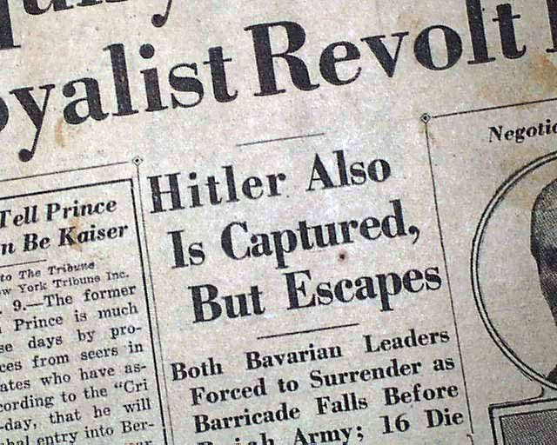
What went wrong?
At 5am on the 9th November, Hitler and his supporters marched through the streets of Munich. They were met by the police and army reinforcements who had been called in by Kahr, Sessier and Lossow.
By midday Hitler decided to continue with the revolt – he had 1,000 SA and 2,000 volunteers supporters (paid for by money stolen from Jewish banks)
They marched through the city to declare Hitler the President of Germany.
Most of the townspeople failed to support Hitler – the Bavarian army remained loyal. Hitler was outgunned (only 2,000 rifles)
Eventually shooting began – Goerring was shot in the thigh, Hitler was dragged into a car by his supporters.
14 of his supporters and four policemen were killed.

Slide 9
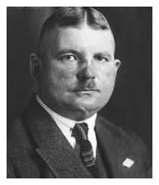
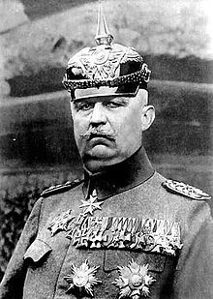
Learning Task Two
Targets 1-4
For each, two bullet points on how they caused the putsch to fail.
Targets 5-7
For each, three bullet points on how they caused the putsch to fail. Also explain the impact of their actions.
Targets 8-9
For each, three bullet points on how they caused the putsch to fail. Also explain the impact of their actions and how it would have helped if they did the opposite.

Slide 10
