Slide 1
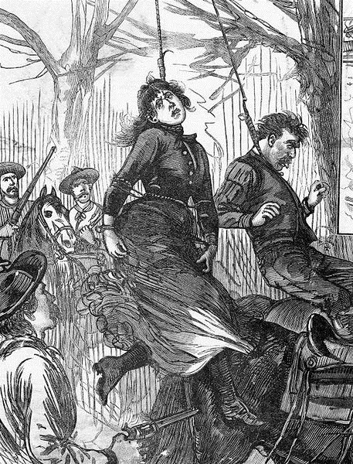
What happened at the OK Corral in 1881?
In this lesson, we will:
Describe what happened at the O.K. Coral
Assess to what extent the west can be defined as ‘wild’
Starter: Who are these two people and why are they important?

Slide 2
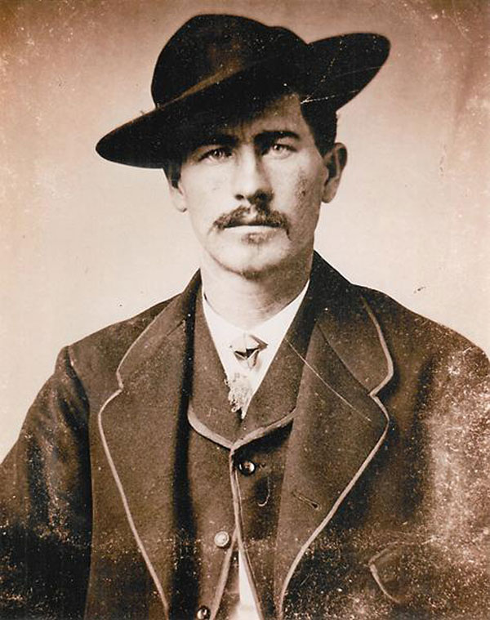
Who was Wyatt Earp?
Marshall in Dodge City, Arizona from 1876 to 1879.
In 1879, he moved to Tombstone in Arizona with his brothers Virgil and Morgan.
By the time the Earps arrived, it was a boom town of 1,000 people controlled by rich mine owners and businessmen.
There was a lot of tension between the businessmen, and two ranching families called the Clantons and the McLaury’s
His brother Virgil became Deputy U.S. Marshal, and he became Depty Sheriff.
Together they aimed to bring law and order to Tombstone.

Slide 3
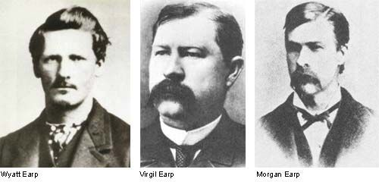
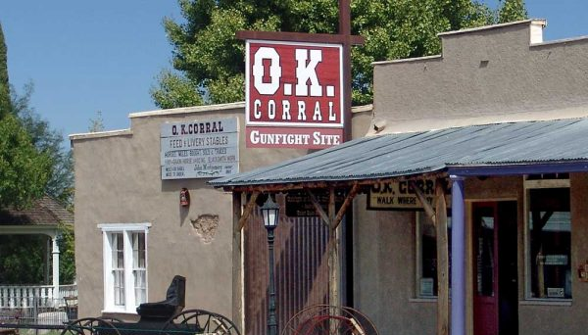
What happened at the O.K. Corral?
On October 26th 1881, Ike Clanton, Billy Claiborne and others threatened to kill the Earps.
Virgil was told they were armed and were at the O.K. Coral.
Virgil, Wyatt and Morgan all went to disarm the.
At 3pm, they found five men at the entrance to the O.K. Corall on Fremont Street.
Two of the men ran away, but Tom McLaury, Frank McClaury and Billy Clanton stood their ground.

Slide 4
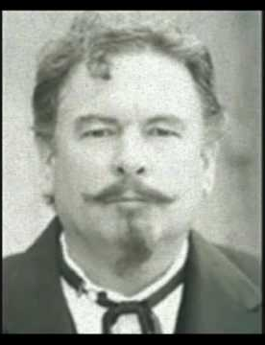
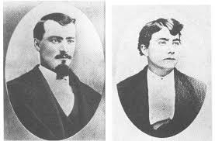
Task One – Watch & Learn
When Ike Clanton ran up to Wyatt Earp – what happened?
What happened to Virgil and Morgan Earp?
What happened to Tom McLaury?
What happened to Frank McLaury?
What legend developed about Wyatt Earp after the shootout?
Ike Clanton
Tom McLaury
Frank McLaury
https://www.youtube.com/watch?v=60jUIO0a54I

Slide 5
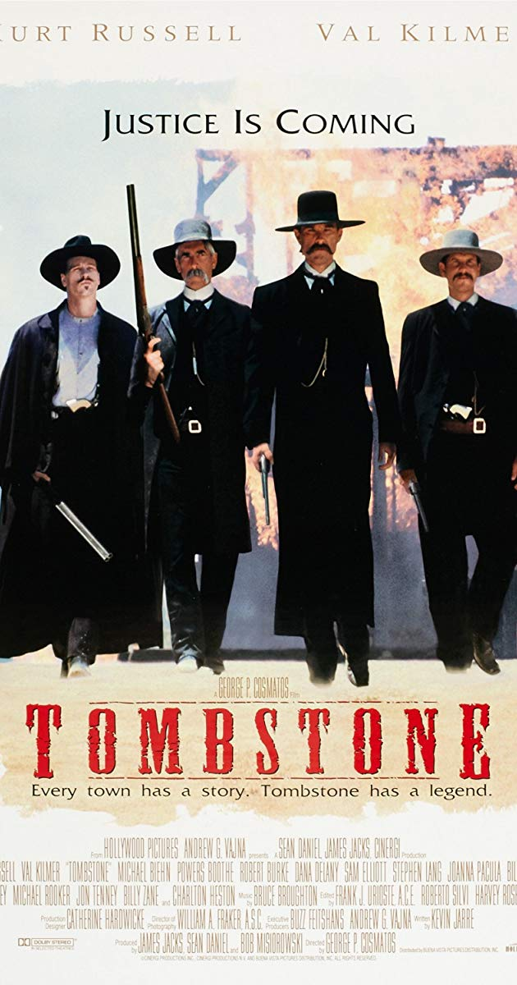
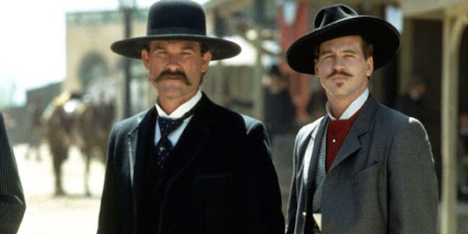
Watch this clip from the film ‘Tombstone’ – it stars Kurt Russell as Wyatt Earp. How have they portrayed the Earps?
https://www.youtube.com/watch?v=FRiWAxMMX5o

Slide 6
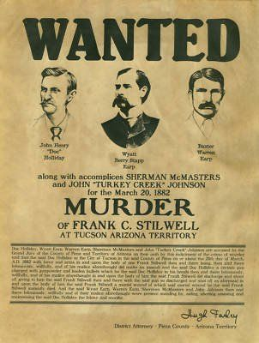
What happened next?
Ike Clanton filed murder charges against the Earps and Holliday. One month later, all men were declared innocent in court.
Their reputation as destroyed – many cowboys looked for revenge.
In December, Virgil Earp was shot and killed between two saloons in Tombstone. Ike Clanton’s hat was found at the scene.
Morgan Earp was murdered on March 18th 1882 while playing billiards, shot by gunmen firing from a dark alley through a door window.
The next day, Wyatt put together a posse of men to hunt down the men he thought were responsible.
He shot and killed them in cold blood.

Slide 7
Task Two
Evidence of a ‘Wild West’ | Evidence that it wasn’t a ‘Wild West’
Using what we’ve now studied about the west assess the following:
‘The Wild West’
You should argue both for and against this concept using evidence from the 19th Century.
https://www.youtube.com/watch?v=60jUIO0a54I

Slide 8
Evidence of a ‘Wild West’ | Evidence that it wasn’t a ‘Wild West’
Outlaws like Billy the Kid showed the violent nature of the west and how weak the justice system was. Mining towns often had high crime rates (gambling, murder, fighting, prostitution etc.) For example; San Francisco. Lawmen were often extremely violent e.g. Wyatt Earp shot and killed three men at the O.K. Corall, his brothers were killed, and then he murdered their killers. The law often didn’t work effectively e.g. Earps declared innocent, Billy the Kid escaping, Pat Garrett feeling he had no choice but to shoot the Kid. WSGA used wealth to buy their freedom WSGA felt they had to take laws into own hands to stop rustling. Hired Texan gunmen to hunt down their enemies. Lynch mobs often organised to take law into own hands e.g. killing of Ella Watson and Jim Averill. | Lawlessness generally decreased, as people needed their business and families to be secure e.g. resident often voted to ban guns within city limits. Towns eventually became connected by rail and electric telegraph, so law officers and judges could keep in contact with state government. People often rejected violent gunslingers e.g. Earps became outlaws, Garrett became hated. People often rejected men taking law into own hands e.g. Sheriff Angus raising a posse to stop the Invaders killing in Johnson County

