Slide 1
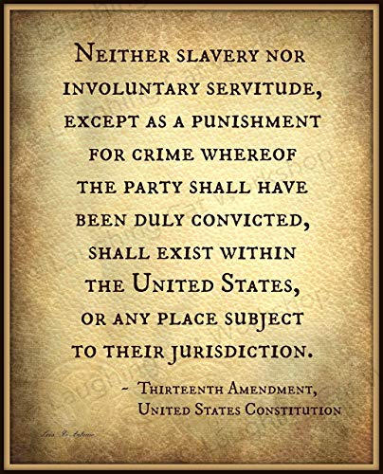
What caused an exodus to the west in the 1870?
In this lesson, we will:
Explain why the Exoduster movement occurred.
Explain the consequences of this movement for the west.
Starter: Identify what happened in the following years: 1836
1846
1862
1865

Slide 2
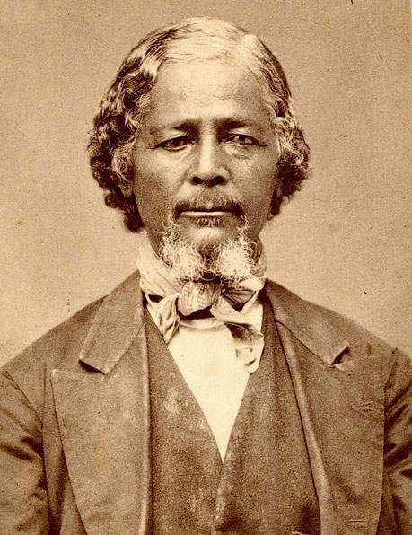
What was the Exoduster movement?
Due to the violence, racism and poor conditions in the South, some ex-slaves began to migrate west.
A former slave called Benjamin Singleton set up a settlement in Kansas in 1873.
In the south, he held meetings, gave out leaflets and placed adverts in newspapers to convince blacks to settle in Kansas.
In 1879 a rumour spread that the government had given the whole of Kansas to ex-slaves.
This caused over 40,000 ex-slaves to migrate to Kansas, Missouri, Indiana and Illinois.
They became known as the ‘Exodusters’ ( an exodus to a dry, dusty west)

Slide 3
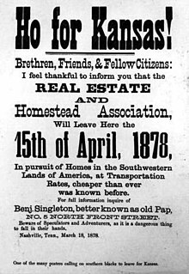
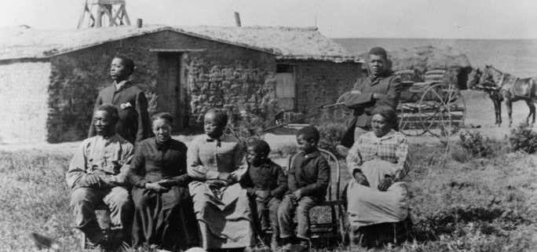
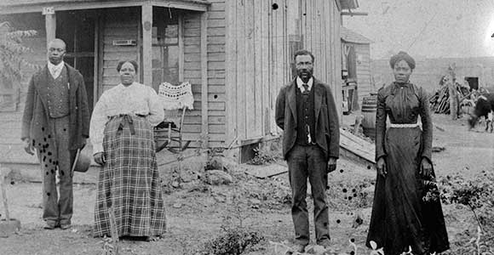

Slide 4
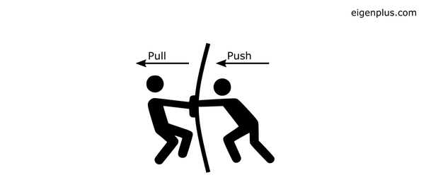
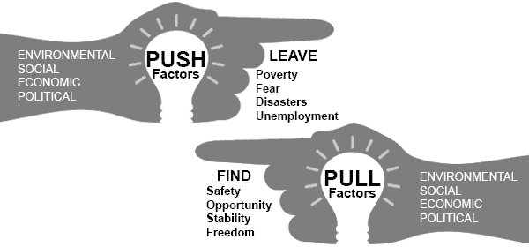
Learning Task One
Design a diagram to show the push and pull factors responsible for the Exoduster movement.
Colour code to show the difference.
Be sure to link your learning e.g. Civil War, Homestead Act, Railroad Act etc.

Slide 5
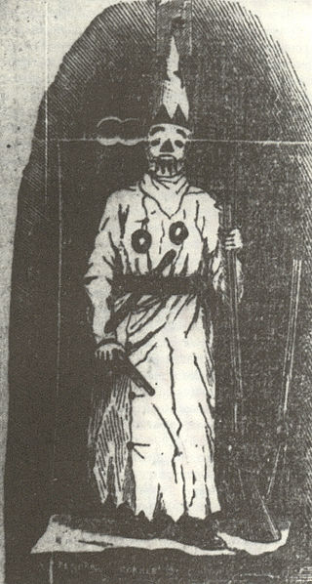
What impact did this have?
Led to more African Americans in the west – by 1880, there were 43,107. Settlements were formed e.g. Nicodemus in Kansas.
Led to difficulties for blacks – all the best land had already been taken. Blacks were left with land that was dry and difficult to farm.
Led to charities being formed – many blacks arrived ill from yellow fever and struggling to live. Kansas government set up organisation to help migrants (e.g. money, food)
Led to tension – whites in Kansas did not like that blacks received help and they did not. Many wanted them to return to the south.
Led to racism – ‘White Prophet’ balls and clubs were set up to establish white supremacy in Missouri

Slide 6
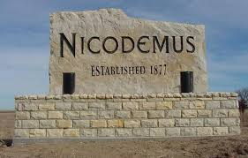
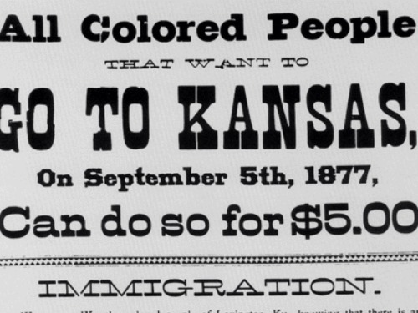
Learning Task Two
Read p.78 Using this information, explain how the Exoduster movement led to the following:
Tension/Racism
Settlement
State Charity
Stretch challenge:
Draw a Venn diagram to show the similarities and differences between Exodusters and Mormon migration.

