Slide 1
Why was there a rebellion in July 1087?
In this lesson, we will:
Explain why there was a succession crisis.
Explain how King William II defeated it.
Starter task: Why is this place significant?

Slide 2
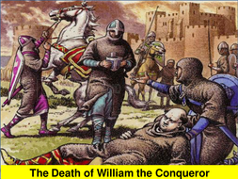
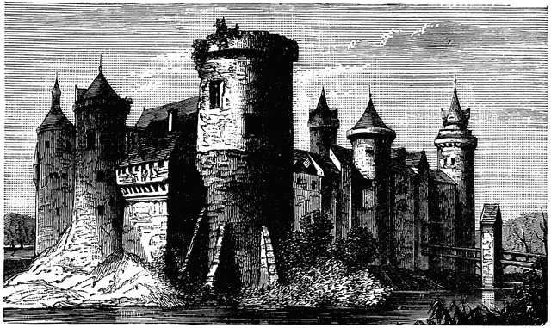
How did William I die?
In August 1087, King William I lay dying at his castle in Rouen.
In July, he had been on campaign in Mantes, France. His saddle had dug into his fat gut and caused internal injuries.
On his death bed, he decided that Robert should become Duke of Normandy. He made all his barons in England and Normand swear loyalty to Robert.
William wanted his youngest son, William, to become King of England. However, he said he would let God decide.
He had his brother Odo released from prison.

Slide 3
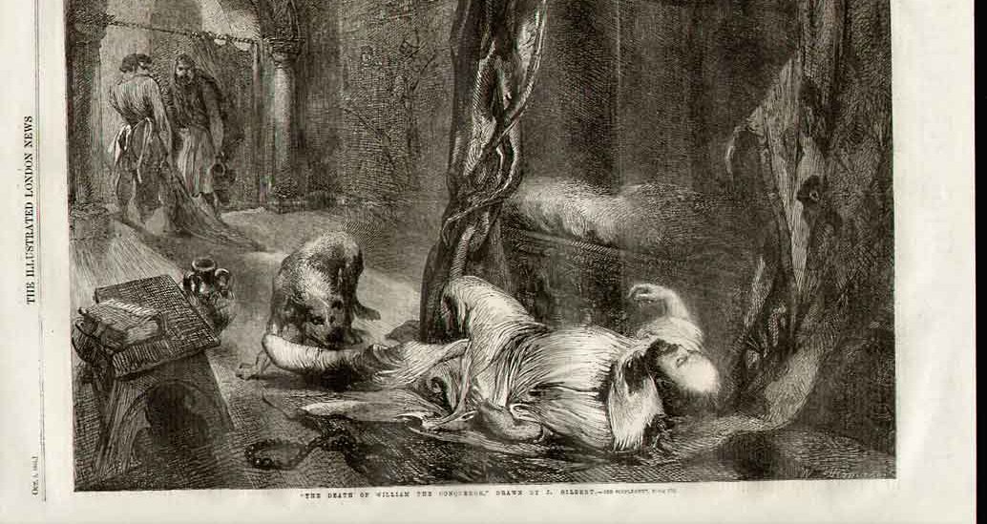
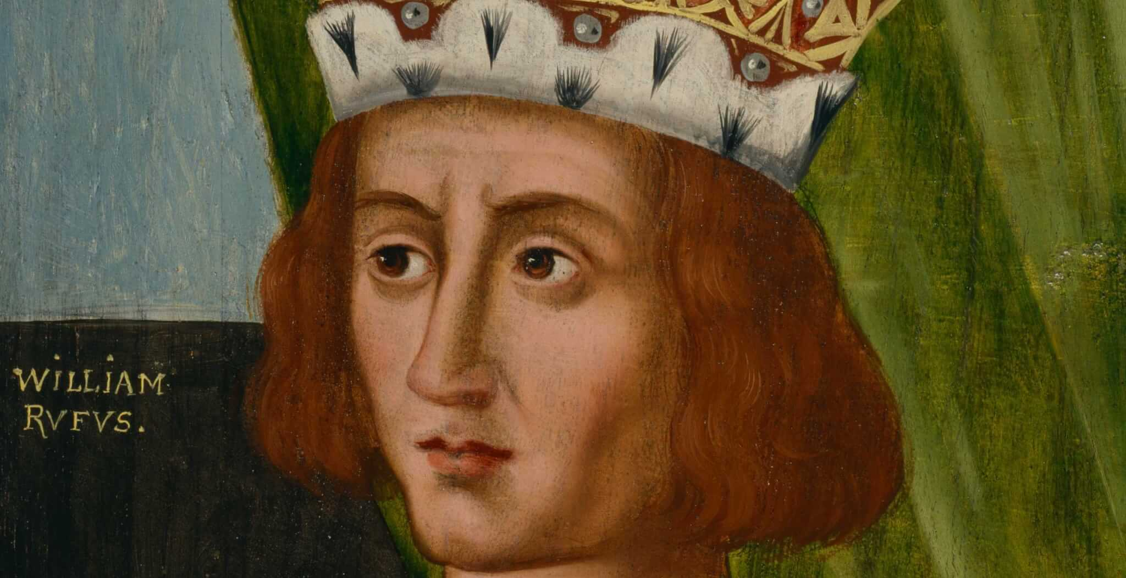
How did William II become king?
On September 9th 1087, King William I died.
William Rufus travelled from Rouen to London with a letter written by his father.
He showed it to Archbishop Lanfranc and convinced him to crown him King William II in September 1087.
As Lanfranc represented the Church, the Witan were not needed.
By 1088, England was plunged into a rebellion.

Slide 4
Bishop Odo led a rebellion.
He wanted Robert, Duke of Normandy to be king of England. Robert was weak and could be easier to control. King William II was too much like his father. He raised an army with William’s other half brother (Robert of Mortain)
King William I had divided his Empire.
Norman Barons held land in both Normandy and England. This meant they now had two over lords, two sets of laws, two sets of taxation. They wanted one single ruler to make it easier. Also if England and Normandy went to war, it would create more problems for them.
Why was the a ‘succession’ crisis in 1066?
Duke Robert of Normandy made a claim.
As the eldest son, he should inherit all of his father’s estates. Also dividing up the kingdom, it destroyed the Norman Empire. Claiming England again would enhance his strength, and riches through taxation.

Slide 5
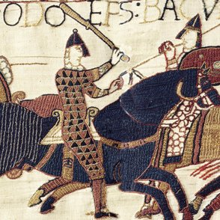
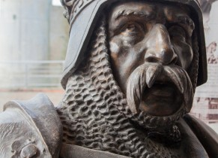
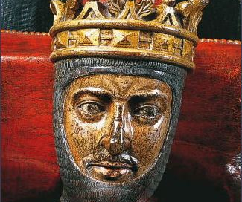
Learning Task One
For each of the people below, explain how they caused a problem in 1087:
Robert, Duke of Normandy
William I, King of England and Duke of Normandy
Odo of Bayeux and Earl of Kent

Slide 6
Many Normans and Saxons did not support Odo.
Every Norman land owner (except one) and the English population were against Odo’s rebellion. This stopped men from joining Odo and Robert’s army.
King William II’s siege of Pevensey
King William raised an army and sieged Pevensey Castle for six weeks. He used local fyrd to attack the castle and stopped any supplies getting into. This allowed him to forced Odo and Robert to give up. He even managed to arrest Robert, which was a massive blow to the rebellion. Odo was also eventually captured.
How was William II able to crush it?
Duke Robert was never able to invade and join Odo
King William II raised an army from his tenant-in-chief. Rather than the knights fight, he had them give money. He then used this to bribe Norman barons to not support Robert. This forced Robert to pull his planned invasion of England, allowing William to arrest Odo.

