Slide 1
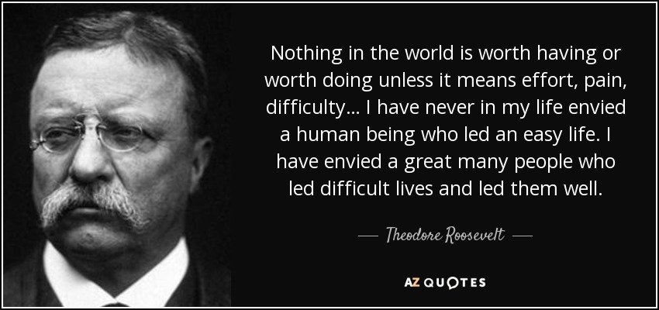
Revisit Lesson: Session 3
Starter: Read through the paper you have been given back. Compare your answers with the sample answers. Where have you gone wrong? Where have you gone right?

Slide 2
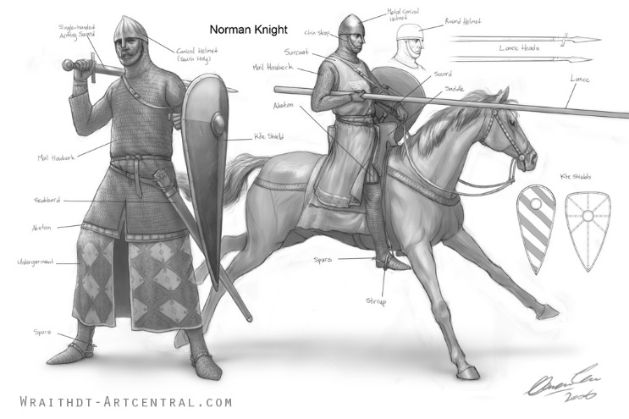

Slide 3
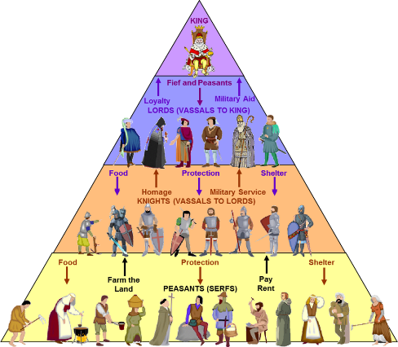
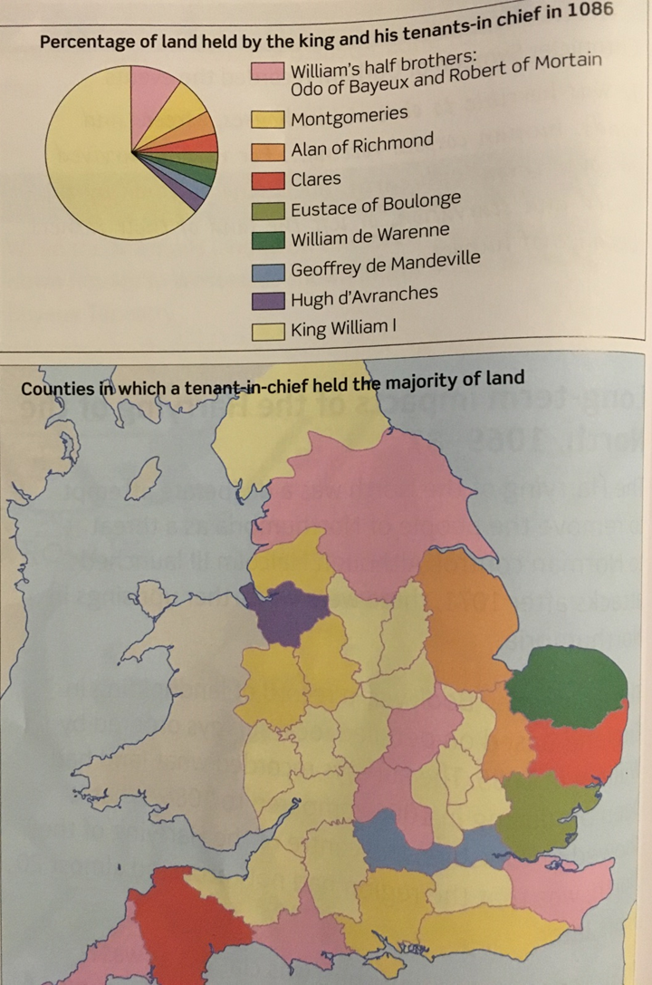
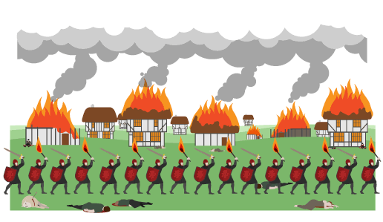
However…
On the one hand…
“By 1075, William had secure control of England”
In addition…
Additionally…
Also…

