Slide 1
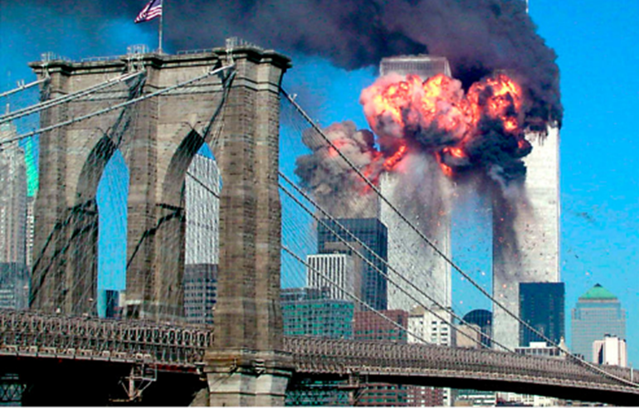
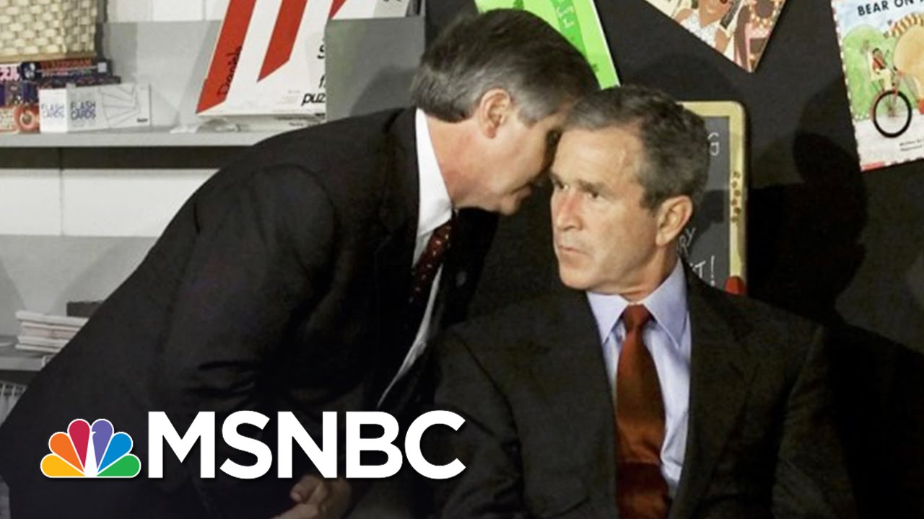
The events of September 11th 2001
On 11th September, the Islamist terrorist group al-Queda hijacked four aircrafts.
Two planes were flown into the twin towers of the World Trade Centre in New York.
Both towers eventually collapsed due to the damage.
A third plane crashed into the Pentagon building in Washington, DC.
A fourth plane, United 93, crashed in Pittsburgh after the passengers wrestled with the hijackers.
2,977 people were killed (including 19 terrorists)
On 16th September, President George W. Bush launched his “war on terror”

Slide 2
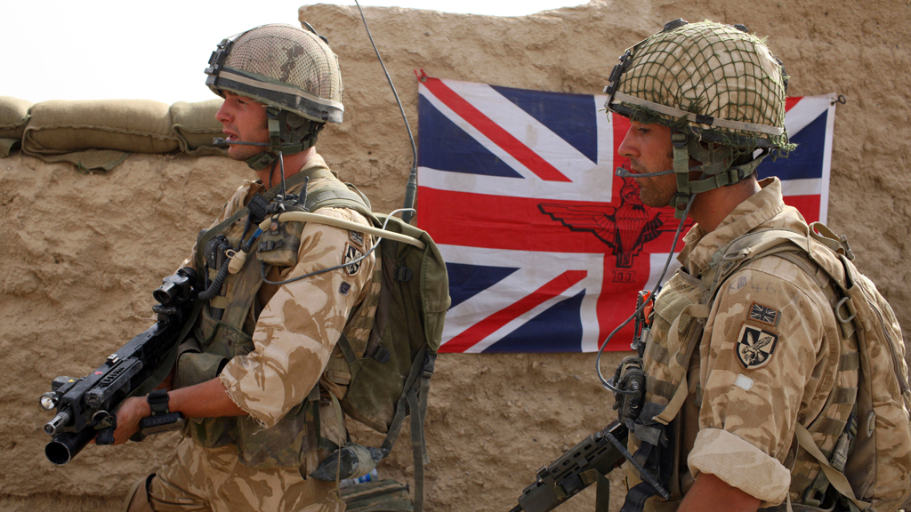
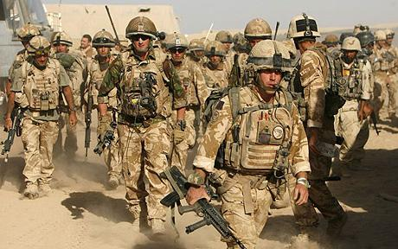
The Invasion of Afghanistan, 2001
Tony Blair supported Bush’s “war on terror”
In keeping with the principles of the ‘Blair Doctrine’, he announced that Britain would support America in their struggle.
On 7th October 2001 Britain joined the USA in a military campaign to overthrow the Taliban and expel Al-Qaeda from Afghanistan. This was supported by NATO and the UN.
It was hoped that a new democratic state could be set up, however it was not an instant success.
Although a new democratic regime was established, progress was slow.
The Iraq War drew more attention allowing the Taliban to regroup in 2006 and 2007.

Slide 3
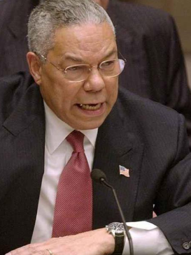
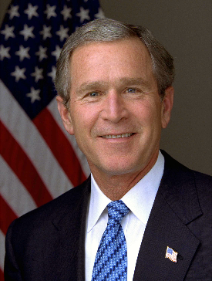
Why did the US invade Iraq?
The 9/11 attack gave the Bush administration justification for an invasion of Iraq to finally remove Saddam Hussein from power. Since the First Gulf War he had been contained by economic sanctions. Taking out Hussein would make the Bush administration look strong for re-election.
The US feared that Iraq might link up with Al-Qaeda and provide them with a new base for terrorism (just like Afghanistan did in 2001). They also feared that Hussein’s regime had developed weapons of mass destruction (WMD).
The UN had forced Hussein to allow weapons inspectors into Iraq in 2002. However by 2003 the US accused of him of not cooperating and there was a debate in the UN over whether or not military forces were legally allowed to take part in these inspections. In February 2003, the IAEA “found no evidence or plausible indication of the revival of a nuclear weapons program in Iraq“.
On the 5th February, Secretary of State Colin Powell appeared before the UN to argue that Iraq was hiding WMD and had ties to Al-Qaeda. In March – an invasion was being planned.

Slide 4
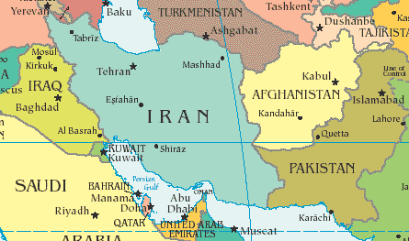
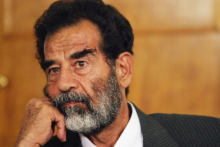
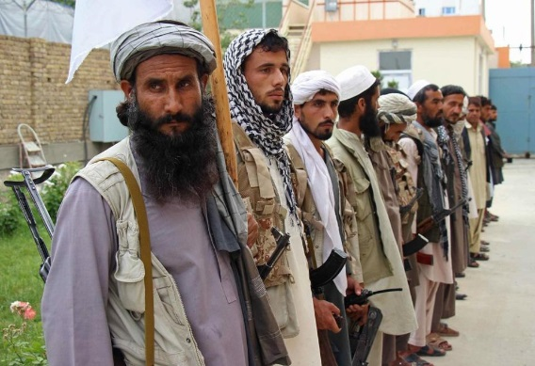
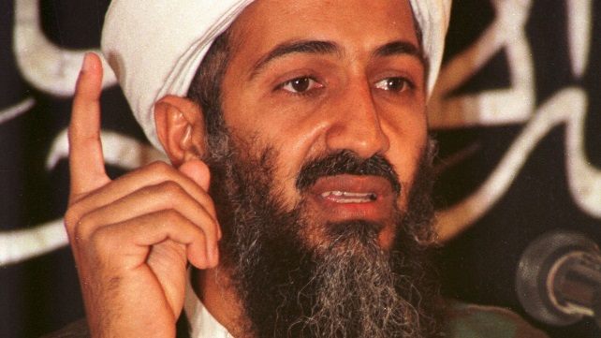
Since 1980s had been taken over by Taliban (radical islam)
Was the base for the terrorist group Al-Qaeda led by Osama Bin Laden
Officially supported the invasion of Iraq
Pledged to stop the flow of weapons and explosives heading to Iraq.
Accused by Americans of supplying weapons to Iraqi militias (no proof)
Played a role in supporting the invasion of Afghanistan by supplying resources.
However, provided a safe haven for radical Islamist movements (e.g. Bin Laden)

Slide 5
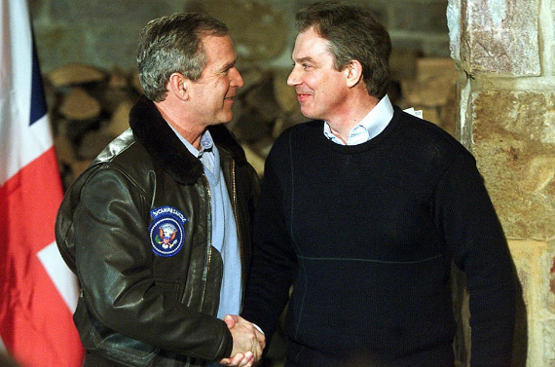
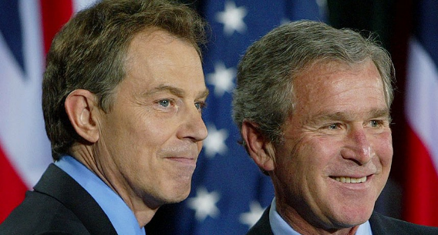
Why did Blair want to invade Iraq?
Blair had been brought up politically in the 1980s when Labour lost elections partly because it was seen as “soft” on defence and being anti-US. Blair was keen to maintain a strong relationship with the United States.
Following 9/11 – Blair had pledged to stand “shoulder to shoulder with out American friends” and to “not rest until this evil is drawn from our world”
In public, Blair was initially very cautious about his responses to military intervention in Iraq, but in private he was 100% supportive. Eight months before the invasion, he wrote a six page memo to President Bush backing for war well before UN weapons inspectors had completed their work, saying: “I will be with you, whatever.”
The UK House of Commons held a debate on going to war on 18 March 2003 where the government motion was approved 412 to 149.
https://www.youtube.com/watch?v=vHFnP1tu0B8

