Slide 1
Was Britain the sick man of Europe by 1963?
Key Term | Definition
Inflation | The record of all economic transactions between a country and the rest of the world e.g. exports, imports, financial capital and transfers (e.g. trading)
Budget Deficit | A sustained increase in the general price level of goods and services in an economy over a period of time.
Balance of Payments (BOP) | Something that occurs when expenses exceed revenue.
In this lesson, we will:
Describe Macmillan’s economic strategies.
Assess how strong Britain’s economic management was by 1963.
Starter: Match up the economic key term to the definition. You may wish to refer back to previous lessons on Conservative economic management.

Slide 2
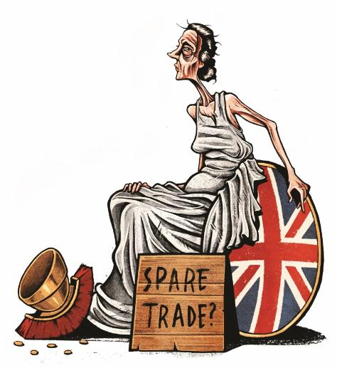
Sick man of Europe: a label given to a European country experiencing a time of economic difficulty or impoverishment. The term was first used in the mid-19th century to describe the Ottoman Empire.

Slide 3
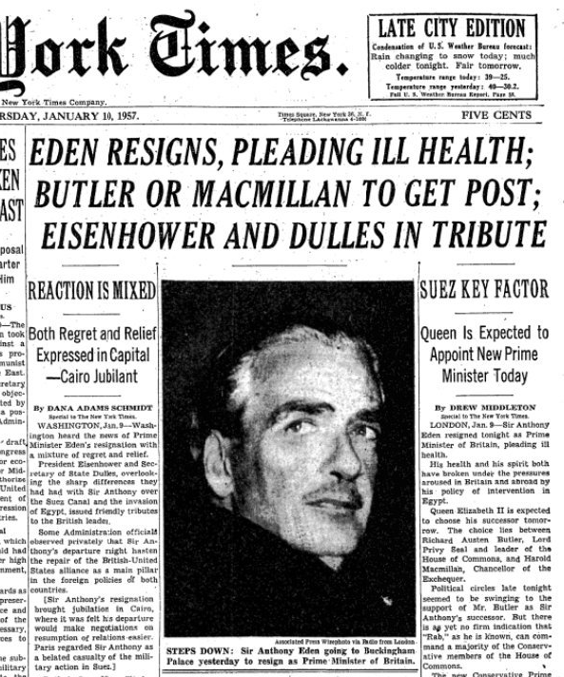
On 8th November, Labour motioned a vote of confidence in the government. Despite winning, it showed the fragility of Eden’s government.
When Eden returned to the House of Commons in December, he made a statement claiming “there was not foreknowledge that Israel would attack Egypt”.
Eden had lost the support of many Conservatives on the left of the party.
Throughout Christmas, Eden suffered from flu symptoms. He was told by his doctors that if he continued as Prime Minister, he would die.
On 9th January 1957, Eden announced his resignation.

Slide 4
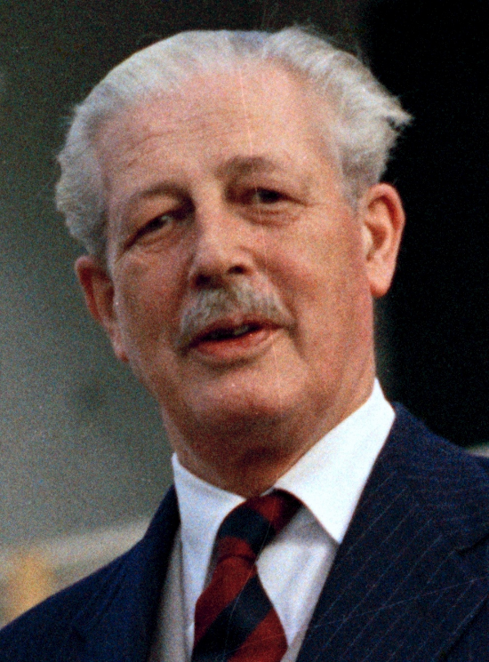
At that time the Conservative Party had no formal mechanism for selecting a new leader.
Queen Elizabeth appointed Harold Macmillan as Prime Minister and leader of the Conservative Party.
Macmillan had the support of Churchill as well as the Cabinet (most of whom wanted anyone but Butler as leader)
He had been Housing Minister (1951 – 54), Defence Minister (1954-55), Foreign Secretary (1955) and Chancellor (1955 – 57)
Upon taking office, he informed the Queen that he could not guarantee his government would last six weeks.

Slide 5
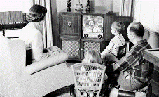
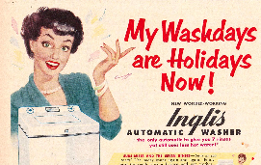
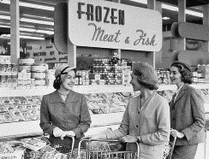
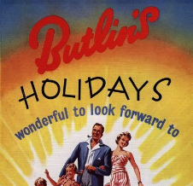
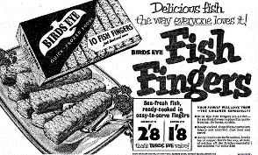
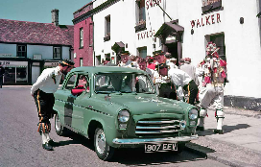
TV sales up 32%
Washing machine sales up 32%
First supermarkets opened 1952
The affluent society
Butlins popular (60% of all holidays)
Convenience food launched like Fish Fingers and tea bags!
Wages increased from £8.30 a week in 1951 to £15.35 in 1961. Between 1955 and 1969 could afford to buy more with the money they earned. Consumer spending increased by 115%
Car ownership up 250%

Slide 6
The Consumer Cycle
More goods are bought, causing businesses to make more money
More jobs and higher wages
People feel they have more money to spend
Rising Inflation
Tax Cuts

Slide 7
Election
Tax Increases
Tax Cuts
Tax Increase
Tax Increase
IMF Loan
Pay Freeze
Interest rates increased
Election
Tax Cuts
Tax Cuts
Tax Cuts
Election

Slide 8
Budget politics: the act of using budgets* to win votes for elections, most often through tax cuts for the middle class.
* A budget is a document prepared by the government’s Chancellor of the Exchequer. It presents their anticipated tax rates and proposed spending for the coming financial year.

Slide 9
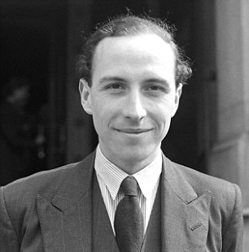
We should consider precisely what the Chancellor did almost exactly three months ago in his Budget. He gave away £135 million in extremely regressive taxation concessions. In other words, he increased the demand in the country three months ago deliberately, as an act of Government policy. In view of what is now happening, can the Chancellor think of any single argument, other than that of electioneering convenience, for the step which he took in his Budget?
Roy Jenkins MP for Birmingham, 26th July 1955

Slide 10
Manufacturing using out-dated production methods (slow and expensive)
British shipbuilding overtaken by Japan in 1956.
Lack of advanced infrastructure. Relying on steam trains whereas most of Europe had switched to electric or diesel.
Slow economic growth compared to France and West Germany
Economic problems facing Macmillan in 1957
Poor industrial relations with a growing number of days lost to strike action. From 1951 – 1956 there had been over 12,000 strikes across Britain.
Lack of economic strategy: too much use of budget politics (stop-go)
Lack of economic diversity: 47% of economy was mining, farming, construction and manufacturing. These industries were declining causing rising unemployment.
National debt of £564 million and pressure on sterling caused by Suez.

Slide 11
Primary tier: Coal mining and agriculture
Secondary tier: Manufacturing and construction
Tertiary tier: Service industries (e.g. transportation, nursing, banking, legal, retail, education etc.)

Slide 12
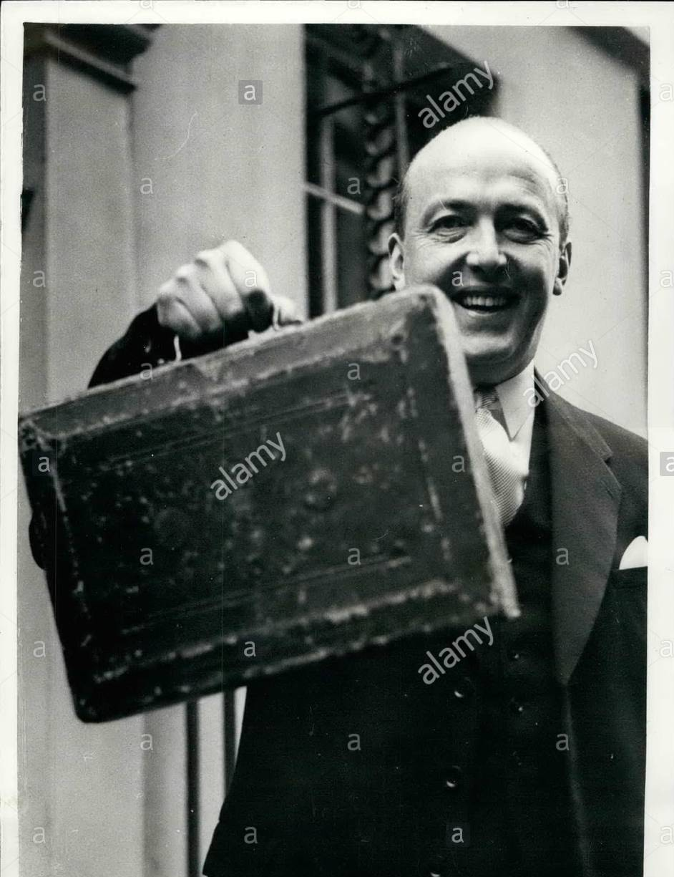
Much like his predecessors, Macmillan was a advocate of Keynesian economics
His main priority was to keep employment high and inflation low.
He chose to demote his rival, RA Butler, to Home Secretary and appointed Peter Thorneycroft as his Chancellor.
His only budget was on 9th April 1957. It included a range of tax cuts.
It was criticised as “a rich man’s budget” by the Labour Party.
Interest rates were increased by 2% (5% to 7%)

Slide 13
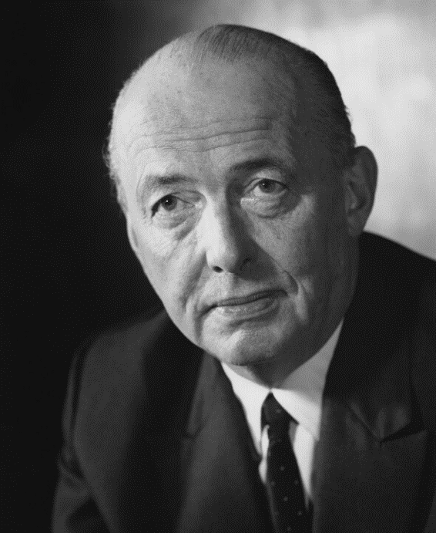
Thorneycroft believed that inflation was caused by a lax approach to the money supply.
In September 1957, he argued that to control inflation the government had to control the supply of money (monetarism)
He attacked Keynesian economics as causing economic uncertainty, runs on the pound and inflation.
He called for £50 million of cuts to the welfare state (NHS, housing etc.)
Macmillan refused to support, as he argued it would cost the Conservatives the next election. In protest, Thorneycroft resigned.

Slide 14
Chancellors of the Exchequer, 1958 - 1964
Derick Heathcoat-Amory
1958-1960
Selwyn Lloyd, 1960-1962
Reginald Maudling, 1962-1964

Slide 15
Issue | Macmillan’s handling of it | Overall judgement on performance by 1963
A high rate of economic growth.
Low and stable inflation
Low unemployment.
Advanced infrastructure (telecommunications, railroads, transportation)
Diversified economy (economic health is not tied to a single industry)

Slide 16
Analyse this interpretation of Conservative economic policies from 1951 to 1963:
What is Franklin’s interpretation?
To what extent to you agree with Franklin’s interpretation? Provide detailed examples to either agree or disagree with this.
For a deeper understanding…use your knowledge from today and previous lessons on economic policy to complete the fact-checking exercise for the 1964 Labour Party manifesto!

Slide 17
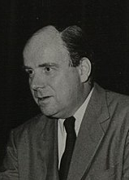
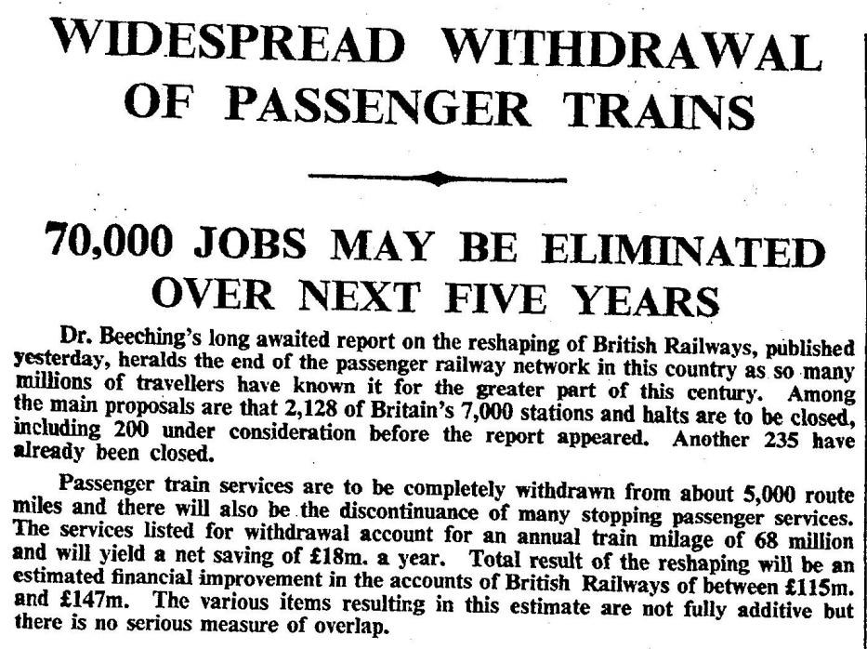
1957
1958
1959
1961
1962
1963
1964
Massive pressure from cost of Suez and US pressure started run on the pound (£ worth less than $). Peter Thorneycroft wanted to limit wage increases and cut money supply. This heavily divided Tory’s – some opposed this as it would lead to unemployment e.g. Iain McLeod.
Macmillan decided to side with McLeod – Thorneycroft resigns alongside Enoch Powell. Macmillan shrugs this off as “a little local difficulty”.
1959 budget provided huge tax cuts of £370 million. Tory’s were riding the wave of affluence – the economy was doing very well. However the threat of inflation was every present. As wages went up, so too did the price of goods. From 1960 – 1964, trapped in cycle of “stop-go”
Pay-pause introduced to hold down wage inflation. IMF prop up the £ by loaning Britain £1.5 billion. Britain struggles to keep up with rest of Europe without access to EEC. Trade within commonwealth not enough.
NEDC and NICKY set up to keep an eye on wages and pricing. Made up of government representatives, academics, employers and trade unions. Shows willingness to work in collaboration
Beeching Report published and recommends massive cuts in Britain’s rail network. Closing 30% of the rail network. Many communities left isolated. Public outrage.
Reginald Maudling, the new Chancellor, pushed the economy into a go stage by lowering the bank rate to encourage spending. Exports at 10%, imports at 20%. BOP in £800 million deficit!

