Slide 1
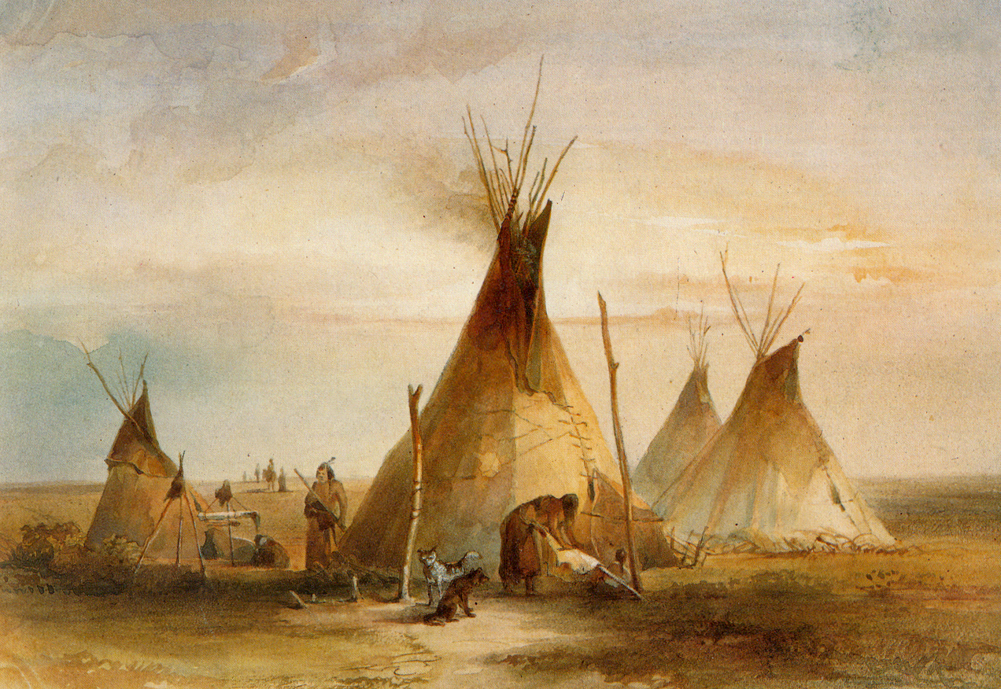
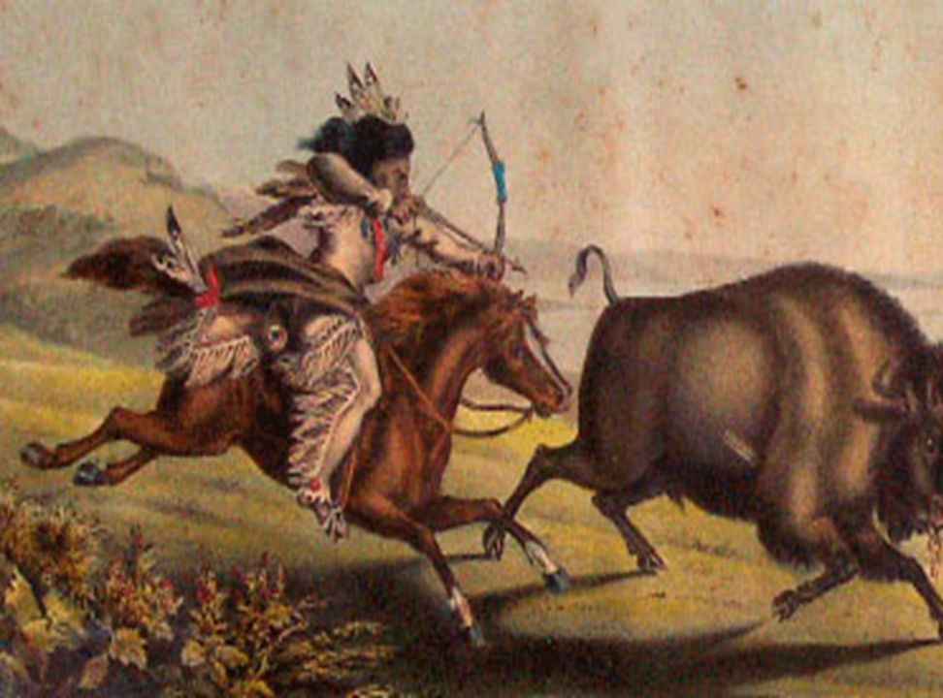
How did the US government negotiate with the Indians between 1834 and 1851?
In this lesson, we will:
Explain why there was tension between the Indians and white Americans by 1850.
Describe the two solutions put forward by President Fillmore in 1851.
Starter: Based on your previous knowledge can you describe how the Indians lived?
Key words: nomadic, buffalo, sun dance, chief, tepee

Slide 2
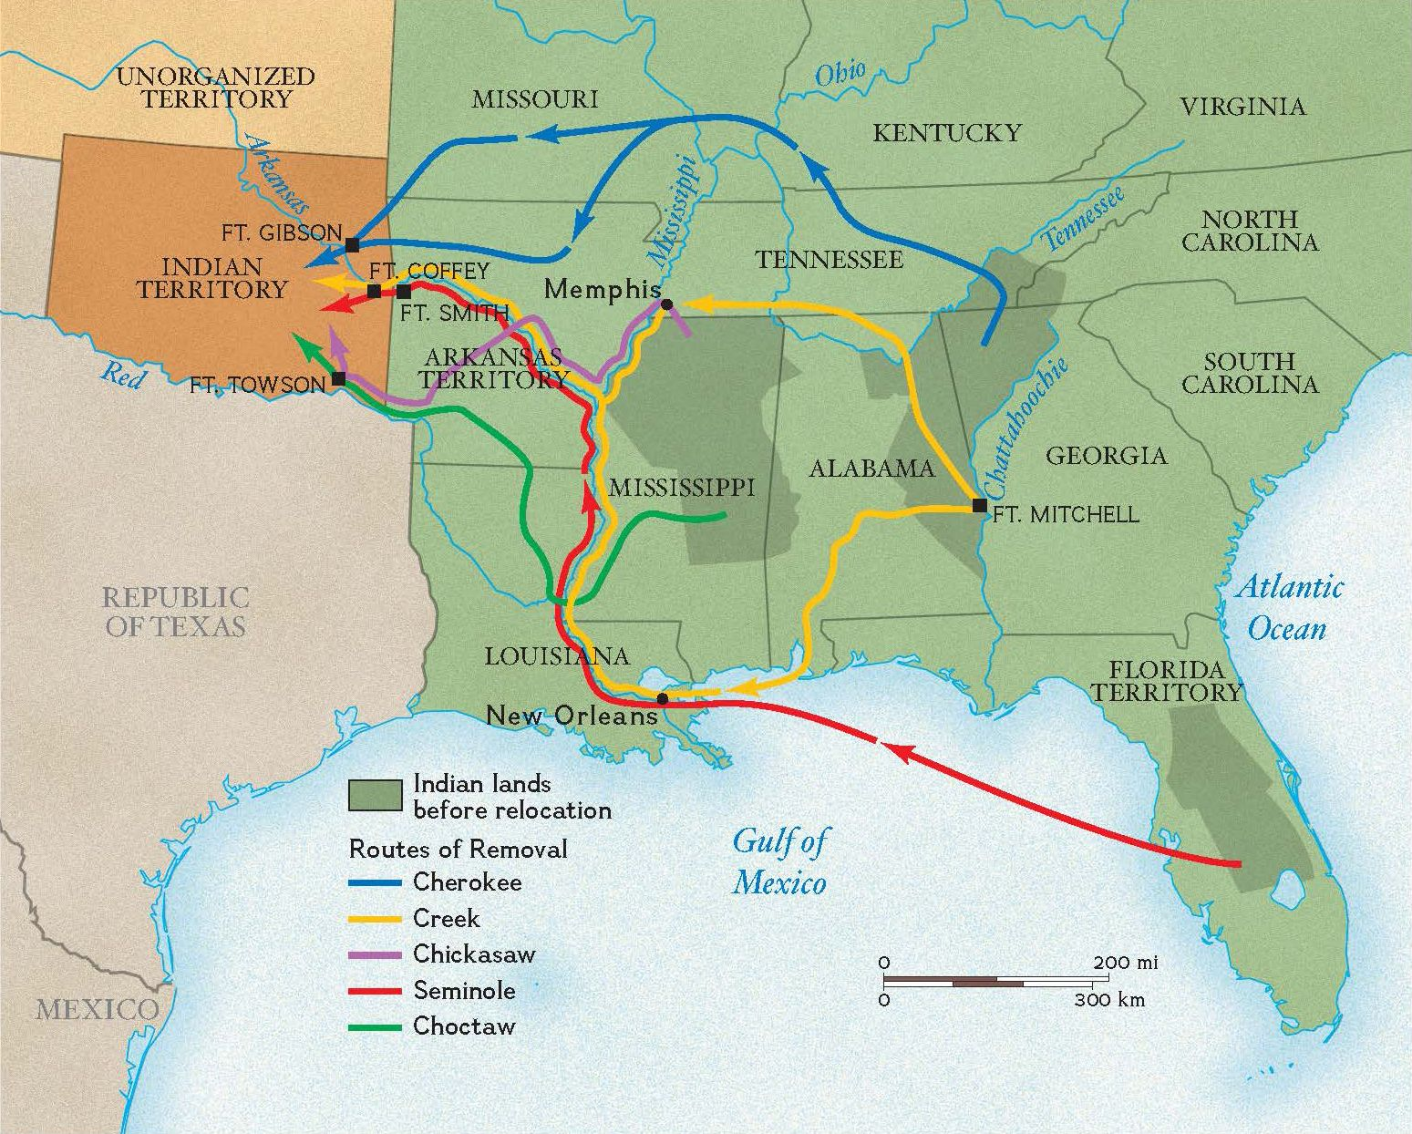
A little background to the story…
In the very early 19th Century, the US government struggled with how best to deal with the ‘Indian problem’
The land that the Indians lived on, such Georgia, Alabama, North Carolina, Florida etc. was very valuable as it was perfect for growing cotton.
Many white plantation owners began to attack Indians in the hope of driving them out.
In 1830, President Andrew Jackson signed the Indian Removal Act which gave the government the power to move tribes to “Indian zones” west of the Mississippi river. (technically outside the ‘United States of America’).
However, this was just a temporary solution.
Between 1834 and 1851, the US government would struggle to come with a solution to the “Indian problem”

Slide 3
What did you need to know about?
Permanent Indian Frontier (1834)
US gaining land, threatening Indian life. (1834-1850)
Indian Appropriations Act (1851)
Fort Laramie Treaty (1851)
You may be asked to explain the consequences of these events, or why they are important or write a story of the key events between 1834 and 1851. So you must, must, must memorise these events.

Slide 4
Permanent Indian Frontier
1834
1851
1834-1850
Two solutions:
Indian Appropriations Act
Fort Laramie Treaty
America gains lots of land, e.g. Texas, Oregon
Gold is discovered in California
More white people begin to travel through Indian land.

Slide 5
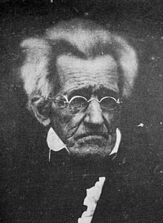
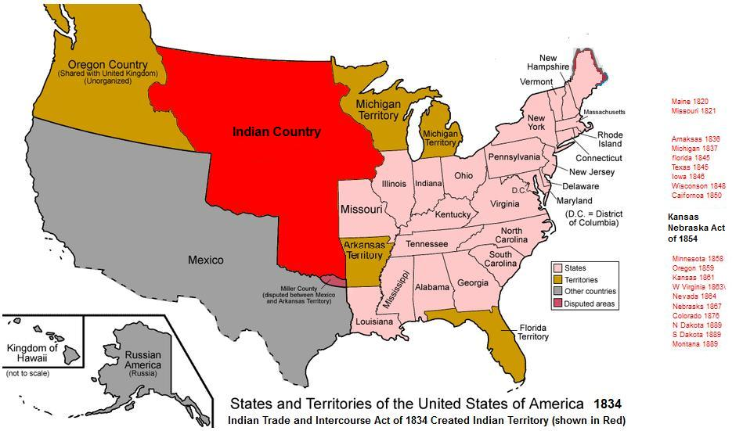
Permanent Indian Frontier - 1834
In 1834, the US government (led by President Andrew Jackson) passed the Indian Trade and Intercourse Act
This act established a ‘permanent’ Indian Frontier, which created a line between Indian land and the rest of America.
Indian Territory was all land west of the Mississippi River.
All white people were banned from living on their land, or selling them weapons.
All along the border, US army forts would protect it.

Slide 6
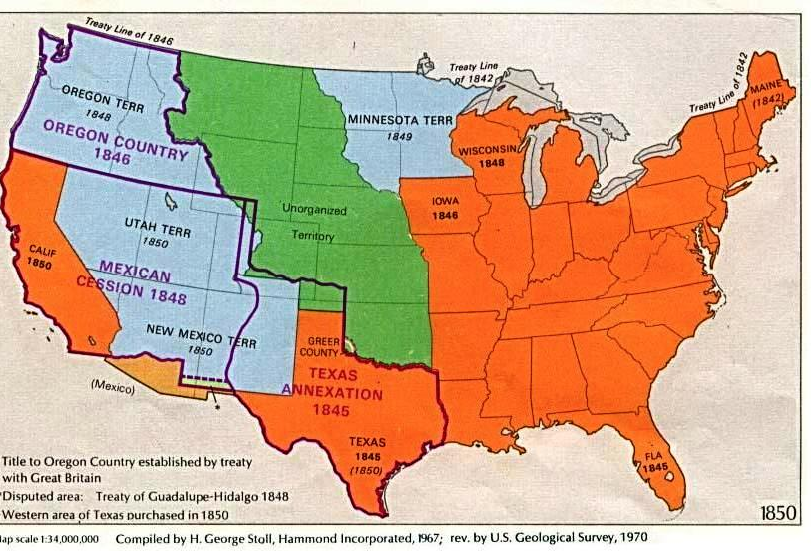
America gaining land
American gained a lot of new land during this period e.g. Texas was taken from Mexico in 1848.
People began to travel on the Oregon trail, through Indian Territory, to live on this new land.
Gold discovered in 1849, drew thousands out west. They travelled through Indian Territory to reach California using Oregon Trail.
Indians begin to become very annoyed that lots of people are travelling through their land.

Slide 7
Solution 1: Indian Appropriations Act - 1851
Due to America gaining lots of new territory, there was a big demand from whites to settle on Indian land e.g. 124,000 Indians lived in Mexico. The new President, Millard Fillmore was largely against Indians and called them “an annoyance”
The Indian Appropriations Act allowed government money to pay for moving Plains Indians onto reservations.
Reservations were areas of land ‘reserved’ for American Indians. They were controlled and managed by the US government.
On reservations, they were encouraged to live like ‘whites’ by farming rather then hunting the buffalo.

Slide 8
Solution 2 - Fort Laramie Treaty (17th September 1851)
Set up a boundary for Indian land and promised not to take it from them.
Forced the Indians to allow safe passage for white settlers on the Oregon trail.
Allowed roads and forts to be built across this Indian land.
Indians would be paid $50,000 per year for 50 years, as well as food.
Railroad companies would be allowed in to scout the land begin plans for a railway.

Slide 9
Fort Laramie Treaty – Consequences
Indians became more dependent on the US government/money.
It was the first step towards reservations, because it set out territory for individual tribes, rather than allow nomadic movement
More people began to travel west because it would be safer without Indian attacks.

Slide 10
So, let’s recap that…
Permanent Indian Frontier
1834
1851
1834-1850
Two solutions:
Indian Appropriations Act
Fort Laramie Treaty
America gains lots of land, e.g. Texas, Oregon
Gold is discovered in California
More white people begin to travel through Indian land.
Indians annoyed about this.

Slide 11
One last time…
Permanent Indian Frontier
1834
1851
1834-1850
Two solutions:
Indian Appropriations Act
Fort Laramie Treaty
America gains lots of land, e.g. Texas, Oregon
Gold is discovered in California
More white people begin to travel through Indian land.
Indians annoyed about this.

Slide 12
And one for good luck…
Permanent Indian Frontier
1834
1851
1834-1850
Two solutions:
Indian Appropriations Act
Fort Laramie Treaty
America gains lots of land, e.g. Texas, Oregon
Gold is discovered in California
More white people begin to travel through Indian land.
Indians annoyed about this.

Slide 13
1. Cut out 4 medium sized cards
2. On one side of them, write the following:
Permanent Indian Frontier (1834)
US gaining land, threatening Indian life. (1834-1850)
Indian Appropriations Act (1851)
Fort Laramie Treaty (1851)
3. On the other side, write the following:
4 – 5 sentences about what this was, including the consequence.
4. Lastly, spend some time reading through them – highlighting key words, phrases and names.
5. Take them home, memorise them as you will be tested on this in a few weeks time.

