Slide 1
How was Anglo-Saxon England organised in the 11th Century?
In this lesson, we will:
Describe how the hierarchy worked in Anglo-Saxon England.
Assess to what extent King Edward of England was a weak monarch
Your Name
GCSE History
Option B1: Anglo‐Saxon & Norman England c1060‐ 66
Mr Johnston
Starter: Please fill in the front of your history book. Glue in any handouts your teacher has given you.

Slide 2
Paper | Topic
Paper 2.1 British Depth Study 50 minutes | Anglo Saxon and Norman England, 1060 – 88 | Year 10
Paper 1: Thematic Study 1 hour 15 minutes | Medicine in Britain, ,1250 – present British sector of the Western Front 1914-19: injuries, treatments and the trenches.
Paper 3: Modern Depth Study 1 hour, 20 minutes | Weimar and Nazi Germany, 1918 – 1939 | Year 11
Paper 2.2: Period Study 50 minutes | The American West, 1835 - 1895
Revision

Slide 3
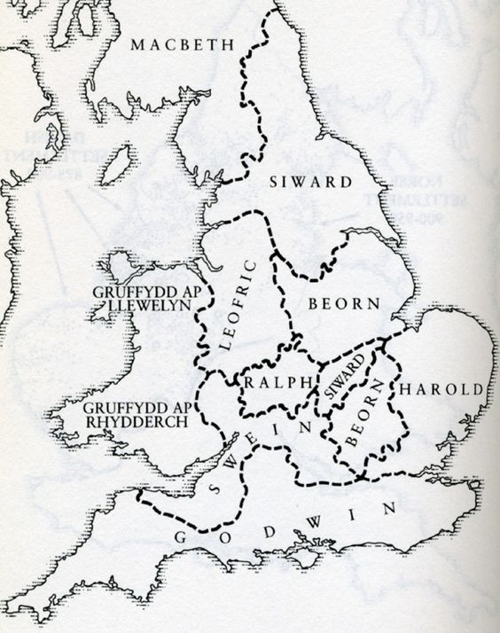
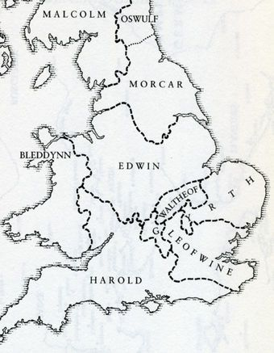
Scotland was a separate Kingdom, ruled by King Macbeth since 1040.
Wales was smaller, separate kingdoms that by the 1050s had been unified by Llewely ap Gruffydd (except in the south)
By the reign of Edward the Confessor, England was one single Kingdom divided into separate Earldoms.
Each earldom was ruled by an Earl who pledged allegiance to the king in return for land and power.
The largest were Northumbria, Mercia, Wessex and East Anglia.

Slide 4
Edward was the seventh son of King Ethelred II
When he was 10, his family were forced to go into exile by King Sweyn Forkbeard of Denmark.
By 1017, he was the only surviving heir of King Ethered II (the House of Wessex)
He spent the years 1013 to 1042 growing up in exile in Normandy, France.
Whilst in exile, he became extremely close with Duke Robert I of Normandy
When King Harthacnut of England died in 1042 without an heir, Edward was chosen by the Witan.
On 3rd April 1043, Edward was crowned King of England in Winchester Cathedral thus ending Viking rule of England.

Slide 5
Defend the country
Pass laws/ensure laws were obeyed
Defend the Church and appoint church leaders
Manage his earls and other nobles

Slide 6
Household
Made up of king’s family and his housecarls (soldiers)
Servants also made up the Royal Household
Witan
Group of wisemen
Met whenever monarch decided
Made up of earls, bishops and Archbishops
King appointed people to Witan
Witan had a role in appointing and crowning a new monarch
Administrators
Small group of men (usually from within the Church)
They wrote all the king’s laws and sent them out to the earldoms (writs)
Travelled with the king wherever he went in England.
The King’s Royal Court

Slide 7
Anglo-Saxon Hierarchy
King
His role was to protect his people from attack and give them laws to maintain safety and security.
Every boy at the age of 12 swore an oath of loyalty to their king.
Made new laws, controlled circulation of pennies, granted land to his followers and could take land away (could raise people to title of thegn), had the power to raise an army.
Would give each earldom to an earl. Relied on support of earls, without them they were powerless.
In return, an Earl would be faithful, pass on tax, implement the king’s laws and raise an army when needed. Could challenge a king
Earl
Most important lords in the kingdom, who controlled a large area of land (earldom) in the name of the king.
They had many powers that a king had such as collecting taxes (they took 1/3 of this and had to ensure their earldom was well defended), overseeing legal matters and raising an army of soldiers for the king.
They had elite bodyguards called housecarls who were highly trained warriors.
In return, a thegn would provide men for the fyrd (army), pass on taxes, fight in the king’s army, and run the courts.
Thegn
Would divide up their earldom into estates and grant them to thegns.
They held large estates of land for their lord (a thegn)
4,000 of them in England by 1060
They lived in a large house with a tower and church.
Would provide food and taxes for thegn. Would serve in the fyrd for 40 days per year.
Peasant
Would give a peasant farm land, as well as protection
Farmed land given to them by a thegn
They took some of their produce to live off and the rest was given to their lord, along with taxes.
Could be evicted from land if they did not carry out work.
Usually tied to land, but some could move from farm to farm (ceorls)

Slide 8
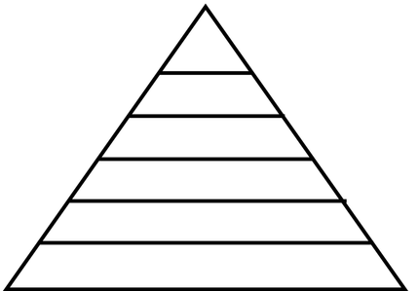
On your blank diagram of the Saxon hierarchy:
Identify where each of the following would be:
Earl
Thane
Ceorl
King
Peasant
2. For each, explain their role and powers in Anglo-Saxon England.
A deeper understanding:
In this system – who really holds the most power and influence? Explain your answer.

Slide 9
Use the resource sheet on King Edward’s kingdom to complete the following:
Draw a table showing both examples of Edward being an effective king, and evidence of him being a weak king.
On a blank map of England, annotate the following:
All land held by Earls Siward, Leofric, Godwin, Harold, Ralph and Beorn.
The area known as the ‘Danelaw’
The area controlled by Godwin’s family
Target 8 – 6
To what extent did King Edward of England sacrifice some of his power to ensure Godwin’s loyalty?
Target 5 - 4
‘Anglo-Saxon monarchs like Edward did not have as much as power as they thought’ Do you agree with this?
Target 3 - 2
Based on todays lesson – would you say that King Edward of England was a powerful monarch?

Slide 10
Homework
In your yellow homework book, complete the following:
Explain the difference between central and local government.
Draw a small diagram to show how local government was organised, using the following key terms:
Earl
Hundred
Shire
Shire-reeve (or sheriff)
3. Define the following key words:
Blood feud
Wergild
Hue & Cry
4. Draw a mindmap to show the different types of trials that existed in the Anglo-Saxon legal system

