Slide 1
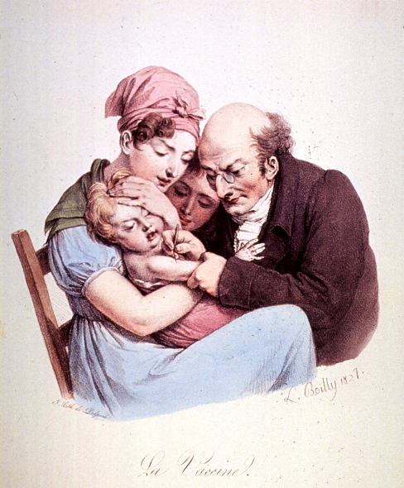
How was the first vaccine developed in the 18th Century?
In this lesson, we will:
Describe how Edward Jenner created the smallpox vaccine.
Explain why some opposed Jenner’s vaccine in the 18th and 19th Centuries.
Starter: Can you explain one similarity in ideas about the cause of the plague in the 1300s and 1600s? [4 marks]
Tip: Remember to give example from both time periods to show similarity!

Slide 2
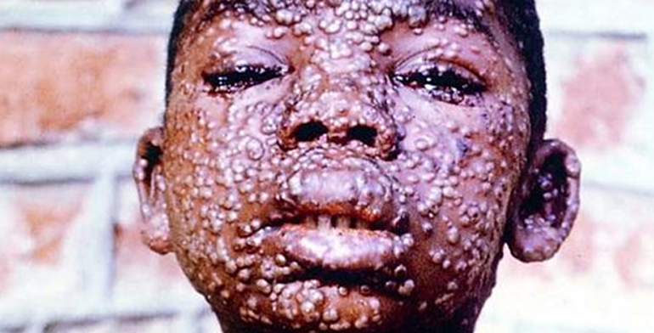
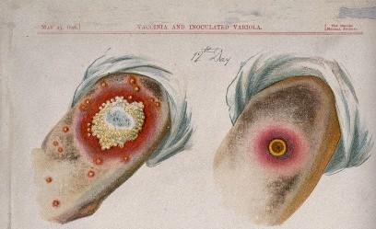
How did smallpox effect 18th century Britain?
By 1750, smallpox was at its height. Between 1760 and 1770, 25,000 people died in London. In Glasgow, 6,000 people died.
No one knew the cause, but did know how to avoid it.
People noticed that if someone caught a mild form of smallpox, then they could not catch it again.
As a result, the process of ‘variolation’ (inoculation) began. The middle classes would bleed, purge and starve their children and then expose them to another child with smallpox.
Royal Society proved in 1728 that inoculation had a 1 in 50 chance of killing the patient

Slide 3
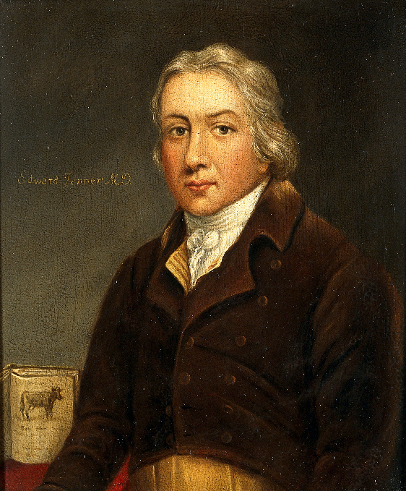
Who was Edward Jenner?
Edward Jenner was a doctor working in Gloucestershire in the late 1700s. He had trained down in London to become a surgeon and then moved back to his home town to be a GP.
He was determined to find a better way of fighting smallpox than inoculation.
He regularly treated dairy maids for cowpox and noticed that they seemed to not catch smallpox. He believed the cowpox made them immune.
In 1796 he tested his theory on James Phipps and published test in 1798.
He named the technique ‘vaccination’ after the Latin word for cow ‘vacca’

Slide 4
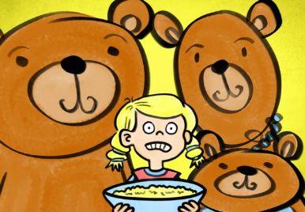
Checkpoint One: Can you describe how Edward Jenner developed a vaccine?
Rhyme Time! You ill be shown 2 statements, the answers to which rhyme. You must write down the two answers! It may be a picture. Below is an example!
Disease responsible for 25,000 deaths in London in ten years.
Answer:
Smallpox
Goldie Locks

Slide 5
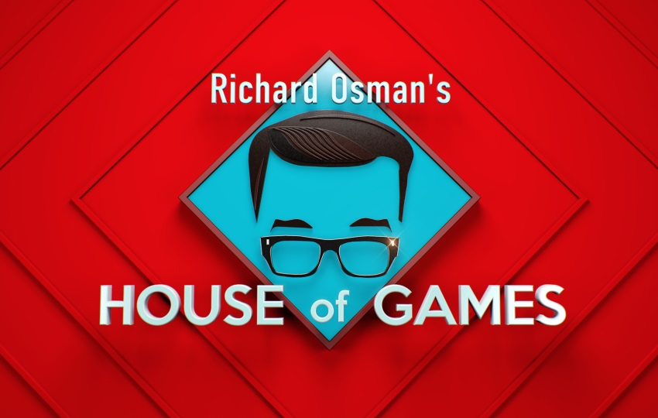
Earth tremor
Edward Jenner
A relatively small or short-lived movement on the earth’s surface, similar to an earthquake.
18th Century English GP working in Gloucestershire.

Slide 6
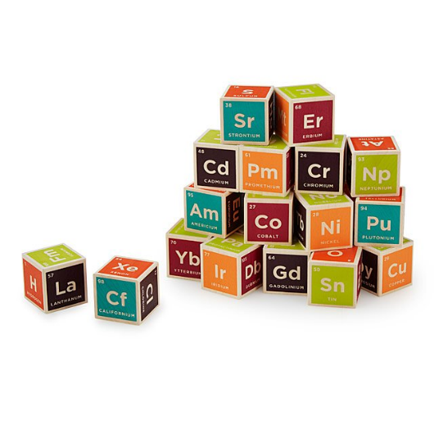
A viral disease of cows' udders
Smallpox
Building blocks

Slide 7
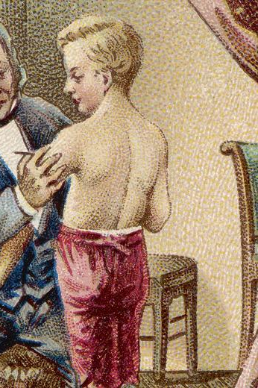
an obscuring of the light from one celestial body by the passage of another between it and the observer or between it and its source of illumination.
Eclipse (solar or lunar)
James Phipps

Slide 8
Location of the tower that King Kong climbed up. Filming location for Ghostbusters, Home Alone, Doctor Strange, Fantastic Beasts and Spider-man: Homecoming
the ability of an organism to resist a particular infection or toxin by the action of specific antibodies or sensitized white blood cells.
Immunity
New York City

Slide 9
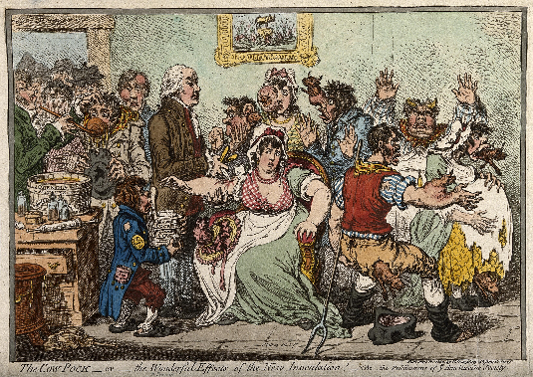
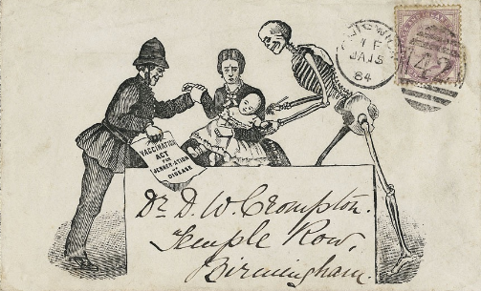
Who opposed Jenner?
Cowpox did not occur widely and doctors who wanted to test the new process had to obtain cowpox matter from Edward Jenner. This resulted in cowpox bacteria becoming contaminated and not working, so some rejected it.
Men who had made a lot of money inoculating (called variolators) were against it as they would lose money.
Many were scared of being injected with cow bacteria (see cartoon to right)
The Royal Society were against it because Jenner did not support his work with scientific research into how it worked.

Slide 10
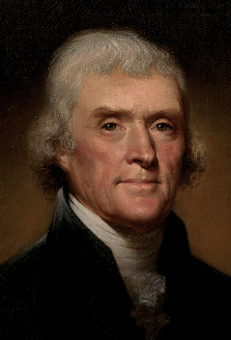
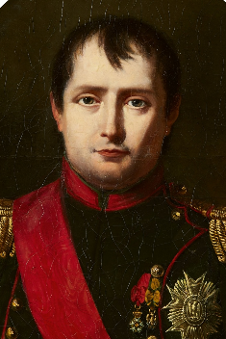
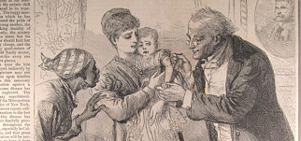
Who supported Jenner?
Edward Jenner spent much of the rest of his life trying to promote the smallpox vaccine.
He had a lot of support from some famous people in the word like Thomas Jefferson (one of the founding father of the USA) and Napoleon Bonaparte.
The British government supported Jenner, and gave him over £30,000 between 1802 and 1807.
In 1840, they agreed to use tax to pay for compulsory vaccines for all children. In 1872, the UK began to enforce compulsory smallpox vaccinations for all people.
The Royal Family supported Jenner – in 1803 they paid to set up the Royal Jennerian Society which vaccinated 12,000 people in two years.

Slide 11
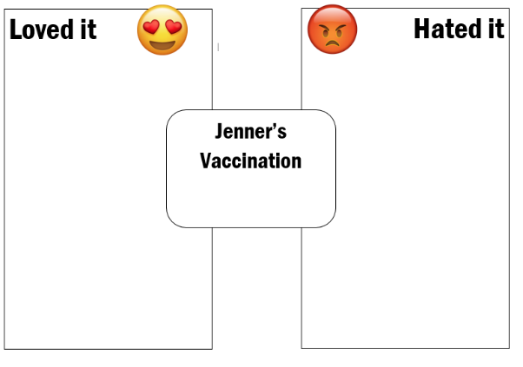
Checkpoint Two: Can you explain why some opposed Jenner’s vaccine?
Below are a list of people who either loved or hated Jenner’s vaccine. Categorise them on a neatly drawn diagram
The Church
Inoculators
The Royal Society
The British Government
Thomas Jefferson
Napoleon Bonaparte
For each, give examples to show their approval or opposition.
Stretch challenge:
For each, suggest one reason why they would have felt they way they did.

