Slide 1
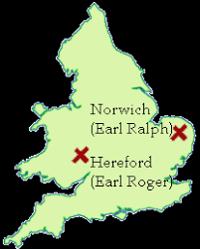
In what ways was Kristallnacht a turning point in Nazi Germany?
In this lesson, we will:
Explain who could be held responsible for the events of Kristallnacht.
Describe the consequences of Kristallnacht.
STARTER: Describe two features of the 1075 Revolt of the Earls (4 marks)

Slide 2
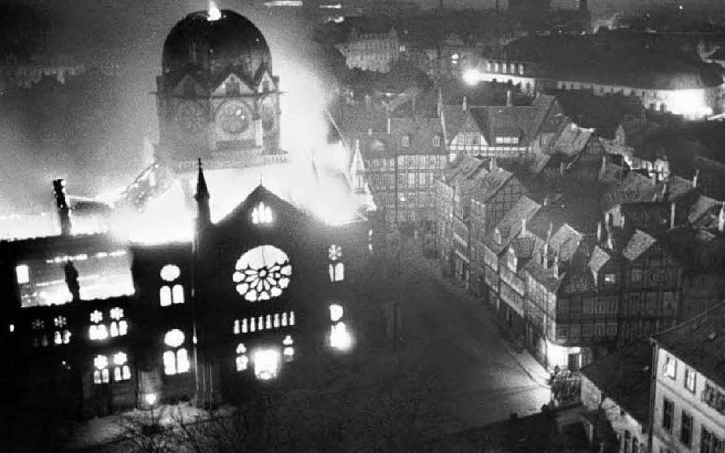
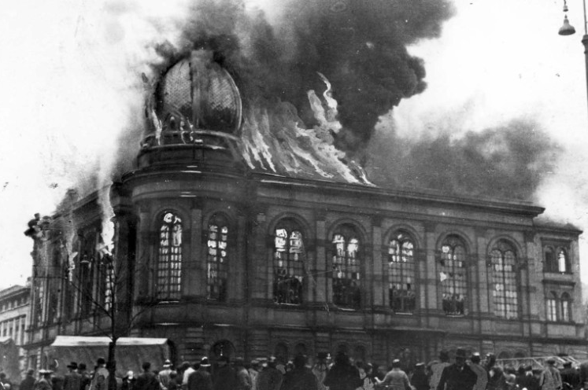
On 8th November 1938, the SA, SS and Gestapo began to attack local synagogues and Jewish homes in Hannover
On 9th November Nazi leaders across Germany began to attack Jews on the streets and burn down their property.
Some gangs were in Nazi uniforms, others were plainly clothed.
100 Jews were killed, 814 shops destroyed, 171 homes burned and 191 synagogues attacked.
Between 8th and 12th November 20,000 Jews were arrested and sent to concentration camps.

Slide 3
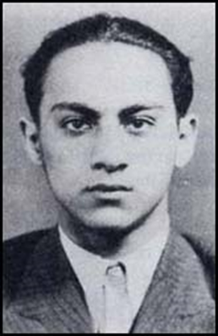
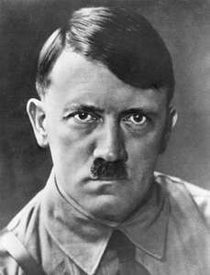
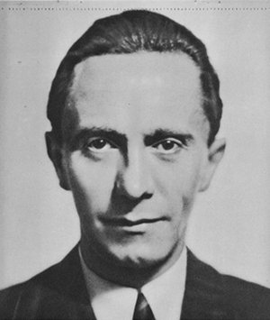
Learning Task One
As a class, read p.136
For each picture:
Identify who they are
Explain how they caused Kristallnacht
Topical thought
How could Kristallnacht be considered a turning point in Nazi Germany?

Slide 5
Herschel Grynszpan
17 year old Polish Jew.
Was so annoyed with how his parents were being treated under Nazi laws that he shot and killed a Nazi diplomat in Paris.
Adolf Hitler
Fuhrer of Germany and leader of the NSDAP.
His anti-Semitic laws between 1933 and 1938 are what infuriated Grynzpan to shoot von Rath.
Joseph Goebbels
Minister for Propaganda
Used the shooting to stir up trouble against German Jews.
Ordered papers to print stories condemning Jews for the attack.
Ordered SS, SA and Gestapo to begin attacking Jewish property in Hannover.
Convinced Hitler to turn it into a national pogrom.

Slide 6
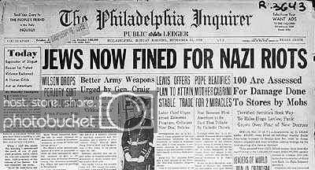
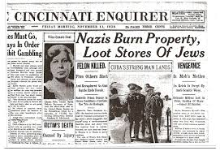
In exile, Wilhelm II claimed “For the first time, I am ashamed to be German.”
Goring was furious that so much property had been destroyed.
The Jewish communities of Germany were forced to pay a fine of 1 billion marks ($5.5 billion).
20% of all Jewish assets in Germany were claimed by the state.
Between 1938 and 1939 more than 115,000 Jews emigrated Germany to America, Palestine and China.

Slide 7
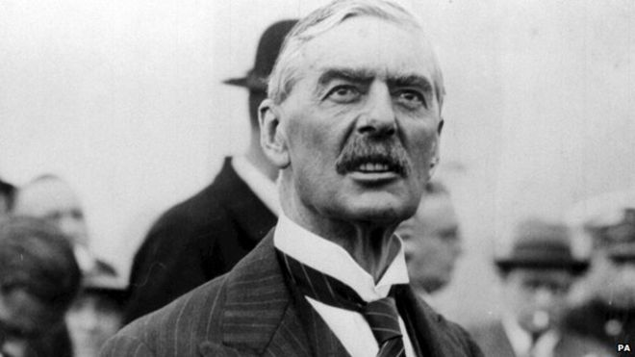
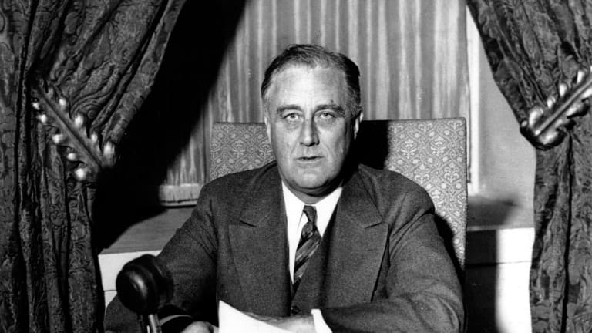
British Prime Minister Neville Chamberlain refused to condemn the pogrom, but expressed “deep sympathy” for those affected.
Between 1938 and 1939 his government organised the evacuation of 10,000 Jewish children from Germany to Britain.
US President Franklin D. Roosevelt openly criticised the attack. He withdrew the US Ambassador from Berlin.
US government voted down a bill to accept Jewish refugees.

Slide 8
Learning Task One
For each figure below, explain what it refers to:
1 billion
20%
115,000
10,000

