Slide 1
How were minority groups treated in Nazi Germany?
‘Life in Germany’ by Steve Waugh (2009)
From 1936 to 1939 wages increased, but this was due to a longer working day rather than an increase in hourly wage rates. In addition, the cost of living rose in the 1930s, which meant that real wages actually fell.
Starter: What is the difference between interpretations 1 and 2 on the impact of Nazi policies on working conditions?
‘Nationalism, dictatorship and democracy in 20th Century Europe’ by Hall, Shuter, Brown and Williams (2015)
For Germans who conformed to Nazi expectations, living standards went up. Unemployment dropped. Nazi statistics show that real wages rose…though only if a worker worked overtime.
In this lesson, we will:
Describe the Nazi racial hierarchy and it’s impact on German society.

Slide 2
What is the difference between interpretations 1 and 2 on the impact of Nazi policies on working conditions?
‘Life in Germany’ by Steve Waugh (2009)
From 1936 to 1939 wages increased, but this was due to a longer working day rather than an increase in hourly wage rates. In addition, the cost of living rose in the 1930s, which meant that real wages actually fell.
‘Nationalism, dictatorship and democracy in 20th Century Europe’ by Hall, Shuter, Brown and Williams (2015)
For Germans who conformed to Nazi expectations, living standards went up. Unemployment dropped. Nazi statistics show that real wages rose…though only if a worker worked overtime.

Slide 3
Key word – eugenics (the science of selective breeding)
Encouraged reproduction
Aryan Race
(Herrenvolk)
Untermencschen
(Slavs, homosexual Germans)
Prevented reproduction
(sterilisation)
Lebensunwertes
(Jews, Gypsies, Disabled)

Slide 4
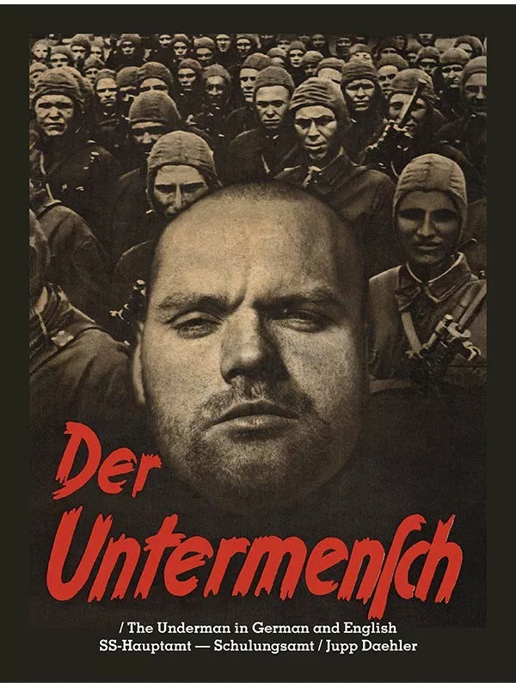
Just as the night rises against the day, the light and dark are in eternal conflict. So too, is the subhuman the greatest enemy of the dominant species on earth, mankind. The subhuman is a biological creature, crafted by nature, which has hands, legs, eyes and mouth, even the semblance of a brain. Nevertheless, this terrible creature is only a partial human being.
Although it has features similar to a human, the subhuman is lower on the spiritual and psychological scale than any animal. Inside of this creature lies wild and unrestrained passions: an incessant need to destroy, filled with the most primitive desires, chaos and coldhearted villainy.
‘Der Untermensch, 1941’

Slide 5
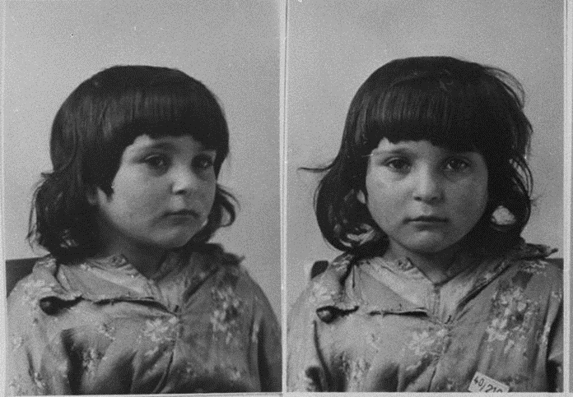

Slide 6
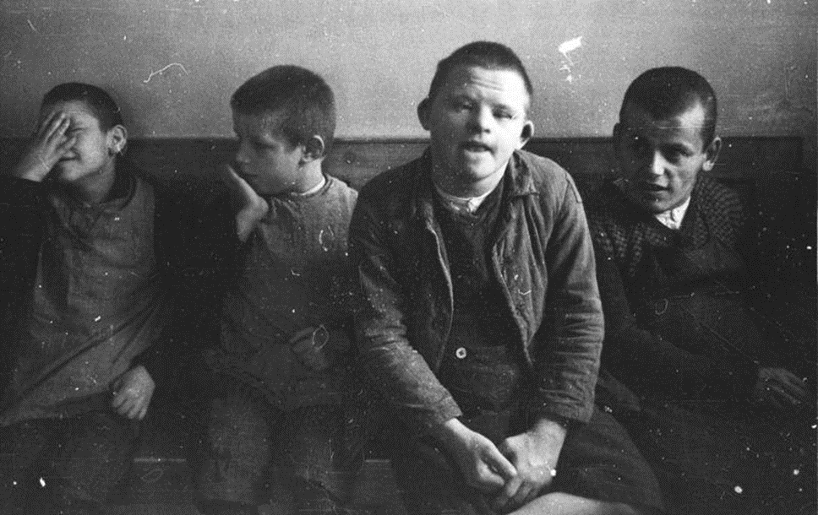

Slide 7
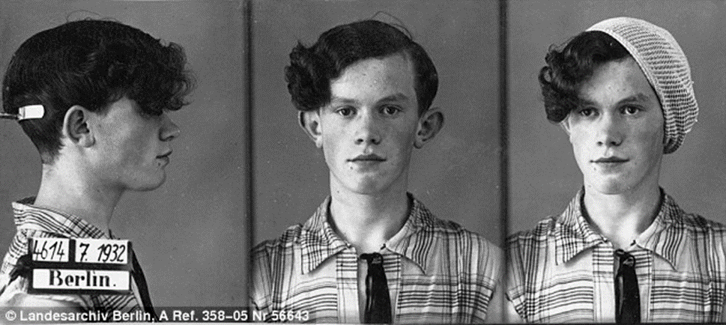

Slide 8
Learning Task One
On your black hierarchy diagram, arrange all key words and minority groups to show Nazi views on race, life and sexuality.
For each level of the hierarchy, explain how they were treated by the Nazi government.

Slide 9
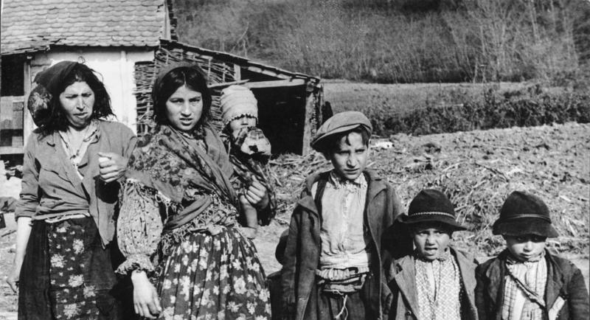
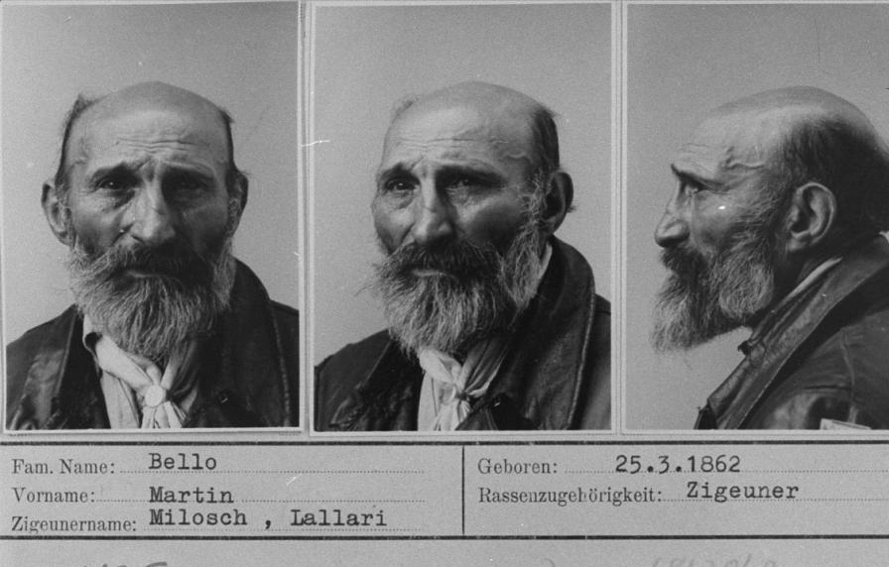
Roma Gypsies
Roughly 26,000 Roma people in Germany.
Believed they did not work had enough.
Believed they posed a threat to German racial purity.
After 1933, they were arrested and sent to concentration camps.
After 1936, special camps were set up just for gypsie prisoners.
After 1938, they were catalogued and tested for racial characteristic. They lost their citizenship.
They were banned from walking in groups and after 1939 were deported from Germany.

Slide 10
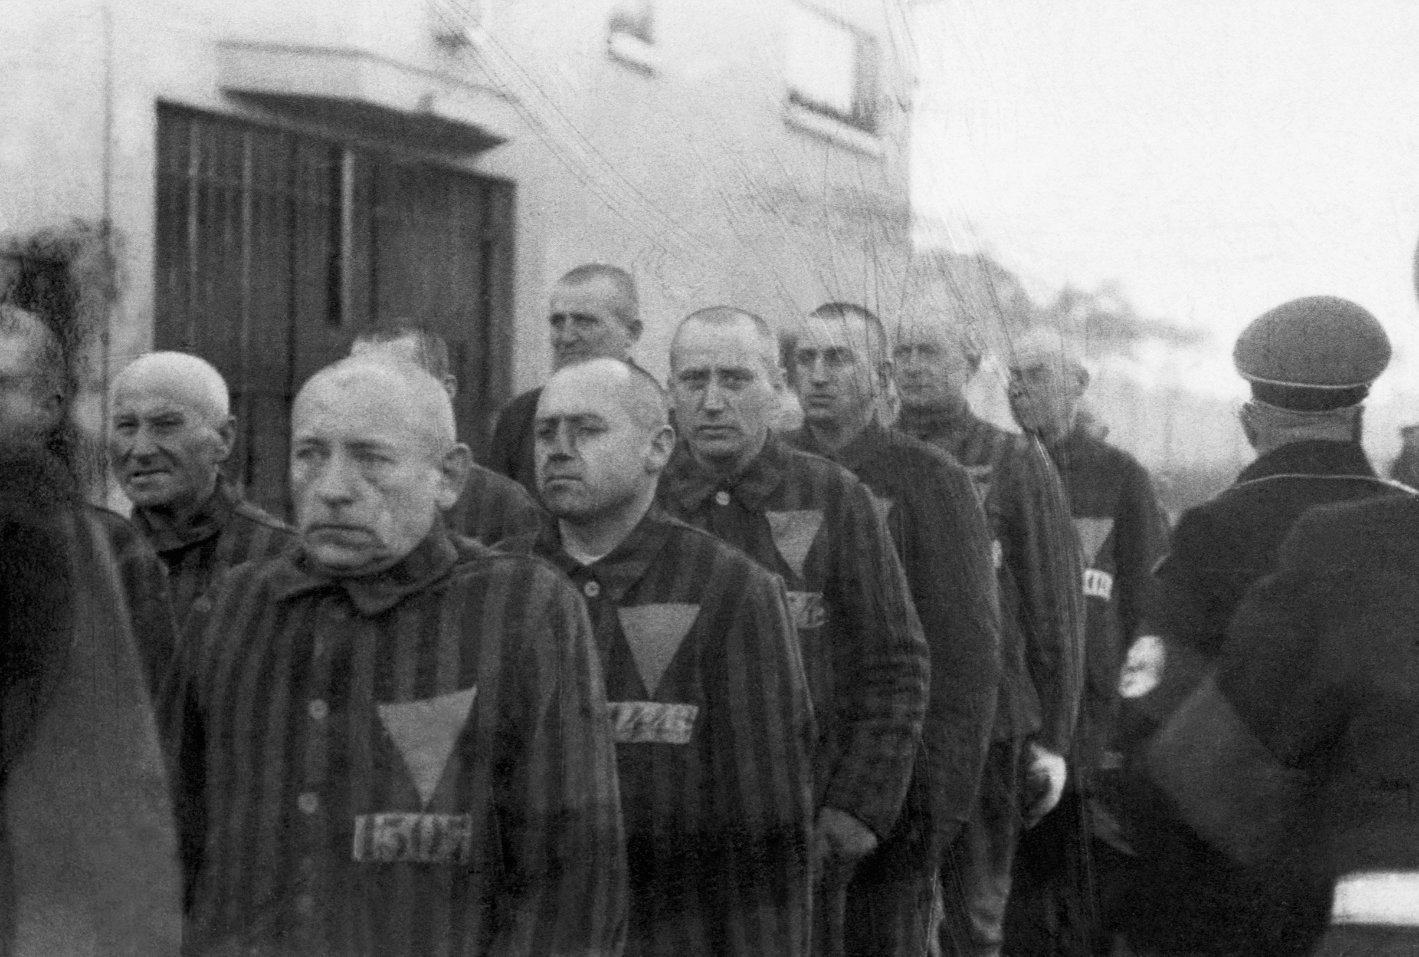
Homosexuals
Believed that homosexuals lowered moral standards
In 1935, the Nazis strengthened the laws against homosexuality.
Arrests increased from 766 in 1934 to 4,000 in 1936 and 8,000 in 1938.
In total, 100,000 gay men were arrested under Nazi rule.
Sent to concentration camps, where they were often worked to death.
Nazi laws also encouraged the voluntary castration of homosexuals.

Slide 11
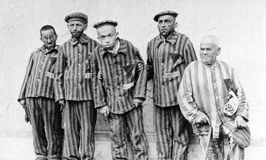
Disabled people
People with disabilities were a burden on society and weakened racial purity
In 1933 a law was passed to compulsory sterilise anyone who was “mentally ill, alcoholic, deformed, epileptic, deaf or blind”
400,000 people were sterilised, using surgical operations, by 1939.
In 1939, the Nazis ordered that babies with severe mental or physical disabilities should be killed by starvation or lethal overdose of drugs. This became known as the T4 Programme
Over 5,000 children with disabilities were killed.

