Slide 1
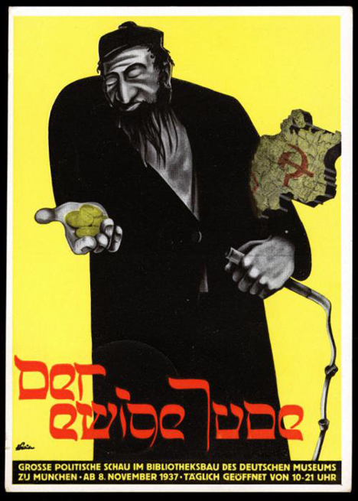
How were Jewish Germans treated under Nazi rule?
In this lesson, we will:
Describe the process of persecution against German Jews in the 1930s.
Starter:
What evidence is there in this cartoon that the Nazis were anti-Semitic?

Slide 2
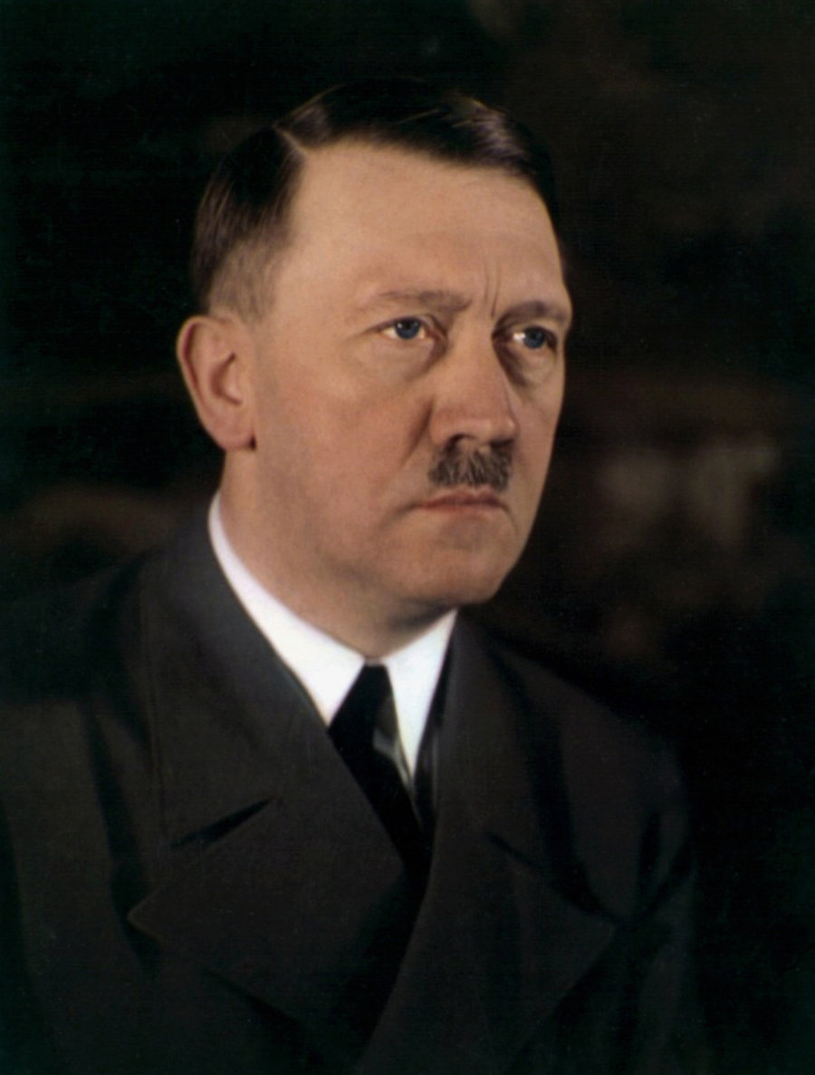
“If I am ever in power, the destruction of the Jews will be my first and most important job. I shall have gallows after gallows erected in Munich. Then the Jews will be hanged one after another, and they will stay hanging until they stink…Exactly the same procedure will be followed in other cities until Germany is cleansed of the last Jew”
- Conversation to Josef Hell, 1922

Slide 3
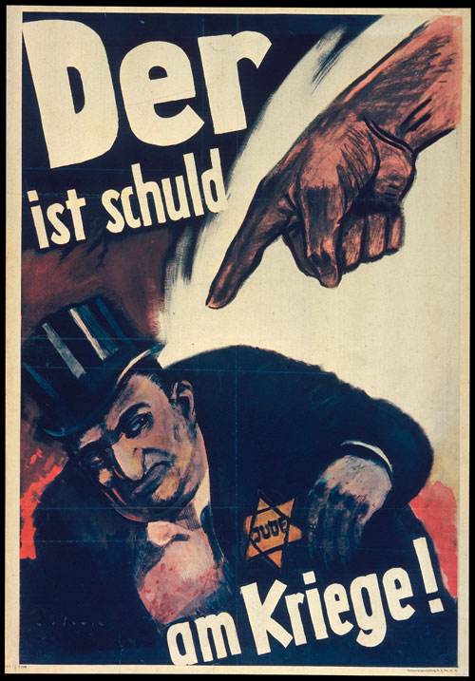
Why were the Jews disliked?
Germany had been unified into one country in 1871 – to achieve this nationalism attacked Germany’s ‘enemies’ including the Jews.
Most of Germany was Christian (Catholic or Protestant), Jews were seen as different.
In Christianity, Jews were blamed for the Crucifixion of Christ.
Jews often got involved in money lending and finance, so there was a lot of jealously.
Historically, Jews were the scapegoat of Europe (e.g. during outbreaks of plague)

Slide 4
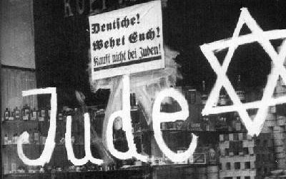
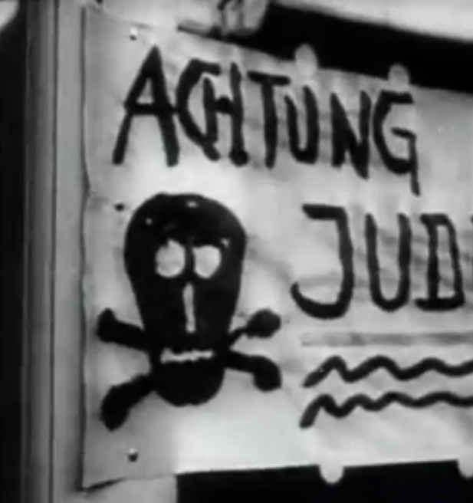
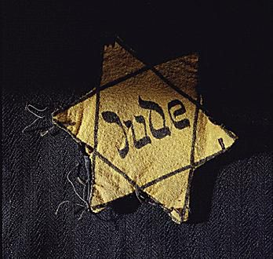
Phase One: Persecution
German was flooded with anti-Semitic propaganda after 1933. Posters, textbooks and signs called them “vermin” and “filth”.
It began with slowly excluding Jews from positions of power. E.g. Between 1933 and 1935, Jews were banned from jobs in government and teaching, owning land or serving in the army.
Some councils also began to follow this by banning them from parks, swimming pools and separate benches.
In 1933 Hitler announced a boycott of Jewish businesses, doctors and lawyers. SA painted Jewish stars or JUDE on all businesses and would stand outside stopping people from going inside.
In 1935, the Nuremberg Laws were passed. These stopped all Jews from being German citizens (so they couldn’t vote, or have a passport) and made them wear a yellow star. They also prevented Jews from marrying or having sex with Germans..

Slide 5
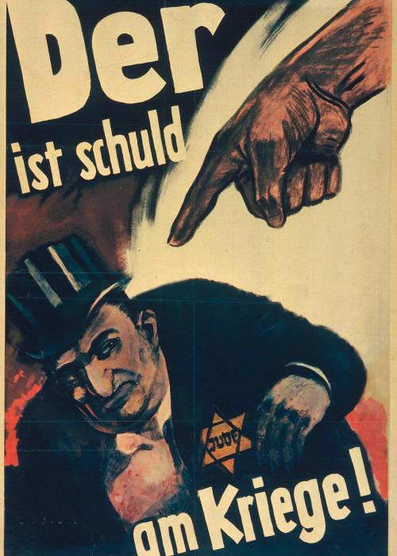
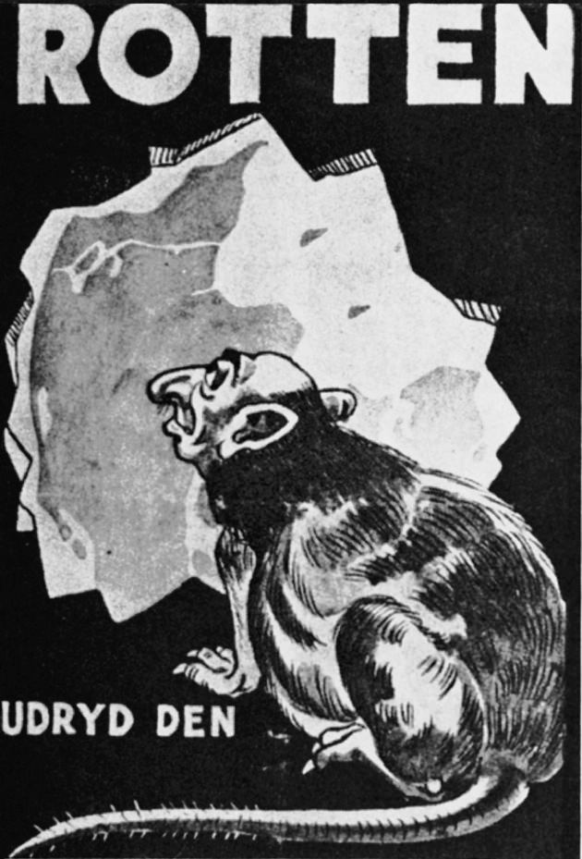

Slide 6
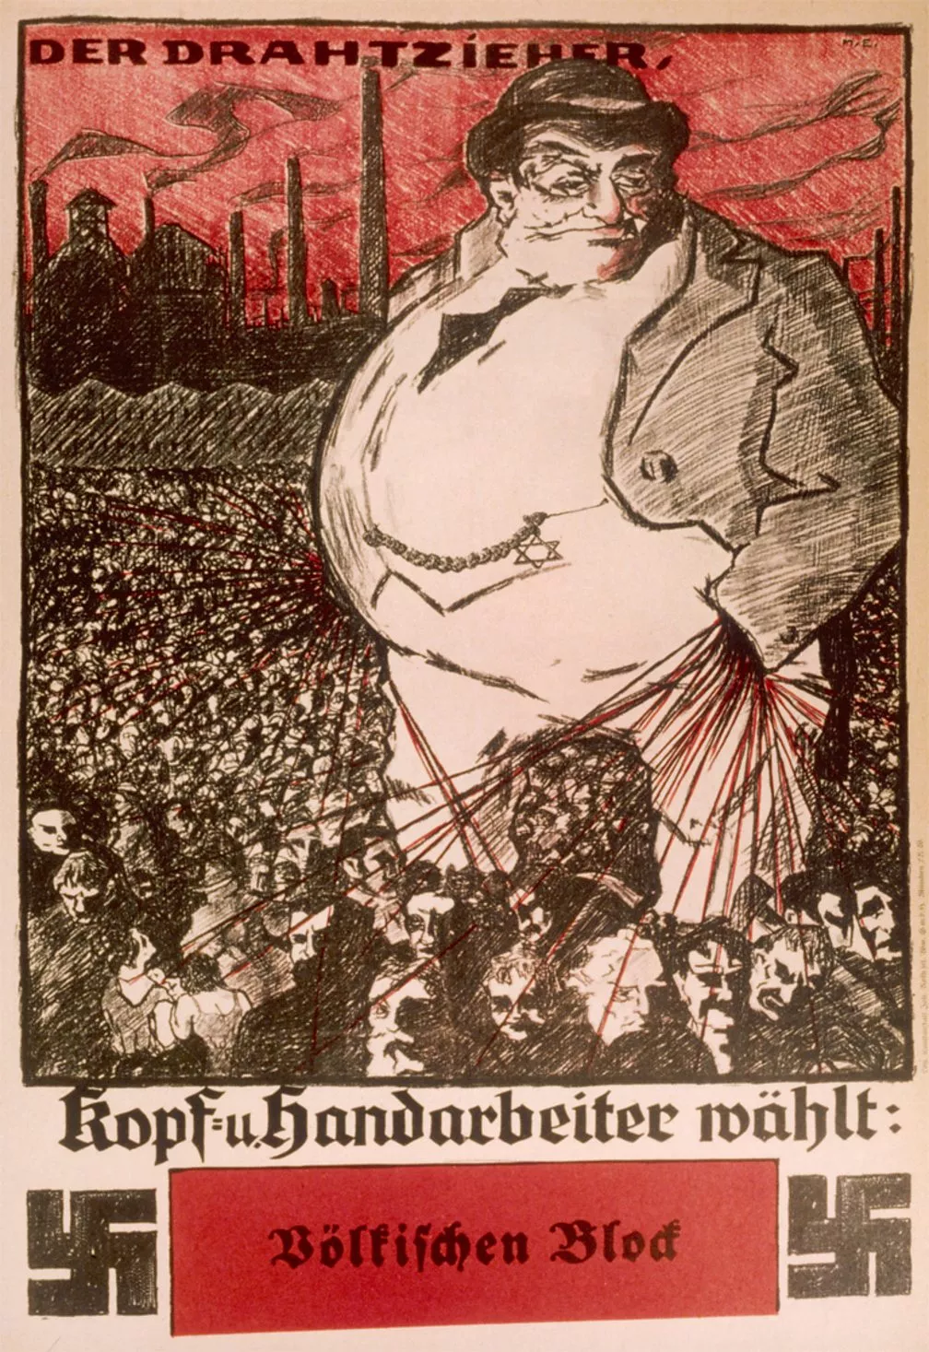
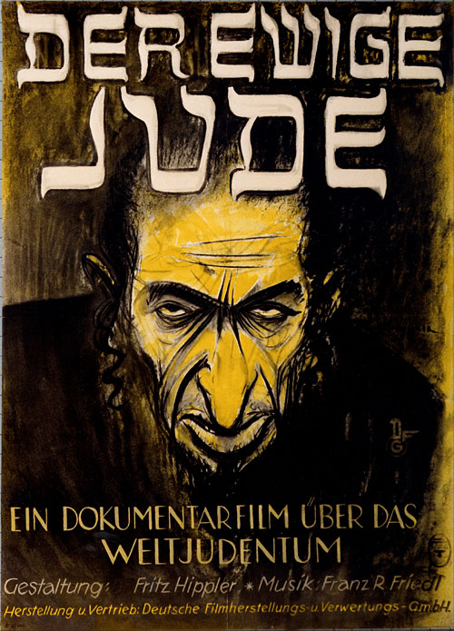

Slide 7
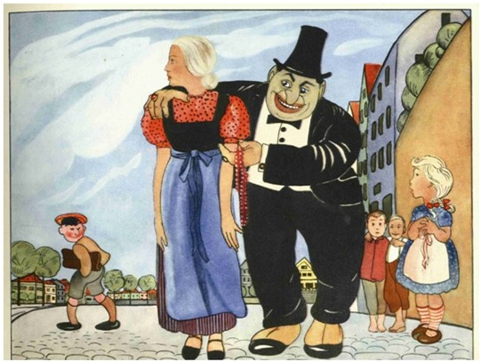

Slide 8
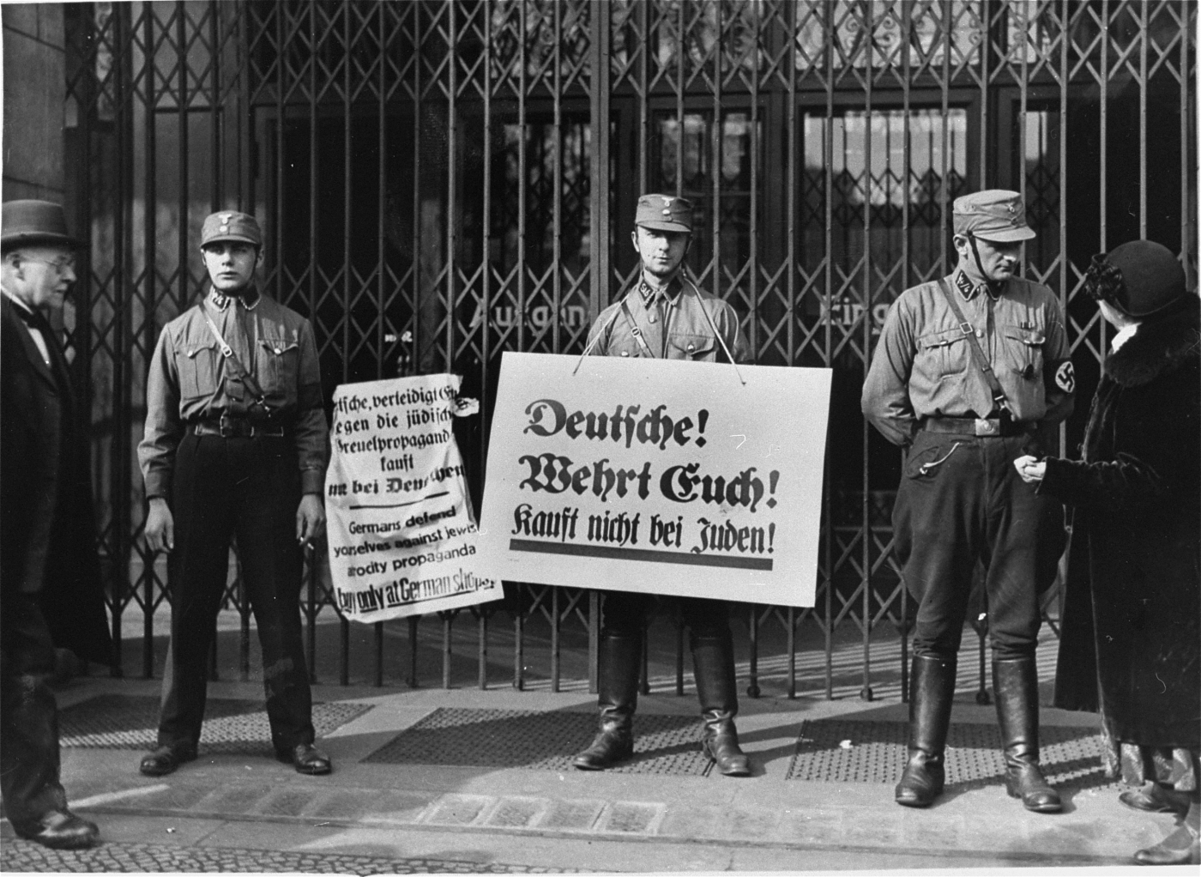

Slide 9
Learning Task One
All targets
As a class, read through pp.134-135
As we read, highlight key words, dates and examples.
Use this information to create a timeline on Nazi persecution against the Jews.
Topical thought:
By passing all of these laws – what were the Nazis trying to achieve? What was their desired outcome?

Slide 10
March 1933
Boycott of Jewish businesses, doctors and lawyers.
April 1933
Jews banned from government jobs. Civil servants and teachers sacked.
September 1933
Jews banned from inheriting land.

Slide 11
1934
Some local councils banned Jews from public places (parks and pools).
May 1935
Jews banned from serving the armed forces.
September 1935
Nuremberg Laws introduced. Jews banned from marrying Germans, also lost citizenship

Slide 12
March 1938
All Jews had to register their belongings with the government.
May 1938
Jews ordered to carry identity cards to prove they were Jewish.

