Slide 1
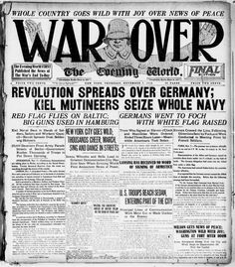
How well organised was the Weimar Constitution?
In this lesson, we will:
Describe how the Weimar Constitution was organised
Assess its strengths and weaknesses
Starter: What prevented Germany from plunging itself into anarchy in 1918?

Slide 2
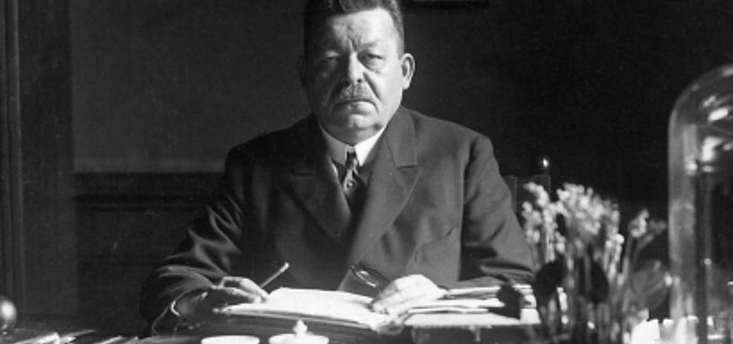
In November 1918, the ‘Council of Representatives’ took power of Germany.
Ebert announced there would be elections to elect a new government.
On 19th January 1919, the first democratic elections were held.
40% of the seats went to moderate parties (SPD and Centre Party)
In February 1919, the new government met up in a small town called Weimar.
On 31st July, the new government signed a new constitution.
Frederick Ebert was elected President, Phillip Schiedemann was elected Chancellor.

Slide 3
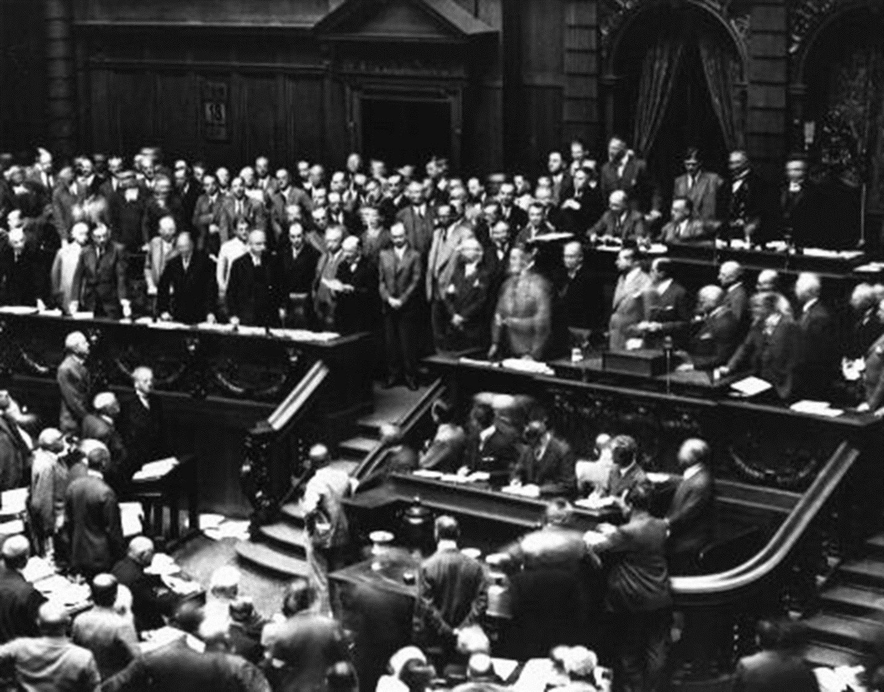

Slide 4
How did the Weimar Constitution work?

Slide 5
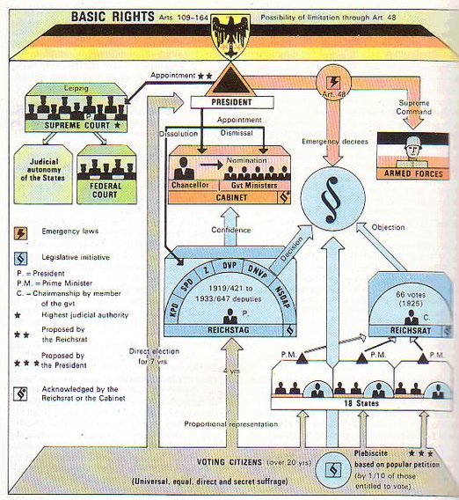
Learning Task One
Create a simplified diagram to show how the Weimar Republic was organised.
It should contain the following key words:
President
Chancellor
Cabinet
Reichstag
Reichsrat
Electorate
Make sure you include what power each had, and the role it played in running the country.

Slide 6
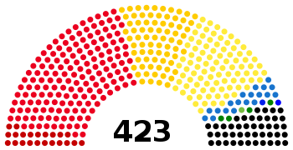
Was the Weimar government doomed from the start?
German elections would use a ‘proportional representation’ voting system.
This meant that many small parties managed to get seats in the Reichstag (in the 1920s there were over 29 of them)
No single party could ever get a majority, so coalitions were often formed.
Between 1919 and 1923, 9 coalition governments had been formed and collapsed.
Due to so many small, radical parties in the Reichstag – it often became paralysed.
The President often had to use Article 48.

Slide 7
Learning Task Two
‘Doomed from the start’
Do you agree with this statement about the Weimar Consitution?
Choose either a thumbs up or thumbs down to explain your opinion.

