Slide 1
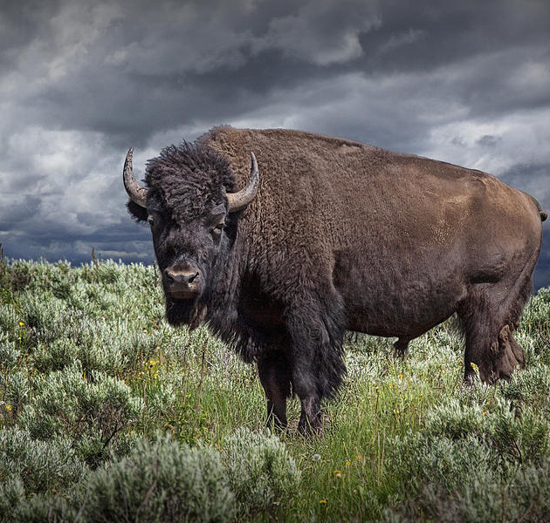
How was Plains Indian culture destroyed in late 19th Century?
In this lesson, we will:
Explain the impact of the mass killing of buffalo on the Great Plains
Describe other ways that Indian culture was destroyed.
Starter: Why was the buffalo so important to the Plains Indians during the 19th Century?

Slide 2
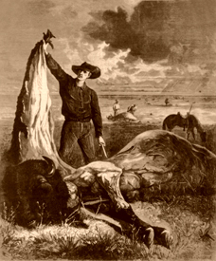
Why kill the buffalo on the Great Plains?
After 1871, buffalo skin could be turned into leather to make belts. Huge profits could be made from this.
Once the skin was removed, the rest of the buffalo was left to rot. In 1872, 1.5 million were killed for skin.
Railroad workers would kill them for food during construction, and to clear the tracks.
Bones were used for china and sugar – they sold for $8.00
An estimated 31 million buffalo were killed between the years of 1868 and 1881 with only 500 buffalo left by the year of 1885.

Slide 3
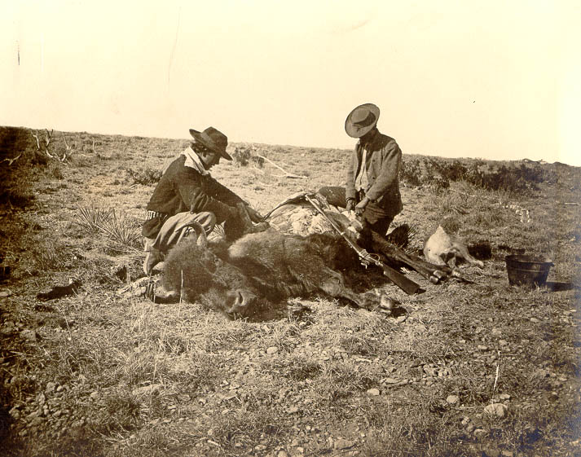

Slide 4
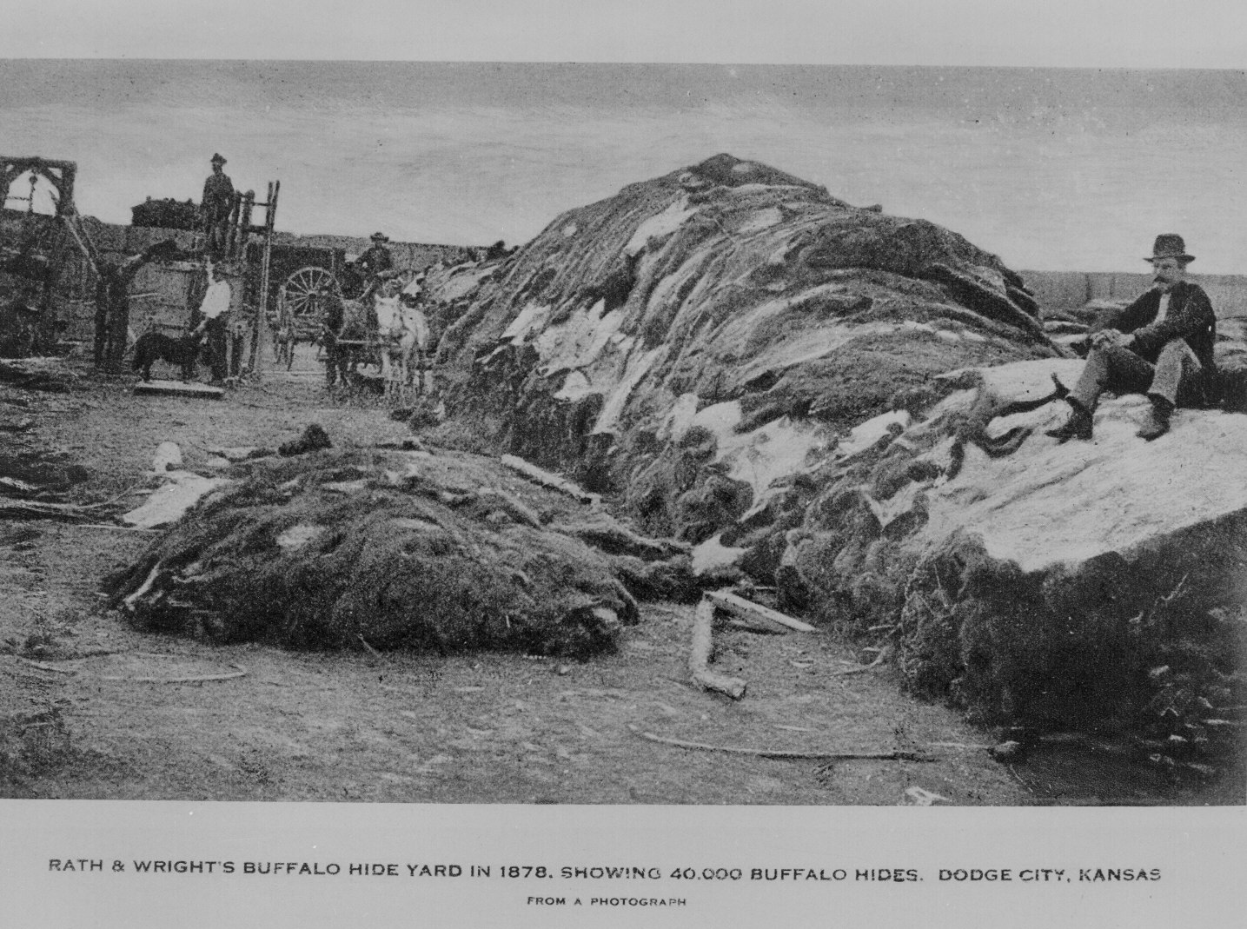

Slide 5
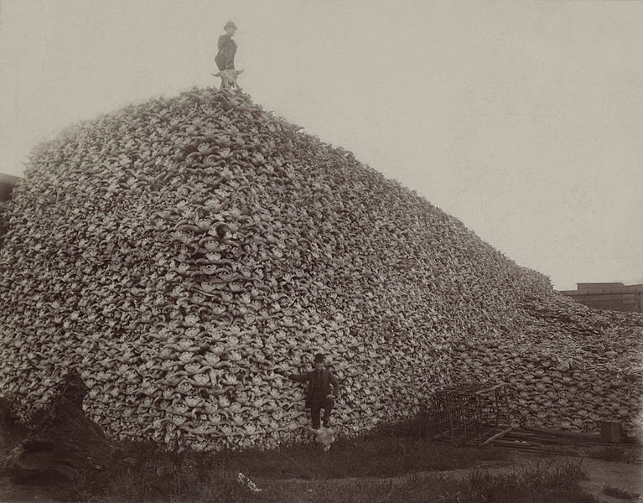

Slide 6
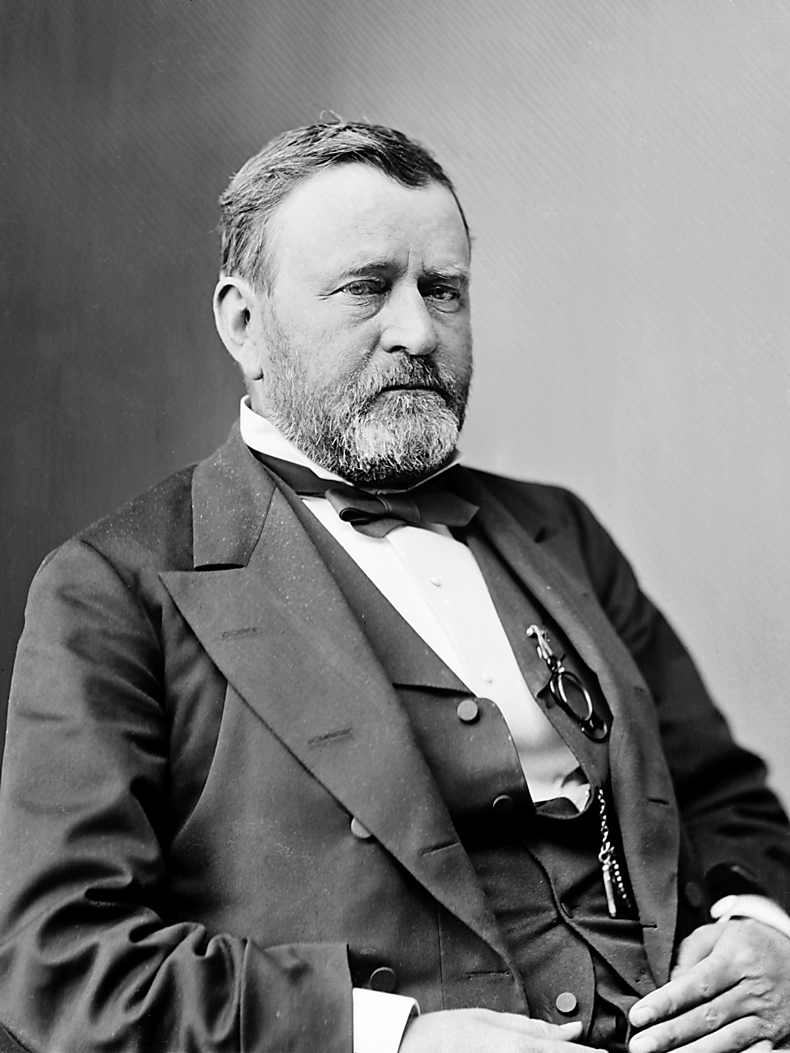
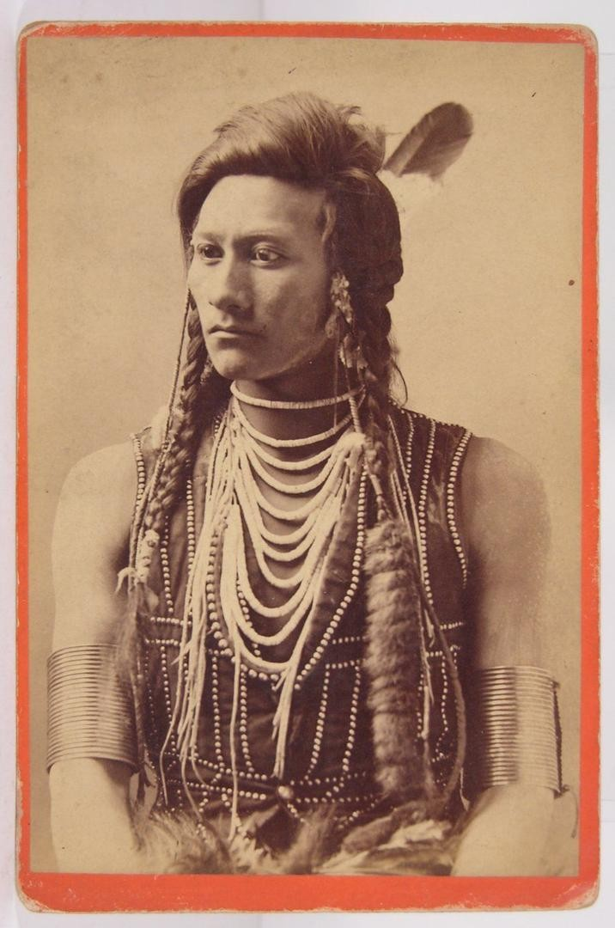
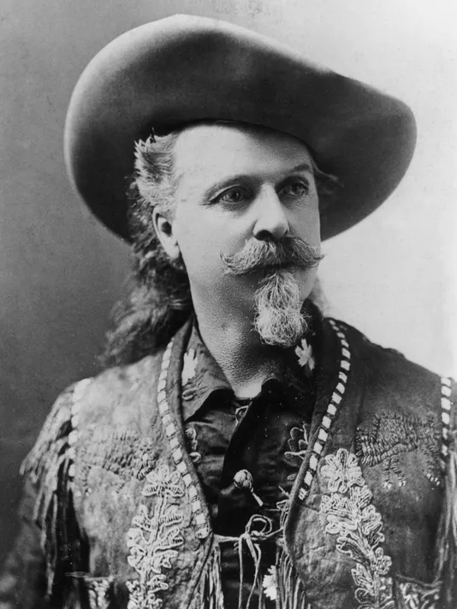
Learning Task One
As a class, read through p.91.
For each American figure, explain how the extermination of the buffalo effected them.
Remember – some benefitted, some did not!

Slide 7
Previous deals gave Indians the right to hunt on large areas outside the reservation as long as the buffalo were there. With the buffalo gone, these deals were void.
With less reliance on buffalo, it would force Indians to farm or ask the government for food. This gave the government power over the Indians.
Forced many to start cattle ranching to survive.
Reservation Indians became 100% dependent on the U.S. government for food.
Government could punish Indians with less rations for rebelling.
Many Indians died from diseases like flu and measles.
Buffalo allowed white hunters to make huge profits, as their hide was worth $3.
Also – less buffalo opened up the Great Plains for cattle ranching.

Slide 8
Learning Task Two
Dark green group – The Dawes Act (1887)
Light green group – Shrinking the reservations
Orange group – The use of government agents
Blue groups – Reducing the power of tribal chiefs
Each group will be given sugar paper
You will be given one area to look at.
On your paper, you should design a graffiti board to teach the class about how this destroyed Native American culture.

