Slide 1
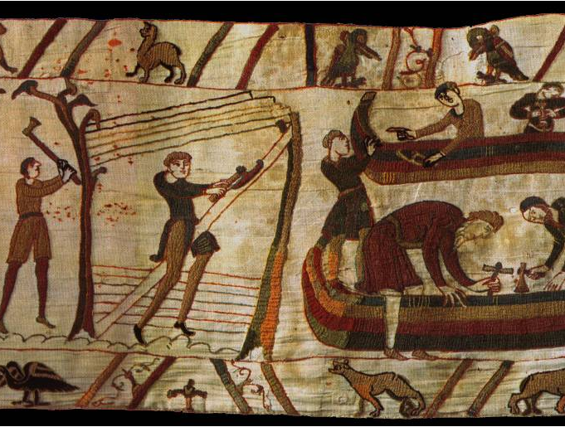
How vulnerable was Harold’s Kingdom by September 1066?
In this lesson, we will:
Describe the preparations made by both Harold and William.
Explain why English forces were defeated at Gate Fulford.
Starter: What do you think is happening in this scene from the Bayeux Tapestry?
Provide contextual knowledge to explain why this may have been happening.

Slide 2
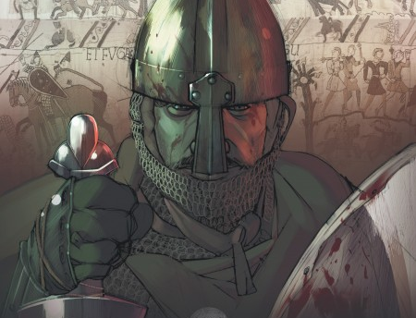
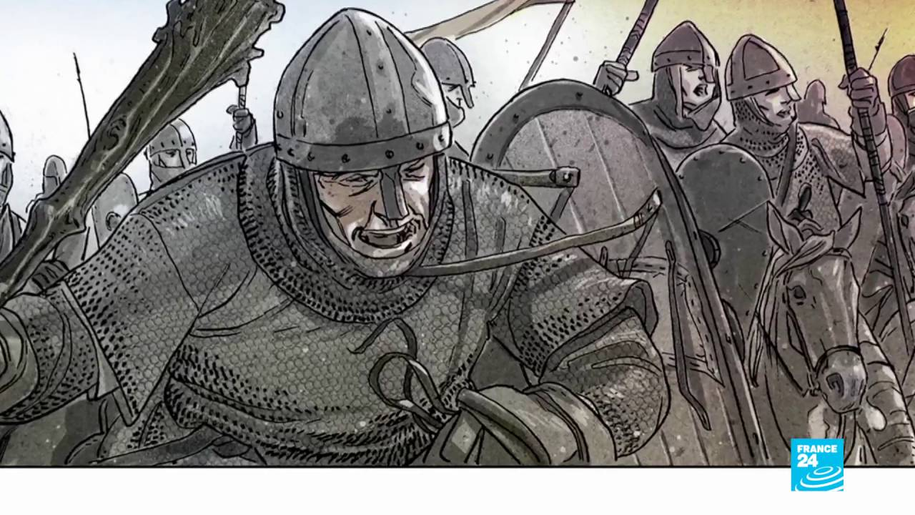
How did William react?
When William heard of the news, he became enraged. He used Harold’s holy oath to convince the Pope to give him a papal banner.
William immediately began gathering an invasion force to take England by force.
He used his papal banner to recruit mercenaries from France, Breton and Belgium.
At the mouth of the Dives, he gathered between 5,000 and 10,000 men by August.
However, the winds were unfavourable and his armada remained trapped all summer.

Slide 3
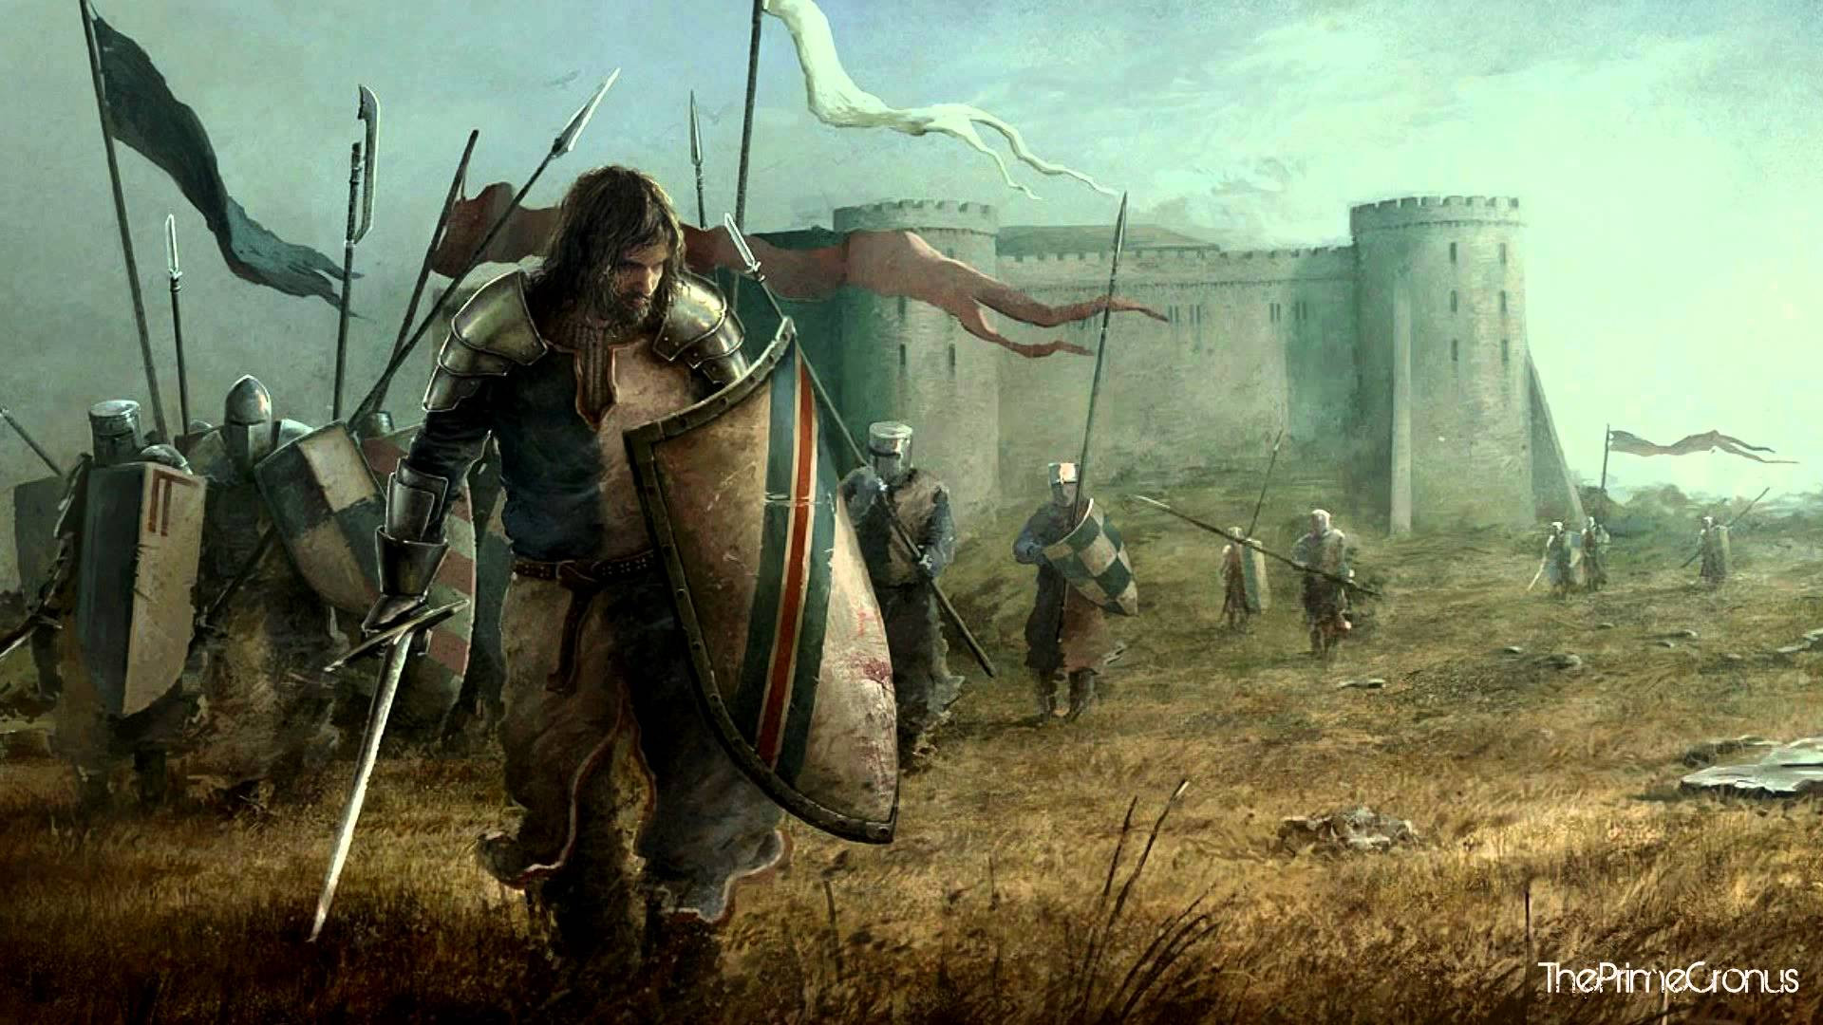
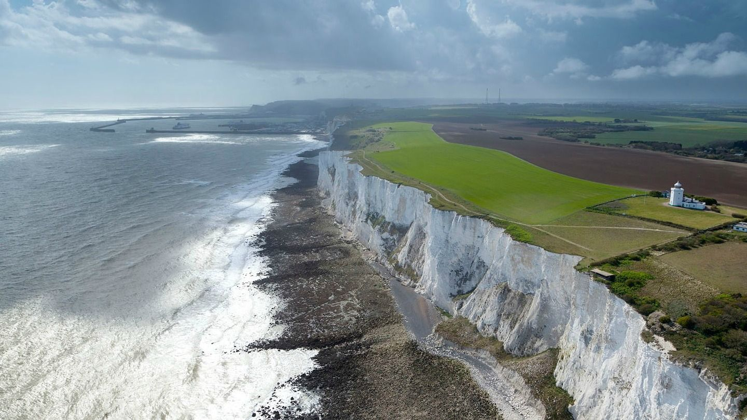
How did Harold react?
King Harold and the Witan knew that Duke William would act on his claim.
He immediately raised the Fyrd and positioned the army and fleet on the south coast of England.
Harold’s forces numbered 7,000 to 8,000.
After two months of waiting, food reserves had become low.
By September Harold was forced to disband the fyrd as William’s armada didn’t come.

Slide 4
Learning Task One
Green Groups
Divide your book page into sections:
William’s preparations
Harold’s preparations.
Make a list of what each man did to prepare for war in 1066.
Below – who do you think was in the better position by September 1066?
Orange and blue Groups
Your teacher will give you a list of preparations made by either Harold or William in 1066.
In your book, categorise the into who did what!

Slide 5
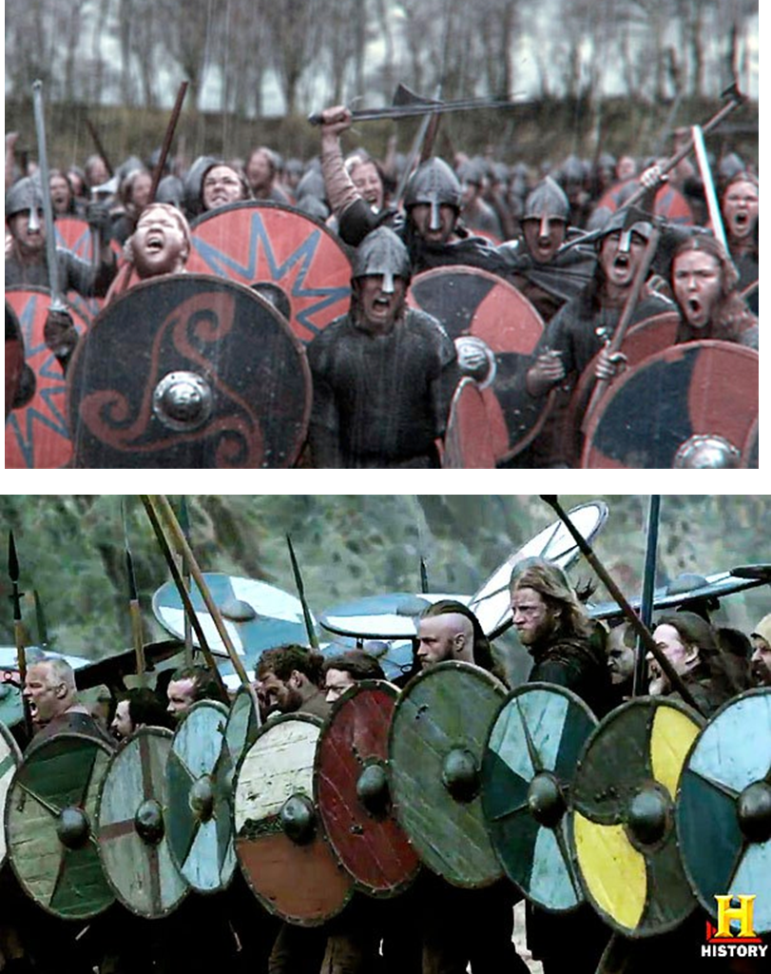
Who attacked England first in 1066?
10 days after disbanding his fyrd, a large force attacked England to claim the throne.
They sailed from Norway, down the east coast of England and began to raid Scarborough. They then sailed up the Mouth of the Humber and landed 10 miles outside York.
Earl Morcar of Northumbria, and Edwin of Mercia raised an army to meet them at Gate Fulford.
This invasion force consisted of 10,000 Viking and Belgian soldiers. They were led by King Harald Hardara and Tostig Godwinson.

Slide 7
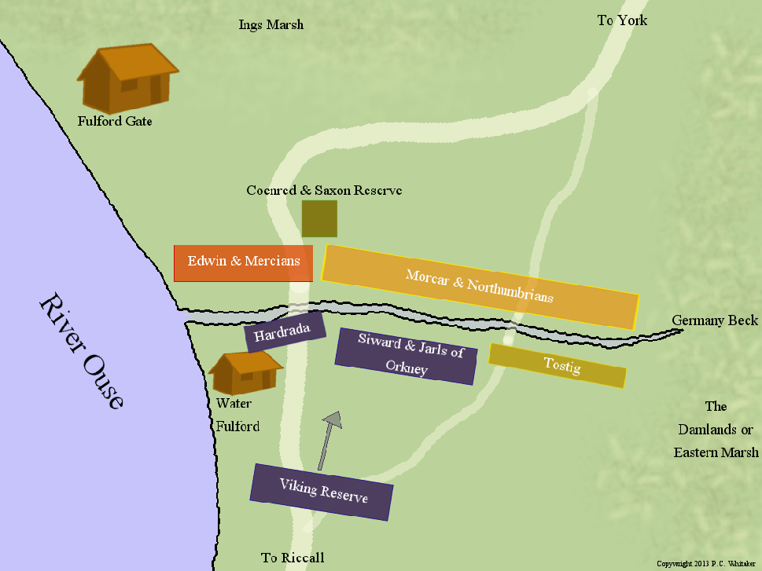
https://www.youtube.com/watch?v=m9NdbxQWdJ8

Slide 8
Learning Task Two
Write down three reasons why Hardrada won the Battle of Gate Fulford.
For each, explain clearly how this would have helped him achieve a victory! (A02)

Slide 9
Numerical advantage
Edwin and Morcar were outnumbered – Hardrada had 3,000 more men. This would mean that they couldn’t afford to take as much damage as the Viking forces.
Why did Hardrada and Tostig win at Fulford?
Tactical mistakes by Morcar & Edwin
They positioned their army with a marsh to their backs. This meant their troops had nowhere to go when they were pushed back. This made them easy to kill.
Hardrada’s clever strategy
Hardrada and his housecarls positioned Tostig’s weaker troops on one wing. This encourage the Saxons to attack there first, allowing his men to attack them from the side. This allowed him to defeat the Saxons.

