Slide 1
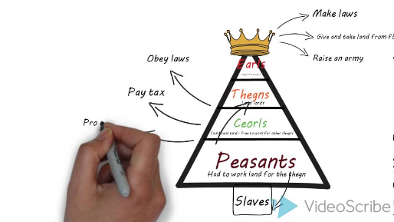
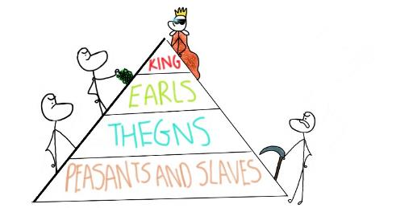
Was Edward the Confessor a weak king?
In this lesson, we will:
Describe the various threats that could effect order in the Anglo-Saxon kingdom.
Explain how the Saxons attempted to improve security.
Starter: Please make sure you have completed your ‘hierarchy’ diagram from last lesson.
If/when completed, have a go at the crossword puzzle to get to grips with key words.

Slide 2
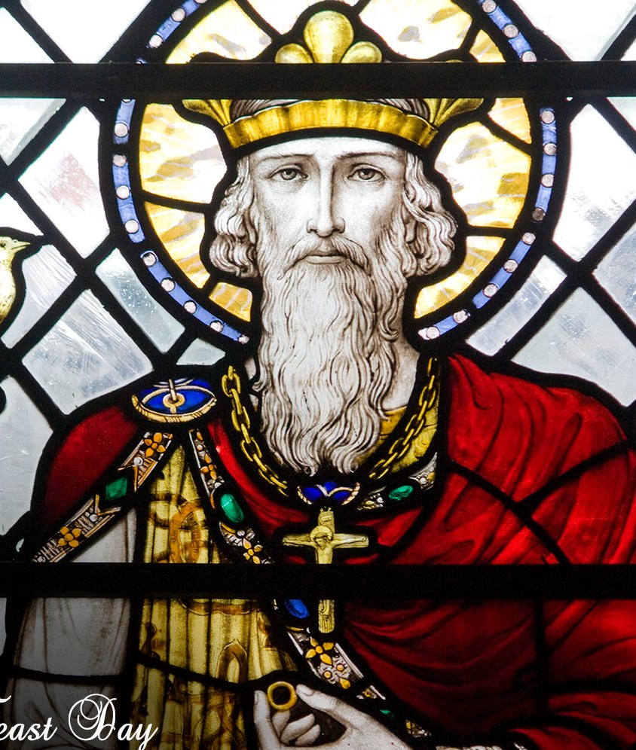
What qualities made a good Anglo-Saxon king?
Manage the law and order of the kingdom.
Deal with any external threats to the kingdom
Deal with any followers who disobey orders.
Produce a male heir
Have the support of the Church.

Slide 3
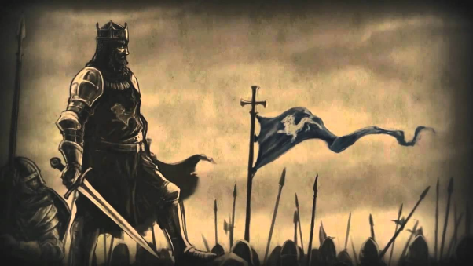
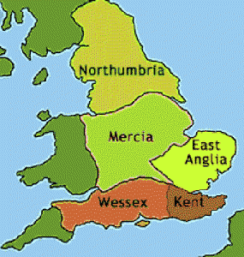
How was Earl Godwin a threat to Edward?
Wessex was the most powerful earldom in England, and the Godwin family owned so much land that they were rich as the king. (Tostig in Northumbria, Godwin in Wessex, Gyrth in East Anglia)
The Godwins directly ruled over 2 of the 5 main earldoms in England.
They were lords to so many thegns that they were militarily much more powerful than Edward.
Godwin had blocked many of Edward’s decisions e.g. introducing Normans to important positions in the Church.
In 1050, Edward decided to do something to deal with the Godwinson's.

Slide 4
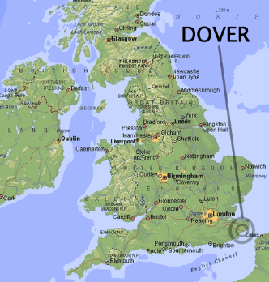
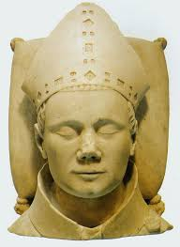
How did Edward try to deal with Godwin?
Edward teamed up with his close ally Robert of Jumièges (from Normandy)
In 1050, Edward invited Robert to come to England from Normandy to become Archbishop of Canterbury. Knowing this would anger Godwin, he told them to land at Dover in Wessex.
When Robert’s men were attacked in Dover, Edward demanded that Godwin punish the men responsible.
When Godwin refused, Edward and the Earls of Mercia and Northumbria forced Godwin and his family into exile.
In 1051, Godwin returned with an army from Europe. To prevent a war, Edward restored his family’s power.
https://www.youtube.com/watch?v=J2DKtmNoiKg (09:40 – 12:32)

Slide 5
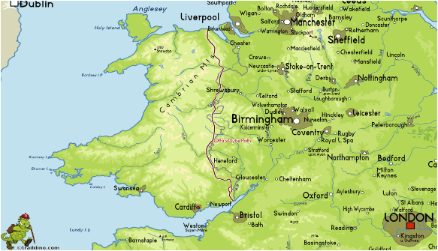
What other threats were there to Edward’s kingdom?
External
Raids from Vikings and Germans
Raids from the Welsh on the border
Internal threats
Blood feuds
Crime in villages
Earl Godwin of Wessex
The Viking’s had been raiding England regularly since AD793. To help deal with it, the Saxons had a ‘geld tax’. The money from this would be used to pay off the Vikings to stop them raiding!

