Slide 1
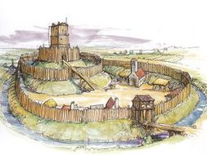
How secure was Anglo-Saxon England?
In this lesson, we will:
Describe what happened in various rebellions between 1066 and 1070.
Explain how William dealt with these rebellions.
Starter: How did the marcher earldoms help William govern England?

Slide 2
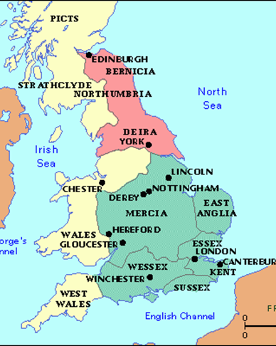
Why did Saxon England rebel in 1068?
Resentment against William caused Morcar and Edwin to rebel in 1068.
They resented the high taxation, mass building of castles and the illegal land grabs committed by Normans (e.g. Odo)
Edwin was angry that William went back on his word to allow him to marry his daughter. William had made his earldom smaller.
They were supported by Bleddyn of Wales and the Sheriff of Yorkshire. Also from Earls Walteheof and Gospatric of Northumbria and Edgar Aethling.
William marched north with an army, building castles as he went. Rebels quickly surrendered. Edgar fled to Scotland.

Slide 3
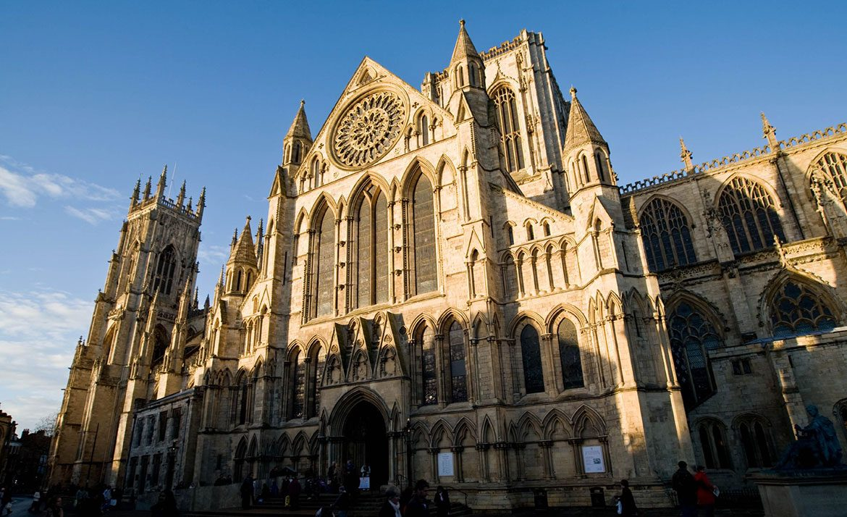
Why did Saxon England rebel in 1069?
In Spring, a series of rebellions erupted in the north. Rebels from Northumbria had slaughtered William’s new Earl of Northumbria Robert Cumin.
Another outburst happened in York which killed many Norman troops.
These rebels were united and joined by Edgar Aethling and his army from Scotland. The clashed with William’s army at York and were quickly defeated by burning York to the ground.
William had a castle built and granted it to William FitzObern.
In summer the Danes attacked the east coast and were joined again by Edgar. Again he marched north with army to destroy the rebellion. William responds with paying off Danish and Harrying the North.

Slide 4
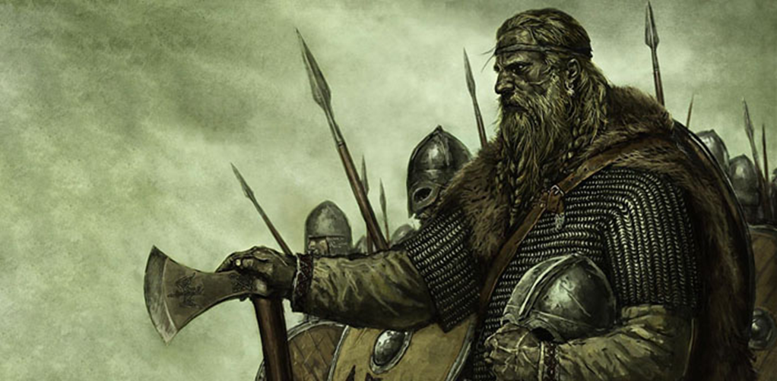
Why did Saxon England rebel in 1070?
A Danish fleet returned to England led by King Sweyn.
They set up their base on the Isle of Ely due to its marchland.
The Danish made an alliance with a Saxon rebel called Hereward the Wake who had been fighting a guerrilla campaign against William’s forces for years.
After raiding Peterborough Abbey, the Danes abandoned Hereward.
He was later joined by Morcar and his men. William marched north with an army and bribed local monks to show them a safe way through the marshes.
They easily retook Ely and captured Morcar.

Slide 5
Rebellion | Why did it happen? | How did William deal with the rebellion?
1068, Morcar and Edwin rebel against William in the North.
1069, the north rebels again and rallies behind Edgar the Aethling
1070, the Danes team up Morcar to take England at Ely.

Slide 6
Rebellion | Why did it happen? | How did William deal with the rebellion?
1068, Morcar and Edwin rebel against William in the North. | Edwin hated William for refusing marriage to his daughter. Odo and Fitzoebern were illegally sieing land from Saxons. Morcar’s earldom had been reduced in size by William. Castles were seen as a symbol of Norman rule, they were hated by the Sazons. Geld tax was increased far too much, they hated that all this money was going to Normandy. William was using England like a ban. | He quickly gathered an army and marched North. They built castles as they went. They captured Warwick in Mercia. He gathered hostages in York and used that to get Morcar and Edwin to surrender. Edwin and Morcar were kept as prisoners by William.
1069, the north rebels again and rallies behind Edgar the Aethling | Rober Cumin, the new Earl of Northumbria began attacking towns in the North to punish them for 1068. This was a mistake as the rebels began to fight back. Cumin was slaughtered in his sleep. Uprisings began in York. Edgar had an army and was keen to take England. The Danish Vikings were keen to join this rebellion and capture key areas of England. | William sent troops north, to crush the rebellion, but when his army arrived, the rebels would scatter. To crush them, he Harried the North – causing a famine of 100,000 deaths. Bribed the Danes to abandon the cause and leave England.
1070, the Danes team up Morcar to take England at Ely. | Danes were extremely keen to gain territory in England and seek revenge for Hardrada; death. Hereward wanted his land back that had been seized. Morcar saw a chance to restore Anglo-Saxon customs | William raised an army and marched to Ely. He paid the local monks to show him a way across the marshes. He captured Ely. Morcar was arrested and imprisoned

