Slide 1
How powerful were Anglo-Saxon Earls?
Starter: Describe two key features of the Anglo-Saxon monarchy (4 marks)
In this lesson, we will:
Assess how powerful Earls were.
Describe key features of Earldoms.

Slide 2
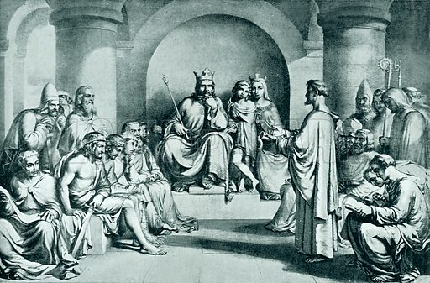
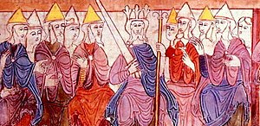
What was the Witan?
Edward spent most of his time focussing on religious matters (e.g. the construction of Westminster Abbey)
He relied heavily on his Witan to help run the kingdom.
This was a council of earls and bishops that advised the king on important issues.
Advised on threats from foreign powers, religion and land disputes.
The monarch did not have to listen to the Witan.

Slide 3
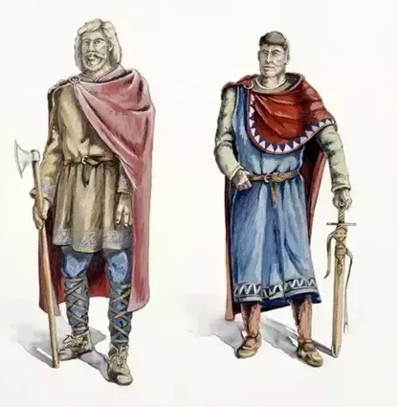
They ruled over all thegns within their Earldom
Collected tax, took 1/3 of it
Acted as military leaders for the king (e.g. raising an army)
Had to ensure their earldom was well defended.
Their huge earldoms meant they were extremely rich and powerful.
Oversaw criminal trials and punishments.

Slide 4
WEAKNESS
STRENGTH
When a king was strong, earls were often kept in check – they would be punished if they were not obedient.
Earls could be overthrown by their thegns (e.g. Earl Tostig Godwinson of Northumbria in 1065)
Earls could challenge a weak king e.g. Edward’s decision to bring Normans to the English court.
The king could not raise an army without their support.
Their earldoms gave them so much power and wealth.

Slide 5
Learning Task One – Group work!
Your teacher will split you up into small groups.
On the large piece of A3 paper, draw the outlines of:
A king
An Earl
Two of you write down examples of strengths.
Two of you write down examples of weakness.
Stretch challenge:
As a group, decide who held the most power during the reign of Edward the Confessor!

Slide 6
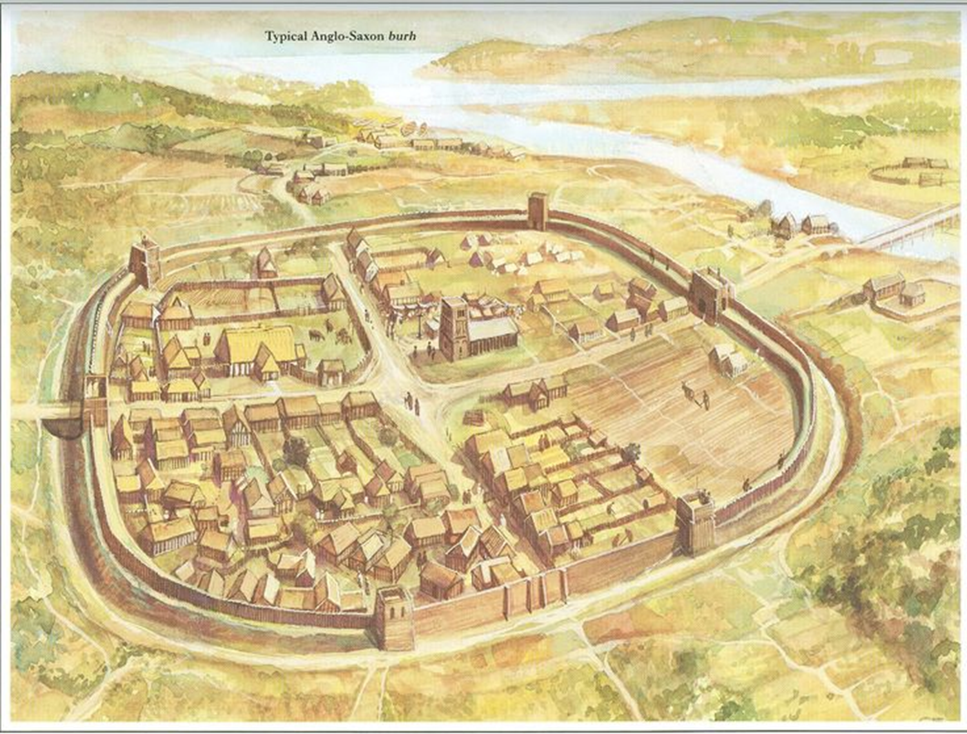
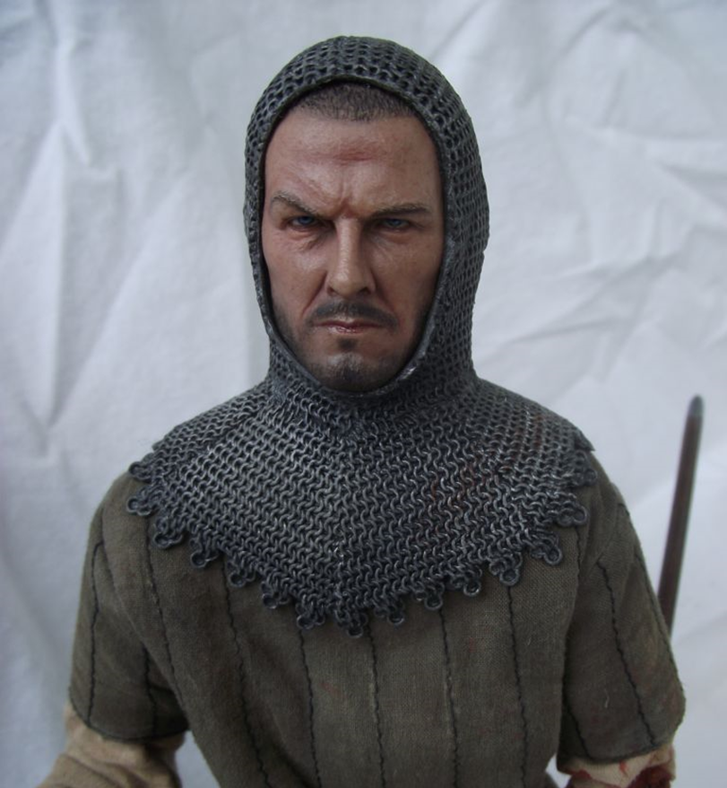
How were earldoms organised?
Earldoms was divided into shires – they had courts, provided troops for the fyrd etc.
At the centre of each shire there was a burh (fortified town). Burhs had strong walls which had to be maintained by the thegn who lived there.
Each shire had a sheriff who worked for the king, they would carry out various tasks like collecting tax, fines and maintaining the fyrd.
It had an army (fyrd). Every man had to fight for upto 40 days.
Burhs were also trading hubs. Trade had to take place here so tax could be paid to the sheriff.

Slide 7
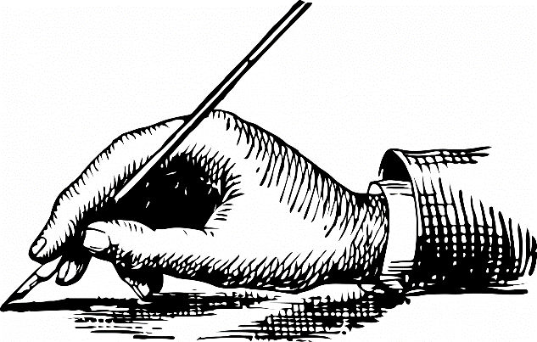
Learning Task One
Green groups
“Edward the Confessor was a weak, ineffective king” How far do you agree? You may wish to consider both sides of this argument, either in paragraph or table format.
All groups
For each of the following key words, describe two key features of it:
Shire
Burh
Sheriff
Fyrd
Trading
Orange group
What evidence is there that Edward had an advanced kingdom?
What evidence is there that Edward’s kingship was weakening?
Blue groups
Literacy challenge! Try to write a short paragraph using as many of these 5 key words as possible. It must make sense as a paragraph, it cannot just be another definition of what they mean!

Slide 8
Key term | Definition
Shire | Had it’s own court Was where the sheriff would be Had it’s own burh Provided troops for the fyrd
Burh | Surrounded by strong, wooden walls Thegn would live here Everyone had to share responsibility for maintaining defences Shire reeve/sheriff would probably be based in the burh
Sheriff | Also known as “shire reeve” King’s deputy in charge of making sure the king’s law was being carried out. Collect tax from king’s land Collect fines Make sure men were joining the fyrd Make sure the roads and defences were being maintained
Fyrd | Every man had to serve 40 days military service Select fyrd made up of thegns who were well equipped. General fyrd made up of men who would fight in their local area (peasants)
Trading | Often took place in burhs or in cities. York traded with Denmark, Bristol with Scandinavia and Ireland. London traded with Germany, France, Normandy and Flanders. Wine, spices, cloth, dyes, pottery and wool would all be traded.

