Slide 1
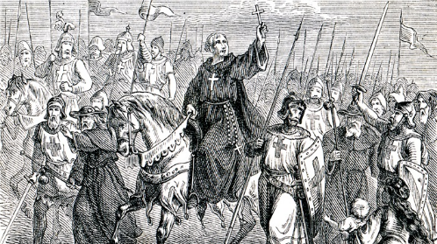
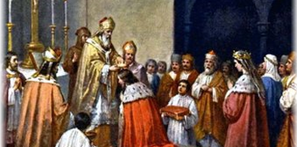
How powerful was Harold Godwinson by 1066?
In this lesson, we will:
Describe which regions Harold and his family ruled over.
Explain how much of a threat Tostig was to Harold by 1065.
Starter: Have a got at the cross word puzzle!

Slide 2
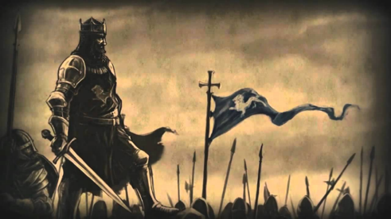
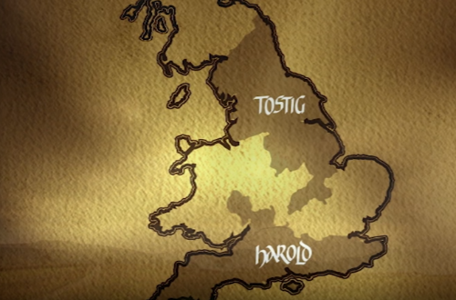
Where was Harold by 1066?
In 1053, his father Godwin collapsed and died at a banquet in Winchester. Harold became Earl of Wessex.
His brother Tostig was Earl of Northumbria.
Gyrth and Leofwine were the Earls of East Anglia and Kent.
After the successful invasion of Wales in 1056, Harold was made ‘sub-regulus’. King Edward’s second in command.
Harold’s sister Edith was married to King Edward.

Slide 3
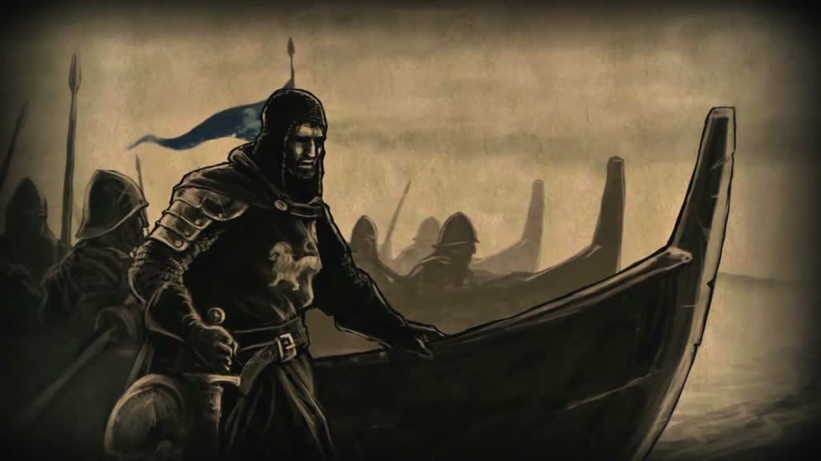
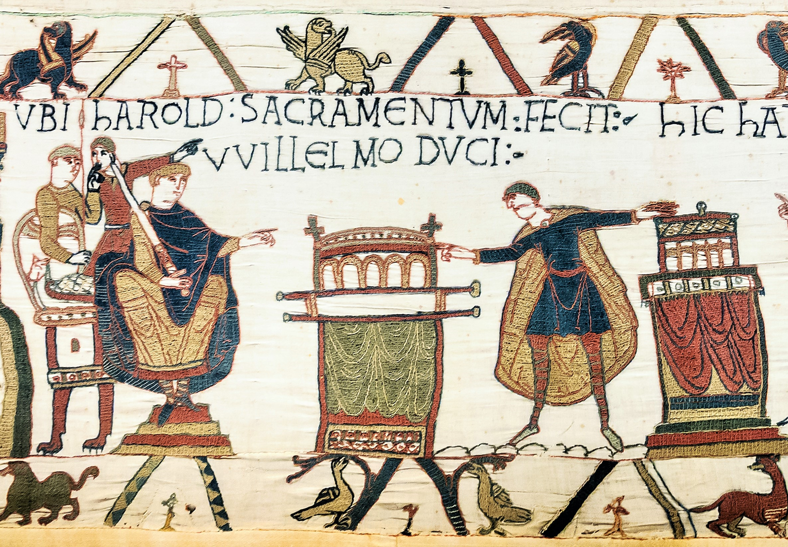
How do we know Harold was important?
We know Harold was very powerful, because of an embassy in 1064.
Edward tasked Harold to sail to Normandy on an official visit to Duke William of Normandy.
There are two stories as to why he was sent.
It was either to negotiate the release of Saxon hostages, or to negotiate William becoming King after Edward’s death.
The fact that Harold was sent on this shows how powerful and important he was in England.

Slide 4
Learning Task One
Green groups
Shade in each area that is directly controlled by Harold’s family. Explain how with precise knowledge and examples.
Shade in each area that is indirectly controlled by Harold’s family
Cut out the diagram of Anglo-Saxon earldoms, in the centre of your book page – please glue it in neatly.
Orange group + blue groups
Shade in each area that a Godwinson controlled.
Draw an arrow away from each, and explain who ruled over each area.

Slide 5
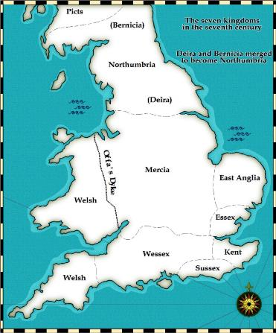
Earl Tostig was Earl of Northumbria, giving them a massive power base in the North.
East Anglia was ruled by Gyrth, Harold’s teenage brother. He also served on the Witan.
In the 1050s, the Earl of Mercia was exiled and replaced with those loyal to the Godwin's.
In 1062, Tostig and Harold launched an attack on the Welsh king. They replaced him with a king that they could control.
Harold ruled Wessex; he was England’s defence against attacks from Europe so he was very important. He eventually became “Sub-regulus” – the King’s deputy and was in charge of the army.

Slide 6
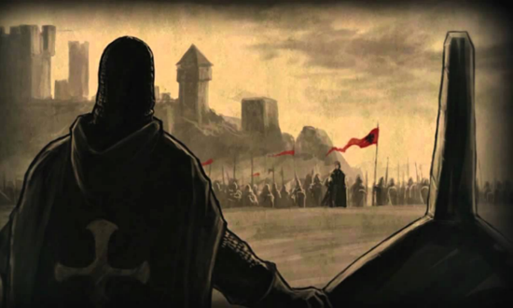
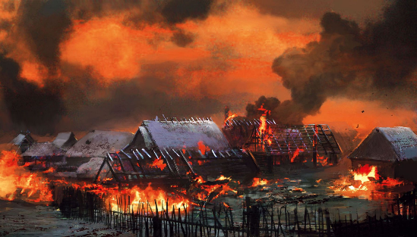
How did Tostig threaten Harold’s power?
In 1065, all the thegns in Northumbria rose up against Earl Tostig. They were supported by Mercia.
They raised an army, marched on York and killed anyone who had supported Tostig.
They demanded that Morcar of Mercia be made Earl.
King Edward ordered Harold to march north with an army, crush the rebels, and reinstate Tostig.
Instead, Harold married Morcar’s sister as a sign of loyalty. He then made Morcar Earl of Northumbria and exiled Tostig from England.

Slide 7
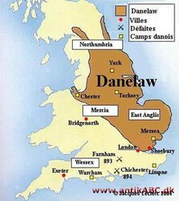
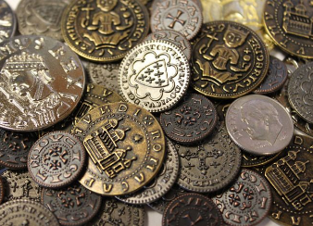
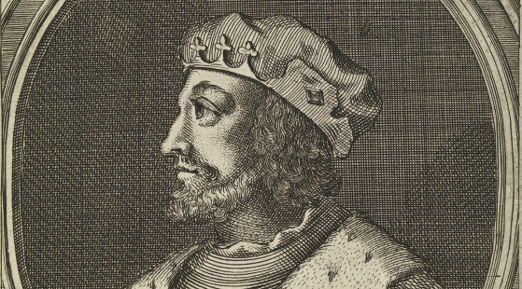
Why did Northumbria rebel?
Most of Northumbria was part of the Danelaw – the massive area where mostly Viking people had settled.
The region was known for being wild, lawless and the people were very distrusting of southerners.
Many of the laws, customs and even language were rooted in Viking culture rather than Saxon culture.
Tostig was acting like a tyrant e.g. he had two of his rivals murdered. He even had a thegn killed when he threatened to complain to King Edward.
He raised taxes very high which angered the locals.
In 1061, King Malcolm III of Scotland raided into Northumbria. Rather than punish them, Tostig made peace and became very close to them.

Slide 8
It showed that Harold had his eyes on the throne – he needed a united kingdom and a war with Mercia and Northumbria would have weakened it. Hence why he sided with them and betrayed Tostig.
Tostig was so angry that Harold had betrayed him that he travelled across Europe seeking support for an invasion of England. Tostig therefore became a major threat.
Why is Tostig’s exile so important?
Harold and the other earls of England has openly disobeyed Edward – this showed the weakness of Edward and just how powerful and influential Harold had become by 1065.

Slide 9
Learning Task Two
Evidence that Harold had a lot of control over England | Evidence that Harold did not have a lot of control over England.
“By 1066, Harold had a firm control of England” How far do you agree with this statement?

