Slide 1
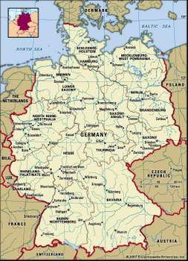
How much trouble was Germany in by 1918?
In this lesson, we will:
Describe the problems that existed in Germany in 1918.
Explain how Frederich Ebert prevented Germany from plunging into Civil War.
Starter: How much do you know of German and its history?
What is a Kaiser?
By a republic; what do we mean?
What is the capital of Germany?
What is a constitution?
If someone is a communist; what do they believe?

Slide 2
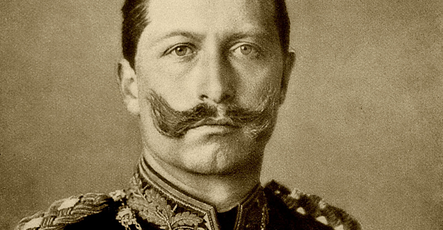
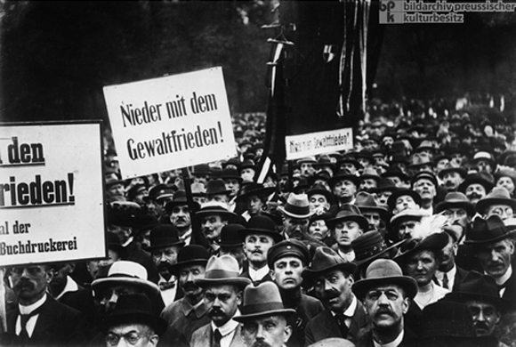
The situation in Germany by 1918
During the First World War, over two million Germans had died and four million wounded (55% of all German soldiers)
The Allied naval blockade had caused massive food shortages and over 750,000 deaths.
In Stuttgart, workers went on strike and demonstrated in the streets. In Hannover soldiers refused to stop protestors.
In Berlin it was clear that Kaiser Wilhelm II and his ministers had lost control.

Slide 3
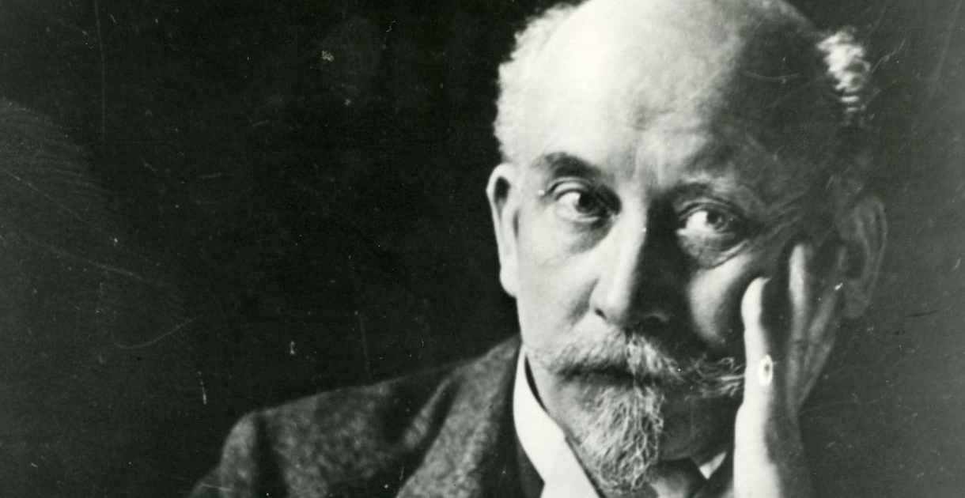
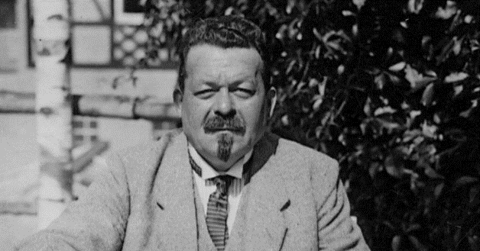
On 10th November 1918, Kaiser Wilhelm II abdicated.
Members of the Reichstag began to put things in place to establish a new government.
The aim was to create a government of centre politicians. The centrists aimed to prevent the extreme left and right from seizing power.
Politicians like Philip Schiedemann and Frederich Ebert of the Social Democratic Party (SDP) appealed for a peaceful transition.

Slide 4
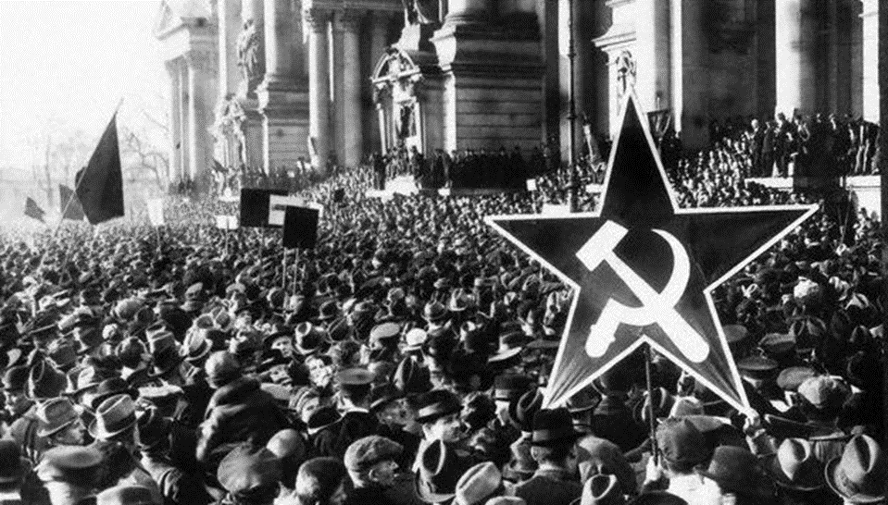

Slide 5
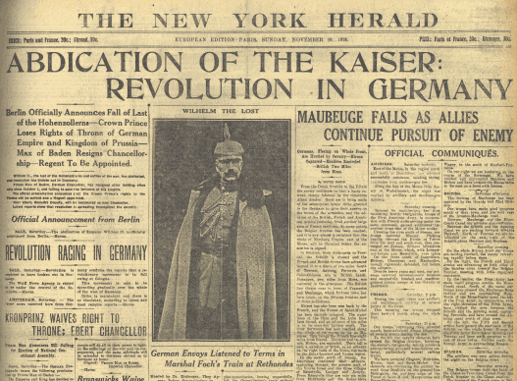

Slide 6
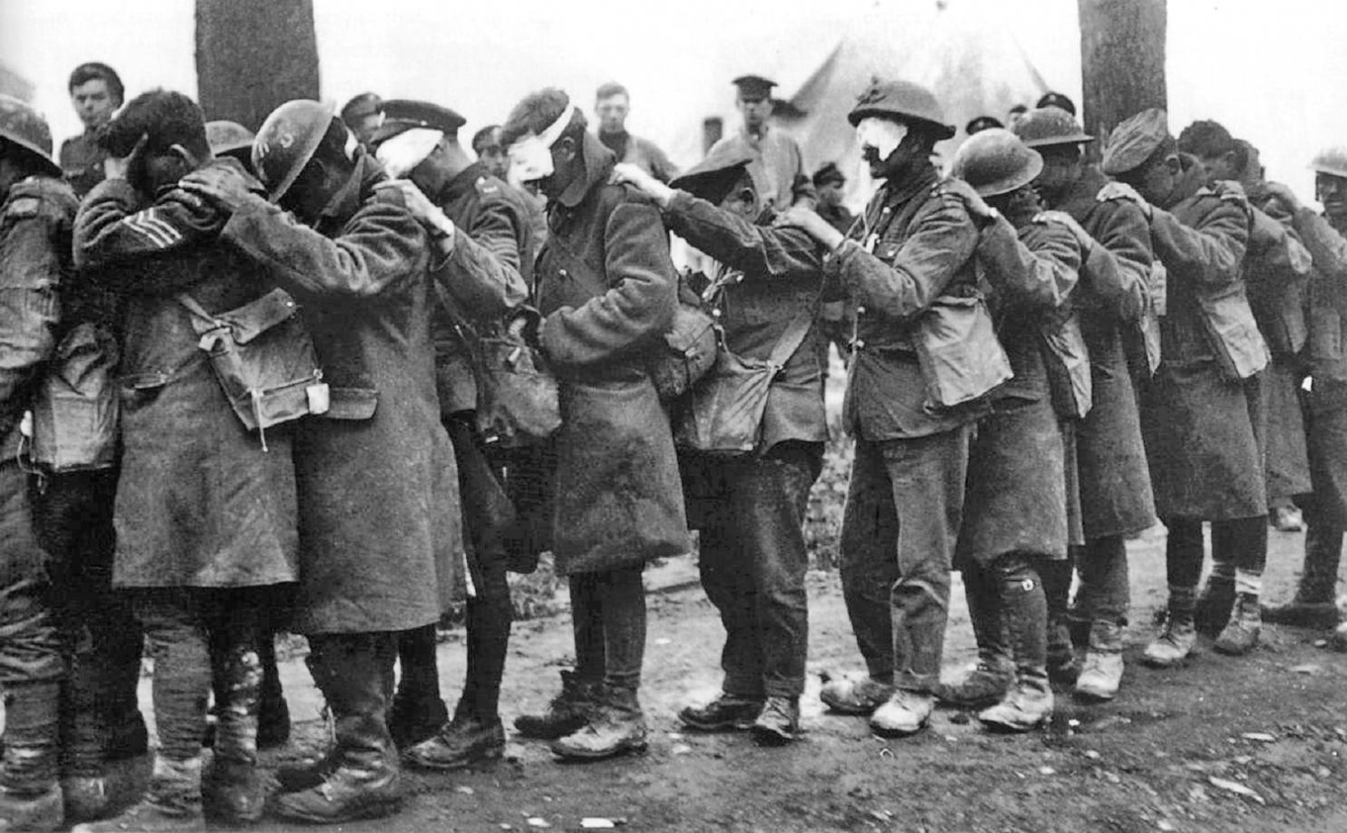
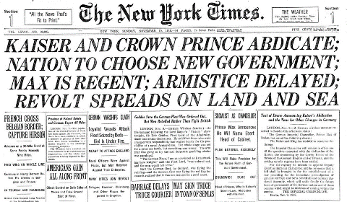
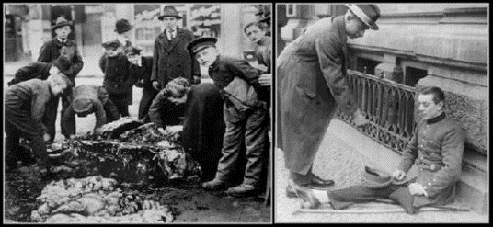
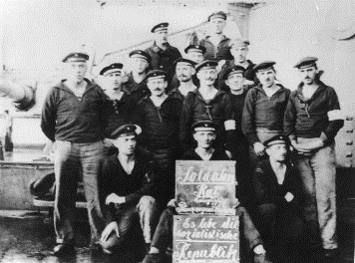
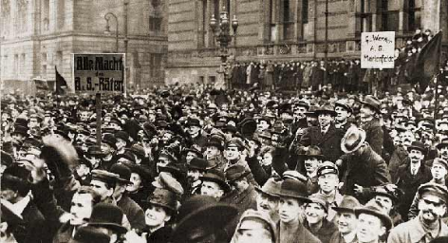
Learning Task Two
Green Groups
Foreign problems
Domestic problems
For each, explain what issues were occurring and how dangerous they were to Germany
Blue Groups
‘Revolution in Germany!’
Provide examples from 1918 to support this headline of Germany from the New York Herald.

Slide 7
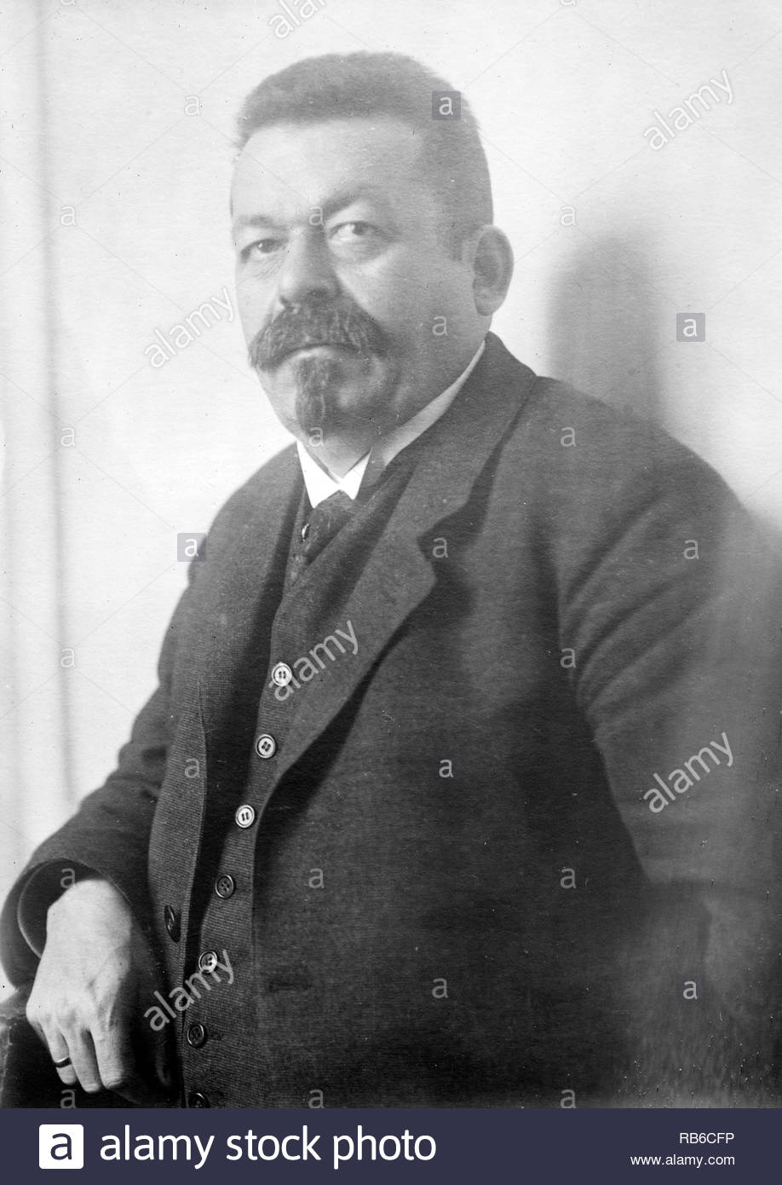
Learning Task Two
Green Groups
For each of the following problems, explain how Ebert solved them:
Lack of army support
Lack of industrial support
Lack of trade union support
Blue Groups
How did Frederich Ebert make sure that the German government continued to work?
How did he get people on the side of the centrists?

Slide 8
Promised General Groener that a new government would not reform the army and would seek peace with the Allies.
Promised industrialist that his government would not nationalise industry. He was the best way of stopping a Communist government from seizing power.
Promised trade unions that a new government would support a limit on working hours per week and would seek a fair peace treaty with Allies.
He convinced civil servants of the previous government to continue working. That way the day-to-day running's of government still worked e.g. taxes being collected

