Slide 1
How much has diagnosis and treatment changed by the 20th Century?
In this lesson, we will:
Assess how much diagnosis has changed between 1700 and 2000?
Describe the key events in the development of ‘magic bullets’

Slide 2
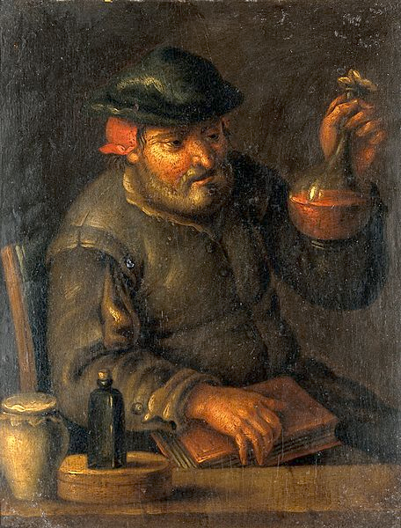
How would people be diagnosed in the 1700s?
In the early 1700s, some physicians still relied using urine samples to look for imbalances in the humours (colour, smell, taste)
After the work of Sydenham, some physicians began to observe the symptoms of the patients.
Except from this, diagnosis hadn’t changed much as technology was very basic.
There was no way to check blood, or DNA.

Slide 3
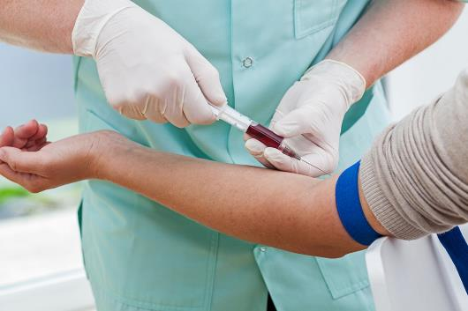
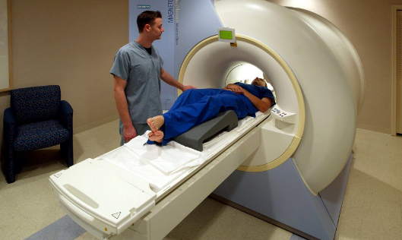
How would people be diagnosed in the 2000s?
Blood tests have been used since the 1930s to look for conditions.
Blood pressure monitors have been used since the 1880s to check high and low blood pressure.
Endoscopes have been used since the 1900s to insert small cameras inside the human body.
X-rays have been used since the 1890s to help see inside the human body.
MRI and CT scans have been used since the 1970s.

Slide 4
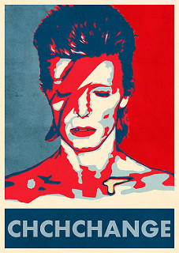
Learning Task One
Take the subheading: “Diagnosing illness in the 21st Century”
Split your page into two:
Evidence of change
Evidence of continuity
Explain one difference in diagnosing illness in the 1500s and 2000s. (4 marks)

Slide 5
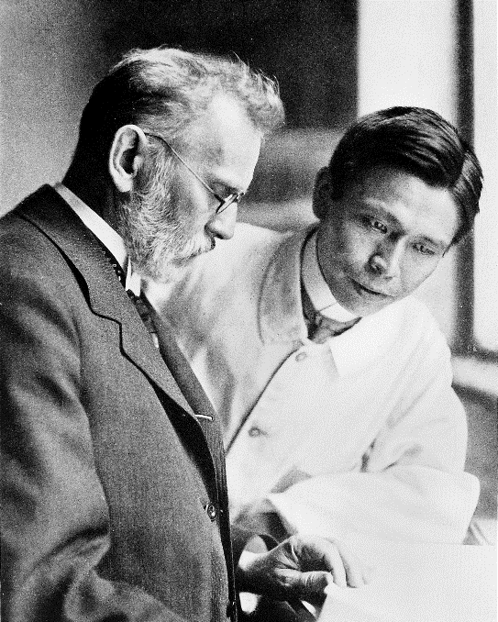
How would people be diagnosed in the 2000s?
A ‘magic bullet’ is a term which means any chemical that can sure a disease.
Because of Robert Koch, scientists of the 19th Century knew specific microbes caused specific diseases.
The hunt was on to find chemicals that could fight these microbes inside the human body.
The first big breakthrough in 1970 was in treating syphilis – a nasty STI!

Slide 6
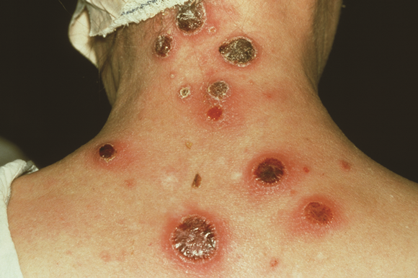

Slide 7
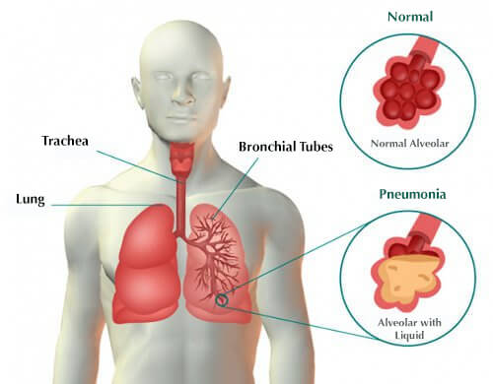

Slide 8
Learning Task Two
Targets 7-5
Drawn and complete a timeline to show the key events which led to the development of magic bullets.
It should begin in 1907!
Using the information we have just read through, as well as the video your teacher has shown you:
Targets 4-2
Cut out each picture, and each box of text.
Arrange them in chronological order.
Glue them onto a timeline. Go through, and highlight key words.

Slide 9
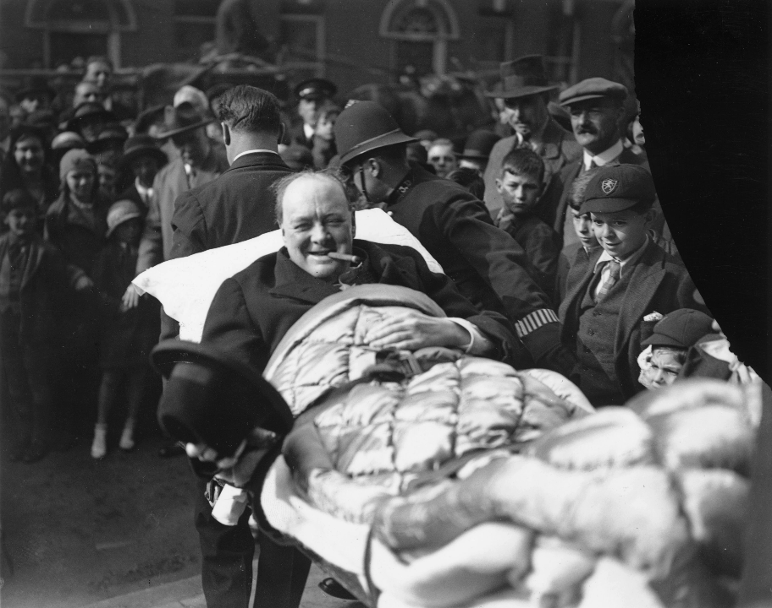
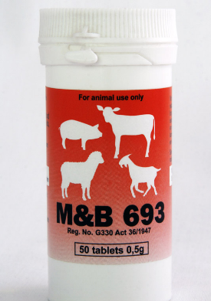
Churchill recovering from pneumonia – thanks to M&B 693!

Slide 10
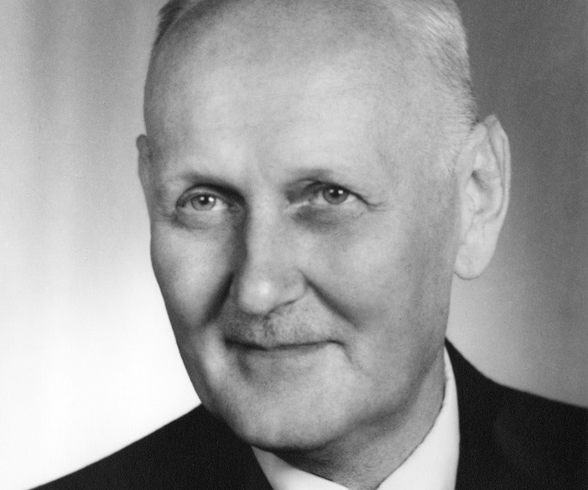
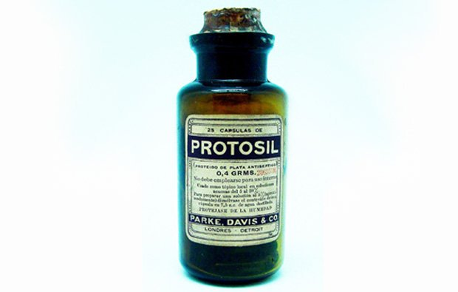
Domagk is happy his daughter is alive thanks to Prontosil!

Slide 11
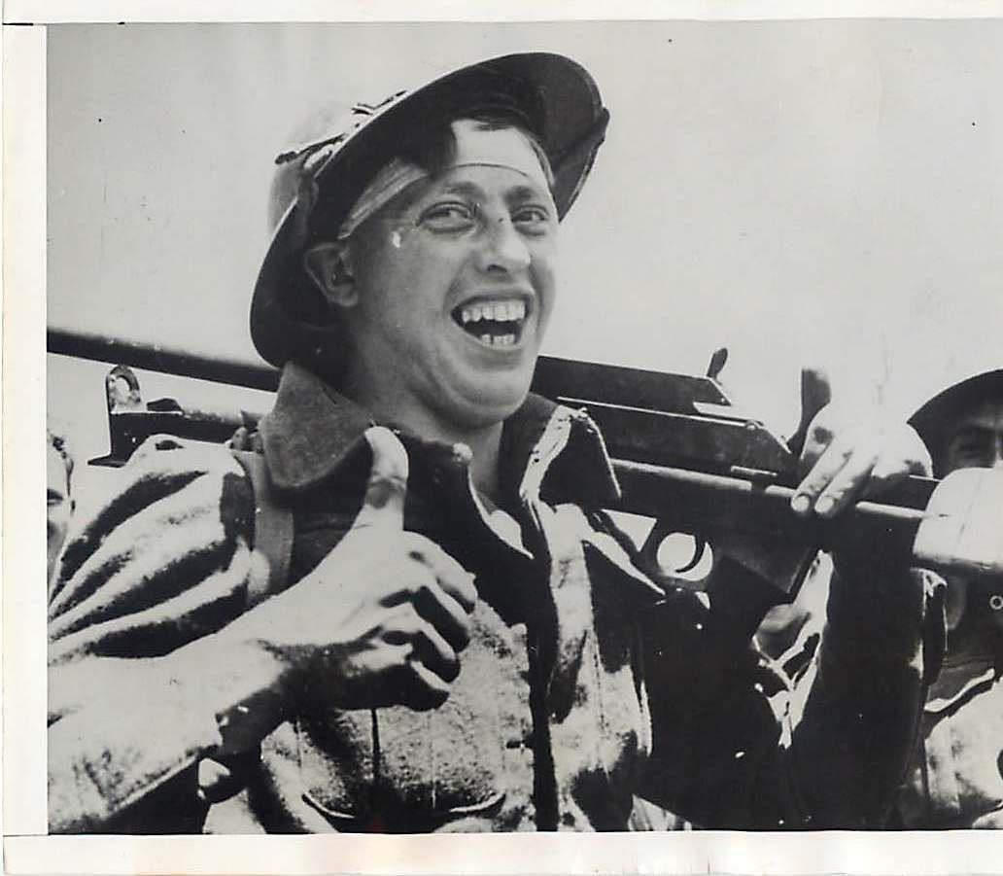
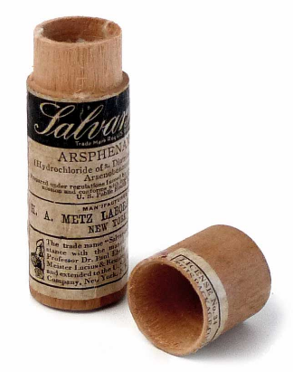
This soldier is happy that his syphilis is cured thanks to Salvarsan 606!

Slide 12
