Slide 1
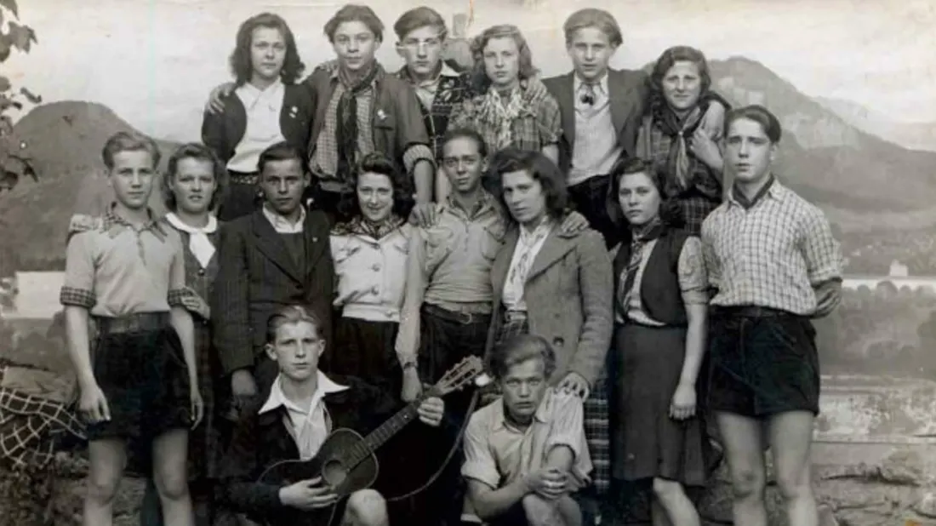
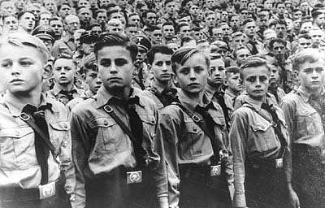
How much did young people in Germany resist the Nazis in the 1930s?
Starter: Look at the pictures of the Edelweiss Pirates and the Hitler Youth. What are the differences and similarities?
In this lesson, we will:
Describe how the Edelweiss Pirates and Swing Movement rebelled.
Assess to what extent this can be considered ‘resistance’

Slide 2
“We hardly had any free time. Everything was done in a military way, from bugle call, first parade, raising the flag, morning sport and ablutions, through breakfast to the ‘scouting games’, lunch and so on into the evening. Several participants left the camp because the whole slog was too stupid for them…Comradeship was very poor, and everything was done for command and obedience”
-Unknown man describing his time in the Hitler Youth in 1938.
Read through your extract and underline any key words that suggest the Hitler Youth was not enjoyed by children.

Slide 3
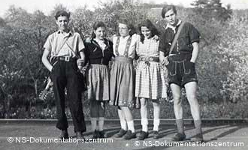
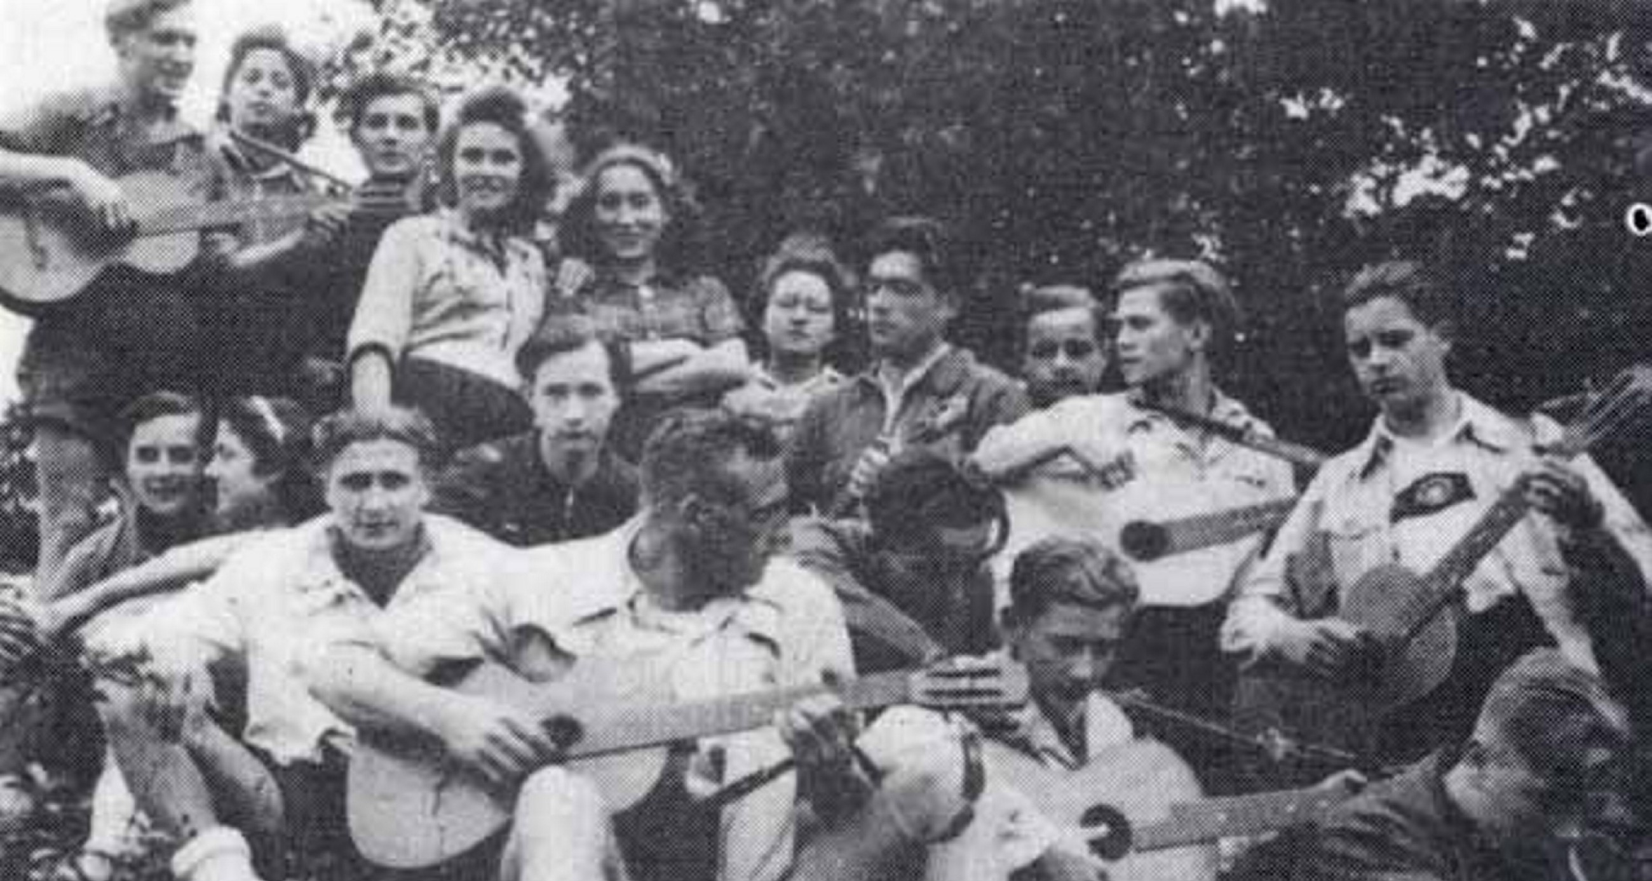
Who were the ‘Edelweiss Pirates’?
An association of a number of youth movements that had developed in western Germany in response to the Nazi regimentation of youths.
Most cities in Germany had a version (e.g. Navajos in Cologne or Travelling Dudes in Essen)
Mostly working class teenage boys and girls
Largely inspired by blues and jazz music coming from the USA through France. Grew their hair and wore American style clothing.

Slide 4
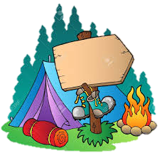
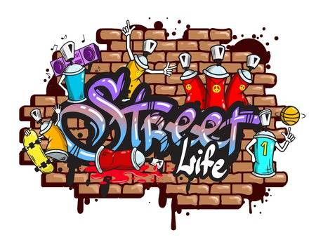
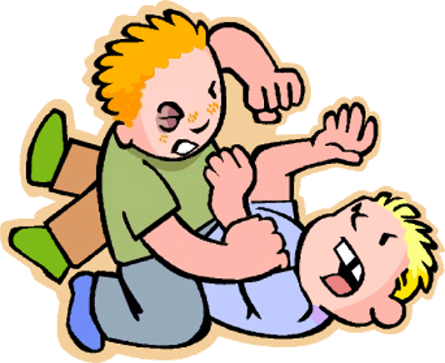
Camping trips to listen to music and have open discussions.
Would leave anti-Hitler and anti-war graffiti across cities.
What did the Edelweiss Pirates do?
Taunt and attack members of the Hitler Youth.
Spread jokes about Hitler and the NSDAP.

Slide 5
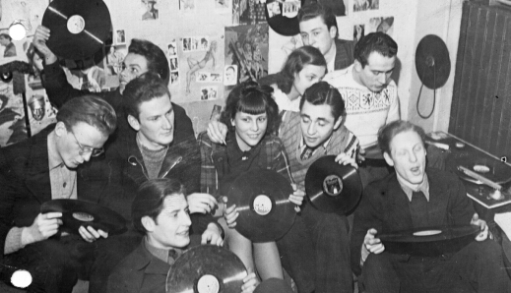
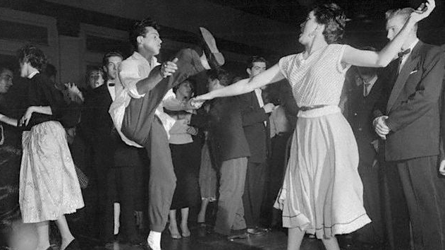
Who were the ‘Swing Youth’?
Most middle and upper class children.
Inspired by American film and music.
Organised illegal dances (over 6,000 people)
Listened to swing music, consumed alcohol, smoked and danced ‘modern dances’
Some listened to jazz music (Jazz Youth).

Slide 6
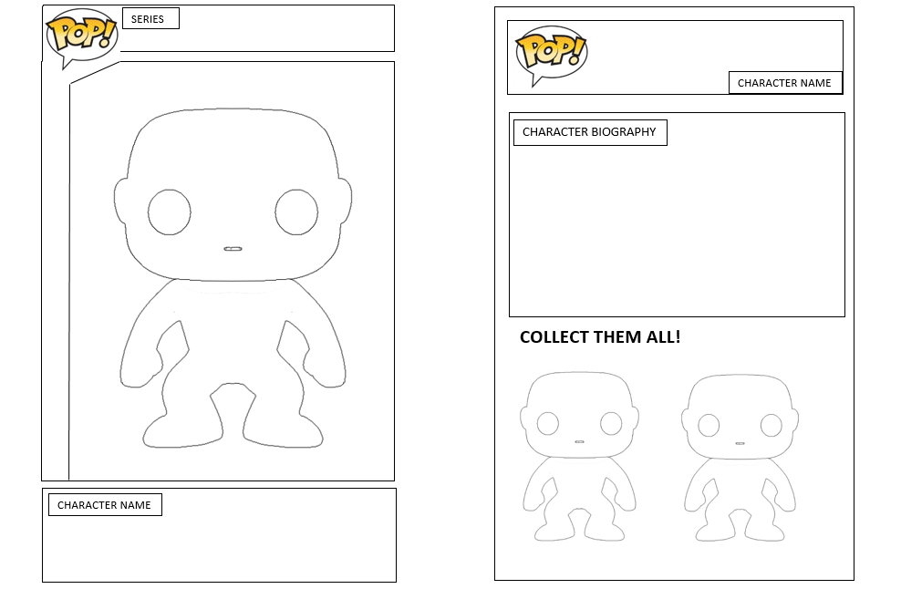
Learning Task One
For each pop vinyl character:
Design the figure the style of: Hitler Youth, Swing Movement and Edelweiss Pirates.
Describe key features of each movement.
Extension:
Did young people oppose the Nazis or resist the Nazis? What do you think?

