Slide 1
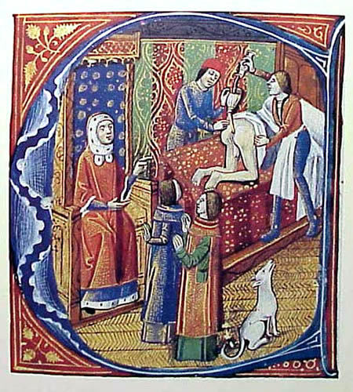
How much did preventions change during the Renaissance?
In this lesson, we will:
Describe ways in which people tried to prevent disease in the Medieval and Renaissance periods (1200 – 1700)
Assess to what extent their was a change or a continuity.
Starter: To the right you will see a picture. Identify whether it is a medieval or a renaissance way of treating illness.

Slide 2
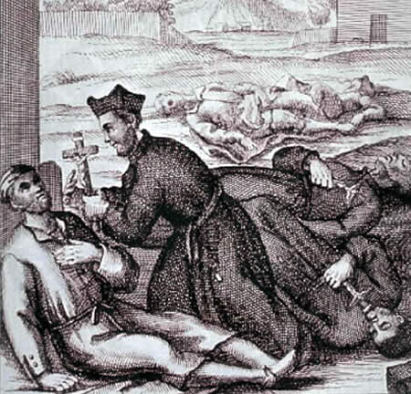
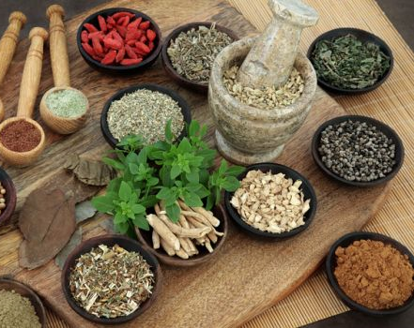
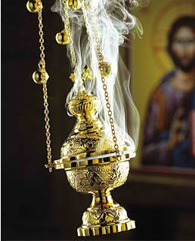
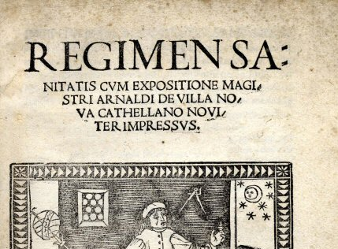
Medieval Preventative Measures
The Church said to stay healthy you had to lead a life free of sin. Pray regularly and offer tithes to the Church.
What and when you ate were very important in preventing an imbalance. Eating too much was seen as a cause of illness. Several kings during this period died as a result of eating too much, or having too rich a diet. For example, Edward I died of dysentery in 1307 whilst marching north to fight the Scottish king, Robert the Bruce.
Due to the belief in miasmic theory, many believed that having a sweet smelling home would ensure health and vitality. Hence why incense was often burned both in houses and in the Church!
The Regimen Sanitatis were a set of rules for a physician to help a patient stay in good health. It was often tailored to the lifestyle of the patient. Advice included regular bathing in a public bath or river. People were told to wash their hands before and after very meal. Houses had to be kept clean and smelling nice.

Slide 3
Renaissance Preventative Measures
Practise things in moderation e.g. not too much fatty food, not be too lazy.
Cleanliness was still important. Bathing was less important after arrival of syphilis (spread through bathhouses via STI). People would rub themselves with linen and change their clothes regularly. Regimen Sanitatis still used, but not as much.
People would change their surroundings (move away from the disease). Maybe to better weather. People would use barometers and thermometers to measure and record weather conditions.
Miasmic theory still believed – people began to tidy up the streets and would be fined for litter. Projects were set up to drain swamps and bogs, remove sewage and clear rubbish (often by criminals)

Slide 4
Learning Tasks
Things that stayed the same | Things that changed
The belief in miasmic theory. Medieval people would use incense and nice smells to purify the air, Renaissance people would tidy streets and drain swamps to stop bad smells. | The idea that weather was linked to disease. Medieval people tended to stay in their village during outbreaks, but Renaissance people would move to better climates e.g. countryside.
Take the subheading: Preventing disease in the Medieval and Renaissance periods (1200 – 1700)
Draw a table with two columns:
Things that stayed the same
Things that changes
3. In each column, give examples from the Medieval and Renaissance periods. Use the information on pp.26-27 and pp.50 -51 to help you.

Slide 5
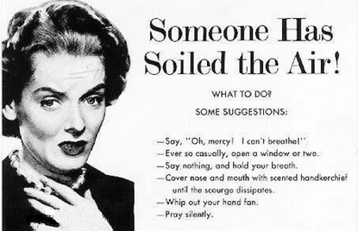
Recap
Without looking at your notes, or a book, can you identify whether the image is:
Medieval belief
Renaissance belief
Both

