Slide 1
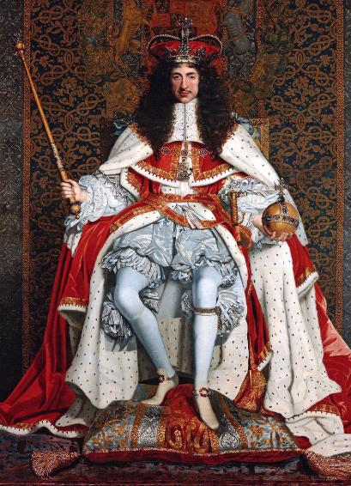
How much did medical care change between 1200 and 1700?
Starter:
Read the article given to you by your teacher. It was written about the death of King Charles II in 1685 by his physician Sir Charles Scarburgh. It is a perfect example of medicine in the Renaissance using a mixture of old and new ideas!
With one colour, highlight evidence of medicine that had stayed the same.
With another, highlight examples of new treatments.
In this lesson, we will:
Compare medical care in the Medieval and Renaissance
Describe how hospitals changed between the Medieval and Renaissance periods.

Slide 2
Traditional medieval treatments
New renaissance treatments
When Charles II of England lay dying from a convulsion which attacked him while shaving, the medicos of that day left no stone unturned in helping him along to the Great Beyond. First, he was bled of a pint of blood. Then his shoulder was cut and eight ounces more of blood was extracted by cupping.
Then followed an emetic, a purgative and another purgative. Next, an enema in which they used antimony, sacred bitters, rock salt, mallow leaves, violet, beet root, camomile flowers, fennel seed, linseed, cinnamon, cardamom seed, saffron, cochineal and aloes. This enema was repeated. In two hours, another purgative was given.
He was given drinks of barley water, licorice, sweet almonds, white wine, absinthe, anise seed, extracts of thistles, rue, mint and angelica. When these did not cure him, they gave him a poultice of burgundy pitch and pigeon dung, to be applied to his feet.

Slide 3
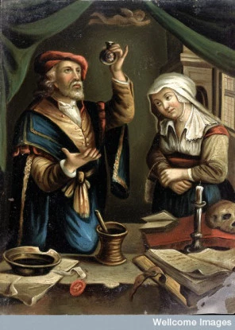
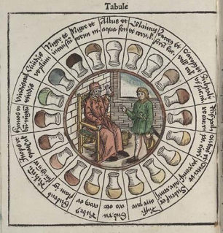
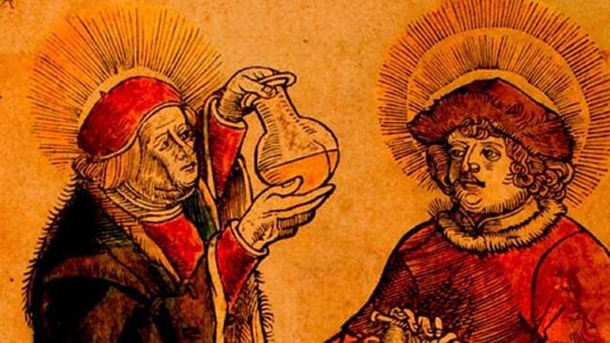
Medics in the Medieval Period
Without a health service, most people were treated at home by female family members. (e.g. most women would deliver babies at home)
If you had some money, or required special treatment, there were several places you could go.
Physicians were men who were professionally trained for 10 years at university (either in Oxford, Cambridge, or Padua)
They would diagnose you, but wouldn’t treat you. They would recommend someone to go to for treatment.
To diagnose you, they would look at urine samples and compare them with a urine chart to identify the humour out of balance.
This was only available to the rich, as they were very expensive.

Slide 4
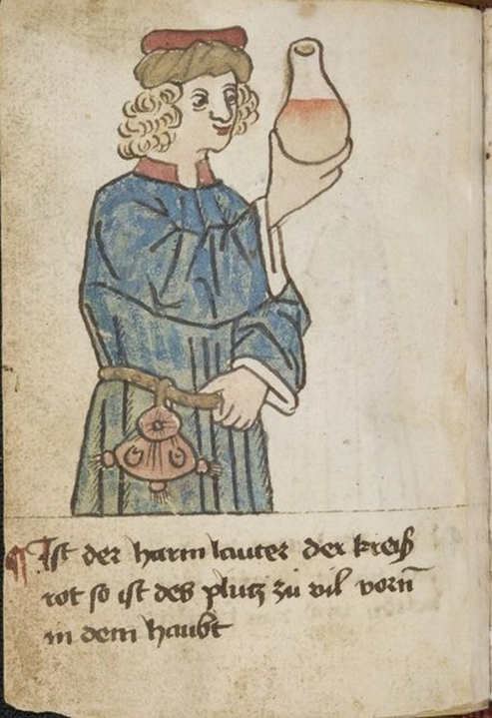
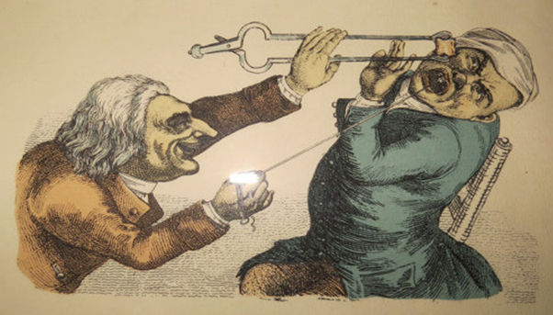
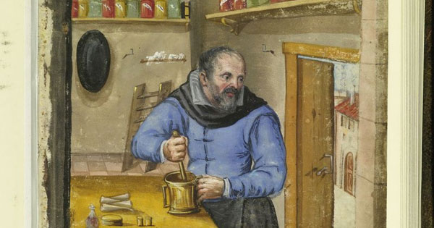

Slide 5
https://www.youtube.com/watch?v=PmhcYfLQvdc

Slide 6
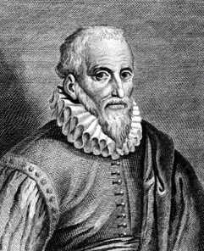
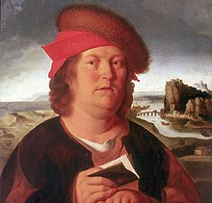
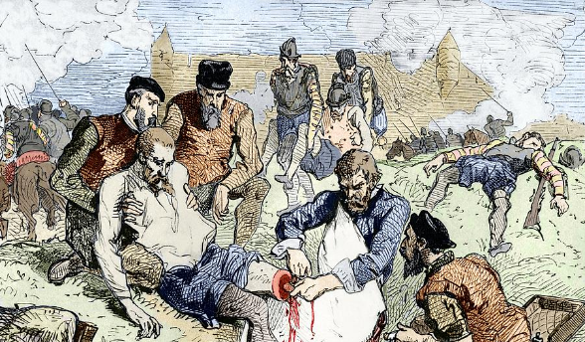
Surgeons in Renaissance periods
French surgeon Ambroise Paré changed people's ideas about surgery. He developed his ideas during his 20 years as a barber-surgeon, when he accompanied the French army on its campaigns.
In 1536 he discovered by chance (when the cautery oil he used to cauterisethe wounds of his patients ran out) that wounds healed better if they were treated with a 'soothing digestive' (boiled poultice) of yolks and rose oil.
He used catgut ligatures to tie arteries during amputations instead of cauterising the wound.
In 1575 he published his 'Apology and Treatise', which advocated changes to the way surgeons treated wounds and amputations.
Paracelsus, a famous Swiss surgeon discovered that laudanum (opium) was a painkiller that could be used to help his patients.

Slide 7
Learning Task One
Targets 7 - 6
In the Medieval box, describe the role of that person in medical care
In the Renaissance box, come to a decision on how much there was change or continuity. Give examples to support what you say.
All targets
Divide your book page into six sections (see right).
In each write:
Medieval Physician
Renaissance Physician
Medieval Apothecary
Renaissance Apothecary
Medieval Surgeon
Renaissance Surgeon
Targets 5-3
In the Medieval box, describe the role of that person in medical care
In the Renaissance box, explain what changed.
Targets 2 – 1
In each box, write down a description of their role. Try to use key words if possible!

Slide 8
Checkpoint One: Can you compare medical care in the Medieval and Renaissance periods?
Complete the worksheet your teacher has given you, without using any notes!

Slide 9
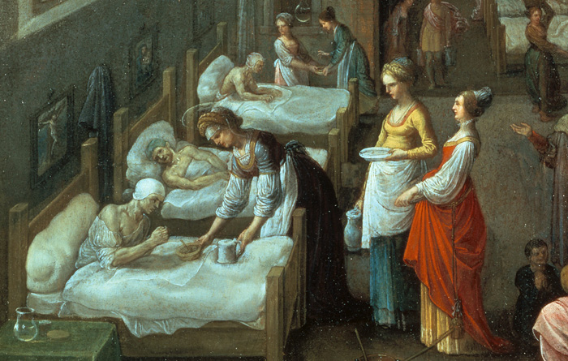
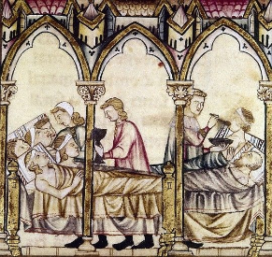
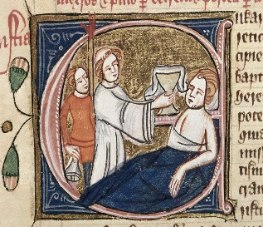
Hospitals in the medieval period
During this period, there were more hospitals than ever before! (1,100 by 1500)
Bury St Edmund’s had six hospitals to care for lepers, the ill and the elderly. It even had a shrine which could heal people (apparently).
30% of hospitals in England were run by the Church, so offered hospitality rather than medical treatment. They were run by nuns and monks.
The other 70% were run set up by rich people who had left money in their will. The Church often ran these too.
Very few people visited them. Most would be treated at home by a woman in their family.

Slide 10
Medieval
Renaissance
Insane and pregnant patients would be turned away.
Patients would share beds
Run by monks and nurses.
Focus was on care rather than curing.
Prayers were encouraged
Often kept clean with fresh linen and clothing changed regularly.
English hospitals had no doctors or surgeons.
Began to focus on curing people e.g. fevers, skin conditions.
A physician would visit often twice a day to observe symptoms and prescribe treatments.
Would have access to apothecaries to mix medicines. This would include new herbs from New World (see lesson on treatments)
Still run by the Church.
Pest houses were set up which would deal with one particular disease e.g. leprosy, plague, pox. This would stop contagious diseases spreading in hospitals.

Slide 11
Checkpoint Two: Can you compare hospital care in the Medieval and Renaissance periods?
Complete the worksheet your teacher has given you, without using any notes!

