Slide 1
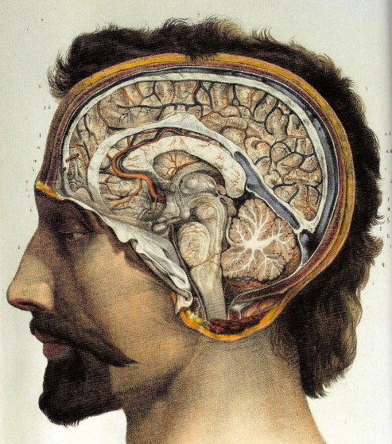
How important were individuals in changing medical ideas between 1500 and 1700?
In this lesson, we will:
Describe the work of Vesalius, Harvey and Sydenham
Explain why medical ideas began to change during this time
Starter: Return to your timeline from last lesson. Ensure it clearly explains how the printing press led to the Royal Society publishing their first journal.

Slide 2
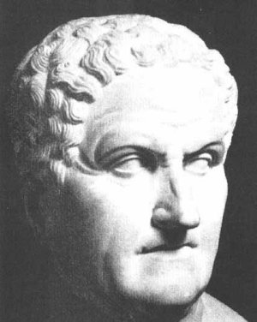
Galen’s ideas on human anatomy
Muscles attach to the bone in the same way in humans and in dogs.
Blood was constantly created in the liver, burned up by muscles.
Holes through the septum, which allowed the blood to flow from one side of the heart to the other.
The human jaw-bone was made up of two bones, like a dog's.

Slide 3
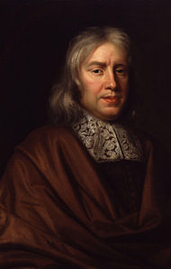
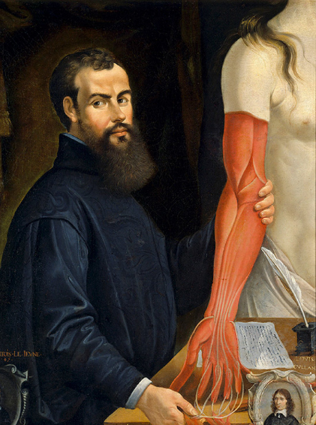
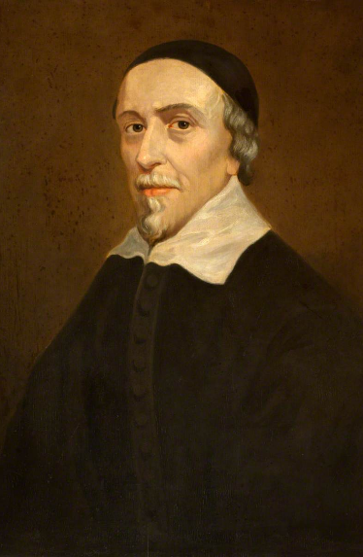
https://www.youtube.com/watch?v=walfj2dpU-E

Slide 4
Andreas Vesalius
1536
He discovered the spermatic vessels. He also realized that the famous doctor Galen could be wrong, when he discovered that he was wrong about two bones in the jaw, and about how muscles were attached to the bone.
1537
He became professor of medicine at Padua University. He said that medical students should perform dissections for themselves, stating that:"... our true book of the human body is man himself.“
1543
He published 'Fabric of the Human Body' (with high-quality annotated illustrations).

Slide 5
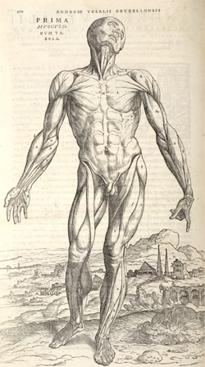
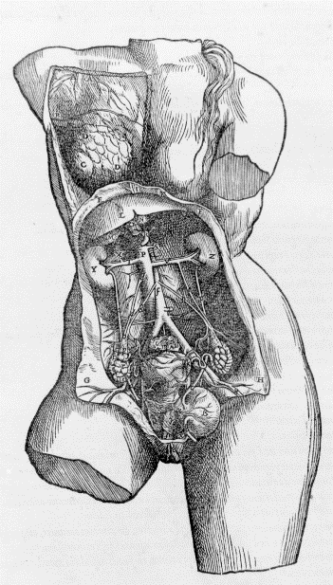
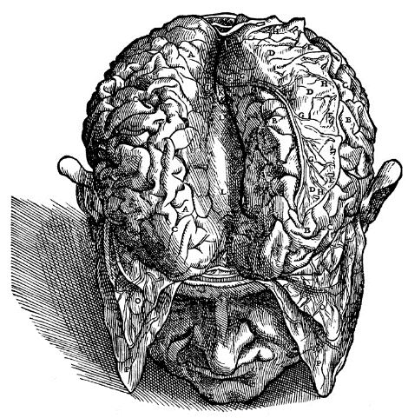
Sketches taken from ‘On the fabric of the human body’ Andreas Vesalius. 1543

Slide 6
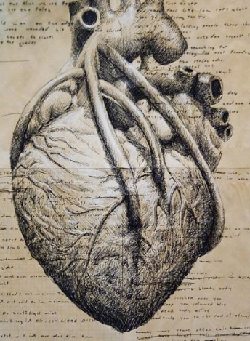
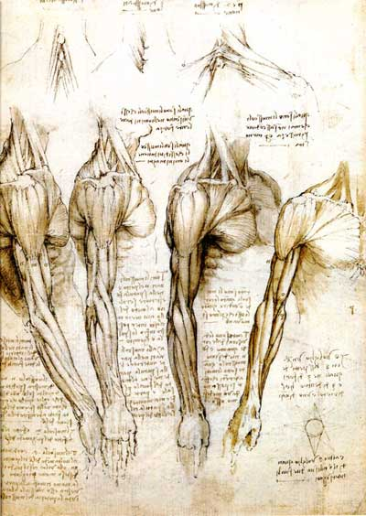
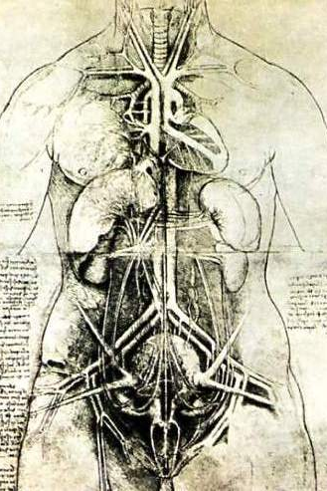
Anatomical sketches, Leonardo da Vinci (1500-1519)

Slide 7
William Harvey
Trained at Cambridge and Padua universities, and became doctor to James I and Charles I of England. Influenced by Vesalius.
1616
He calculated that it was impossible for the blood to be burned up in the muscles (as Galen had claimed).
1628
He published 'Anatomical Account of the Motion of the Heart and Blood', which scientifically proved the principle of the circulation of the blood. This book marked the end of Galen's influence on anatomy.

Slide 8
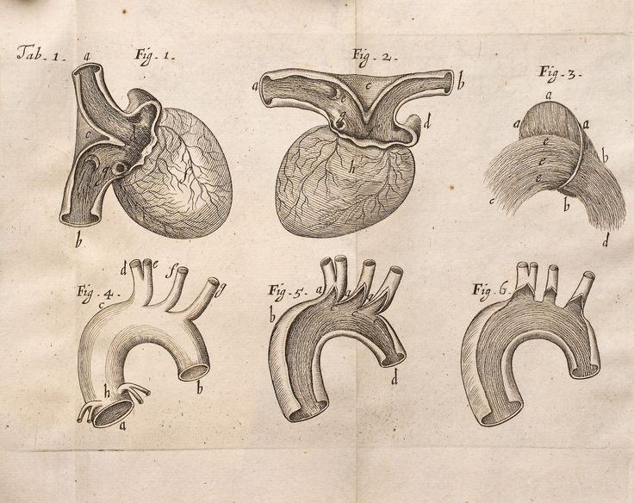
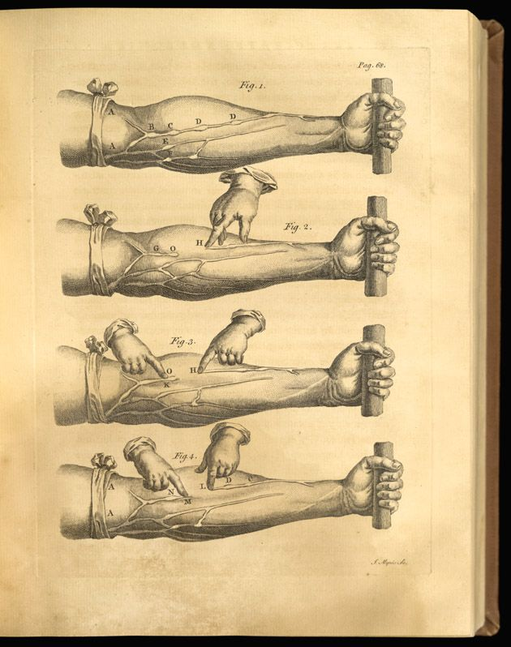

Slide 9
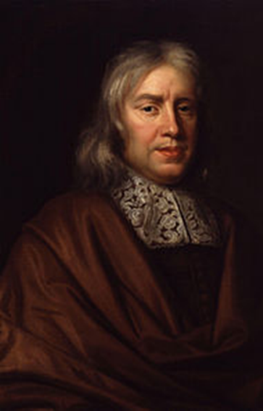
Thomas Sydenham
Refused to use medical textbooks when diagnosing illness. Instead, he observed symptoms. Influenced by Harvey
Rather than seeing all symptoms as side effects of one cause, he would treat each symptom individually.
Said the nature of the patient had nothing to do with the disease.
He was never able to identify microorganisms that cause disease, but he did prove that measles and scarlet fever were separate diseases.

Slide 10
Checkpoint One: Can you describe the contributions of Vesalius, Harvey and Sydenham?
Thinking questions (All targets)
To the right you will find two statements about the three men above.
Have a discussion with your partner about what you think.
Together, jot down some ideas to back up the statements.
‘Without Andreas Vesalius, William Harvey would have never published his theories on the heart’
‘Thomas Sydenham’s way of practising medicine was great change from previous ways’

Slide 11
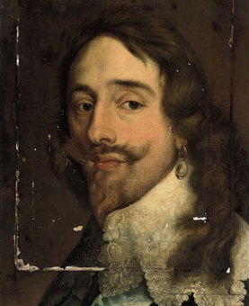
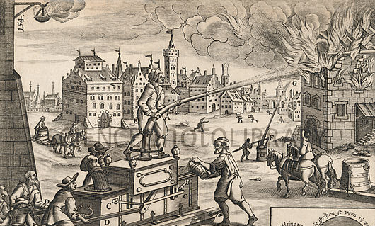
What factors helped Harvey and Vesalius?
Institutions such as the government (King Charles I of England, Charles V of France)
Technology, such as the mechanical firefighter pumps, printing press etc.
Dissections becoming more common
Changing attitudes of the ‘Renaissance’ (accelerated by printing press)

Slide 12
Checkpoint Two: Can you explain why medical ideas began to change during this time?
Thinking questions (All targets)
To the left there are a few reasons why medicine began to change.
For each, discuss with your partner how they caused medicine to change.
Write them down, and jot down some ideas discussed.
Institutions (e.g. government, monarchy)
Technological developments
Dissections
Changing ideas accelerated by the printing press
Work of individual doctors

