Slide 1
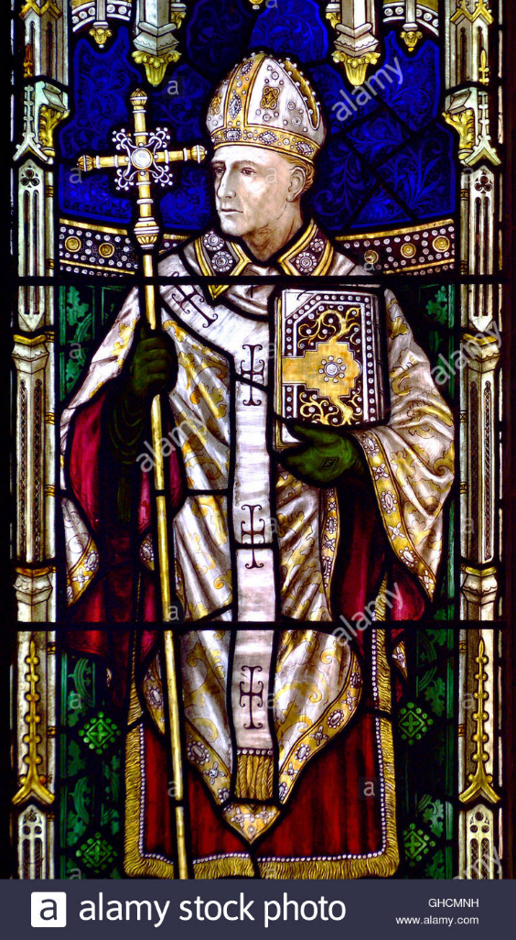
How important was the Treaty of Versailles for Germany?
In this lesson, we will:
Describe the key terms of the Versailles peace treaty
Assess why Germany hated this peace treaty.
Starter: Describe two key features of Lanfranc’s Church reforms (4 marks)

Slide 2
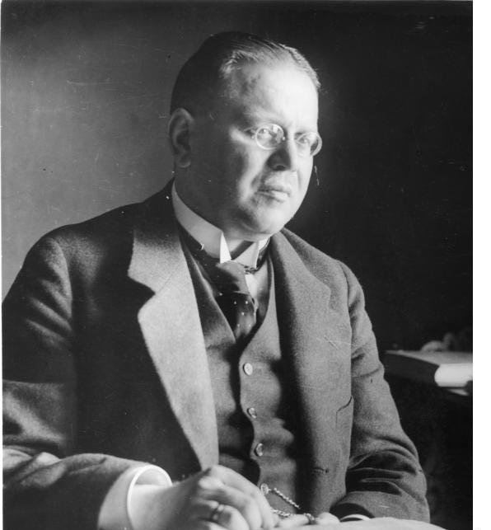
How did Ebert end the First World War?
Before holding elections, Ebert sent Matthias Erzberger to France to negotiate Germany’s surrender.
On a train carriage in the Forest of Copiegne, Erzberger negotiated for 5 days.
The French general, Ferdinand Foch, was unwilling to compromise with the Germans.
On 10th November, General Hindenburg and Ebert telegraphed to say he should sign it on whatever terms were offered.
On 11th November 1918, the armistice was signed that ended the First World War.

Slide 3
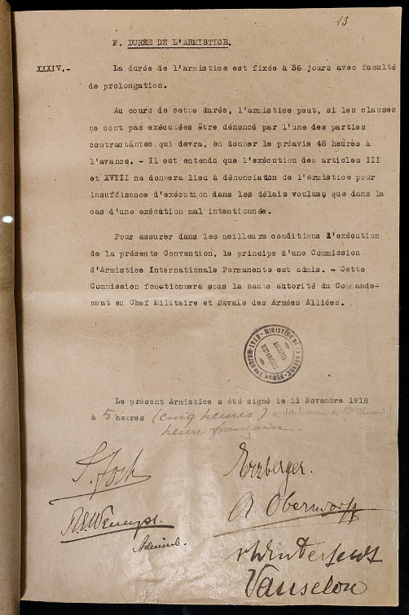
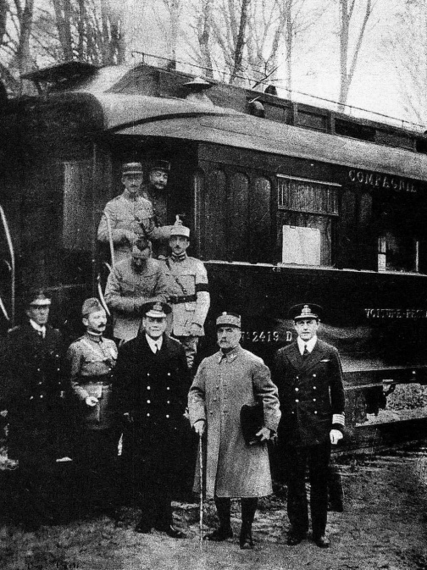

Slide 4
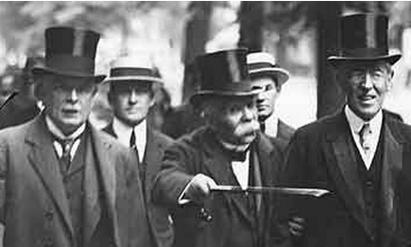
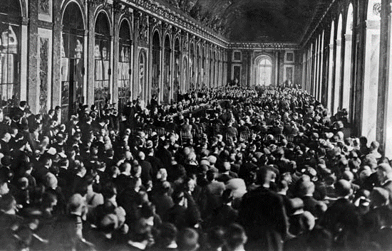
What was the Treaty of Versailles?
By June 1919, the allied powers met at the Palace of Versailles to draw up a peace treaty.
The negotiations were dominated by the ‘Big Three’: David Lloyd George, Georges Clemenceau and Woodrow Wilson.
Germany was not allowed to attend this peace summit, as they had lost the war.
The French, led by Georges Clemenceau, wanted to punish Germany very harshly.
Lloyd George (Britain) did not want to punish Germany too harshly. He did not want the people of Germany to become so disillusioned with their government that they turned to communism.

Slide 6
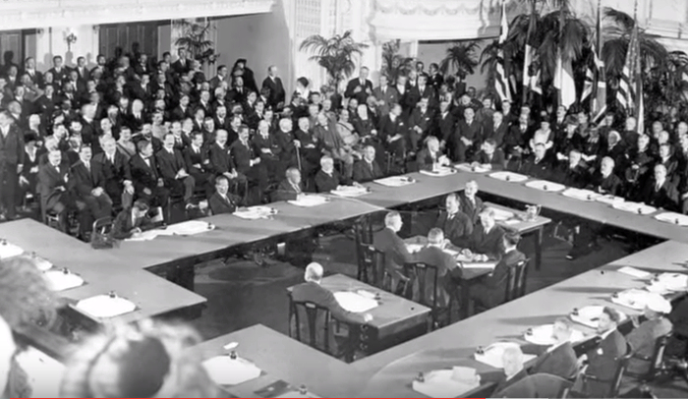

Slide 7
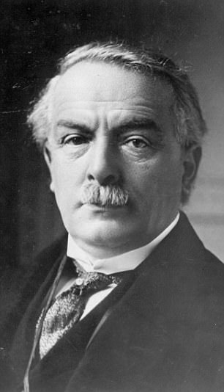
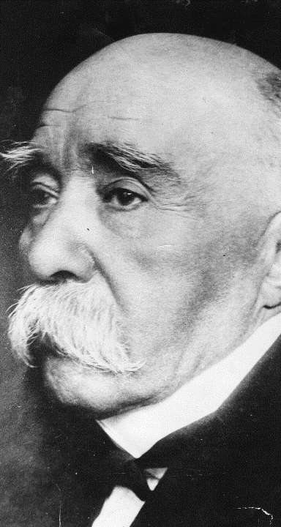
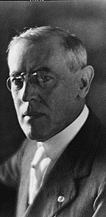

Slide 8
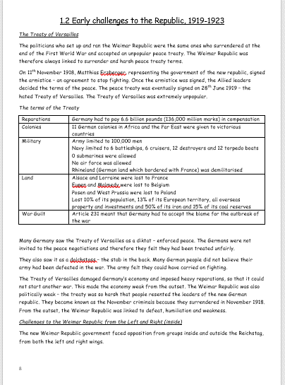
Learning Task One
As a class, read through this sheet on the Treaty of Versailles.
Highlight key words and phrases.
Thought:
Was the Treaty of Versailles that harsh on Germany? Or could it have been worse?

Slide 9
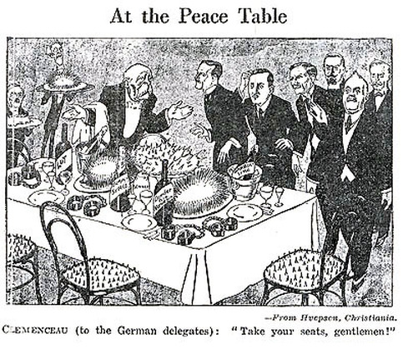
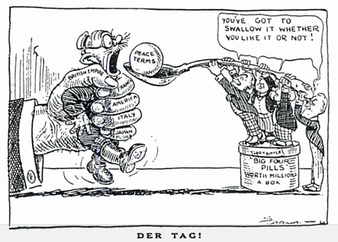
Learning Task Two
For each cartoon:
What is the cartoonist’s interpretation of Versailles?
Provide examples to support it.
Thought:
In what ways could we say that Ebert’s government had no choice but to sign the Versailles Treaty?

Slide 10
Germany is being forced to accept this peace treaty. Most Germans believed Germany would be able to negotiate the terms of peace, but the Allies refused to allow any German representatives to the treaty discussions. It was called ‘diktat’ which means it was forced on them.
Article 231 known as ‘war guilt clause’ stated that Germany had to accept total responsibility for the war.
£6.6 million in reparations
All German colonies in Africa and the Far East were given to the victorious countries
The army was reduced to 100,000 men with no heavy artillery
Navy was reduced to 6 battleships, 6 cruisers, 12 destroyers and 12 torpedo boats. No submarines.
Air force was abolished
The Rhineland was demilitarised and no German troops allowed in. Allied soldiers would stay there until 1930.
Germany lost a lot of land (Alsace Lorraine to France, Eupen to Belgium, Posen to Poland Northern Schleswig to Poland)
The Saar coalfields was given to France for 15 years.

