Slide 1
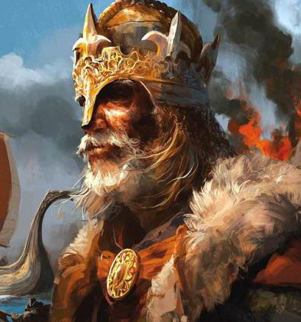
How important was the Battle of Stamford Bridge?
In this lesson, we will:
Explain why King Harold II was victorious at Stamford Bridge.
Assess to what extent this battle helped Duke William of Normandy.
Starter:
What was Harald Hardrada’s claim to the English throne in 1066?
What was Harold Godwinson’s claim to the English throne?

Slide 2
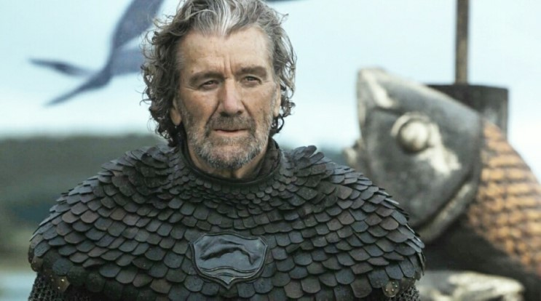
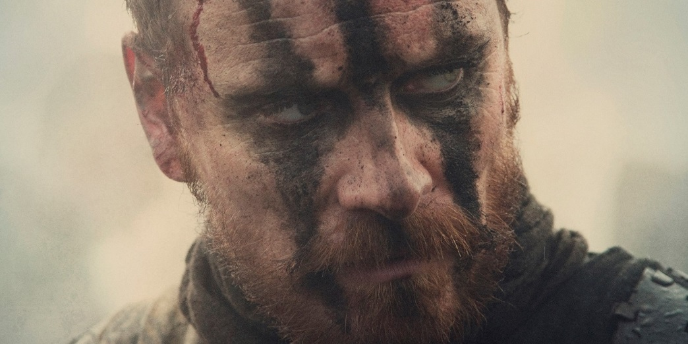
Harald, King of Norway
Harold II, King of England
Was Edward’s brother-in-law
Had been running the kingdom during Edward’s ill-health.
Was a well respected warrior, politician and leader.
Had support from the Witan
Edward had promised him the throne on his deathbed.
Was a direct descendent from King Cnut.
After the death of Magnus, the throne should have passed to Hardrada’s father but instead it went to Edward.
Had huge support in the Danelaw, as well as from Tostig

Slide 3
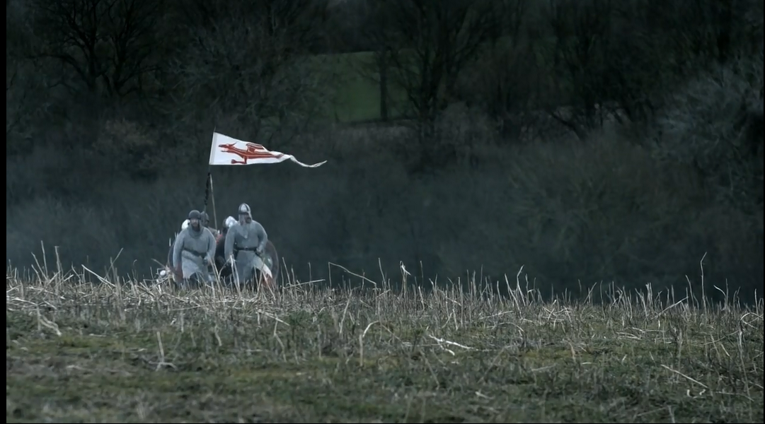
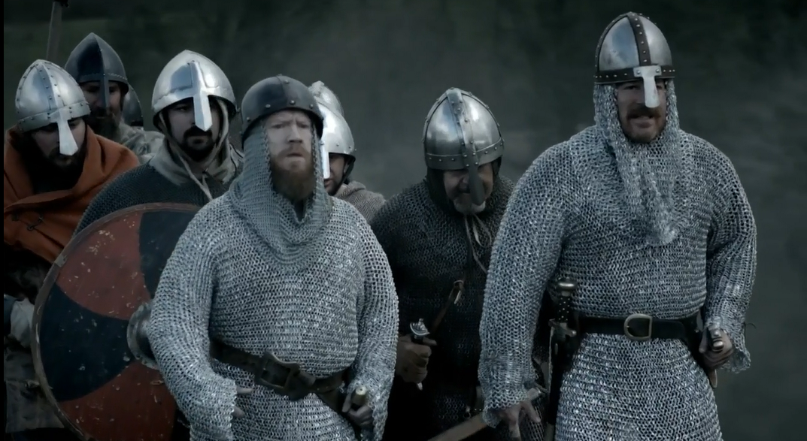
What happened after the defeat at Gate Fulford?
King Harold had heard of the invasion just before the battle at Fulford. He had the difficult task of raising an army as he and his earls marched 185 north to York.
It took Harold five-days to march north whilst gathering troops on the way.
Hardrada and Tostig captured York and waited on the delivery of hostages at Stamford Bridge.
The last thing they expected to see was King Harold’s army!

Slide 4
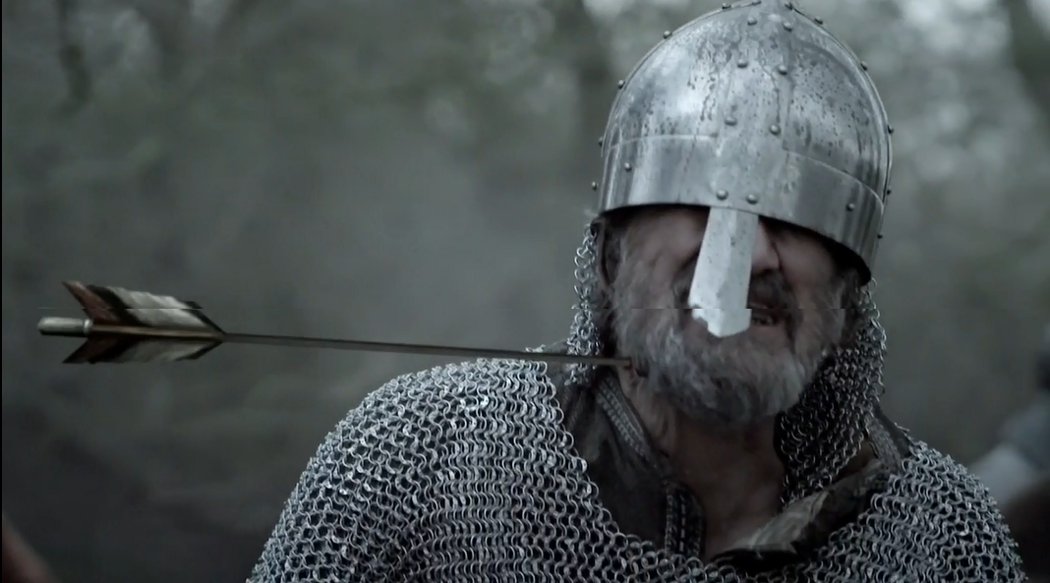
What happened during the battle?
Hardrada and Tostig was so surprised to see the Saxon army, that they had no time to properly prepare.
To kill time, Hardrada ordered a large Viking warrior to stand on the bridge to slow down the oncoming Saxons.
The Viking’s arranged themselves in a shield wall by the time the Saxons reached them.
Due to the element of surprise, exhaustion and the ferocity of the Saxon attack – the shield wall quickly fell.

Slide 5
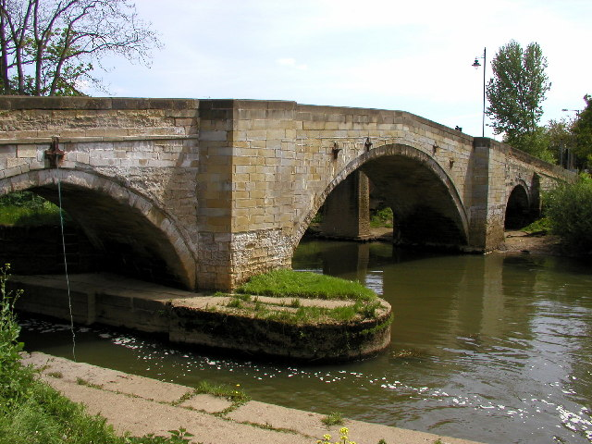
After Fulford, Tostig and Hardrada exchanged hostages with York.
It was agreed that extra hostages would be handed over to them at Stamford Bridge.
On 25th September, something unexpected happened – King Harold attacked!

Slide 6
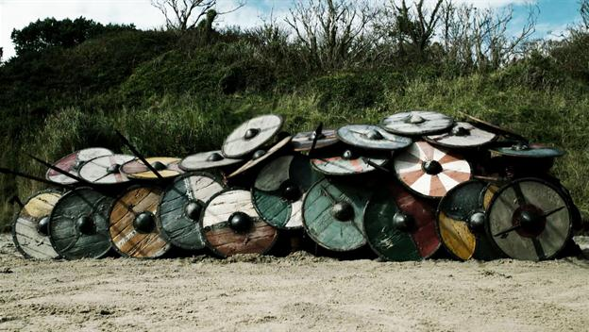
https://www.youtube.com/watch?v=TTYz439cA5w

Slide 7
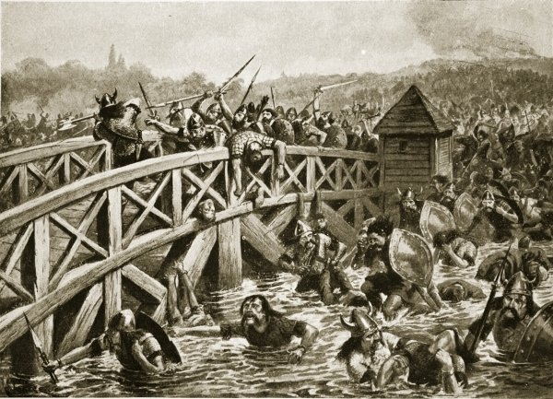
Harold’s Army struggled to cross the bridge due to a large Viking warrior. He was taken out by a spear from beneath.

Slide 8
The Viking had arranged themselves in a shield wall for extra protection but this was eventually broken.

Slide 9
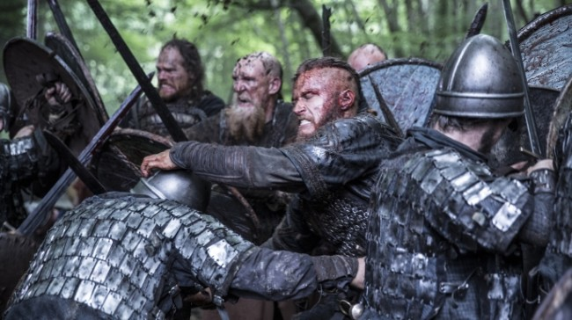
The two forces fought for hours, many Vikings felt misled – they expected the English to hate their new king.

Slide 10
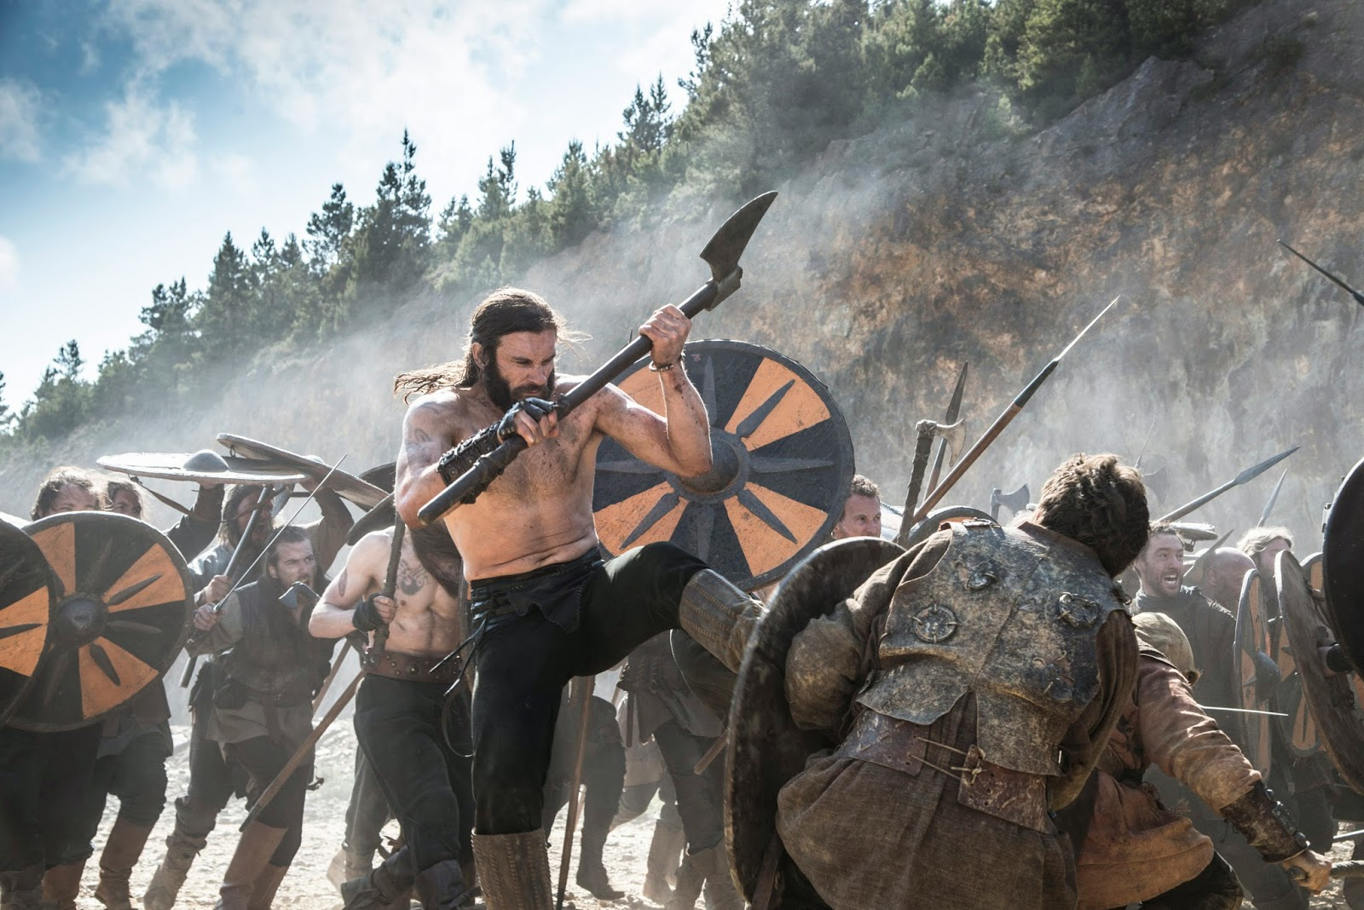
Many Vikings fought without armour, it was very hot and they left it on their boats.

Slide 11
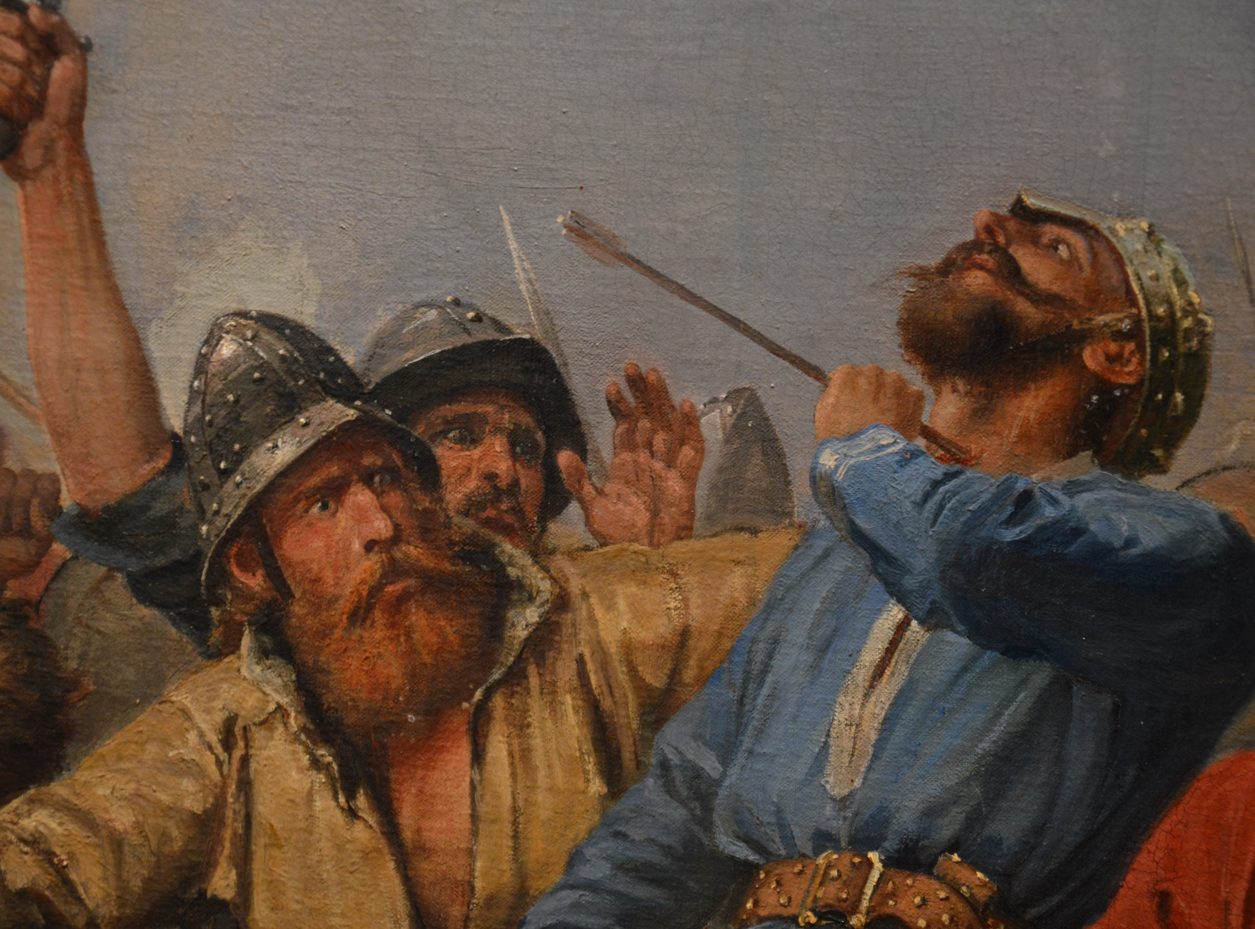
Eventually Hardrada was shot in the neck by an arrow. Tostig was also killed during the attack.

Slide 12
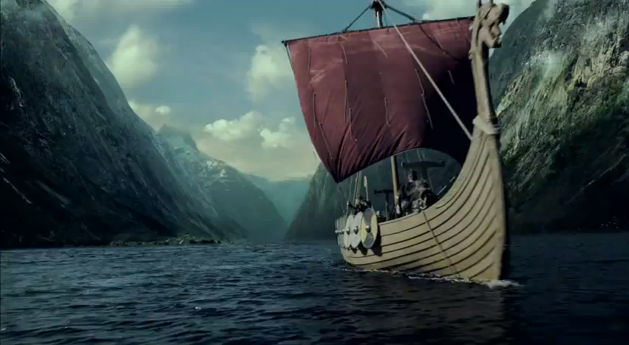
Out of 300 ships, only 24 returned to Norway.

Slide 13
Learning Task One
Green groups + orange groups
Explain how the Battle of Stamford Bridge was a ‘hollow’ victory for King Harold of England.
All targets:
Using the information you have just gathered, complete the following story-board your teacher has provided you.
Blue groups:
How did the Battle of Stamford help William of Normandy?

Slide 14
Hardrada and Tostig’s invasion had drawn Harold’s forces from the South coast. This meant that the south coast was completely open to William
Edwin and Morcar abandoned Harold after their defeat at Gate Fulford – this would have weakened his army.
By having to march 185 miles north, and then south, Harold would have exhausted his housecarls.
4. His victory would have made him over-confident. Instead of waiting for William in London, he decided to rush into battle at Hastings.
Explain how the Battle of Stamford Bridge was a ‘hollow’ victory for King Harold of England.

