Slide 1
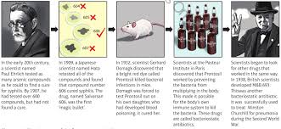
How has the government helped improve public health since the Second World War?
In this lesson, we will:
Describe that the British government has done to improve people’s health since 1945.
Assess how successful these campaigns have been.
Starter: Use 10 minutes to complete your timeline task from last lesson. It should tell the story of how magic bullets were developed throughout the 20th century.

Slide 2
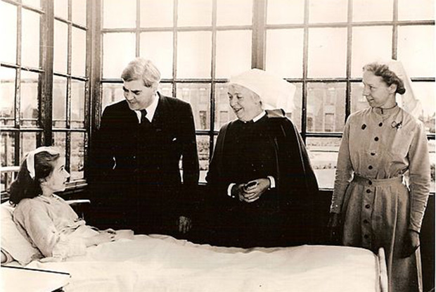
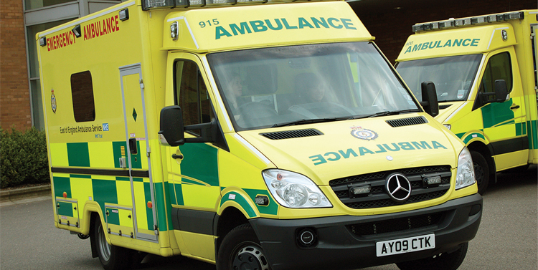
Where did the NHS come from?
The National Health Service was set up by the British government in 1948.
It aimed to provide medical care for everyone in Britain, free of charge. It is funded by tax and National Insurance.
When it was set up, it took over existing hospitals, GP practices and other medical services.
It tried to do better than previous acts, such as the 1911 National Insurance Act (this only provided temporary medical treatment to workers, but not their families)

Slide 3
Problems in the beginning:
Solutions in the 1960s:
Post-War Britain did not have a lot of money, so many hospitals were desperately in need of updating.
GP surgeries and GP training needed updating (25% were not up to standards).
Due to the popularity of it, waiting times increased dramatically.
In the 1960s, the government tried to improve the NHS.
In 1966, a GP’s charters was introduced which gave financial incentives for them to keep up to date with modern developments.
More hospitals began to be built across the country rather than in the south.

Slide 4
Benefits in 2018:
Problems in 2018:
Everyone has access to free medical treatment.
The NHS provides access to the latest drugs and medication.
NHS hospitals usually have the latest technology (x-rays, prosthetic limbs, microsurgery etc.)
NHS hospitals tend to be close to most towns and cities.
Due to a rising population, waiting times are increasing.
Ambulance services are stretched, so waiting times increase.
It is underfunded, so can’t deliver services as quickly as it previously could.
Charges are in place for dentistry etc.

Slide 5
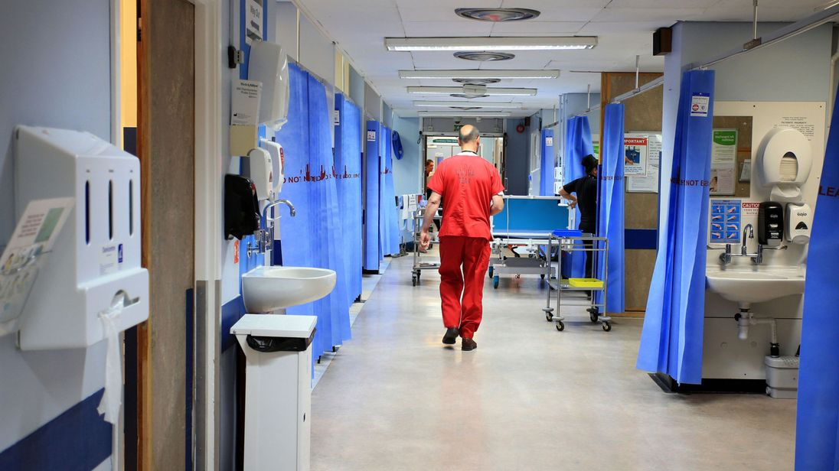
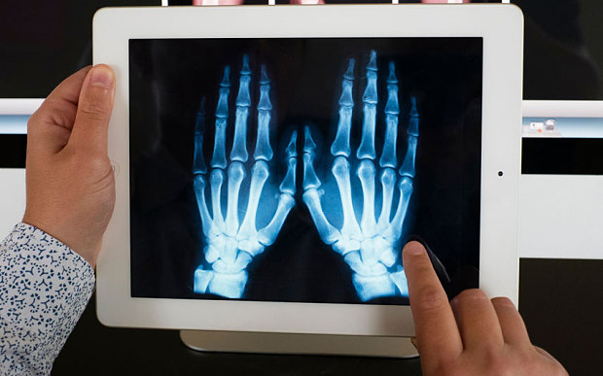
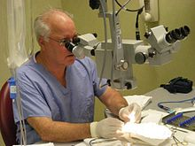
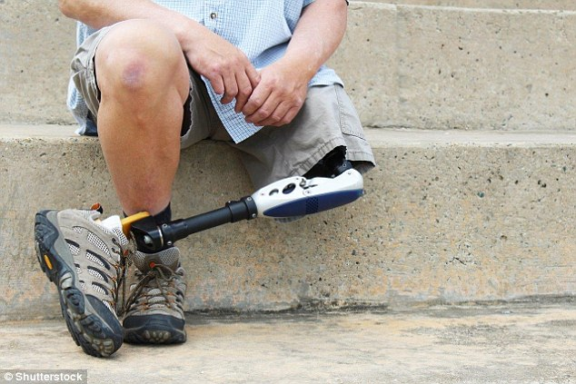
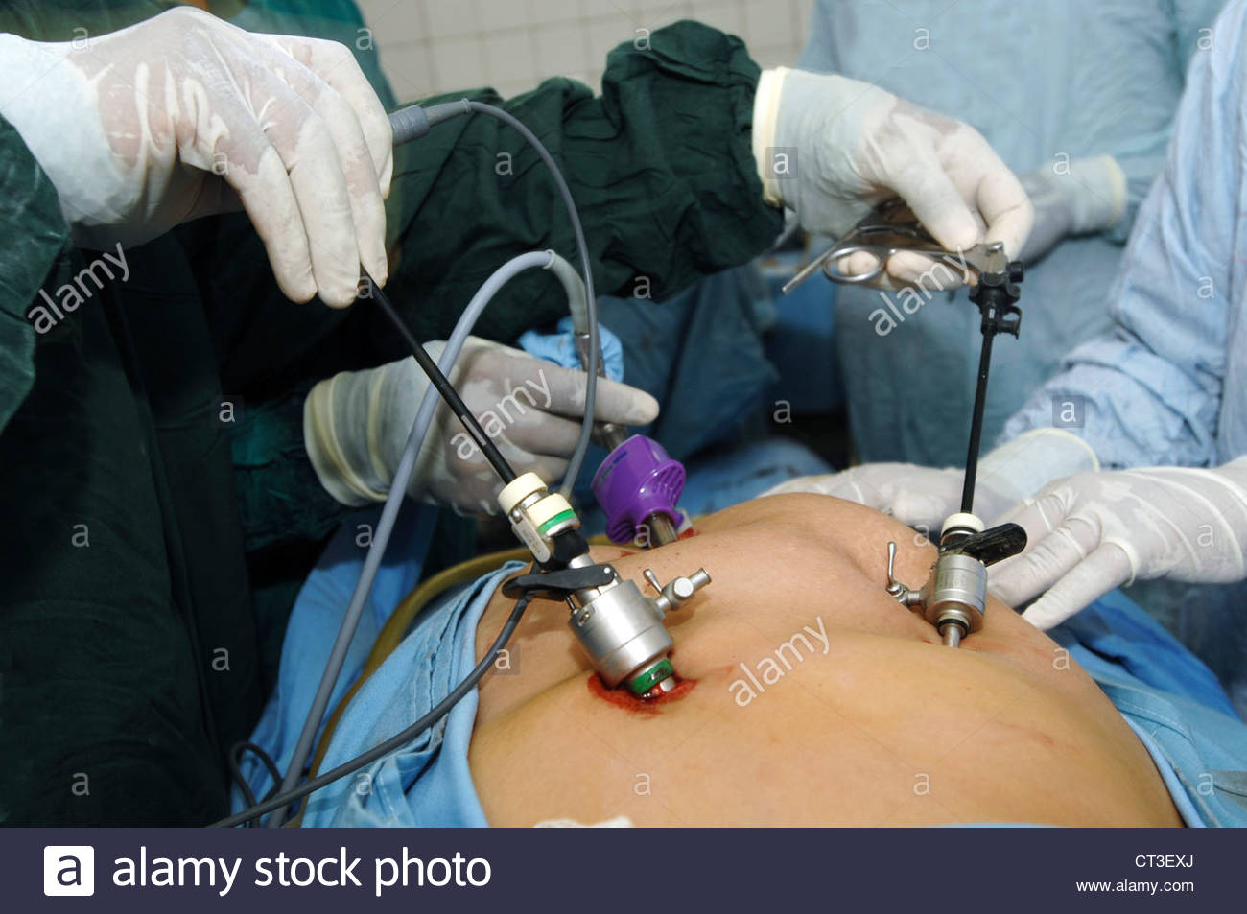

Slide 6
Learning Task One
Split your page into two:
NHS, 1945-1970
NHS, 2018
For each, identify WWW and EBI
(What was going well, and what had to be improved)

Slide 7
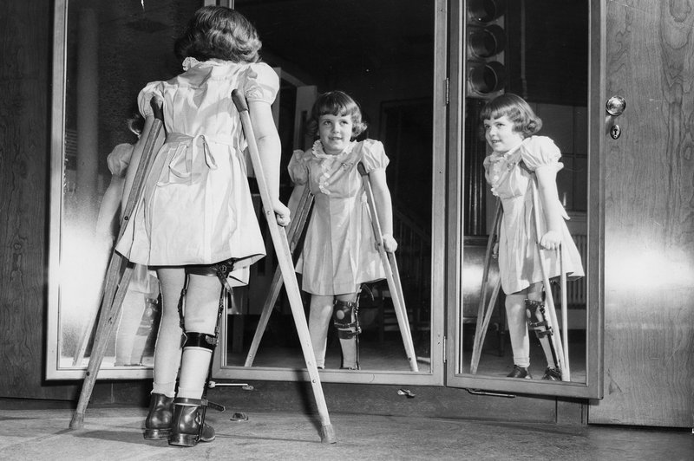

Slide 8
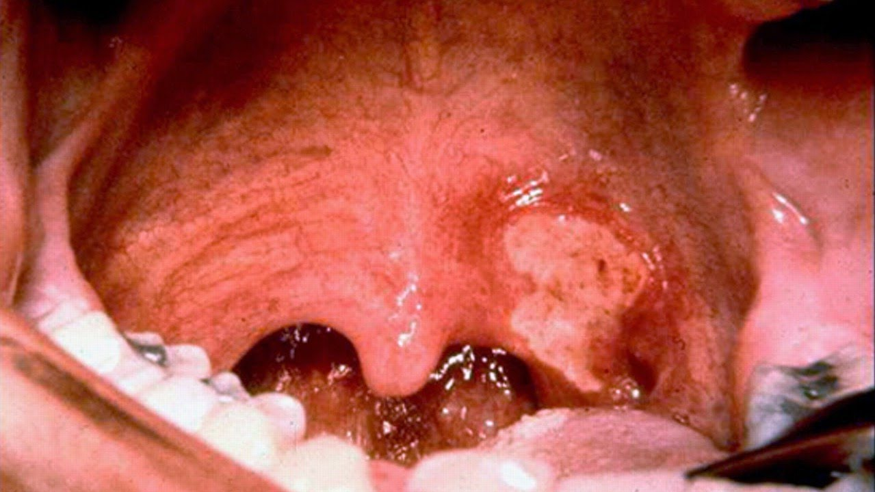

Slide 9
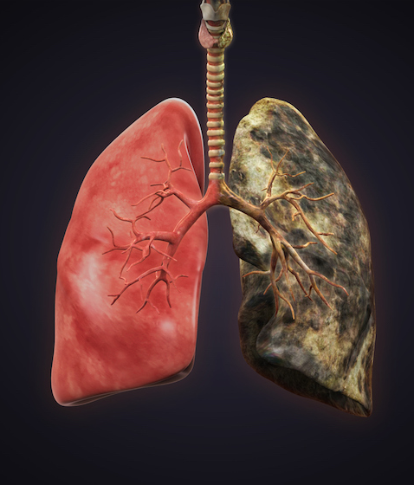
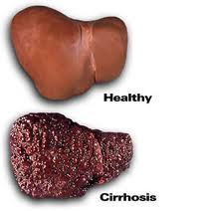

Slide 10
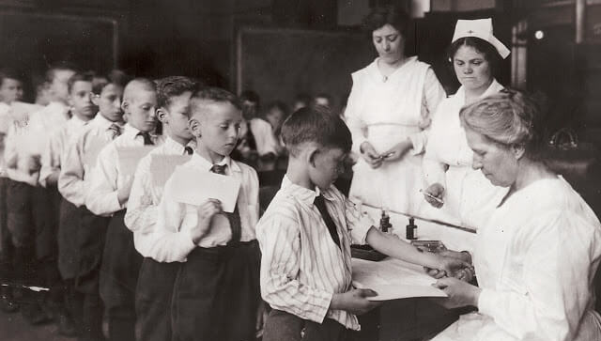
How else has the government helped?
In 1942, it launched compulsory vaccinations for diphtheria. All children had to be vaccinated during WW2.
In the 1950s, the same was done for polio which killed 8,000 people a year. The last case of polio was in 1984 – it’s gone!
Other vaccines that have been introduced in schools include rubella and HPV.
The government has also tried to tackle pollution e.g. Clean Air Acts of 1956 and 1968.
In 2006, the Health Act banned smoking indoors.
All cigarette packages are plain, and hidden in shops. The age of smoking was raised from 16 to 18.

Slide 11
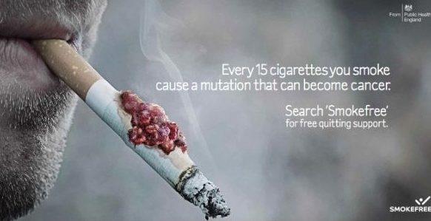
How else has the government helped?
It has funded many campaigns to advertise the dangers of smoking, binge drinking, drug use and unprotected sex.
Healthy eating has been promoted in schools to cut down on sugar and fatty foods.
Sugar Tax was introduced in 2017/18 to increase the price of sugary drinks.
Parliament is currently debating a ban on the sale of energy drinks to those under the age of 18.

Slide 13
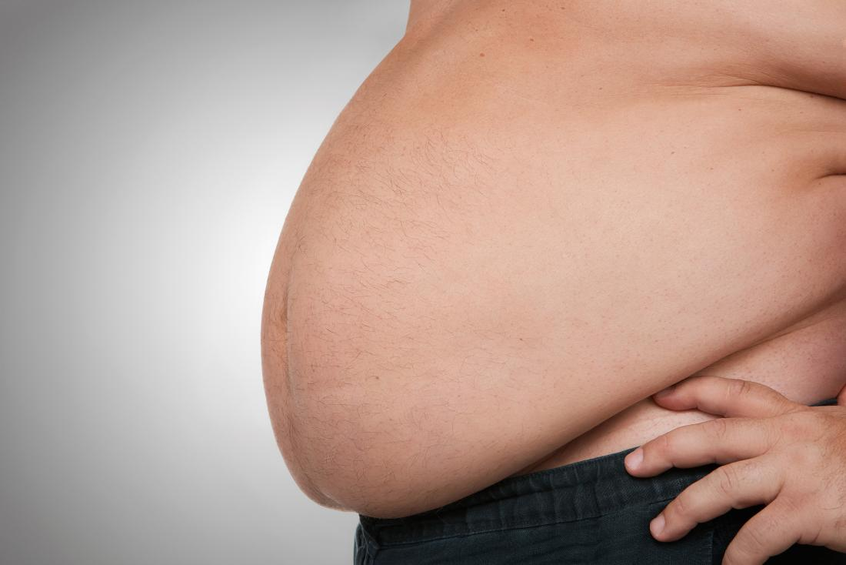
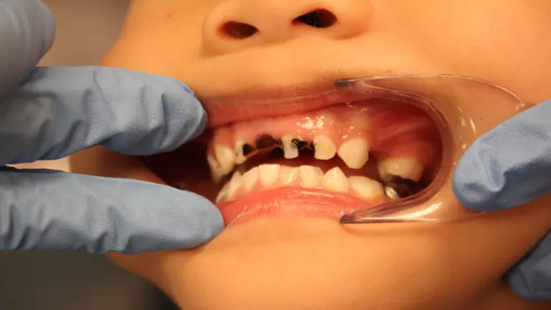
The amount of people who smoke in England and Wales has fallen to 15% in 2018, from 45% in 1974.
Adult obesity rates in the UK have already reached more than 31 per cent.
The amount of workers diagnosed with depression has increased by 30% over the past 5 years.
An estimated 16% of children aged 2-15 in England were obese in 2016.
Obesity costs the NHS a staggering £4 billion a year
The amount of antidepressants being prescribed by the NHS has increased by 108.5% since 1017.

Slide 14
Learning Task Two
Targets 7-5
For each; what have the government done to tackle it?
How effective has this been?
Below are a list of problems existing in Britain since 1945:
Diseases such as polio.
Health problems caused by pollution.
Health problems caused by lifestyle.
Targets 4-2
What has the UK government done to stop these problems?

