Slide 1
How did the NSDAP try to improve working conditions in the 1930s?
In this lesson, we will:
Describe how the Nazis changed working conditions
Assess to what extent Dr Ley was successful as Minister for Labour.
Starter: What can we infer from Source B about the way the NSDAP controlled Germany?

Slide 2
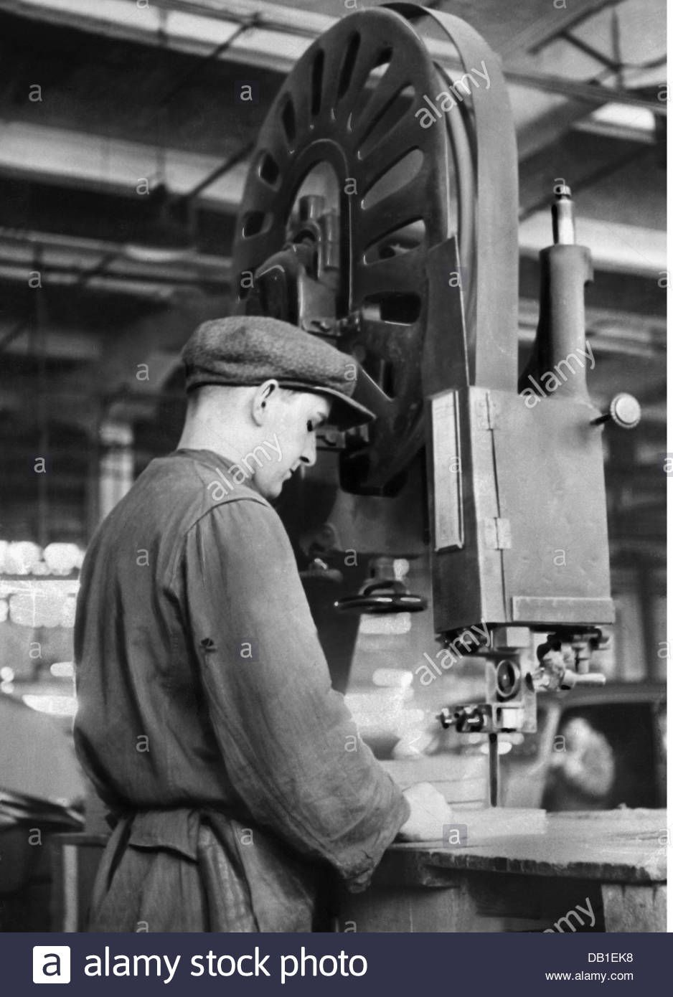
Why did the Nazis want to control leisure time?
Every German had roughly 3,740 hours of leisure time per year.
Hitler wanted to control every hour.
He appointed Dr Robert Ley to lead the ‘German Labour Front’
Ley introduced various policies to ensure that Germans had opportunities to enjoy their work.
He hoped to increase workplace productivity and increase support for the NSDAP.

Slide 3
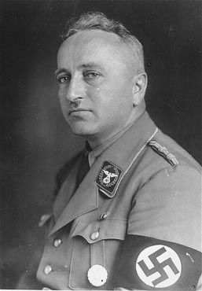
Ban trade unions
Improve work place facilities
How did Dr Robert Ley improve German productivity?
Provide every worker with a car
Make work seem ‘enjoyable’

Slide 4
Learning Task One
Create a profile on Dr Robert Ley.
It should contain:
Name and role within Hitler’s government.
Examples of success
Examples of failure
Deeper Thought:
Was Ley successful at improving working conditions in Nazi Germany?

Slide 5
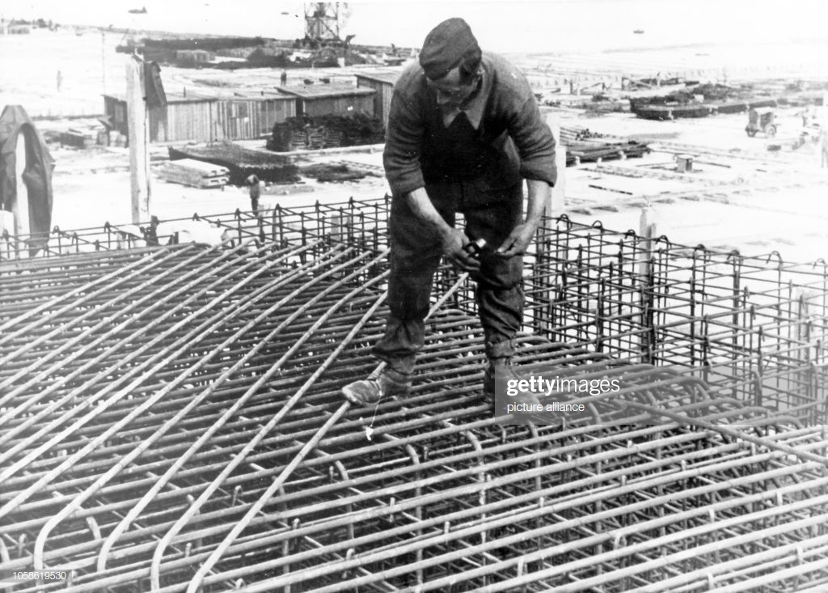
“Beauty of Labour” (SdA)
Ley offered companies and employers tax breaks if they agreed to use this money to improve facilities.
New showers, toilets and offices were built across German workplaces.
However, some employers chose cheap materials in order to keep more of this tax money.
Other employers made their workers build the improvements themselves!

Slide 6
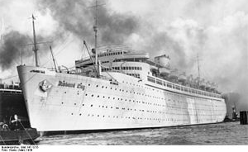
Make work seem ‘enjoyable’
Ley drew the ‘KDF’ (Strength through Joy) to offer incentives to workers.
Cheap holidays were offered e.g. skiing in Bavaria, Italy and Switzerland.
Cruise ships were built to offer trips to the Canary Islands for 62 marks.
However, only senior Nazi officials were ever able to take advantage of these.
Other incentives included museum tours, hikes, theatre trips and operas.

Slide 7
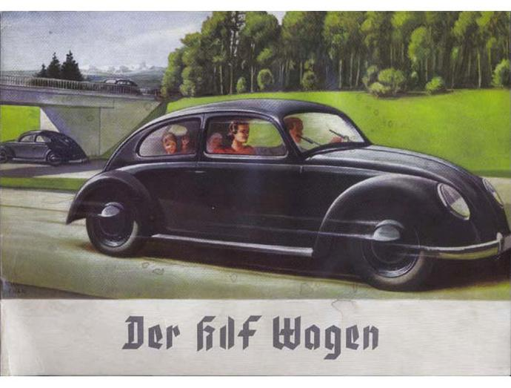
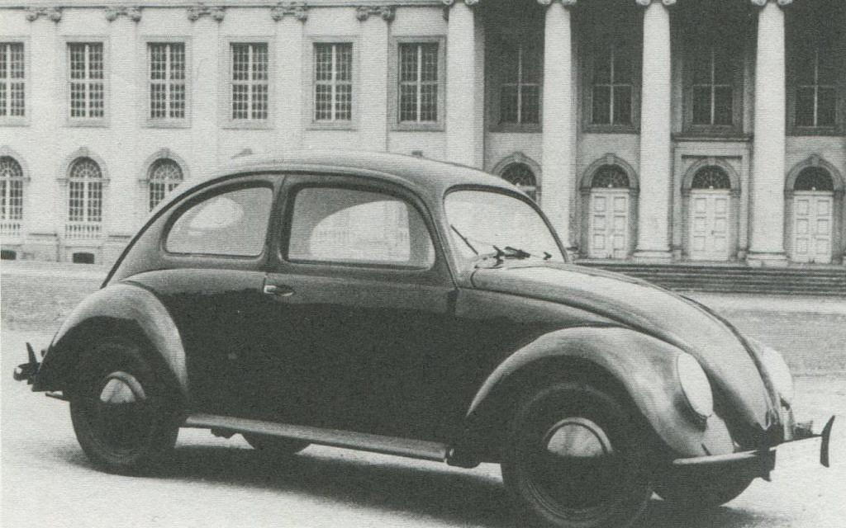
Provide every worker with a car
Hitler ordered the ‘Volkswagen’ (People’s Car) must be built to be affordable.
It was 990 marks (35 weeks wage)
Ley began a hire purchase scheme – 5 marks a week until 750 marks were saved.
Not one single Volkswagen was ever built for a German customer.
In 1939 the factory was converted into a munitions factory.
Millions of marks were lost.

