Slide 1
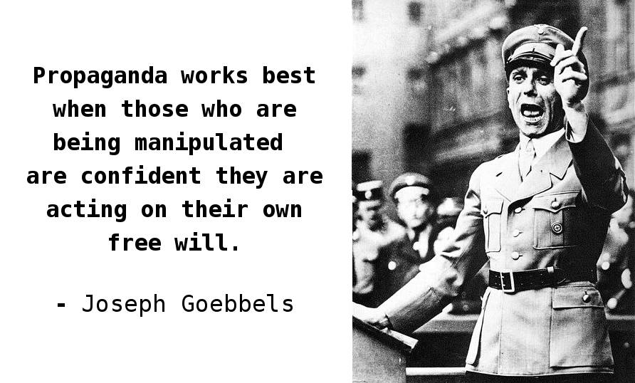
How did the Nazi’s create a police state in Germany between 1933 and 1939?
In this lesson, we will:
Describe the role of the SD, SS and Gestapo
Assess to what extent the Nazis used fear to govern Germany in the 1930s.
Starter: What did Goebbels mean by this quote? Discuss with your partner!

Slide 2
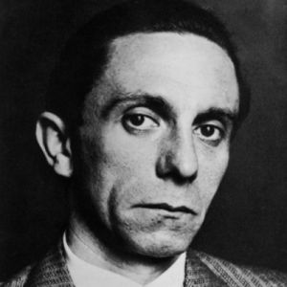
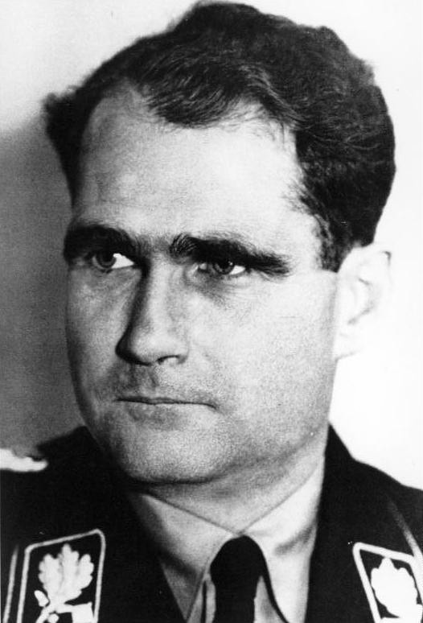
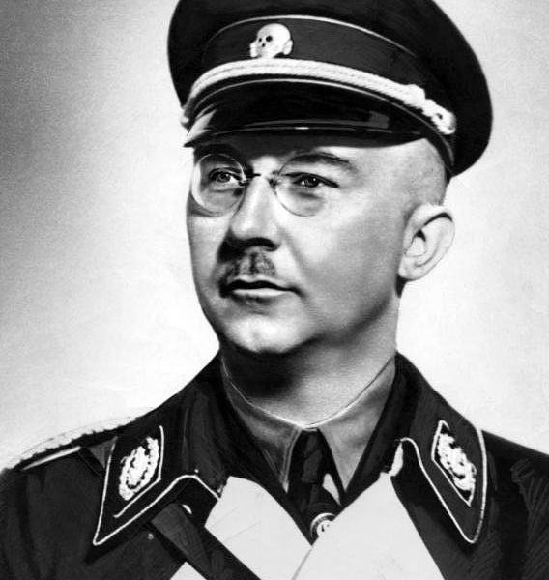
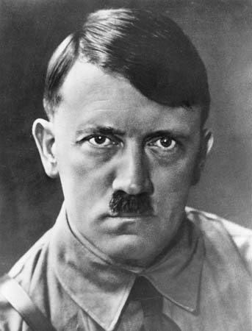
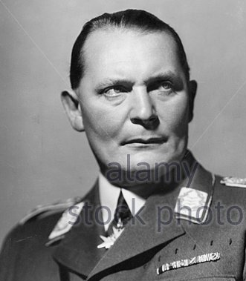
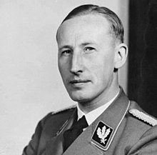
Joseph Goebbels
-Minister of Propaganda
Rudolf Hess
-Deputy Fuhrer of Germany
Heinrich Himmler
-Head of the SS
-Coordinator of concentration camps
Herman Goring
-Prussian Interior Minister
-Founder of Gestapo
Reinhard Heydrich
-Head of the SD
-Head of Gestapo

Slide 3
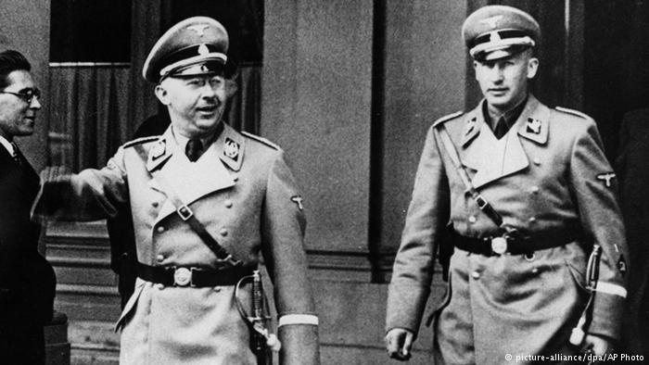
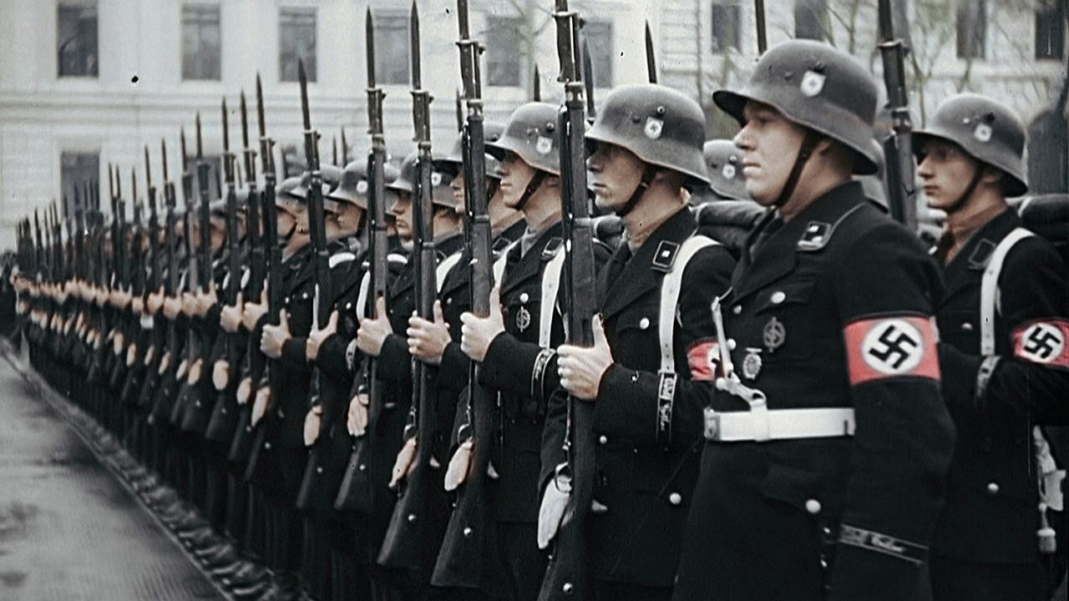
What was the ‘police state’?
In order to control Germany, Hitler created a ‘police state’
This was a system of organisations run by the Nazi Party, not the government.
Their role was to protect the Nazi Party and to arrest any opposition.
The key organisations were the SS, SA and SD.
It was run by two key Nazis: Heinrich Himmler and Reinhard Heydrich.

Slide 4
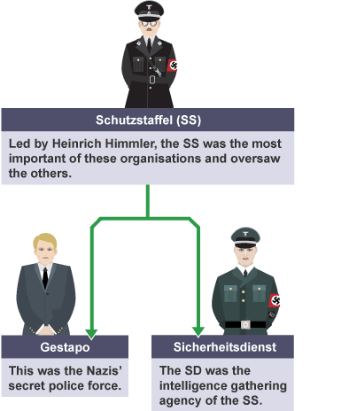
Learning Task One
You will be assigned one of the three groups.
In 10 minutes research and jot down their role in the Nazi Police State.
After the 10 minutes, you will share with the rest of the class.

Slide 5
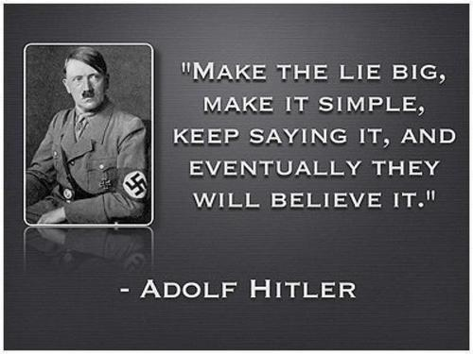
Learning Task Two
Divide into four sections:
Fear
Propaganda
Censorship
Law
Topical thought:
Was propaganda more important than fear in helping the Nazis control Germany?

Slide 6
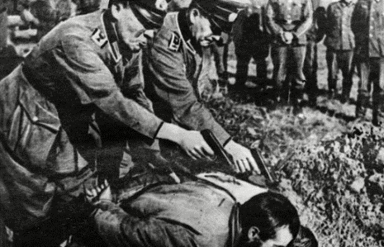
What was the SS?
Run by Heinrich Himmler (right)
In the 1930s, the SS acted as the Nazi police force. They were 100% loyal to Hitler and Himmler.
The SS arrested enemies of the state and had them executed at concentration camps.
They led the campaign to rid the Jews from Germany – in 1938, they arrested 300,000 Jews and sent them to concentration camps.
Himmler wanted only the pure Germans who were expected to marry “racially pure” wives and breed strong soldiers of the future.

Slide 7
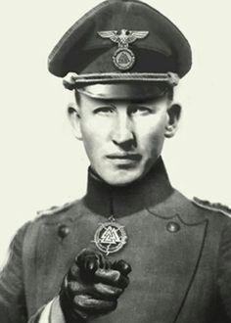
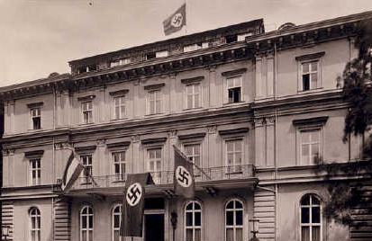
What was the SD?
The SD (Security Force) was originally formed in 1931 by Heinrich Himmler (head of the SS) as a security force to monitor its opponents.
They were led by Reinhard Heydrich (head of the Bavarian police and former Freikorps volunteer)
The SD used a network of officers and spies to collect information on anyone who was opposed to the Nazi Party or German government both at home and abroad.
Records were held at the Nazi Party headquarters in Munich, not at any official government building.

Slide 8
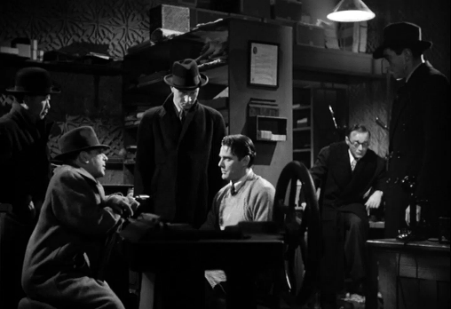
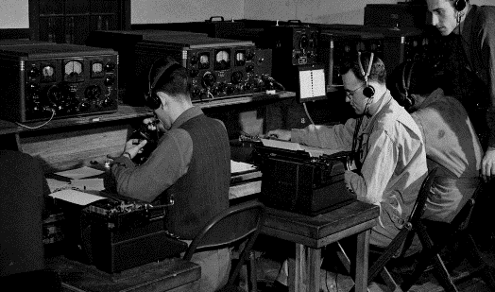
What was the Gestapo?
They spied on people, tapped phones and used a network of undercover agents to identify suspects.
Had the power to torture to gain confessions.
In 1939, 160,000 people were arrested without trial and many were never seen again. People simply disappeared.
Main weapon was fear – Germans were scared of them because anyone could be a gestapo agent. Fear was more powerful than the men themselves – there were only 30,000 Gestapo to police 80 million people.

Slide 9
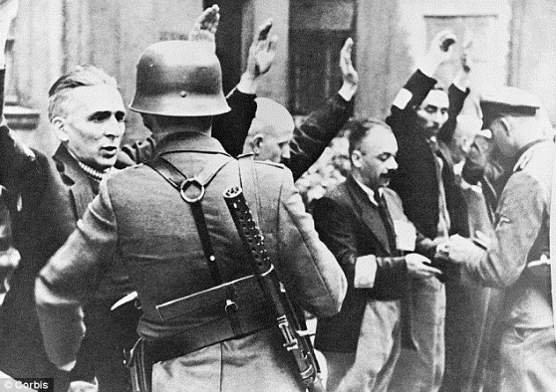
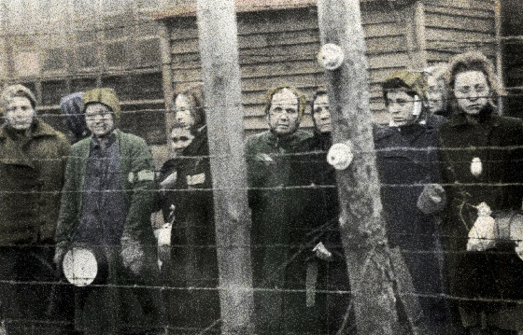
By 1939, 150,000 people had been arrested by the SS or SD.
They were arrested for opposing Hitler and the Nazis.
New prisons were set up, run by the SS – concentration camps.
The first was at Dachau in 1933, then Moringen in 1934.
Located in isolated areas, away from the public. Would be used for prostitutes, homosexuals, Jews and political prisoners (e.g. writers, Communists etc.)
https://www.youtube.com/watch?v=Gr73M5oF6ME

