Slide 1
How did the Nazis use education to control young people?
Source A: Extract taken from Mein Kampf, written by Adolf Hitler between 1919 and 1920.
The masses find it difficult to understand politics, their intelligence is small. Therefore all effective propaganda must be limited to a very few points. The masses will only remember only the simplest ideas repeated a thousand times over. If I approach the masses with reasoned arguments, they will not understand me. In the mass meeting, their reasoning power is paralyzed. What I say is like an order given under hypnosis.
In this lesson, we will:
Explain why teachers in Germany agreed to Nazi policies.
Describe how education was changed by the Nazis.
Starter: How useful is Source A for an enquiry into the reasons behind NSDAP popularity in the 1930s?

Slide 2
Period | Subject
1 | History
2 | Maths
Break
3 | Chemistry
Lunch
4 | English
5 | General Studies
Period | Subject
1 | History
2 | English
Break
3 | Maths
Lunch
4 | Science
5 | P.E.

Slide 3
Period | Subject
1 | German
2 | History
Break
3 | Eugenics/Nazi Theory
Lunch
4 | Biology/Health Education
5 | Domestic Science
Period | Subject
1 | German
2 | History
Break
3 | Eugenics/Nazi Theory
Lunch
4 | Fitness
5 | Maths

Slide 4
Learning Task One
Watch this clip from the 1943 Disney movie ‘Education for Death’.
On your sheet, complete the first ‘circle’ on what you can learn from the movie about schools in Nazi Germany.
Deeper Thought
Is this a reliable source for us as historians studying education in Nazi Germany?

Slide 5
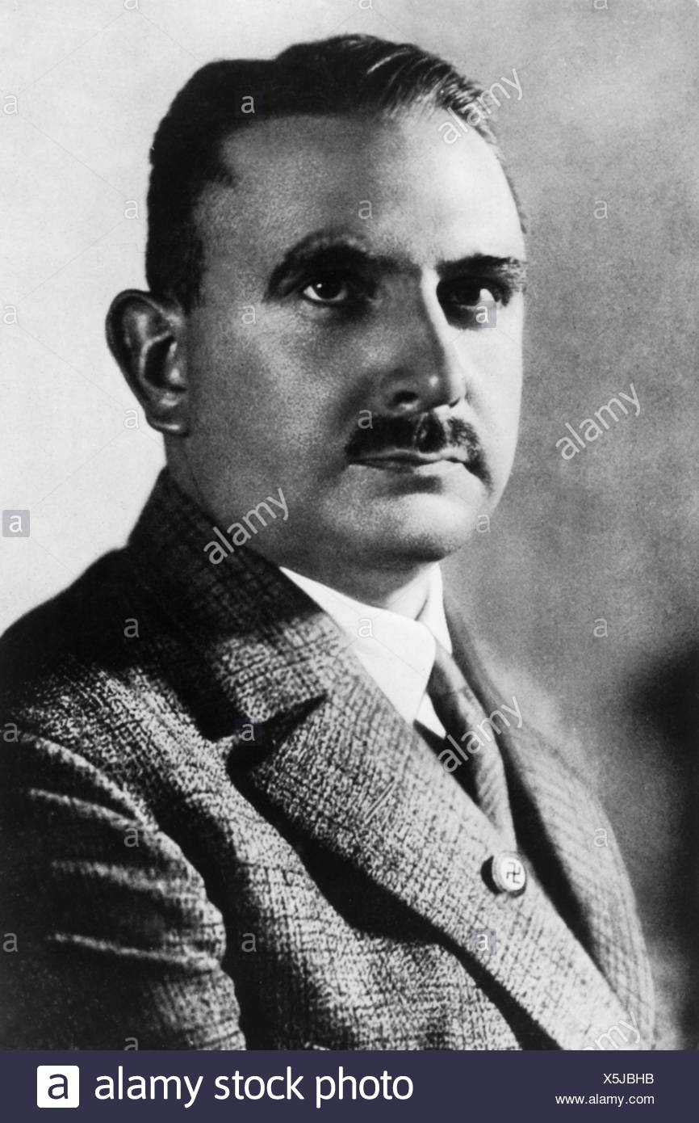
Who was Dr Benhard Rust?
Studied philosophy and art history at university. Gained a PHD in Philosophy.
Served in the Germany during WW1 and joined the NSDAP in 1922.
In 1934, was made Education Minister by Hitler.
Saw schools as a way of controlling the views of young people.
He is quoted as saying “the whole purpose of education is to create Nazis”

Slide 6
The NSDAP had the power to dismiss any teacher or head teacher. In Prussia alone 180 were sacked.
Teachers were forced to perform an oath to the Fuhrer.
How did the Nazis manage to force teachers to agree to these changes?
Over 60% of teachers were forced to attend ‘special camps’ for one month to learn Nazi ideology.
To be a teacher, people had to join the ‘Nazi Teachers League’
Roughly 32% of teachers in Germany were members of the NSDAP. Some wore their uniforms in the classroom.

Slide 7
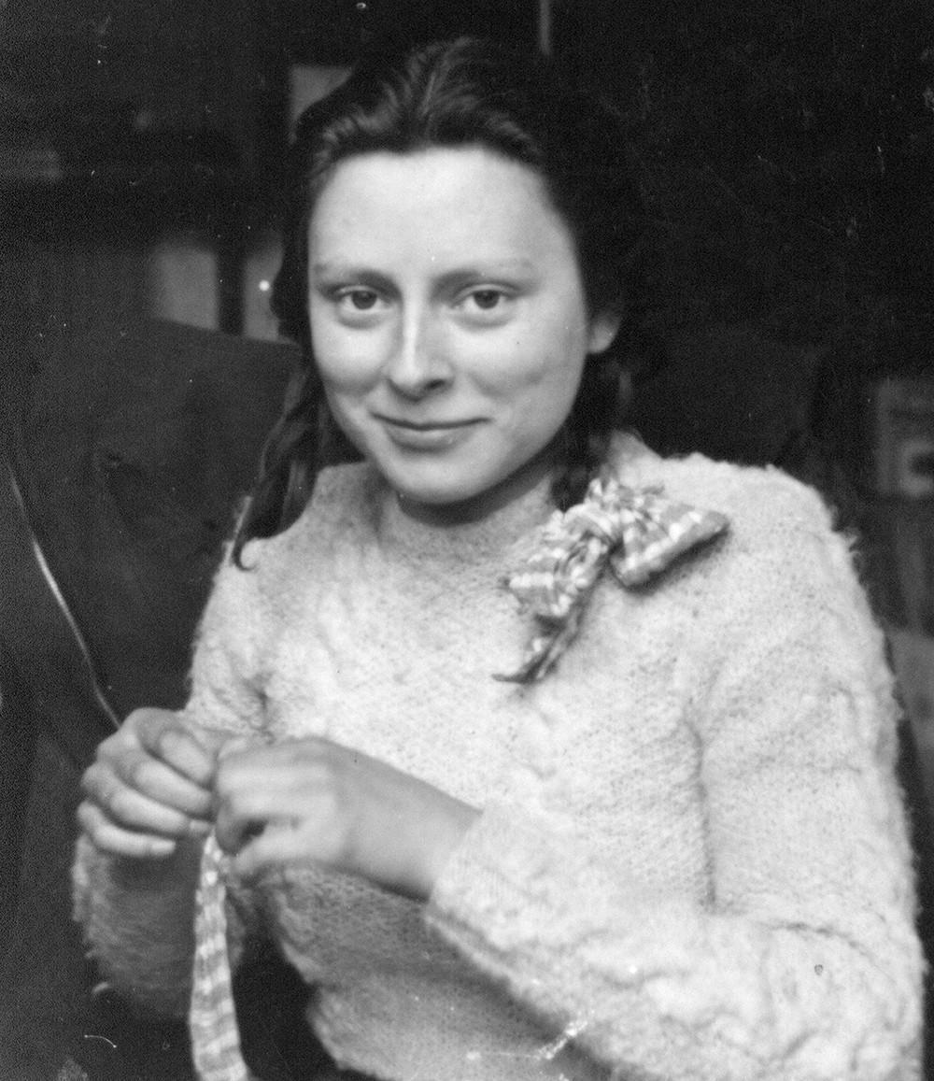
"Teachers had to pretend to be Nazis in order to remain in their posts, and most of the men teachers had families which depended on them. If somebody wanted to be promoted he had to show what a fine Nazi he was, whether he really believed what he was saying or not. In the last two years, it was very difficult for me to accept any teaching at all, because I never knew how much the teacher believed in or not."
Effie Engel

Slide 8
"In 1933, my first teacher was fired for political reasons. I don't know what her involvements were. Gradually, the old teachers were replaced with younger ones, those with Nazi orientations. Then I began to notice a change in attitude. Teachers would make snide remarks about my race. One teacher would point me out as an example of the non-Aryan race. One time, I must have been ten, a teacher took me aside and said, When we're finished with the Jews, you're next. He still had some inhibitions.”
Hans Massaquoi

Slide 9
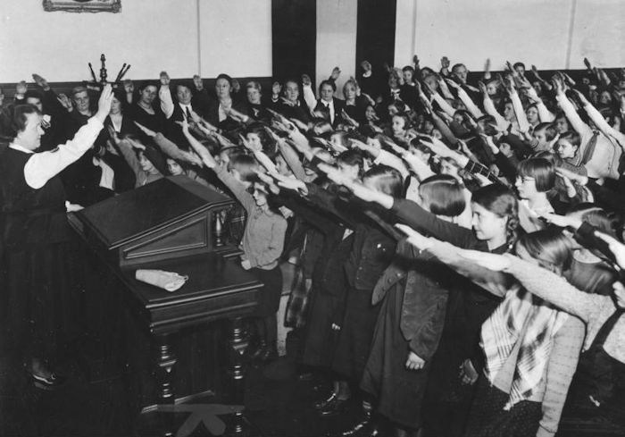
All lessons started and ended with ‘Heil Hitler’
Nazi flags and pictures were put up in all classrooms.
Teachers taught students to salute.

Slide 10
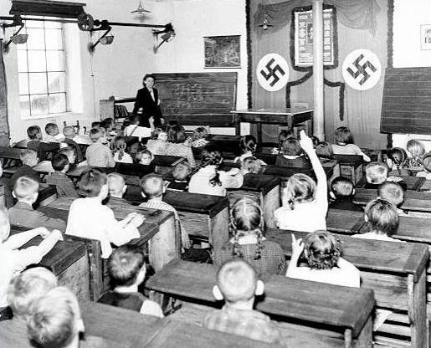

Slide 11
Learning Task Two
Using the information you have now read through, complete the second ‘circle’ of your diagram:
Is this an accurate representation of education in Germany?
Deeper Thought
Is this a reliable source for us as historians studying education in Nazi Germany?

Slide 12
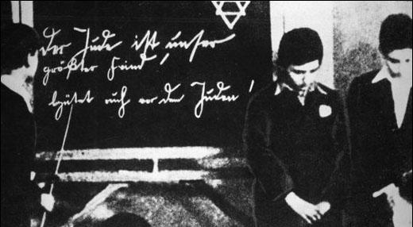
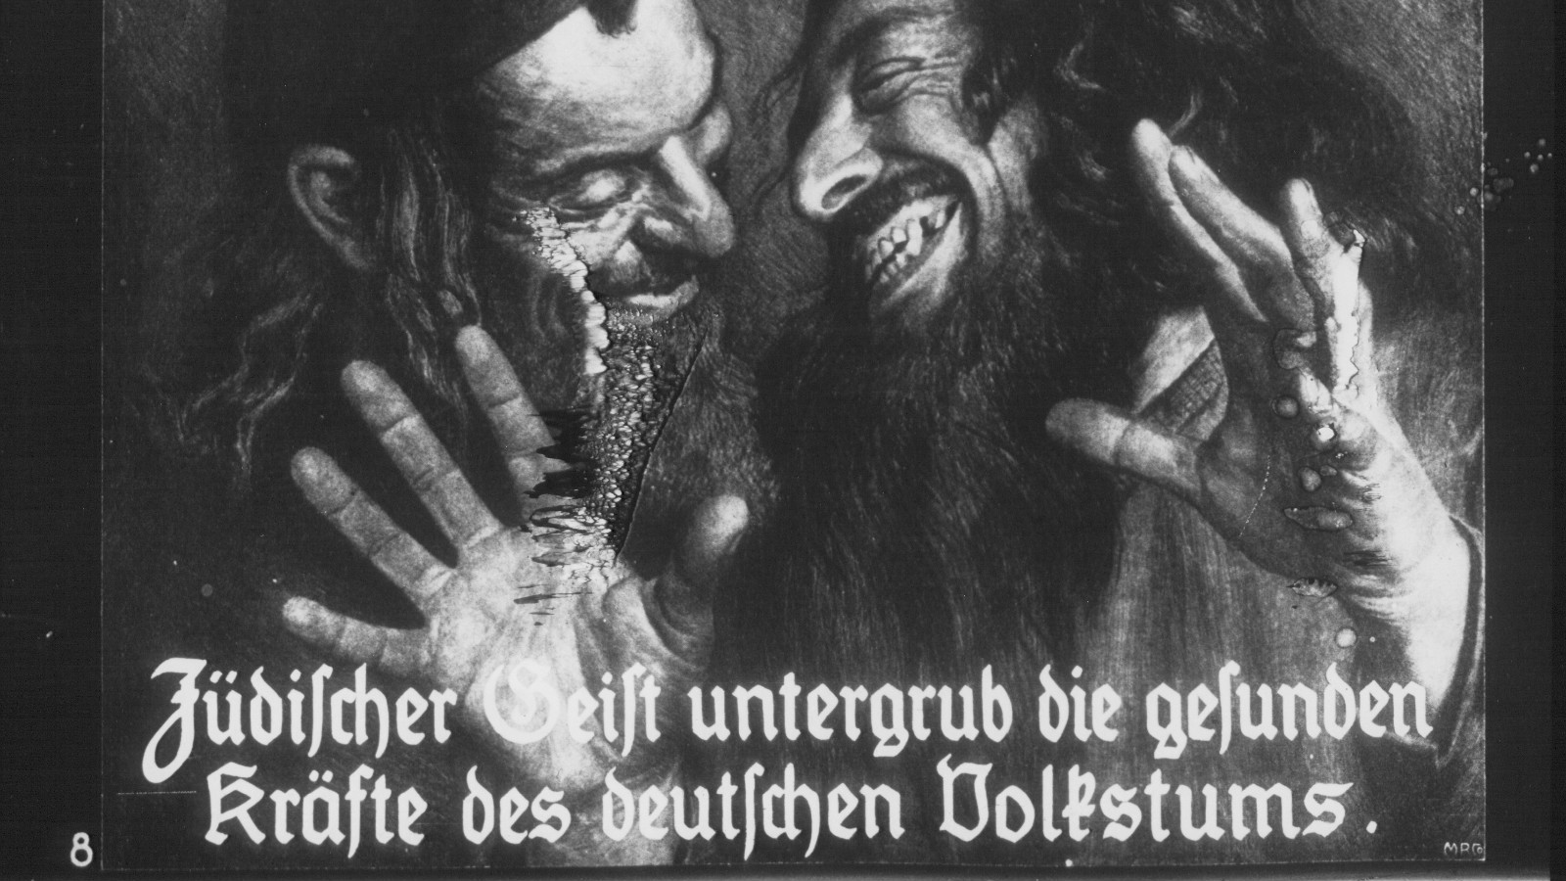
How did the Nazis change the curriculum?
New subjects were taught, like ‘race studies’
Traditional subjects (maths, history etc. were changed with a Nazi spin.
PE and sports were doubled (1/6th of the timetable)
Girls had to learn domestic science (cooking, needlework etc.)
Textbooks were rewritten (e.g. history books explained that Germany had been betrayed during the war by Jews)

Slide 13
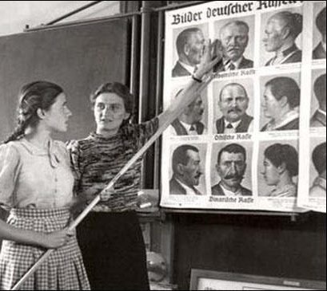
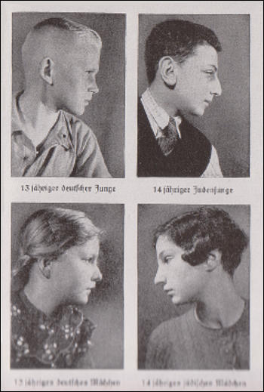

Slide 14
Learning Task Three
Targets 9–6
How does each extract link to Nazi ideology/beliefs?
What were the NSDAP trying to achieve with this?
Read through each extract from German school textbooks.
Complete the target tasks to the right!
Targets 5-4
What were the Nazis trying to get children to believe with these questions?
Deeper Thought
Why do you think Disney called their film ‘Education for Death’? What were they implying?
Targets 3-2
Explain why some people may have been upset by these school lessons.

Slide 15
‘A plane on take off carries 12 bombs, each weighing ten kilos. The aircraft makes for Warsaw , the centre of international Jewry. It bombs the town. On take off with all bombs on board and a fuel tank containing 1500 kilos of fuel the aircraft weighed 8 tonnes. When it returned from the crusade, there were still 230 kilos of fuel left. What is the weight of the aircraft when empty?’
The construction of a lunatic asylum costs 6 million marks. How many houses at 15,000 marks each could have been built for that amount?
MATHS

Slide 16
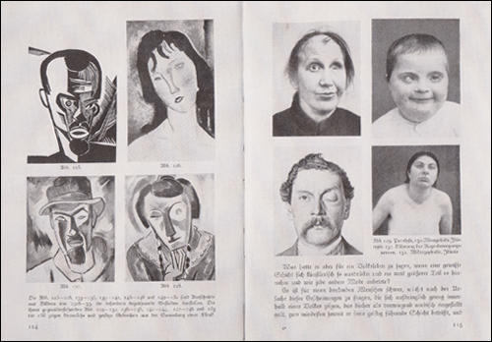
Textbooks used in the classroom were very hostile to modern art, something that was considered to be degenerate.
For example, the artist Amedeo Modigliani (plate 126) is compared to a person with Down's Syndrome.
ART

Slide 17
Each of us must keep his body strong through exercise and healthy living habits in order to develop his capacities and use them to serve his people. Those who do not do so are unsuitable for life and will perish. Our Führer tells us:
He who wants to live must fight, and he who does not want to fight in this world of perpetual struggle does not deserve to live!” (Mein Kampf, p. 317)
BIOLOGY

